Slide 1
Employee Data Analysis using Excel
STUDENT NAME: k. Subathra
REGISTER NO: unm143922cza61
DEPARTMENT: Commerce
COLLEGE : Shree chandraprabhu jain college

Slide 2
PROJECT TITLE
Employee Performance Analysis using Excel

Slide 3


AGENDA
Problem Statement
Project Overview
End Users
Our Solution and Proposition
Dataset Description
Modelling Approach
Results and Discussion
Conclusion
3/21/2024 Annual Review

Slide 4

PROBLEM STATEMENT
1. Inconisistent employee performance data 2. Identifying pattrens 3. Employee metrics 4. decision making 5. actionable insights

Slide 5

PROJECT OVERVIEW
.
CONTENT •AIM; To streamline employee data analysis using excel tools •OBJECTIVES; Identify key metrics, analyae trends & provide data - driven insights.

Slide 6

WHO ARE THE END USERS?
▪ HR mangers ▪ team leads & departments heds ▪ company exectives company manager

Slide 7

OUR SOLUTION AND ITS VALUE PROPOSITION
CONTENT: Implement excel- based data analysis techniques. Generate automated reports and dashboards. Enable easy data manipulation and visualization

Slide 8
Dataset Description
CONTENT: Data collected from employee records,including performance,attendance,& demographics Number of records,time span,& key variables

Slide 9

THE "WOW" IN OUR SOLUTION
CONTENT: automated reporting : our excel based system automates complex reporting tasks, saving HR managers hours of manual work. Tise enables quick access to insightful data withoout the need for extensive excel expertise
3/21/2024 Annual Review
9

Slide 10
MODELLING
CONTENT: Data cleaning and preprocessing Using excel functions for statistical analysis Visualization using excel charts and pivot tables
10

Slide 11
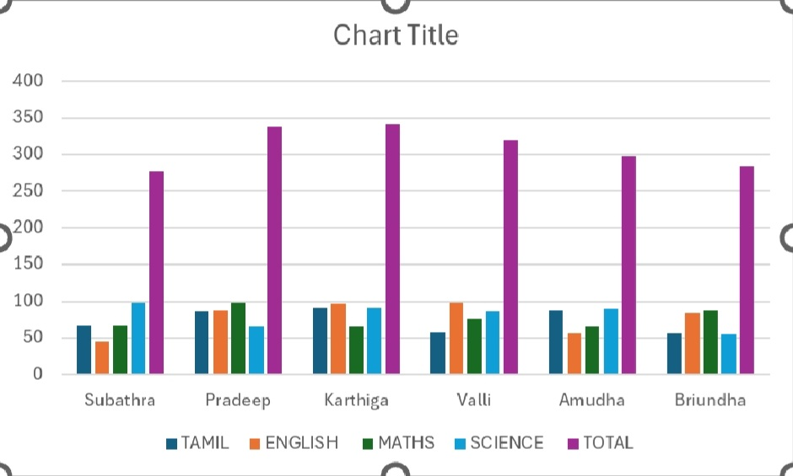
RESULTS
11

Slide 12
conclusion
CONTENT: Summary of insights gained impact on decision- making and empolyee management Future steps for futher analysis or implementation

