Slide 1


ERS Research
Observability Tools

Slide 2
Open Source DB Tools
InfluxDB
The InfluxDB time series platform is purpose-built to collect, store, process and visualize metrics and events.
InfluxDB is the time series platform for developer, Made for developers to build time-series-based applications quickly and at scale.
InfluxDB provides a time series database designed to handle high write and query loads and offers highly scalable clusters on infrastructure with a management UI.
Features: API’s & Toolset, A Time Series Engine, Community & Ecosystem, Easy to build & Easy to share and Start from UI.
Cortex
Cortex is an open source time series database and monitoring system for applications and micro services.
Based on Prometheus, Cortex adds horizontal scaling and virtually indefinite data retention.
Features: Horizontally Scalable, Prometheus compatible, Virtually infinite data retention, Designed for micro services & containers, Hundreds of integrations.
Loki
Loki is a horizontally scalable, highly available, multi-tenant log aggregation system inspired by Prometheus.
It is designed to be very cost effective and easy to operate. It does not index the contents of the logs, but rather a set of labels for each log stream.
Loki’s minimal indexing approach means that storing the same set of logs in Loki requires far less storage than with other solutions.
Features: Log any & all formats, Fast writes, Tiny indexes, Cheaper to run, Simpler to operate, Fast queries, Cut and slice your logs in dynamic ways (Flexible).

Slide 3
Prometheus/Telegraf/Fluentd for collecting metrics and logs
Prometheus:
Event monitoring and alerting tool
Prometheus exporter + Prometheus Storage + Alert Manager
Store real-time metrics in a time series database
HTTP pull model for scarping metrics from target and storage in tsdb for query
Telegraf:
Plugin-driven server agent for collecting and sending metrics and events
Used in TIG stack( Telegraf + InfluxDB + Grafana) for monitoring
Push model, Telegraf write metrics to storage like InfluxDB
Fluentd:
Open source data collector for building the unified logging layer
Once installed on a server, it runs in the background to collect, parse, transform, analyze and store various types of data
Fluentd collects events from various data sources and writes them to files, RDBMS, NoSQL, IaaS, SaaS, Hadoop and so on
Prometheus:
Event monitoring and alerting tool
Prometheus exporter + Prometheus Storage + Alert Manager
Store real-time metrics in a time series database
HTTP pull model for scarping metrics from target and storage in tsdb for query
Telegraf:
Plugin-driven server agent for collecting and sending metrics and events
Used in TIG stack( Telegraf + InfluxDB + Grafana) for monitoring
Push model, Telegraf write metrics to storage like InfluxDB
Fluentd:
Open source data collector for building the unified logging layer
Once installed on a server, it runs in the background to collect, parse, transform, analyze and store various types of data
Fluentd collects events from various data sources and writes them to files, RDBMS, NoSQL, IaaS, SaaS, Hadoop and so on

Slide 4
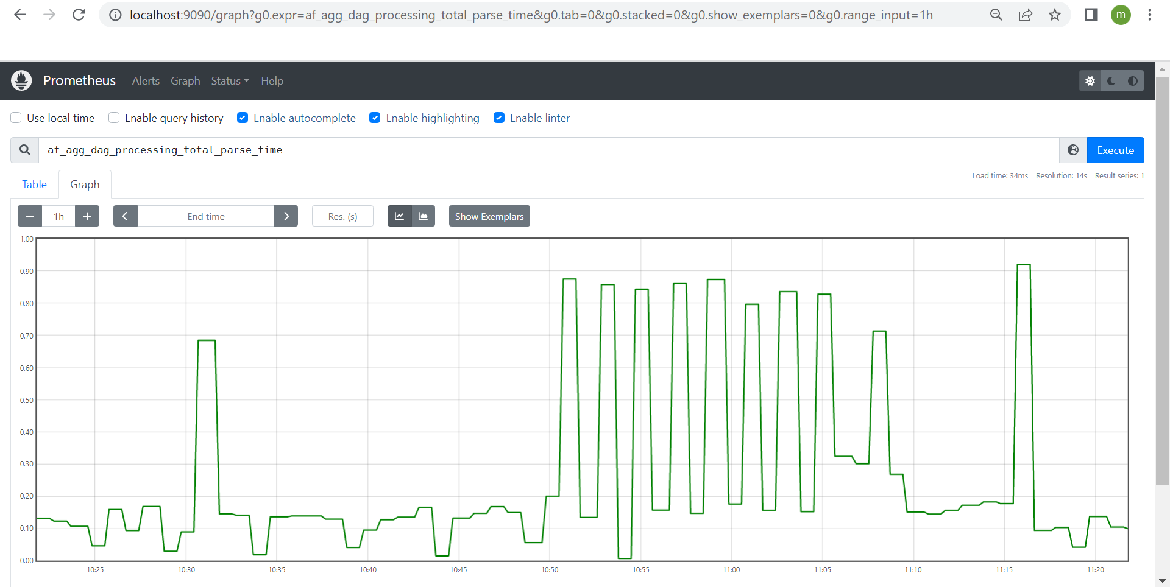
Prometheus: Airflow metrics query

Slide 5
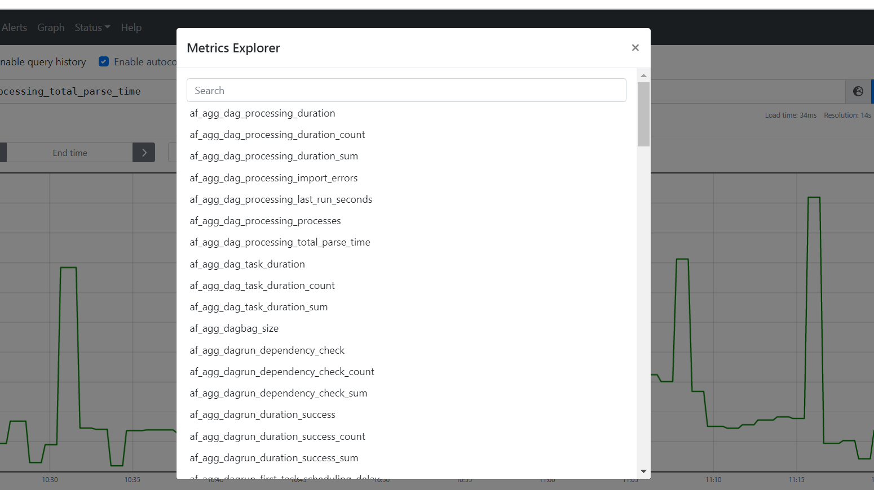
Prometheus: Airflow few metrics list

Slide 6
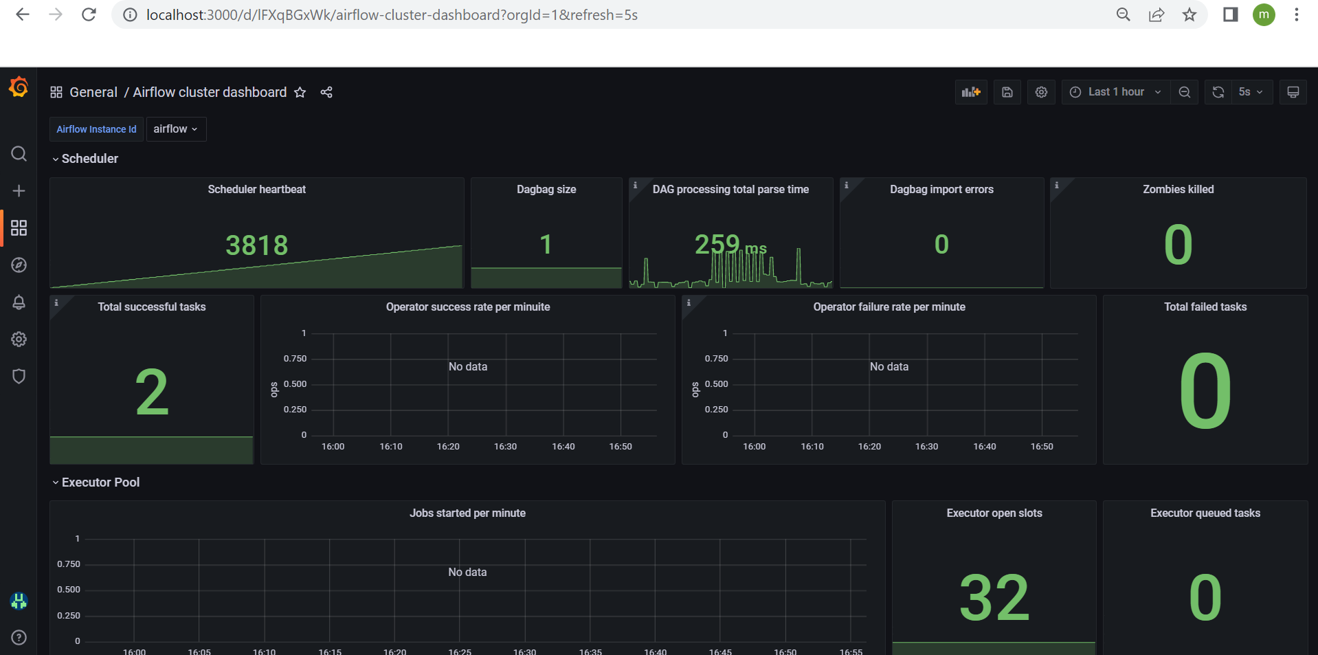
Grafana: Airflow metrics dashboard

