Slide 1


Mango Leaf Disease Detection Using Machine Learning
Presented by:
Sk. Imran (21491A05W8)
K.Khadar peer Saheb (21491A05U5)
K.Subbarao (21491A05R3)
K.Shanmukh (21491A05U4)
A.Surya (21491A05U6)
G.Anvitha (21491A05S4)
G.Charitha (21491A05T7)
Under the Guidance of
Mr.K. Kishore Babu
Assistant professor
Department of AIML

Slide 2

Outline
Abstract
Introduction
Literature Review
Motivation
Objective
Existing Method
Proposed Method
Hardware & Software Involved
Advantages And Application
System Architecture/Proposed Work Block Diagram
UML Diagrams (CSE & Allied)/DFD CSE & Allied / Prototype (Others)
Implementation(part Of The Code)
Testing/Simulation
Results And Discussions
Conclusions And Future Scope
References

Slide 3
Abstract
Even if the population grows rapidly, agriculture can provide food for everyone. It has been demonstrated that early prediction of plant diseases in agriculture is important for the nutrition of the entire population. Unfortunately, the disease can be predicted early in the harvest. The idea behind the article is to raise farmers' awareness of technology that reduces foliar diseases. Since mangoes are just vegetables, precise machine learning and image processing algorithms are used to identify mango diseases.
In this research, mango leaf diseases were discussed. Due to these unfavorable patterns on mango leaves, farmers can easily spot the disease as early symptoms. First, the mango leaf pattern was converted to 256x256 pixels, and then histogram equalization was used to improve the quality of the mango pattern. K-means clustering is introduced to divide the data space into Voronoi units. Remove the borders of the leaf pattern using contour tracing. Various descriptors such as differential wavelet transform, principal component analysis, and gray-scale co-occurrence matrix are used to extract the information of leaf patterns. Finally, machine learning such as support vector machine (SVM), convolutional neural network (CNN), and K-nearest neighbor (K-NN) are used to classify the extracted features. The accuracy of the above-mentioned model was tested on samples detected using SVM (88%), K-NN (97%) and CNN (99.6%).
Keywords:-
Mango leaf diseases
Machine learning
Image processing
Early detection
Agricultural sustainability

Slide 4
Introduction
Introduction:-
Developed technologies have enabled the production of sufficient food to meet societal demand. However, challenges like climate change, declining pollinators, and plant diseases still pose significant threats to agricultural productivity. Addressing these issues is crucial for ensuring food security and safety.
The application of modern analysis and detection technologies helps farmers mitigate these problems. For example, during the COVID-19 pandemic, recent technologies were essential in addressing issues and reducing the transmission of diseases.
Plant diseases can lead to substantial losses, especially in commercial farming, and pose a significant threat to human life by potentially causing droughts and famines.
Technologies like computer vision and machine learning (ML) have proven effective in combating plant diseases. In this paper, ML is employed to provide a solution for plant disease detection. The proposed method involves three stages: identifying, analyzing, and verifying with the available database

Slide 5
Literature Survey
Ref. No | Title | Technique Used | Pros | Cons
1 | Mango Leaf Disease Identification Using Fully Resolution Convolutional Network | FrCNnet | Accuracy of 99.2% achieved | Multiple steps and may be complex to implement
2 | Deep Convolutional Neural Networks for South Indian Mango Leaf Disease Detection and Classification | Deep(CNNs) | High performance and categorization | Large and diverse datasets are needed
3 | Machine Learning based Classification of Diseased Mango Leaves | DT,SVM,NN,LR | These techniques allows for higher classification accuracy | It requires a large and diverse dataset to train
4 | Deep Learning and Computer Vision based Model for Detection of Diseased Mango Leave | CNN and ML classifiers | computer vision techniques helps farmers to prevent losses | These are expensive, laborious, and highly infeasible
5 | Recognition of mango leaf disease using convolutional neural network models: a transfer learning approach | CNN with transfer learning approach | Higher accuracy in image recognition | The pre-existing dataset used for TL and difficulty in fine-tuning the model

Slide 6
Literature Survey
Ref. No | Title | Technique Used | Pros | Cons
6 | ESDNN: A novel ensembled stack deep neural network for mango leaf disease classification and detection | GAN algorithm, and NSGA-II clustering algorithm | accuracy rate of 98.57%, surpassing state models. | Including need for large dataset, focus only on biotic diseases
7 | Mango leaf disease recognition using neural network and support vector machine | KNN,SVM, GLCM matrix | time savings & increased mango production | Inability to detect different sizes and densities of data
8 | Leaf disease detection using machine learning and deep learning: Review and challenges | SVM, Random Forest, MTSVM, | workflow mechanism and challenges in image quality | potentially insufficient for future environmental condition
9 | Light-Weight Deep Learning Model for Accelerating the Classification of Mango- Leaf Disease | CNN, image classification, DenseNet | low computational requirements and improved training | Impact on hardware resources
10 | Classification of Mango Leaves Infected by Fungal Disease Anthracnose Using Deep Learning | CNN | Accuracy of 96.16% is achieved. | Large and driven datasets are needed

Slide 7
Motivation
Research gap :-
The research gap identified in the context of plant leaf disease detection using computer vision and machine learning highlights several challenges and areas for improvement. One significant gap is the quality of leaf images, which must be high to ensure accurate disease detection. Additionally, the availability of publicly accessible datasets is limited, which hampers the development and validation of robust models. Noisy data can also affect the accuracy of leaf sample analysis, posing another challenge.
Another issue is the complexity of the segmentation process, where diseases may be identified, but the samples still require extensive training and testing to ensure reliability. Classification of diseases is particularly challenging due to the variety of diseases that can affect different kinds of plants and the variation in leaf color caused by environmental factors. These challenges indicate that existing methods may not be sufficient, necessitating the development of more advanced and accurate techniques.
Reason for choosing this project:-
The reason for choosing this project is to address these gaps by leveraging the potential of machine learning (ML) and image processing (IP) tools. The proposed model aims to provide better accuracy in detecting leaf diseases by integrating ML and IP techniques. This approach not only helps in early detection of diseases but also aids farmers in managing plant health more effectively. By focusing on these technological advancements, the project seeks to improve agricultural productivity and food security .

Slide 8
Objective
Enhanced Accuracy: Increased precision of disease detection to help farmers and prevent early diseases, even before it is visible.
Computational Complexity: Break the solution down to a point at wich it is practically possible (to run on smartphone) and not as computationally growing.
Machine Learning & Image Processing Integrated: An improved hybrid model for to get efficient result under all different environmental conditions and with increased leaf diseases.
Create a User-Friendly App: Build an app, that runs on smart phone for the users (farmers) and various plant health issues can be easily diagnosed quickly.
Agricultural Productivity Impact: Ultimately, the project hopes to help farmers increase crop productivity and feed a growing population by helping deliver an effective tool for managing diseases.

Slide 9
Existing Method
K-mean Clustering + GLCM+ SVM: In this classification scheme we do image segmentation using K mean clustering, feature extraction is achieved by GLCLM and finally the SVM classifier for segregation. The average accuracy of this approach was ~89%.
LBP (Local Binary Patterns )+ PCA + K-mean Clustering or Nearest Neighbor (KNN) :The approach demonstrated an average accuracy of 97.3 %.
Univariate Statistical Features + SVM: This is the method proposed by Hossain et al, which classified based on univariate statics features and S-VM achieved an accuracy of 90% .
K-mean Clustering + GLCM + SVM: For feature extraction this method also used both k mean clustering and for classification it applies svm which gives 90% accuracy reported.
Fast Enhanced Learning : This method had 99% accuracy by using fast learning algorithm.

Slide 10
Proposed Method
Preprocessing and Segmentation:
The images of leaf samples are enhanced in quality by histogram equalization (HE) and separated in diseased and healthy area by using k-means clustering. The pre-processing enhances the quality of the image and segment the area of diseased portion easily and as an initial decision support we had a decision whether the leaf is diseased or healthy in an early stage.
Feature Extraction:
Features of the segmented leaf images are extracted using Discrete Wavelet Transform (DWT) , Principal Component Analysis (PCA) and Gray-Level Co-occurrence Matrix (GLCM) . These features represent the appearance of healthy and diseased areas of the leaf.
Classification:
The three classifiers, Support Vector Machine (SVM), K-Nearest Neighbours (KNN), and Convolutional Neural Network (CNN), were employed to classify the features extracted into each corresponding class. The CNN forms the backbone of the end-to-end model for precise disease recognition.

Slide 11
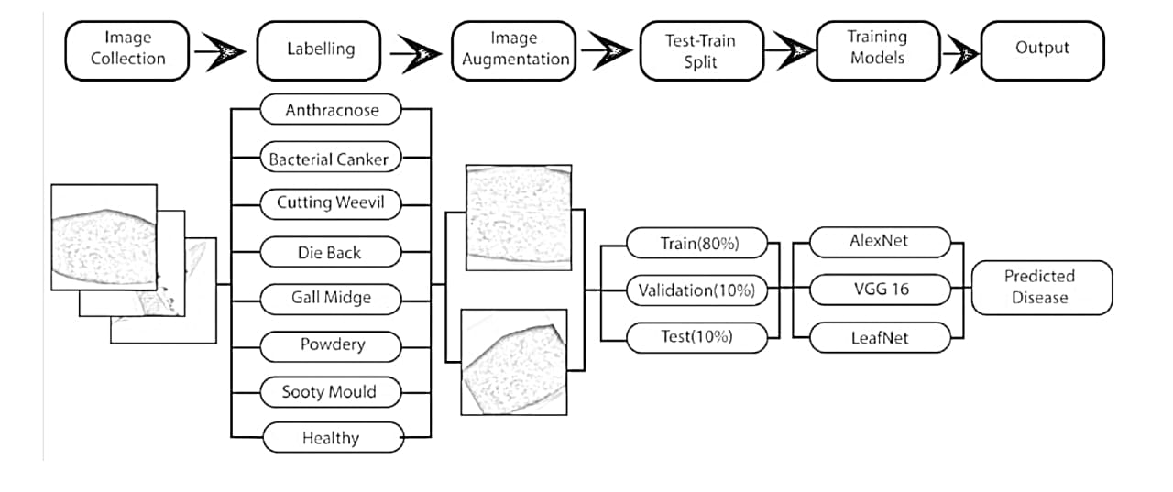
Block diagram

Slide 12
Explanation of Proposed Work
Convolutional Block
What is the use ?
A convolutional block consists of a convolutional layer (CONV) and a max pooling layer (Max Pool).
The convolutional block is used to extract features from images.
The convolutional layer applies filters to the input image to detect patterns, and the max pooling layer reduces the
spatial dimensions of the feature maps to reduce the number of parameters and the number of computations.
How it will be used in the project ?
In the Mangoscan architecture, multiple convolutional blocks are used to extract features from mango leaf images.
Each block consists of a convolutional layer and a max pooling layer, which helps to reduce the spatial dimensions of the feature maps and extract relevant features.
Why it was chosen ?
Convolutional blocks are commonly used in image classification tasks because they are effective in extracting features from images.
The use of multiple convolutional blocks allows the model to learn hierarchical representations of the input images.

Slide 13
Explanation of Proposed Work
VGGNet Architecture (VGG16)
What is it ?
VGG16 is a deep neural network architecture that consists of multiple convolutional layers, max pooling layers, and fully connected layers.
VGG16 is used for image classification tasks, such as classifying mango leaf diseases.
How it will be used in the project ?
VGG16 is used as a baseline model to compare the performance of the proposed Mangoscan architecture.
Why it was chosen ?
VGG16 is a well-known and widely used architecture for image classification tasks.
It has been shown to achieve good performance on various image classification datasets.

Slide 14
Explanation of Proposed Work
Proposed Convolutional Neural Network Architecture (Mangoscan)
What is it ?
Mangoscan is a custom CNN architecture designed for classifying mango leaf diseases.
It consists of multiple convolutional blocks, max pooling layers, and fully connected layers.
Mangoscan is used to classify mango leaf images into different disease categories.
How it will be used in the project ?
Mangoscan is the proposed architecture for classifying mango leaf diseases.
It will be trained on a dataset of mango leaf images and evaluated on its performance.
Why it was chosen ?
Mangoscan is designed to be a lightweight and efficient architecture that can be used on devices with low configurations.
It has fewer parameters and computations compared to VGG16, making it suitable for real-time applications.

Slide 15
Hardware & Software Involved
Hardware :
Smartphones or mobile devices with cameras : These devices will be used to capture images of mango leaves, which will then be used to detect diseases using the Mangoscan model. The camera on the smartphone will be used to take high- quality images of the leaves, which will be processed and analyzed by the Mangoscan model.
Low-configuration devices (e.g. Raspberry Pi): These devices can be used as an alternative to smartphones for deploying the Mangoscan model. They are low-cost, low-power devices that can be used to run the Mangoscan model and perform disease detection
Software :
Python programming language : Python is a popular programming language that is widely used in machine learning and deep learning applications. It will be used to develop and train the Mangoscan model, as well as to deploy it on the target hardware devices.
TensorFlow or Keras deep learning frameworks : TensorFlow and Keras are two popular deep learning frameworks that can be used to develop and train the Mangoscan model.They provide pre-built functions and tools for building and training neural networks, making it easier to develop and deploy the Mangoscan model.
Operating System : The operating system on the target hardware devices, such as Android or iOS on smartphones, or a Linux-based operating system on Raspberry Pi devices.
Database : A database may be used to store the images of mango leaves, as well as the disease detection results. This can be
useful for tracking the health of mango trees over time and providing insights to farmers.
Cloud services : Cloud services, such as Google Cloud or Amazon Web Services, may be used to store and process large amounts of data, as well as to provide scalability and reliability for the Mangoscan model.

Slide 16
Application & Advantages
Applications:
Diseases Identification: This model can be applied to monitor diseases that affect other species of plants, like these tomato leaves, helping us with large scale agricultural monitoring.
Early disease detection: early detection of diseases can enable farmers to take preventive measures so that the entire crop could be saved from destruction.
Mobile implementation: the quite low computational complexity of the model makes it also suitable for smartphone applications, available to the farmer in the field.
Precision Agriculture: Combined with precise phenotyping and microscopic observations, increases the efficacy of providing precise diagnoses of diseases. This could enable better crop management to maximise yield.

Slide 17
Application & Advantages
Advantages:
High Accuracy: The proposed model achieves a high accuracy of 99.09%, outperforming other existing models like
SVM, K-NN, and traditional CNN approaches.
Efficiency: It utilizes advanced techniques like Discrete Wavelet Transform (DWT), Principal Component Analysis (PCA), and Gray Level Co-occurrence Matrix (GLCM) for feature extraction, improving the model's efficiency.
User-Friendly: The integration with smartphone technology makes it easy for farmers to use without needing extensive technical knowledge.
Cost-Effective: Reduces the need for frequent expert consultations and lab testing by providing on-the-spot diagnostics.
Scalability: The model's approach can be adapted to various other crops and diseases, making it highly scalable for different agricultural needs

Slide 18
System Architecture/Proposed work Block diagram
Image Collection
Collect the image of a mango leaf and stored in the data base
Image Classification
Collect a large dataset of images of mango leaves, including healthy and diseased leaves.
image augmentation
It involves applying random transformations to the training images to increase the diversity of the dataset and improve the model's ability to generalize to new or unseen images.
Training & Testing
Training and testing the images for data model and trine the data
training a deep learning model, specifically a Convolutional Neural Network (CNN), on a dataset of images of mango leaves to detect diseases.
Training Models
Output
output of the training model is a classification of the input images into Mango Leaf Disease names

Slide 19
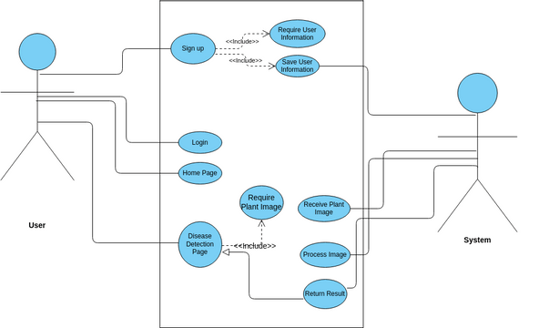
UML Diagrams (CSE & Allied)/DFD CSE & Allied / Prototype (Components description)

Slide 20
Implementation
Component Specifications: When creating a full code, you need to define the specifications of each component involved. This includes the input methods, processing, output, navigation, feedback, and control components. For example, in a Mango Leaf Scanner application, the component specifications might include:
Input methods: file uploader
Processing: AI model function to detect disease
Output: result container to display disease detection result
Feedback: result container to display disease detection result
Control: browse files button to trigger file input field
Coding: Once the component specifications are defined, you can start coding the application. This involves writing the necessary code to implement each component and integrate them together. For example, in a Mango Leaf Scanner application, the coding might involve:
Writing HTML and CSS code to create the user interface
Writing JavaScript code to implement the input methods, processing, output, navigation, feedback, and control components
Integrating the AI model function into the application

Slide 21
Implementation
Application: The application is the final product that integrates all the components together. In the case of a Mango Leaf Scanner application, the application would allow users to select an input method, upload an image , and display the detected disease result.
Integration: Integration involves combining the different components and coding together to create a seamless user experience. This might involve integrating the AI model function with the input methods, processing, output, navigation, feedback, and control components.
GITHUB LINK:-

Slide 22
Testing/Simulation
Cross-Validation Technique: The experiment was carried out using the 5-fold cross-validation technique, to validate the model performance. The data set is split into five groups, with 80% of the total being used for training and the rest 20% is evenly split for the validation and the testing.
Training and Testing Strategy: In every step of the cross-validation process, the training set was used to teach the model on 80% of the data instances. The model was verified at each epoch of training by way of the validation dataset, and testing was done on the test dataset after training was completed.
Performance Metrics: The performance of the model was verified by metrics such as accuracy, precision, recall, and F-score. The mean accuracy of the MangoScan model is 98.55%, so it is a very powerful tool for the detection of mango leaf diseases according to the said report.

Slide 23
Testing/Simulation
Early Stopping: Overfitting was dealt with an early stopping mechanism, which was a training phase event that was introduced to many deep learning models too. A model's training is halted when the validation set improvement ends, and thereby the process is completed.
Performance Comparison: MangoScan was a new development that was compared with the other existing models like VGG16 and AlexNet. MangoScan had a better performance with a higher accuracy rate and it was also less computational-intense.
Robustness: The model has demonstrated robustness, as seen by high results that have been maintained all along the cross-validation folds with very low accuracy level variations.

Slide 24
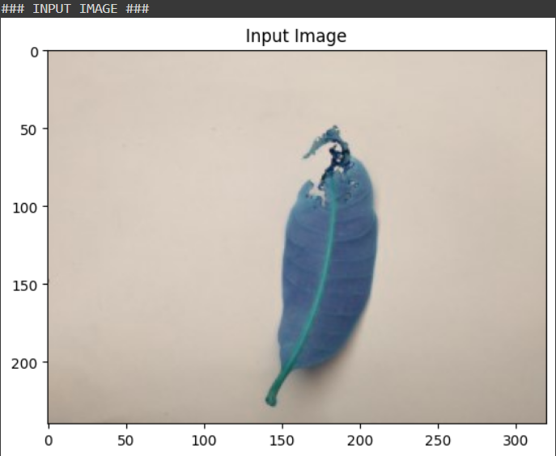
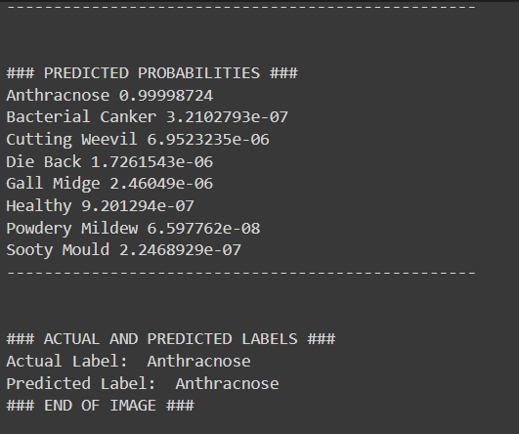
Output For Backend

Slide 25
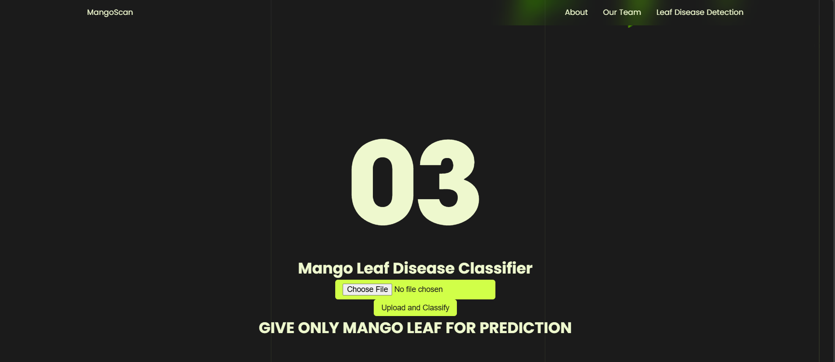
Results/Working
Application
The MangoScan model was integrated into a web application using Flask, a Python web framework. The application allows users to upload images of mango leaves and predict the disease using the MangoScan model.
Frontend
The frontend of the application was built using HTML, CSS, and JavaScript. The user interface is simple and intuitive, allowing users to easily upload images and view the predicted disease.
Middleware
The middleware was built using Flask, which handles the communication between the frontend and backend.

Slide 26
Results/Working
Backend
The backend was built using Python, which runs the LeafNet model and returns the predicted disease to the frontend.
Hardware Requirements
The application was deployed on a server with the following hardware requirements:
Processor: Intel Core i7
RAM: 16 GB
Storage: 512 GB SSD
Operating System: Ubuntu 20.04
Software Requirements
The application requires the following software:
Python 3.8 ,TensorFlow 2.4, Flask 2.0, HTML 5, CSS 3, JavaScript

Slide 27
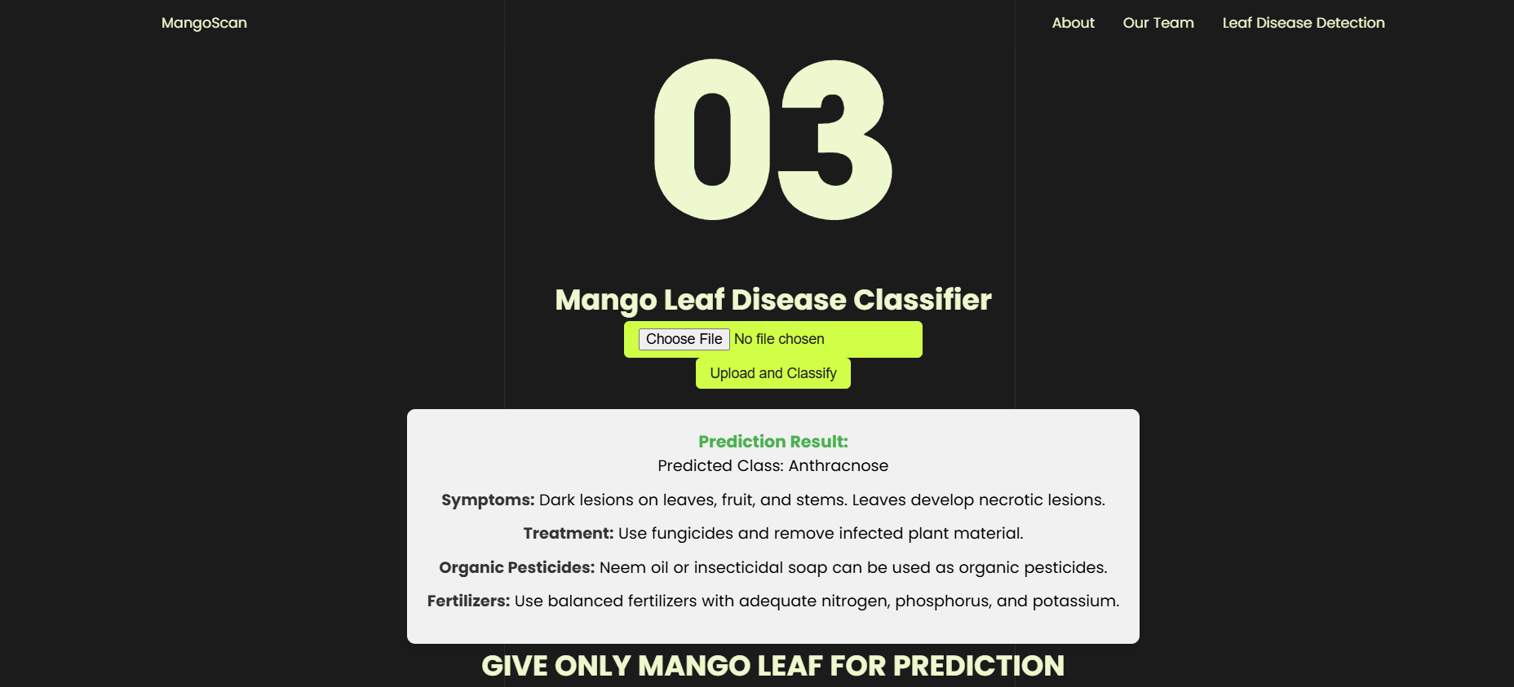
Results/Working
Output

Slide 28
Conclusion & Future Scope
Conclusion
The proposed MangoScan architecture has demonstrated excellent performance in detecting seven prominent mango leaf diseases, achieving an average accuracy of 98.55%. The model's lightweight design, with only 32 million trainable parameters, makes it computationally efficient and suitable for deployment on devices with low configurations. The study highlights the importance of using a well-balanced and diverse dataset, such as the MangoLeafBD dataset, for training deep learning models to accurately predict mango leaf diseases.
Future Scope
Extension to other crops: The proposed MangoScan architecture can be fine-tuned and applied to other crops, such as Mango Leaf to detect various diseases.
Integration with IoT devices: MangoScan can be integrated with IoT devices, such as smartphones and drones, to enable real-time disease detection and monitoring in the field.

Slide 29
Conclusion & Future Scope
3.Development of a Web app: A web app can be developed to deploy LeafNet, allowing farmers to easily detect diseases and receive recommendations for treatment.
4.Incorporation of additional features: Additional features, such as weather data and soil conditions, can be incorporated into the model to improve its accuracy and robustness.
5.Comparison with other models: LeafNet can be compared with other state-of-the-art models, such as EfficientNet and ResNet, to evaluate its performance and identify areas for improvement.
6.Deployment in real-world scenarios: LeafNet can be deployed in real-world scenarios, such as in mango orchards, to evaluate its performance and effectiveness in practical settings.
7.Development of a decision support system: A decision support system can be developed to provide farmers with personalized recommendations for disease management and treatment based on the output of LeafNet.

Slide 30
References
Olivas, P. C., Oberbauer, S. F., Clark, D. B., Clark, D. A., Ryan, M. G., O’Brien, J. J., &amp; Ordoñez, H. (2003). Leaf- level photosynthetic capacity and its relationship with biomass in a lowland tropical rain forest in Costa Rica. Journal of Tropical Ecology, 19(3), 311-321.
Vinay Gautam, Ranjeet Kumar Ranjan, Priyanka Dahiya, and Anil Kumar. ESDNN: A novel ensembled stack deep neural network for mango leaf disease classification and detection. Multimedia Tools and Applications, 83:10989- 11015, 2024. https://doi.org/10.1007/s11042-023-16012-6.The paper was published online on June 26, 2023, and is available through the provided DOI link.
Rizvee, R. A., Orpa, T. H., Ahnaf, A., Kabir, M. A., Rashid, M. R. A., Islam, M. M., Islam, M., Jabid, T., &amp; Ali,M. S. (2023). Leaf Net: A proficient convolutional neural network for detecting seven prominent mango leaf diseases. Journal of Agriculture and Food Research, 14, 100787. https://doi.org/10.1016/j.jafr.2023.100787
Sarkar, C., Gupta, D., Gupta, U., &amp; Hazarika, B. B. (2023). Leaf disease detection using machine learning and deep learning: Review and challenges. Applied Soft Computing, 145, 110534.
Mia, M. R., Roy, S., Das, S. K., &amp; Rahman, M. A. (2020). Mango leaf disease recognition using neural network and support vector machine. Iran Journal of Computer Science, 3, 1-18. DOI: 10.1007/s42044-020-00057-z

Slide 31
References
R.C. Ploetz, The major diseases of mango: strategies and potential for sustainable management,ActaHortic.645(2004)137150,https://d oi.org/10.17660/ActaHortic.2004.645.10.
P. Kumar, S. Ashtekar, S.S. Jayakrishna, K.P. Bharath, P.T. Vanathi, M. Rajesh Kumar, Classification of mango leaves infected by fungal disease anthracnose using deep learning, in: 2021 5th International Conference on Computing Methodologies and Communication (ICCMC), 2021, pp. 1723–1729, https://doi.org/10.1109/ ICCMC51019.2021.9418383.
S. Sankaran, A. Mishra, R. Ehsani, C. Davis, A review of advanced techniques for detecting plantdiseases,Comput.Electron.Agric.72(1)(Jun.20 10)1– 13,https://doi.org/10.1016/j.compag.2010.02.007.
Y. Fang, R.P. Ramasamy, Current and prospective methods for plant disease detection, Biosensors 5 (3) (2015) 537–561, https://doi.org/10.3390/ bios5030537. MDPI.
V.K. Vishnoi, K. Kumar, B. Kumar, Plant disease detection using computational intelligence and image processing, J. Plant Dis. Prot. 128 (1) (Feb. 01, 2021) 19–53, https://doi.org/10.1007/s41348-020-00368-0. Springer Science and Business Media Deutschland GmbH.

Slide 32
THANK YOU

