Slide 1
The database tree for instruments
We have departments and batches
The labs are depended upon the above criteria bio lab has different instruments and chem has another type
The category of inst varies
But same category instruments have same properties
BUT
But when instrument will be used, only the parameters from used instrument will be reduced
So we have 4 tables for instrument database (but will be single way to add and fetch values from the table )

Slide 2

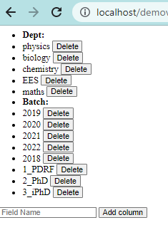
The tables :
The 1st table: has the instrument category id (unique to one category, not to one individual instrument )
The 2nd table: has the instrument access information, 1 represents yes, and 0 represents no, it’ll be auto checked when the data will be called by users, the ID will be Category id, and this will be simply controlled from a section available in admin side

Slide 3
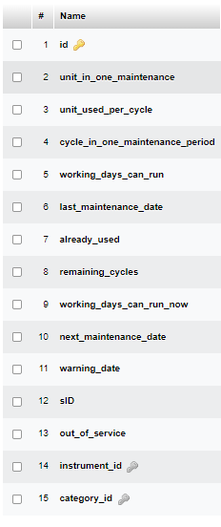
The 3rd table will be the instrument registry, it’ll have the details of categorised instruments so it’ll be better to submit the specification to database and use later when needed
The 4th table will be having present parameters details which are basically specification – used routine
Eg instrument category A has 10 instruments, but when using we’ll be using one from the 10, so the used cycle will be reduced from the particular individual instrument.
The number will be auto generated when submitting the instrument category,
Inst category * quantity = auto-genarated sID ( ID for the individual instrument, autogenerated )
Refer this spreadsheet for checking the calculation algorithm for individual instruments
The ID will be same across all the tables so that it’be easy in the front section to make call of data.
Comment – we can have all this data in a single table, but it would be messy to manage both category and individual instrument at same time.

Slide 4
Few Questions:
The access thing needed to be discussed, how to have it more secure and proper.
Are we going to have a prepared database about the users so that via any one details, consider mail id, we can get their batch and department while they will be signing up, if we’ll keep this open then anyone can signup to a PhD privilege.
Shall we hash the storage of data about user and finance, so that no manipulation can be done from the backend, and if done after hashing then there’ll be data error.
Also, the security system is a question, the PHP MySQL aren’t enough secure, the logs of changes in database, user, finance system needs to be tracked so that no Forgery can be done.

