Slide 1

LOVE🖤
How it’s idea changed from time to time?
Notes:
hey

Slide 2
Origin of the word
In English, the word “love,” which is derived from Germanic forms of the Sanskrit lubh (desire), is broadly defined and hence imprecise, which generates first order problems of definition and meaning, which are resolved to some extent by the reference to the Greek terms, eros, philia and agape.

Slide 3
First Love - Pre Socratic
Philosopher Empedocles says “Elements interact to form different substances. The cause of this mixture and of these interactions are the cosmic forces of Philotes (love, the force of attraction and combination) and Neikos (Strife, the force of repulsion and fragmentation). These two forces are engaged in the eternal dialectic and they each prevail in turn in an endless cosmic cycle”
Empedocles was a well-known physician and arrived at the above conclusion by taking heart as an example. This is likely to be the first time the notion of heart and love are brought together.

Slide 4
Platonic love
Plato provides the notion of love two of his texts, Symposium and Phaedrus
Plato‘s writings say - “Eros (erotica) or desire that seeks transcendental beauty-the particular beauty of an individual reminds us of true beauty that exists in the world”
Phaedrus 249E: “he who loves the beautiful is called a lover because he partakes of it.”
Platonic love is an influential notion of love that says people in love connect at a higher intellectual level which surpasses physical beauty.
Saying so he still makes note that it has the desire and erotic components too

Slide 5
Socrates in love?
In Plato’s Symposium Socrates says that he learned “the truth about love” from a clever woman.” That woman is given the name “Diotima” in the text
The above statement slightly contradicts his famous saying: “The only thing I know is that I don’t know.”
So did he get influenced by love too?
Many historians consider that the character “Diotima” is fictional but there is speculation that this character resembles Aspasia, a clever and well-educated woman in Socrates’ circle who share a similar ideology.

Slide 6
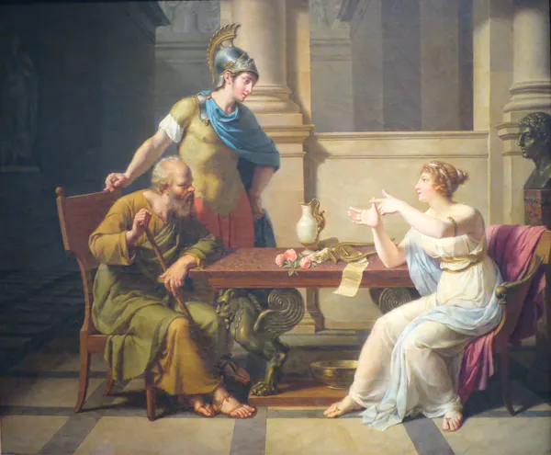
The Debate of Socrates and Aspasia, c. 1800

Slide 7
Aristotle and Love
Aristotle talks about love in the sense of friendship, using the Greek word philia (fondness, friendship, sometimes love)
He says that there are three bases for friendships - “One might like someone because he is good, or because he is useful, or because he is pleasant.”
“If they are equally virtuous, their friendship is perfect. If, however, there is a large gap in their moral development (as between a parent and a small child, or between a husband and a wife), then it will be imperfect precisely because of their inequality.”

Slide 8
He describes perfect friendships as equal and exercise their virtues and discard all other relations of give and take (based on profit or pleasure) as imperfect.
He also goes on to say that perfect friendships are advantageous and make life complete
We can see that above two statements contradict, Aristotle escapes it by saying “friend is another self”, “friendship is for the good of other and only it! And this feeling must be reciprocated”
He mentions love in one more context saying “self-love is an entirely proper emotion provided it is expressed in the love of virtue”
Later he describes two types of self-love one relates to present day egoism and to greater good or virtue

Slide 9
Love in Bible - Christian period
St. Paul, author of Fourteen epistles in New Testament describes love in many places using the phrase Agape (paternal love of God, brotherly love). Few instances are given below
“Love is patient and is kind; love doesn’t envy. Love doesn’t brag, is not proud, does not behave itself inappropriately … does not rejoice in unrighteousness, but rejoices with the truth; bears all things, believes all things, hopes all things, endures all things. Love never fails.” (1 Corinthians 13:5)
“You shall love your neighbour as yourself.” Love doesn’t harm a neighbour. Love therefore is the fulfilment of the law.” (Romans 13:09–13.11)

Slide 10
Collectively, he says that the unconditional love is given as gift by Jesus, who sacrificed himself for all people and all the love we experience in mortal life is of Jesus, through other people.
Below are some more statements from The Bible describing relationships
“God in general prefers asceticism and celibacy. However, good Christians need to give these up if they wish to marry and have children. Thus, God allows sexual intercourse but only for having children, because reproduction serves to continue the human species and does not encourage sin and desire for pleasure of flesh”
“But I would have you know that the head of every man is Christ, and the head of the woman is man, and the head of Christ is God.”
“Let the husband give his wife the affection owed her, and likewise also the wife her husband. The wife doesn’t have authority over her own body, but the husband. Likewise, also the husband doesn’t have authority over his own body, but the wife”

Slide 11
Rousseau’s Love stories - Enlightenment Period
Below are Rousseau’s famous statements pertaining to love
“We share the same picture of the world…. we have the same outlook on the world and why would I not believe that what we share in our hearts we also share in the level of our beliefs and judgements”
“Man can resist almost anything but benevolence, and in order to get benevolence you give it”
According to him a man and a woman seal their love in marriage when they feel that they cannot change what they feel for each other

Slide 12
Rousseau writes a tragic love story titled “Julie” in which Saint-Preux, Julie’s teacher, falls in love with her and, to his surprise and despite all they felt and discovered, she later married the older, wealthy, and educated de Wolmar. Even more interesting is that Rousseau wrote a love story in which, even after Julie gave birth to two children, she remained in love with Saint-Preux and later admitted her affair to de Wolmar, who was saddened upon learning this fact but continued to love her nonetheless
Later in the story Julie dies and her last words to Saint Preux are “No, I am not leaving you, I go to wait for you. The virtue that set us apart on earth will bring us back together in the eternal home”
This is one of the first time, someone came so close to describe the notion of love that prevails today
Rousseau, who was so open-minded in other areas, was so conservative in gender matters. In his book “Emile”, he says that both complements to one another in the eyes of nature. And from the nature argument he infers that a man is (or should be) superior and a woman inferior

Slide 13
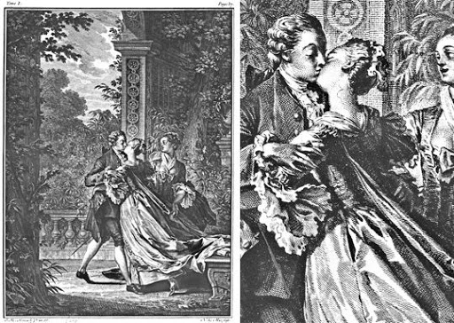
An illustration from a 1774 English edition - “Julie kisses Saint Preux”

Slide 14
Sigmund Freud’s Transference love - Modern Period
He is trained in Neurophysiology, founding father of psychoanalysis
He uses the notion of drives (psychological urges) and says that drives composed of four components: on one side, we have the pair of tension and pressure and, on the other side, the pair of aim and goal
We can see that first two are destructive and later are constructive, this description have a lot of similarities with Empedocles’ use of Philotes and Neikos

Slide 15
Freud identifies the beginning of duality of drive and love in the mother/child relationship, with the first activity of pleasure being a child’s sucking to drink milk. Consequently, the birth of desire, love, and yearning bear witness to these lost original first years of the child’s relationship with his mother, which serves as a matrix for all subsequent relationships, in which people try either to replicate it or deny it and replace it with another better one.
This kind of love that we as grown ups try to repeat Freud calls, as mentioned earlier, transference love.
Freud came to know this through sessions with his patients who fell in love with him, although he recognized that they were not actually in love with him but had transferred their original attachment to their father to him.

Slide 16
How do I define Love?

Slide 17
I would say Love has two notions
Love as a verb (action word). The effort or the energy you put up to show how you feel. The things you do for the person's good. This notion of love pertains to the other person.
Love as an abstract noun (emotion). The way you feel about the person and how much the person means to you. The drive for your actions to impress the person. This notion of love pertains to yourself.
In a relationship, the action and emotional parts of Love of each person define the relationship. Over time, the dynamic of both parts adjust/converge to an optimal value and the relation gets stronger. ❤

Slide 18
Sources
https://iep.utm.edu/love-his - Article by Katarina Majerhold
https://theconversation.com/socrates-in-love-how-the-ideas-of-this-woman-are-at-the-root-of-western-philosophy-109593 - Article by Misha Ketchell
https://www.youtube.com/user/EmmaSaying - Pronunciation of Greek words and Names
Love and Friendship in Plato and Aristotle - A.W. Price

Slide 19
By Arabhi Subhash, Cs17b005

