Slide 1
Customer Churn Analysis
END-TO-END ANALYTICS PROJECT
PYTHON | SQL | POWER BI
SUBESAN T P

Slide 2
Problem Statement
CUSTOMER CHURN IMPACTS REVENUE AND GROWTH.
OBJECTIVE: IDENTIFY CHURN DRIVERS AND PREDICT CHURN RISK.

Slide 3
Tools & Technologies
Python (Pandas, Numpy, Sklearn)
SQL
Power BI
Machine Learning

Slide 4
Data Overview
Customer Demographics
Contract Details
Charges
Churn Label

Slide 5
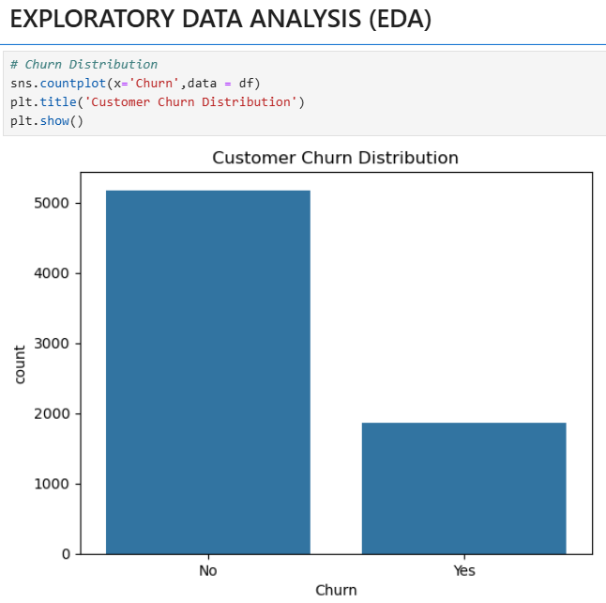
Data Cleaning & EDA
Handled missing values
Removed duplicates
Encoded categorical data
Exploratory analysis
Feature Scaling

Slide 6
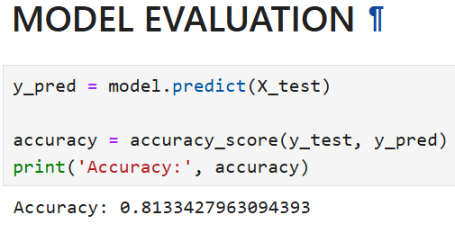
Churn Prediction Model
Logistic regression
Model accuracy ~82%
Evaluated with confusion matrix

Slide 7
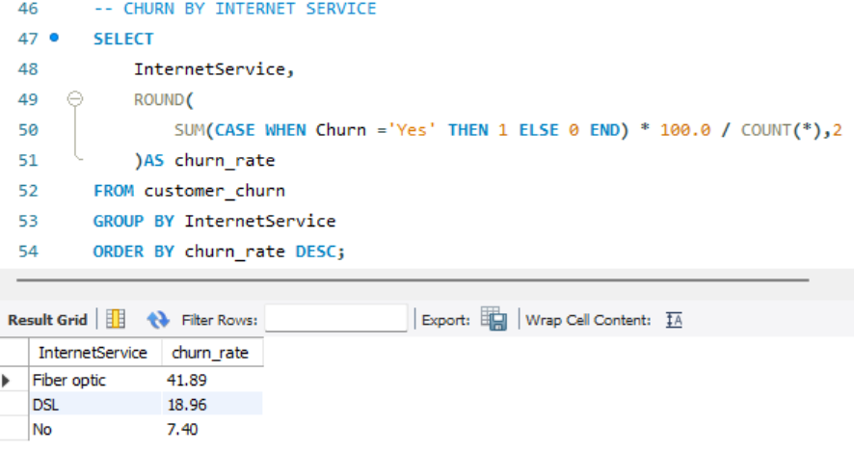
SQL Analysis
Churn rate by contract
High-risk segments
Revenue impact

Slide 8
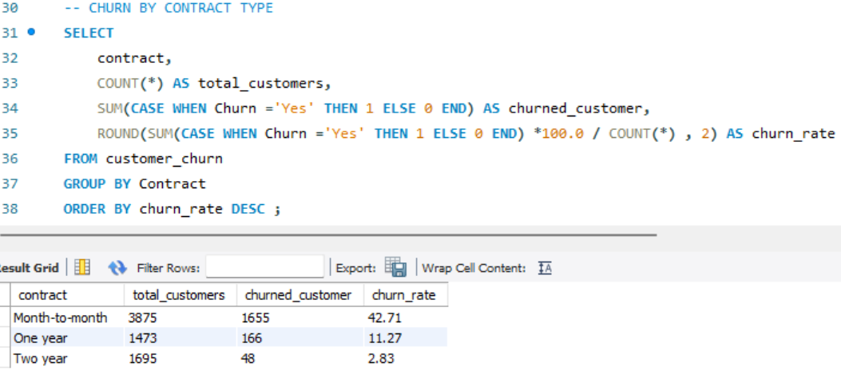
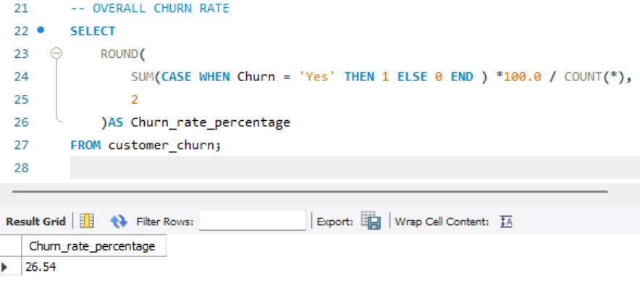
Churn Rate By Contract
Overall Churn Rate

Slide 9
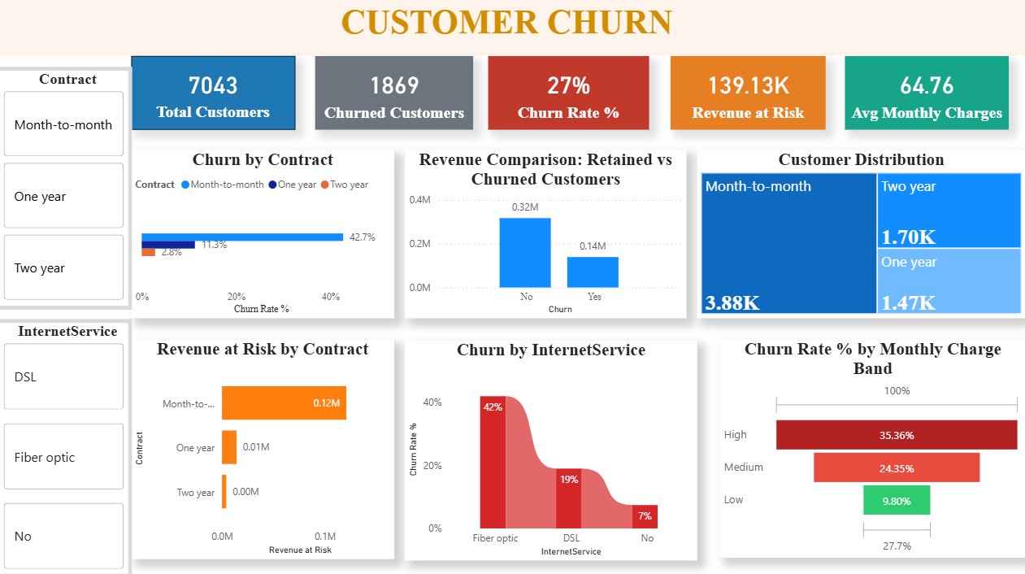
Power BI Dashboard

Slide 10
Power BI Dashboard
KPI : Total Customers, Churned Customers, Churn %, Revenue at risk , Average Monthly Charges
Interactive slicers – Contract , Internet Service
Visuals – Service Analysis

Slide 11
Key Insights
Month-to-month contracts churn more
High charges increase churn
Long-term contracts reduce churn

Slide 12
Business Recommendations
Promote long-term contracts
Early engagement strategies
Targeted customer offers

Slide 13
Conclusion
End-to-end analytics workflow
Business-focused insights

