Slide 1

HR Analysis SQL Report:
Subesan T P | Month & Year: January 2026

Slide 2
PROJECT OVERVIEW
Objective
Conduct comprehensive HR workforce analysis using SQL on 22,214 employee records to identify workforce trends, demographics, retention patterns, and provide strategic recommendations for organizational decision-making.
Database & Data Source
Database Name: project_hr_analysis
Table Name: HR_dataset
Total Records: 22,214 employees (active + terminated)
Time Period: Employees hired 2000-2020, analyzed January 2026
Data Format: CSV imported into MySQL

Slide 3
Methodology
Analysis Approach:
Imported 22,214 employee records into MySQL database
Applied SQL aggregation, segmentation, and temporal analysis
Analyzed 6 dimensions: Workforce, Hiring Trends, Demographics, Geography, Organization, Retention
Generated insights through comparative analysis and pattern identification
Developed actionable recommendations across 3 time horizons (short/medium/long-term)
Outcome: Data-driven insights transforming raw HR data into strategic workforce recommendations.

Slide 4
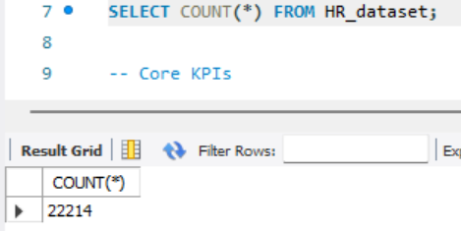
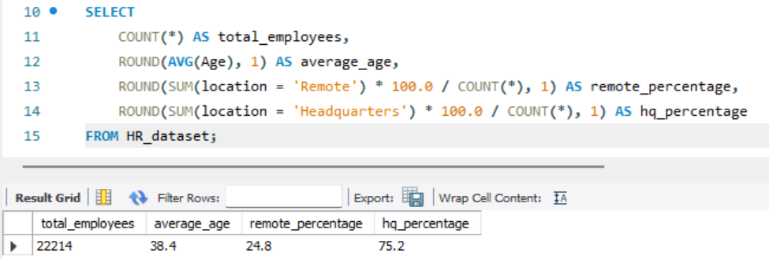
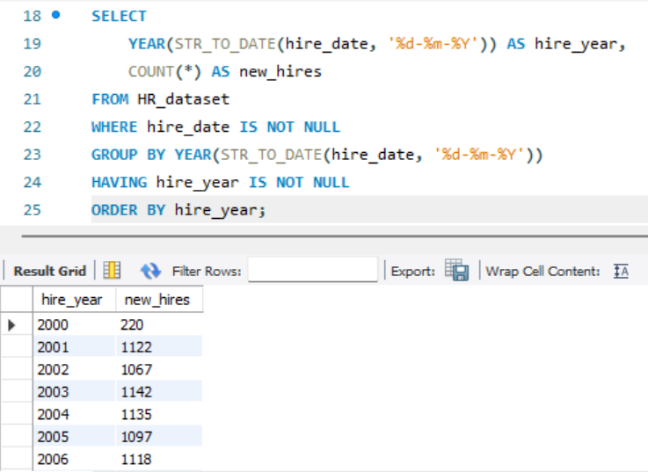
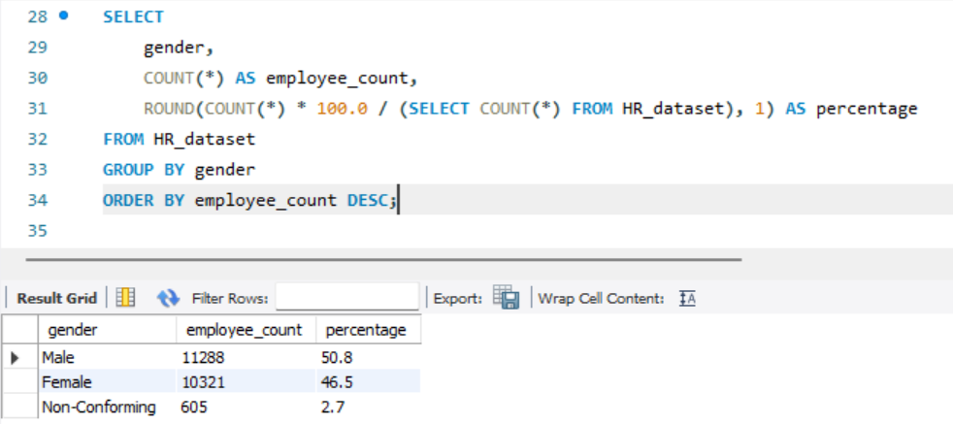
Key Outputs Part - 1

Slide 5
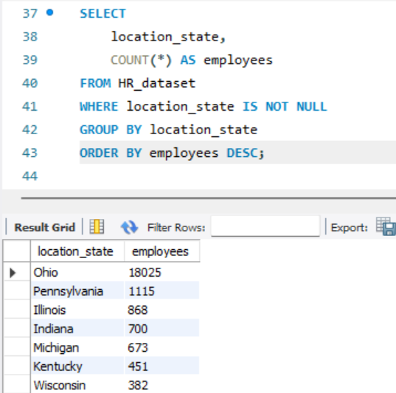
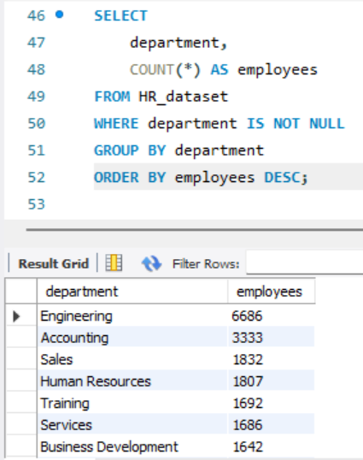
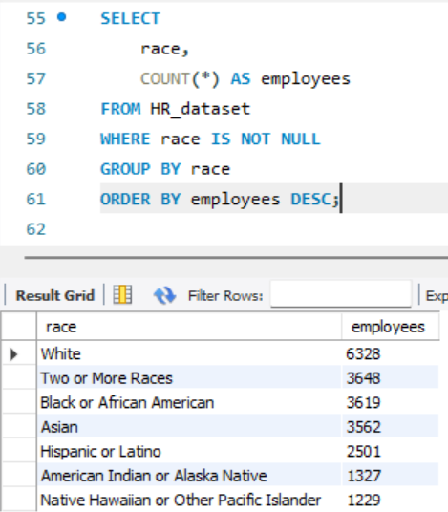
Key outputs Part - 2

Slide 6
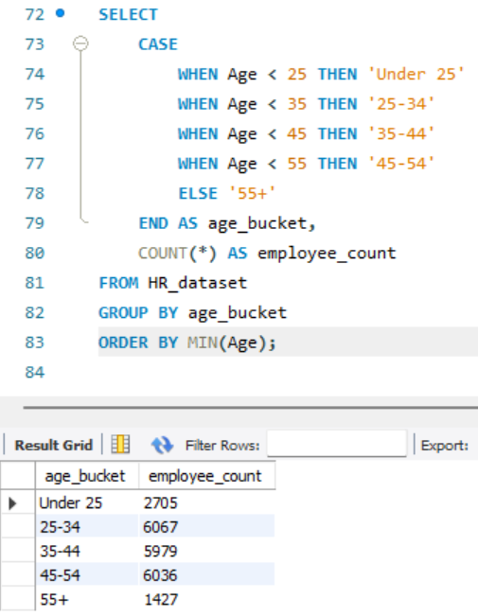
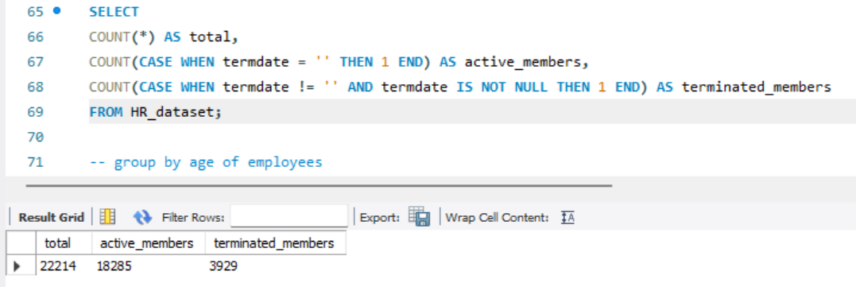
Key outputs Part - 3

Slide 7
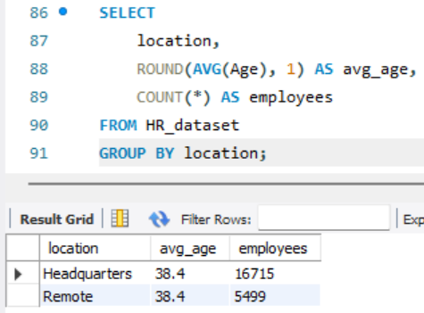
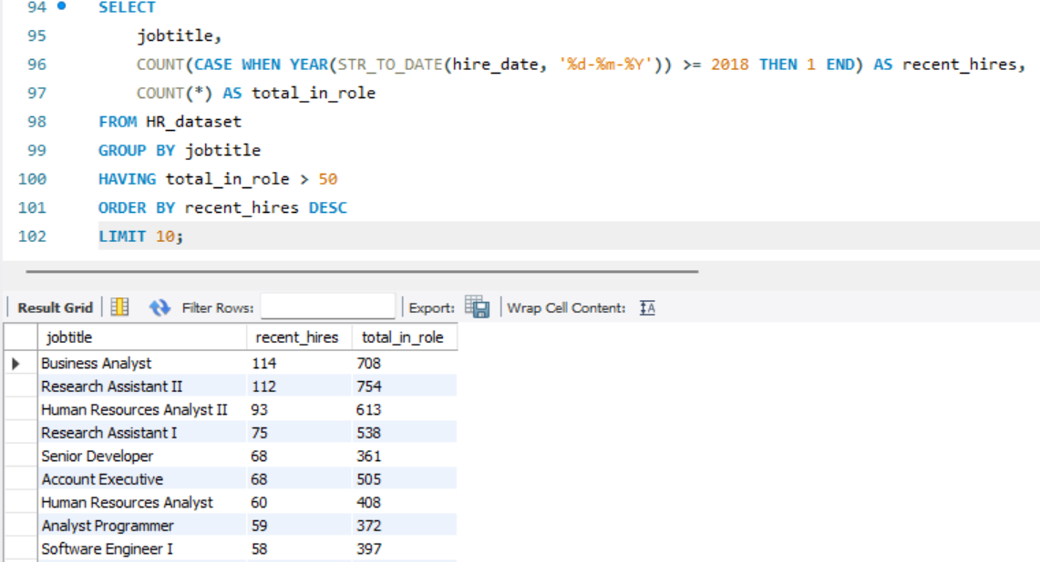
Key outputs Part - 4

