Slide 1
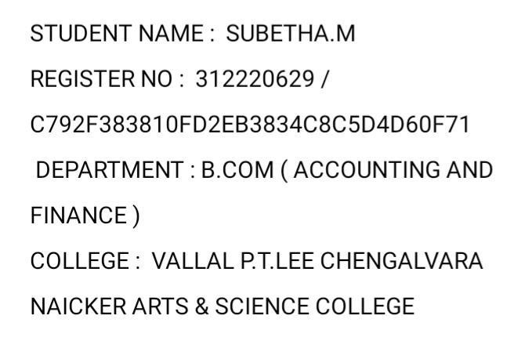
Employee Data Analysis using Excel

Slide 2

PROJECT TITLE

Slide 3


AGENDA
1.Problem Statement 2.Project Overview 3.End Users
4.Our Solution and Proposition 5.Dataset Description 6.Modelling Approach 7.Results and Discussion 8.Conclusion
3/21/2024 Annual Review

Slide 4
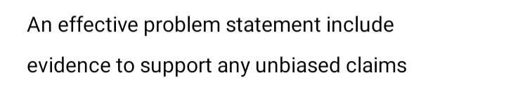

PROBLEM STATEMENT

Slide 5
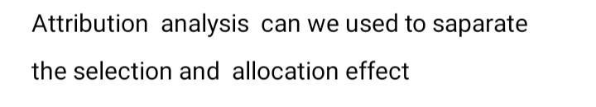
PROJECT OVERVIEW
•.

Slide 6
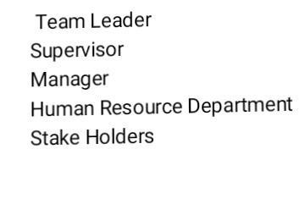

WHO ARE THE END USERS?

Slide 7

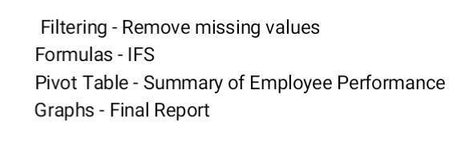
OUR SOLUTION AND ITS VALUE PROPOSITION

Slide 8
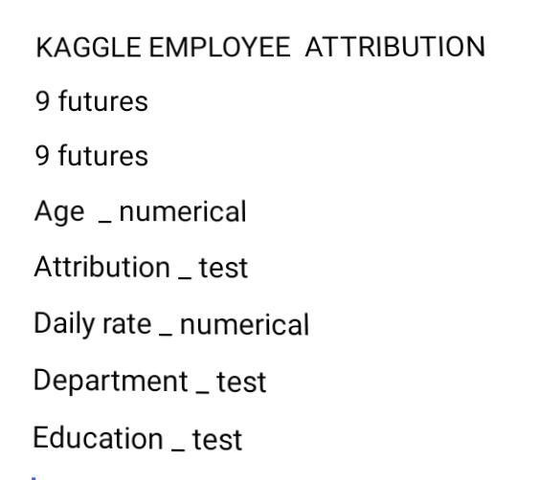
Dataset Description

Slide 9


THE "WOW" IN OUR SOLUTION
3/21/2024 Annual Review
10

Slide 10
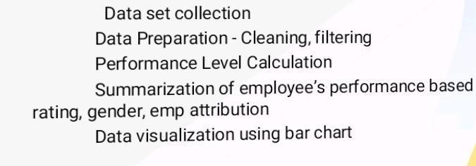
MODELLING
10

Slide 11
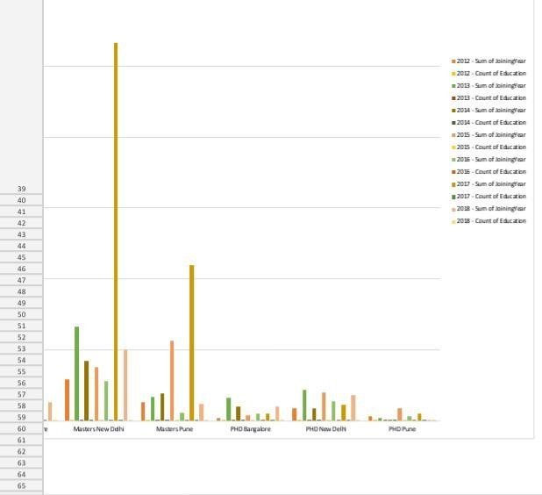
RESULTS
10

Slide 12
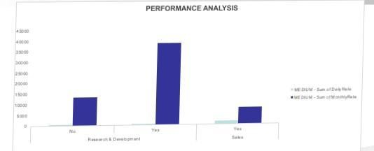

Slide 13


Slide 14
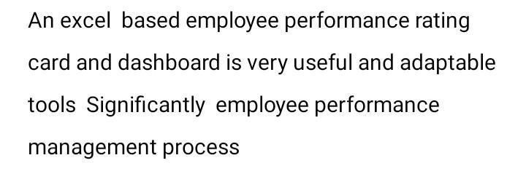
conclusion

