Slide 1
Student Academic Performance Prediction and Reasoning
Subham Biswas

Slide 2


Objective
To predict the performance of a student and identify the reason. Also, to identify parameters that can influence the performance.
Key
Model Build
Understanding
Inference

Slide 3
0. Motivation
Machine Learning Use of SOTA machine learning algorithms.
Interpretable AI Understanding model and reasoning exposure

Slide 4
Architecture
Input
Model
MLI
Analysis
Key
Input - Pre-processed Data
Model - Train and Test
MLI - Model Interpretation/Understanding
Analysis - MLI Inferences and Improvement

Slide 5
1. E.D.A.
Exploratory Data Analysis
Univariate Effective contribution and meaning
Multi-Variate Relationship between univariate variables and dependency

Slide 6
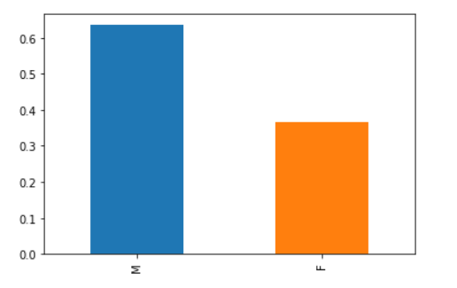
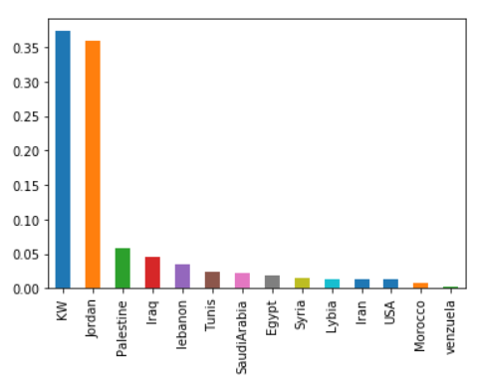
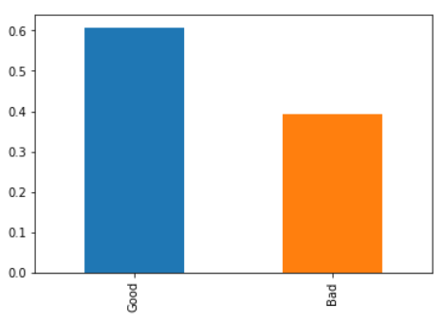
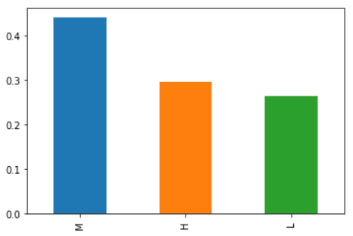
Univariate
Variables Used Gender, Nationality, Place of Birth, Educational Stages, Grade Level, Section ID, Topic, Semester, Parent Relationship, Raised Hands, Visited Resources, Viewing announcements, Discussion groups, Parent Answering Survey, Parent School Satisfaction, Student Absent Days, Class.
Gender
Parents School Satisfaction
Class Grade - Final Label
Nationality

Slide 7
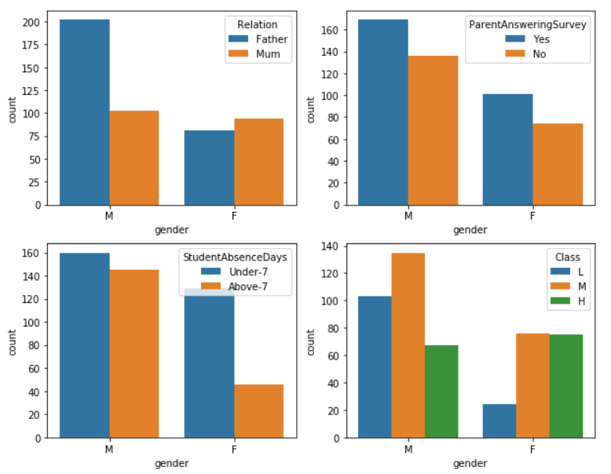
Multi-Variate (1)
Variables Combinations
Gender vs Relation, ParentAnsweringSurvey, StudentAbsenseDays, Class
Observations:
Males have higher count for relation with father compared to females.
Males have higher count for Parents answering survey compared to females.
Males are absent in school for much higher duration compared to females. (Females are focused!)
Males in average score lower compared to girls..

Slide 8
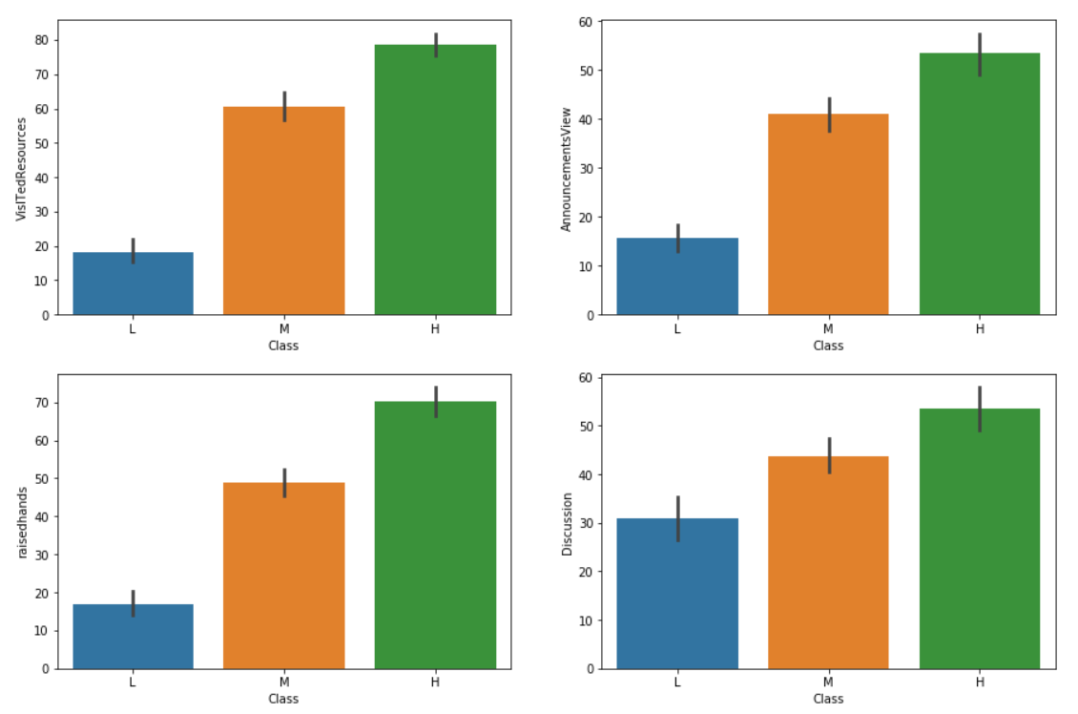
Multi-Variate (2)
Variables Combinations
Class vs VisitedResources, AccouncementViews, RaisedHands, Discussion
Observations:
The students who participated in more of (Discussion, Raisedhands, AnnouncementViews, VisitedResources) got a higher grade

Slide 9
2. Model Build
Training and Testing of Machine Learning models.
Model Train Training the model after pre-processing
Model Test Testing the model against test data and validation with metrics.

Slide 10
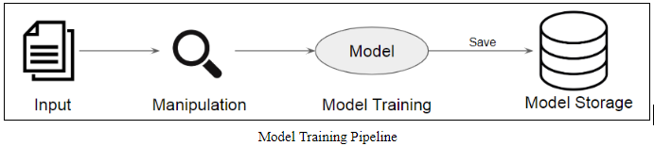
Model Train

Slide 11
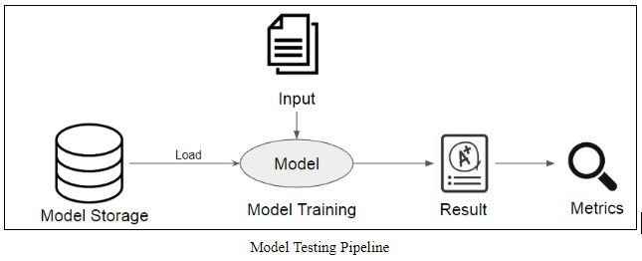
Model Test

Slide 12
Metrics
S.No. | Model Type | Accuracy | Precision | Recall | F1-Score
1 | Naive Bayes | 0.58 | 0.60 | 0.58 | 0.59
2 | Logistic Regression | 0.78 | 0.80 | 0.78 | 0.78
3 | Decision Tree | 0.72 | 0.76 | 0.72 | 0.73
4 | Random Forest | 0.79 | 0.84 | 0.79 | 0.79
5 | SVM | 0.79 | 0.81 | 0.79 | 0.79
6 | Multi-layer Perceptron | 0.42 | 0.25 | 0.42 | 0.31

Slide 13
3. MLI
Machine Learning Interpretability
Model Understanding Understanding the model output behaviour
Top Features Identify top features for test data

Slide 14
Interpretable AI (‘H’)
Reason Identification
Identify features that describe the reason for a prediction/output given by model.
Confidence value of that feature
Top features affecting the output directly
Example:
For a student who score ‘H’, i.e. High, below are the top features with confidence
S.No. | Feature | Confidence
1 | 0.00 < StudentAbsenceDays <= 1.00 | -0.164
2 | RaisedHands > 72.00 | -0.124
3 | AnnouncementsView > 52.25 | -0.116
4 | Nationality <= 3.00 (Egypt, Iran, Iraq, Jordan) | -0.094
5 | ParentsAnsweringSurvey <= 0.00 | 0.076
Key
From this, we can say that the student who :
Raises his hands more than 72 times
Views announcement regularly more than 52.25 times
Has a higher chance of getting ‘H’.

Slide 15
Interpretable AI (‘M’)
Reason Identification
Example:
For a student who score ‘M’, i.e. Medium, below are the top features with confidence
S.No. | Feature | Confidence
1 | 0.00 < StudentAbsenceDays | 0.168
2 | AnnouncementsView <= 14.00 | 0.104
3 | Nationality <= 3.00 (Egypt, Iran, Iraq, Jordan) | -0.100
4 | ParentsAnsweringSurvey <= 0.0 | 0.075
5 | PlaceofBirth <= 3.00 | 0.072
Key
From this, we can say that the student who :
Place of Birth is 0: Egypt, 1: Iran, 2: Iraq, 3: Jordan
Views announcement regularly but less than 14 times
Has a higher chance of getting ‘M’.

Slide 16
Interpretable AI (‘L’)
Reason Identification
Example:
For a student who score ‘H’, i.e. High, below are the top features with confidence
S.No. | Feature | Confidence
1 | StudentAbsenceDays <= 0.00 | 0.154
2 | RaisedHands <= 15.00 | 0.149
3 | VisitedResources <= 18.75 | 0.112
4 | AnnouncementsView <= 14.00 | 0.107
5 | ParentsAnsweringSurvey <= 0.00 | 0.068
Key
From this, we can say that the student who :
Raises his hands less than 15 times
Views announcement regularly but less than 14 times
Visited a course regularly but less than 18.75 times.
Has a higher chance of getting ‘L’.

Slide 17
4. Improvement
Using MLI to improve Student Performance
MLI Analysis Understanding the model output behaviour
Feature Manipulation

Slide 18
Improvement
Input
‘H’ Class
‘M’ Class
‘L’ Class

Slide 19
Feature Groups
For ‘H’, major factors found:
('0.00 < StudentAbsenceDays <= 1.00', 24),
('raisedhands > 72.00', 17),
('AnnouncementsView > 52.25', 16),
('0.00 < ParentAnsweringSurvey <= 1.00', 16),
('NationalITy <= 3.00', 15),
('VisITedResources > 84.00', 7),
('PlaceofBirth > 4.00', 6),
('ParentAnsweringSurvey <= 0.00', 4),
('NationalITy > 4.00', 4),
('42.00 < raisedhands <= 72.00', 3),
('62.50 < VisITedResources <= 84.00', 2),
('PlaceofBirth <= 3.00', 2),
('AnnouncementsView <= 14.00', 1),
('0.00 < gender <= 1.00', 1),
('StageID <= 1.00', 1),
('0.00 < Relation <= 1.00', 1)
For ‘M’, major factors found:
('0.00 < ParentAnsweringSurvey <= 1.00', 15),
('0.00 < StudentAbsenceDays <= 1.00', 13),
('NationalITy <= 3.00', 10),
('StudentAbsenceDays <= 0.00', 9),
('ParentAnsweringSurvey <= 0.00', 7),
('PlaceofBirth <= 3.00', 7),
('AnnouncementsView > 52.25', 7),
('StageID <= 1.00', 7),
('42.00 < raisedhands <= 72.00', 6),
('AnnouncementsView <= 14.00', 5),
('0.00 < gender <= 1.00', 5),
('raisedhands > 72.00', 3),
('NationalITy > 4.00', 3),
('gender <= 0.00', 3),
('VisITedResources <= 18.75', 2),
('15.00 < raisedhands <= 42.00', 2),
('62.50 < VisITedResources <= 84.00', 2),
('VisITedResources > 84.00', 1),
('Discussion <= 20.00', 1),
('PlaceofBirth > 4.00', 1),
('1.00 < StageID <= 2.00', 1)
For ‘L’, major factors found:
('StudentAbsenceDays <= 0.00', 11),
('VisITedResources <= 18.75', 10),
('AnnouncementsView <= 14.00', 8),
('raisedhands <= 15.00', 7),
('NationalITy <= 3.00', 6),
('ParentAnsweringSurvey <= 0.00', 5),
('NationalITy > 4.00', 3),
('PlaceofBirth > 4.00', 1),
('PlaceofBirth <= 3.00', 1),
('0.00 < ParentAnsweringSurvey <= 1.00', 1),
('42.00 < raisedhands <= 72.00', 1),
('0.00 < gender <= 1.00', 1)

Slide 20
Group Improvement ‘L’ to ‘H’
The relation between ‘H’ and ‘L’ are dependent on the following
'0.00 < Relation <= 1.00',
'0.00 < StudentAbsenceDays <= 1.00',
'62.50 < VisITedResources <= 84.00',
'AnnouncementsView > 52.25',
'StageID <= 1.00',
'VisITedResources > 84.00',
'raisedhands > 72.00'
Key
Inference:
‘L’ score -> ‘H’ score
Student needs to reduce Absent Days
Student needs to increase his Resource/Course visit to greater than 84 times.
Student needs to view announcements more than 52.25 times.
Student needs to raise hands by more than 72 times.

Slide 21
Group Improvement ‘L’ to ‘H’
The relation between ‘M’ and ‘L’ are dependent on the following
'0.00 < StudentAbsenceDays <= 1.00',
'1.00 < StageID <= 2.00',
'15.00 < raisedhands <= 42.00',
'62.50 < VisITedResources <= 84.00',
'AnnouncementsView > 52.25',
'Discussion <= 20.00',
'StageID <= 1.00',
'VisITedResources > 84.00',
'gender <= 0.00',
Key
Inference:
‘L’ score -> ‘M’ score
Student needs to reduce Absent Days
Student needs to bring his Resource/Course visit to between 62.50 and 84 times.
Student needs to view announcements more than 52.25 times.
Student needs to raise hands between 15 to 42 times.

Slide 22
5. Conclusion
Academic Performance
What Predicting and Understanding Academic Performance of Students
Why To understand if ML model is learning properly and the important features
How Model -> MLI -> Analysis -> Inference

Slide 23
Thank you

