Slide 1


Spectral Analysis of Lung Sounds for Classification of Asthma and Pneumonia Wheezing
Authors:
Engr. Misha Urooj Khan (Presenter)
Syed Zohaib Hassan Naqvi
Muhammad Umar Khan
Mohammad Ahmad Choudhary
Sumair Aziz
Muhammad Nafees.ul.Hassan
Conference: IEEE ICECCE

Slide 2
Background
Pulmonic diseases: leading global cause of death
Asthma: affects ~235 million worldwide; major cause of hospitalization
Pneumonia: causes alveolar inflammation and fluid buildup
Wheezing: key diagnostic indicator for pulmonic illnesses
Opportunity: low-cost, automated lung sound analysis

Slide 3
Study Objective
Develop automated system to classify normal, asthma wheeze, and pneumonia wheeze
Use spectral domain analysis + machine learning (SVM)
Target: High accuracy, low-cost deployment

Slide 4
Related Work
Prior methods: MFCC + SVM, FPGA, neural networks, genetic algorithms
Challenges: wheeze variability, separation from heart sounds
Need for robust spectral-based system with high accuracy

Slide 5
Proposed Methodology
Steps: Data acquisition → Preprocessing → Feature extraction → Classification
Target: distinguish between normal, asthma wheeze, pneumonia wheeze

Slide 6
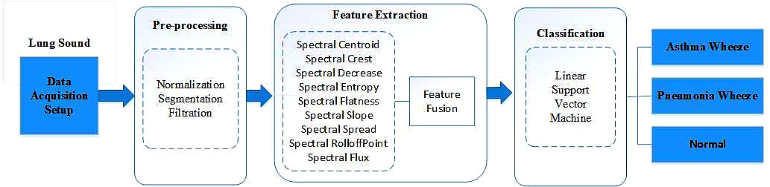
Proposed Methodology of the system

Slide 7
Data Acquisition
Collected at PIMS Hospital, Islamabad
Subjects: 300 (100 asthma, 100 pneumonia, 100 normal)
10 × 10 sec recordings per subject
Equipment: Electret microphone, stethoscope, filter, amplifier

Slide 8
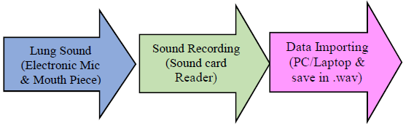
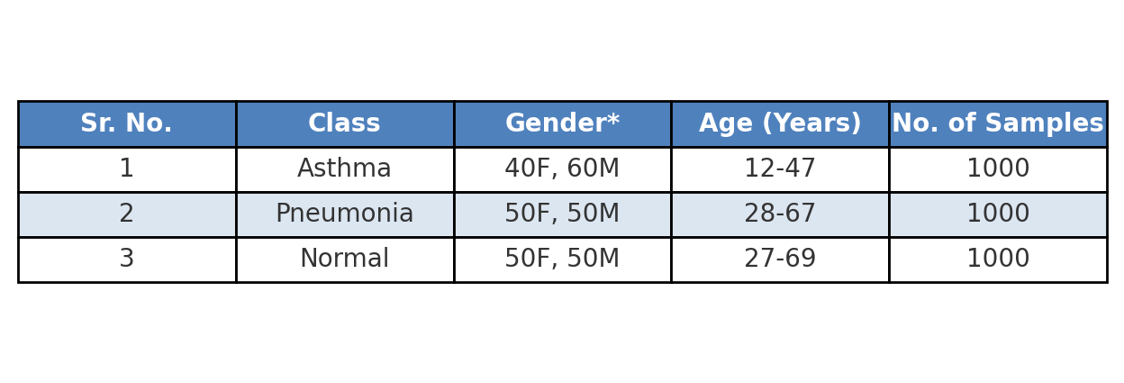
Data acquisition process for breathing sounds
DETAILS OF ACQUIRED SAMPLES

Slide 9
Preprocessing
Normalization: Min-Max scaling (0–1)
Segmentation: 250 ms frames to remove silent/non-breathing parts
Filtration: 10th order Butterworth bandpass (250 Hz–2 kHz)
Purpose: reduce noise, isolate wheeze frequency range

Slide 10
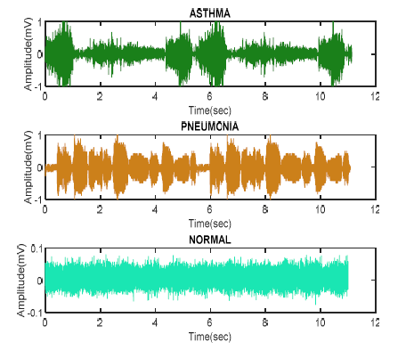
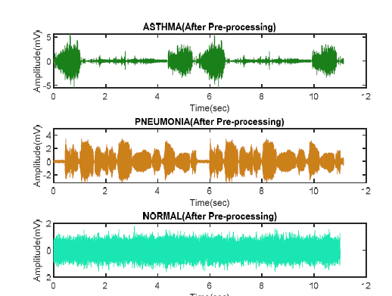
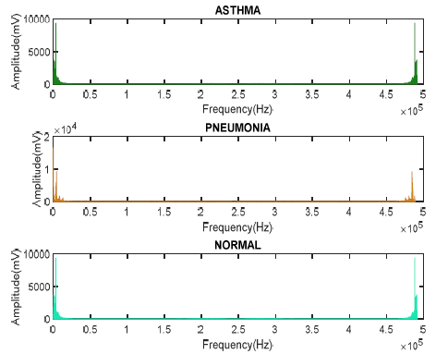
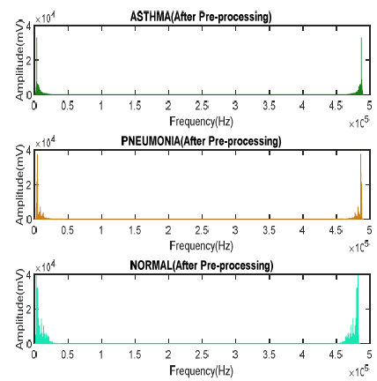
LS signals before pre-processing
LS signals after pre-processing

Slide 11
Feature Extraction
9 spectral features: centroid, crest, decrease, entropy, flatness, flux, roll-off, slope, spread
Features selected for effective discrimination between classes

Slide 16
Classification Approach
Primary classifier: SVM
Compared with: LD, KNB, FT, GNB, FKNN, BT, SKNN
SVM kernels tested: Linear, Quadratic, Cubic, Fine/Medium/Coarse Gaussian
Cross-validation: 5-fold & 10-fold

Slide 17

Results
Best accuracy: Linear SVM – 96.70%
5-fold CV: 96.7% | 10-fold CV: 96.4%
Confusion matrix: minor misclassifications between AW, PW, and N

Slide 18
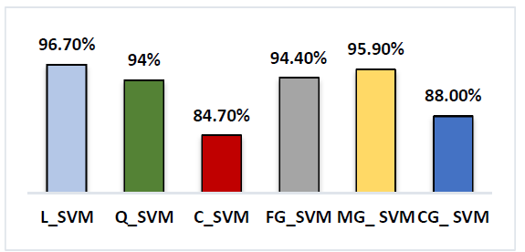
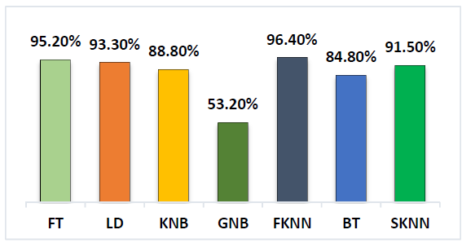
Accuracy of the system on different kernels of SVM
Accuracy of the system on different classifiers

Slide 19
Confusion Matrix of Processed Data

Slide 20
Conclusion
Spectral analysis + SVM effectively classifies wheeze types
High accuracy with low computational cost
Potential for low-cost, portable diagnostic devices
Future work: hardware implementation, other pulmonic abnormalities

Slide 21
Discussion Questions
Could combining spectral and time-domain features improve accuracy?
Impact of environmental noise on performance?
Adaptations for pediatric/elderly populations?
Could deep learning outperform current SVM model?

