Slide 1

Project Presentation of Industry Oriented Hands on Experience (22CS422)
On
Tomato Food Delivery Website
Presented By:
Subha Panja (2211981407)
Supervised By:
Dr. Swati Goel
Assistant Professor
Chitkara University, Rajpura
Department of Computer Science and Engineering,
Chitkara University, Punjab
1

Slide 2
Introduction
Tomato is a trusted food delivery website.
We Deliver fresh and delicious food directly to your doorstep.
Order your favorite restaurants anytime, anywhere .
Enjoy fast, safe, and reliable delivery service .
Secure online payments and real-time order tracking .
Quality food and customer satisfaction our top priorites.
This website is fully customer friendly website.
2

Slide 3
Technology Stack
Frontend: React.js (for building user interface)
Backend: Node.js and Express.js (for server and APIs)
Database: MongoDB (for storing user and project data)
Authentication: JWT (JSON Web Token for secure login)
AI Integration: Google Gemini API (for chat, summary, quiz, flashcards)
UI Design: Tailwind CSS (for responsive and modern design)
Development Tool: Visual Studio Code
3

Slide 4
Project Abstract
Tomato Food Delivery website is fully customer base and user friendly website.
Online platform food order is so easy to user.
Connects user in different restaurant.
Secure online payments.
Quick fast and fresh food deliver on your doorsteps.
Real time order tracking features.
Offers a variety on food options.
4

Slide 5
Objectives
To provide an online food ordering platform.
To create a user friendly interface for users.
Efficient order management to mange menu, update menu, monitor customer order.
Cart and payments system user add multiple items and payments through online mode.
Order tracking system to track order properly.
Responsive web design to work properly and not disturb users.
5

Slide 6
Key Features
User Authentication: Secure login and signup using JWT
Food menu browsing: user browse any items and order it.
Add to Cart: user can add food items, quantity and total price before placing order.
Order placements: user order there items and system store the data through the database.
Order History: the system allows users to check there order history.
Admin management: admin can also track the order efficiently.
6

Slide 7
System Architecture
The system follows a 3-tier architecture: Frontend, Backend, and Database
Frontend (React.js + Tailwind CSS) handles user interface and interactions
Backend (Node.js + Express.js) processes requests and manages application logic
Implements JWT authentication for secure login and access control
Database (MongoDB) stores users, documents, flashcards, quizzes, and results
Data flows from User → Frontend → Backend → AI/Database → Frontend
8

Slide 8
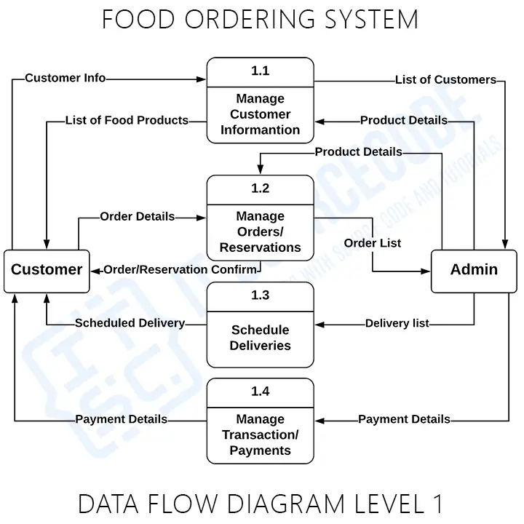
Data Flow Diagram
9

Slide 9
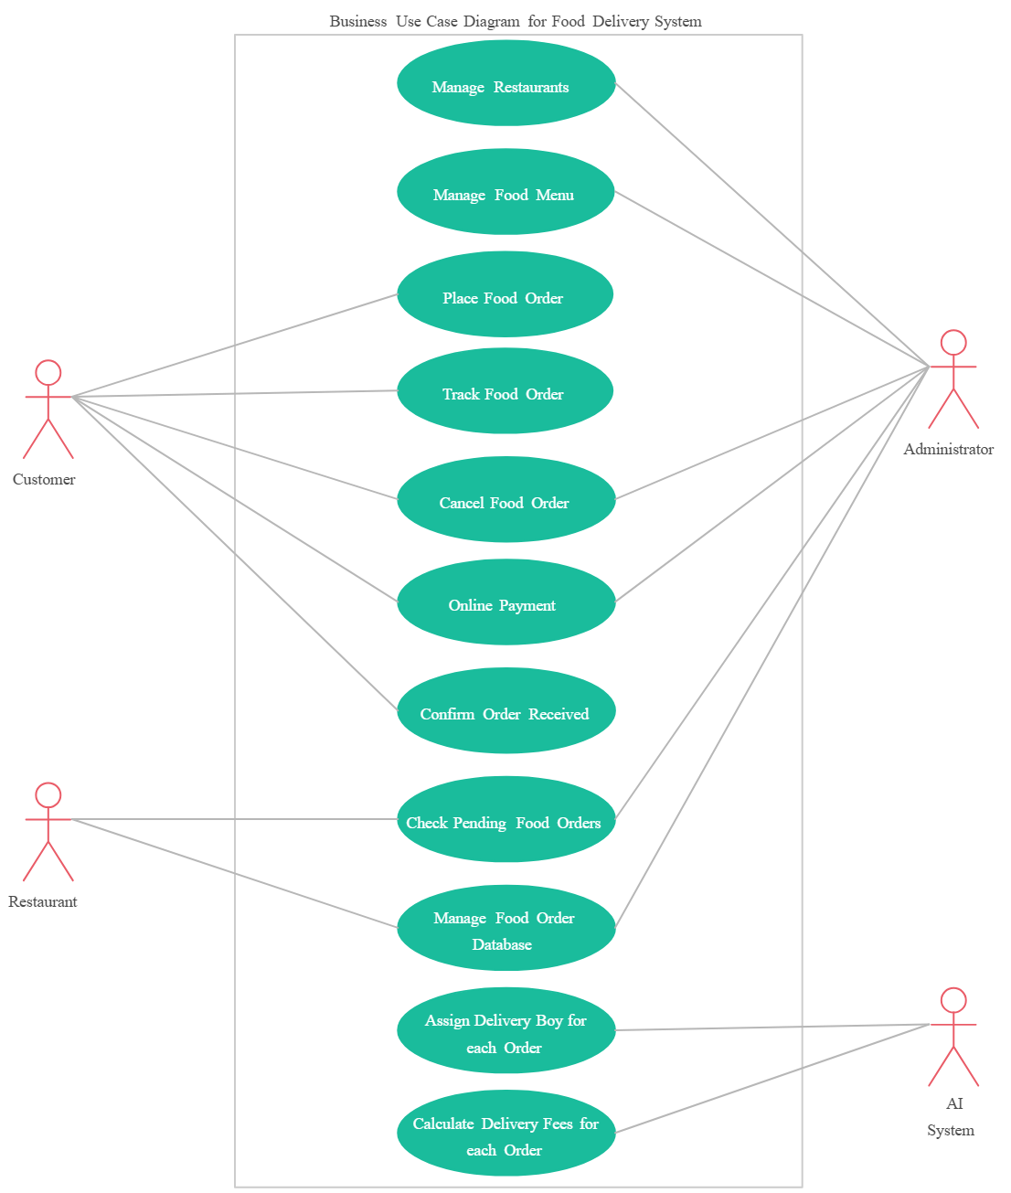
Use Case Diagram
10

Slide 10
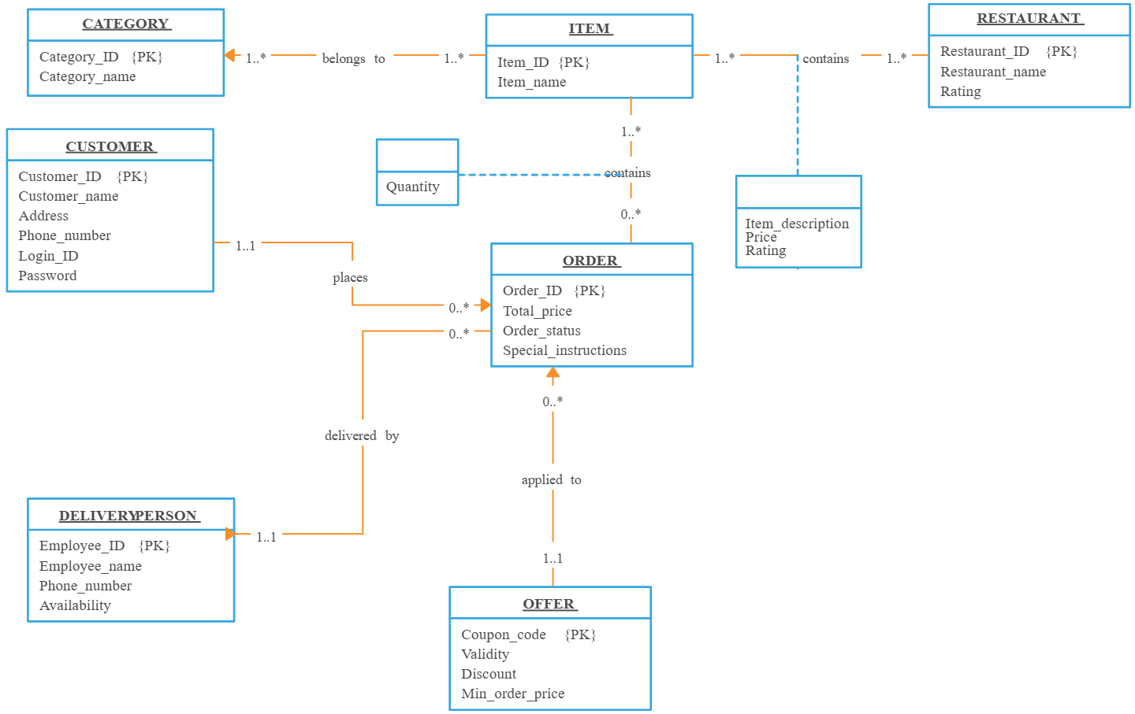
Class Diagram
12

Slide 11
Testing & Results
📌 Testing:
Performed Unit Testing for each module (authentication featurs).
Conducted Integration Testing to check frontend-backend communication.
Verified all features through Functional Testing.
Tested UI for responsiveness and smooth navigation.
📌 Results:
Quiz system displayed correct results with explanations.
Dashboard showed user progress and activity properly.
Overall system provided a smooth and user-friendly experience.
14

Slide 12
Thank You
17

