Slide 1



Distributed Information System
December 7, 2009
Alvin MACCHIONE - Rémy JAVELLE

Slide 2

Summary
1 – What are Web services ?
2 – How does a Web service work?
3 – Different types of Web services.
4 – Examples
5 – Conclusion
December 7, 2009
Alvin MACCHIONE - Rémy JAVELLE

Slide 3
1 – What are Web services ?
2 – How does a Web service work?
Application Programming Interfaces (API)
Request services
REST architecture
SOA architecture
OASIS
World Wide Web Consortium (W3C)
December 7, 2009
Alvin MACCHIONE - Rémy JAVELLE

Slide 4
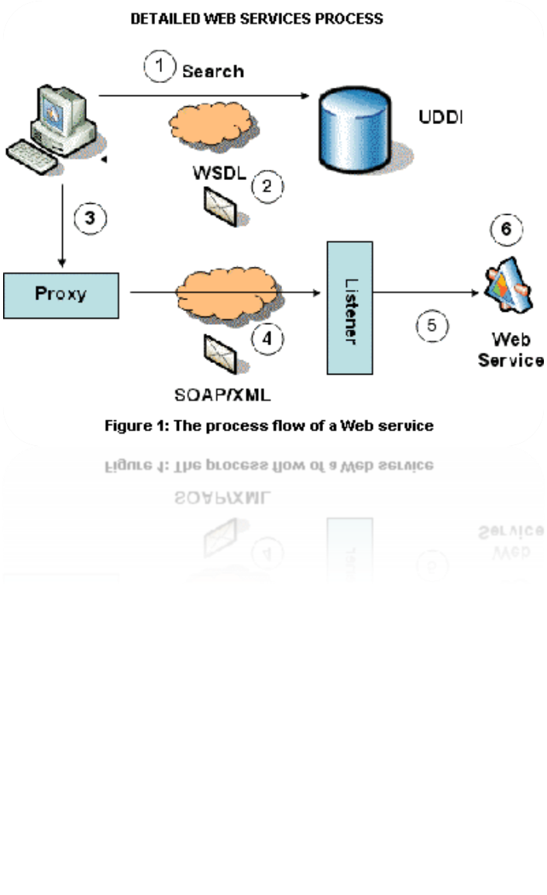
1 – What are Web services ?
2 – How does a Web service work?
3 – Different types of Web services
The client sends a request
Request encoded in XML
Function (GET, POST…) in the file
The server decodes the file
The function is executed
A new XML file is encoded
and re-send to the client
=> Clients and servers communicate over the HyperText Transfer Protocol (HTTP).
December 7, 2009
Alvin MACCHIONE - Rémy JAVELLE

Slide 5
2 – How does a Web service work?
3 – Different types of Web services
4 – Examples
=> Service-oriented architecture (SOA):
SOA defines WS-* Web Services
Communication protocol: SOAP
Web Service Description Language (WSDL)
for description
UDDI (Universal Description Discovery and Integration) directory
December 7, 2009
Alvin MACCHIONE - Rémy JAVELLE

Slide 6
2 – How does a Web service work?
3 – Different types of Web services
4 – Examples
=> Service-oriented architecture (SOA):
Advantages :
- Interoperability between applications on many platforms
Use open protocols
Data and protocols are in plain text
Thanks to HTTP protocol, Web services can run through firewalls
- Easy to implement
December 7, 2009
Alvin MACCHIONE - Rémy JAVELLE

Slide 7
2 – How does a Web service work?
3 – Different types of Web services
4 – Examples
=> Service-oriented architecture (SOA):
Disadvantages :
- Norms are sometimes recent
Low performances
HTTP protocol: Web services can circle security measures implemented by firewalls
December 7, 2009
Alvin MACCHIONE - Rémy JAVELLE

Slide 8

2 – How does a Web service work?
3 – Different types of Web services
4 – Examples
=> Representational state transfer (REST):
December 7, 2009
Alvin MACCHIONE - Rémy JAVELLE

Slide 9
2 – How does a Web service work?
3 – Different types of Web services
4 – Examples
=> Representational state transfer (REST):
Advantages :
Easy to maintain
- No state client administration: Less memory used, simplicity, simultaneous requests, several servers …
- Using URI: setting up cache servers
December 7, 2009
Alvin MACCHIONE - Rémy JAVELLE

Slide 10
2 – How does a Web service work?
3 – Different types of Web services
4 – Examples
=> Representational state transfer (REST):
Disadvantages :
- The client has to keep locally all necessary data for a request: High consuming network bandwidth
December 7, 2009
Alvin MACCHIONE - Rémy JAVELLE

Slide 11
3 – Different types of Web services
4 – Examples
5 – Conclusion
Social Networking (Facebook, Twitter…)
Travel agency (Ryanair, EasyJet…)
Video sharing (Youtube …)
Blogging (MySpace, Blogger…)
E-Commerce (Amazon, Ebay…)
Maps (Google maps, Mappy…)
December 7, 2009
Alvin MACCHIONE - Rémy JAVELLE

Slide 12
4 – Examples
5 – Conclusion
Growing since 2000
Security problems (HTTP)
REST architecture more and more common
. . . QUESTIONS ? . . .
December 7, 2009
Alvin MACCHIONE - Rémy JAVELLE

