Slide 1


SMART INDIA HACKATHON 2024
Problem Statement ID – SIH1556
Problem Statement Title - Develop a Smart Yoga Mat integrated with Artificial Intelligence (AI) capabilities to support smart watch integration for tracking progress and provide curated yoga content by experts, while ensuring its affordability.
Theme - MedTech / BioTech / HealthTech
PS Category - Hardware
Team ID -
Team Name - System 404

Slide 2
IDEA TITLE
System 404
APPROACH
Creating a MAT using Thermo-elastic Polymers (Better and Ecofriendly).
Embedded Capacitive and Pressure sensors for posture detection.
SOLUTION
Measures key metrices such as Heart rate, Calories Burned and Workout Duration by connecting to smartwatch.
PROSPECTS
Gamify the total interface so that for every correct asana the user will get rewarded with tokens and it can be used for premium purchases.
Microcontrollers (ESP32) to connect to Smartwatch and Other Devices.
AI integration keeps track of Progress and recommends the Contents and Exercises accordingly.
Detects and commands the user in posture correction through voice and streaming devices.
Privacy Enabled Practice (No-Camera, Non-Intrusive Solution).
Personalized voice activated AI assistant for real time interaction with user.
Android and iOS application for better user experience.
Use of ML (CNN & regenerative model) for generation of Correct postures and their comparison with Actual posture.
Progressive Web App for user interaction.

Slide 3
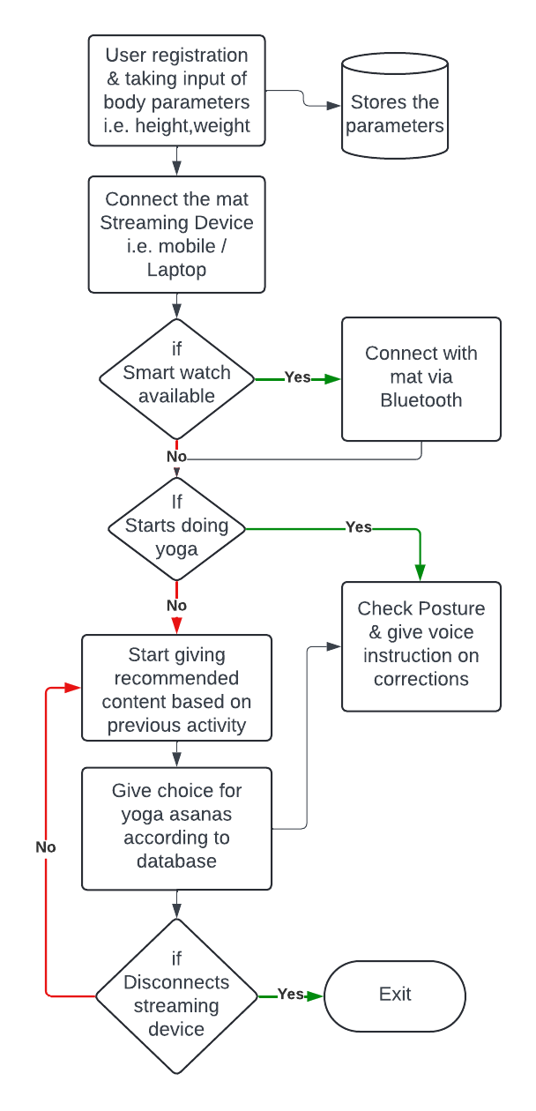

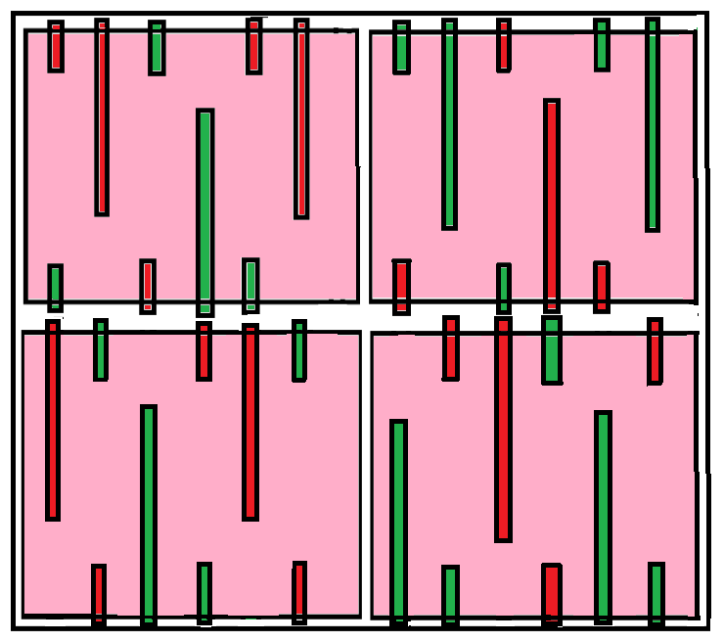
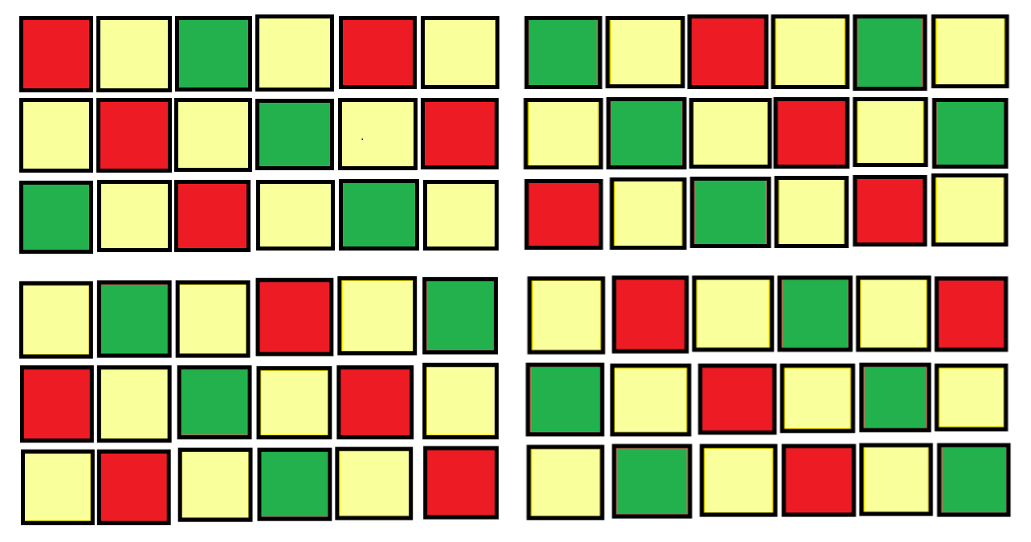



















TECHNICAL APPROACH
System 404
Layer Diagram
16:1 Multiplexer : Used for getting single i/p for ESP32 from all sensor nodes. [74HC4067 IC]
Binary counter : Used a 8 bit counter to count the sensor node o/p ’s . [74HC590 IC]
Microcontroller : Used efficient & low-cost ESP32 for large data collection and data sending to backend.
Capacitive Sensor : Used for the asanas which don’t need pressure rather soft touch or proximity.
Pressure Sensor : Used efficient embedded pressure sensors to generate a 2D pressure map.
Battery & Charging module : Used a separate battery case with 3 x 2000 mAh battery with 3.7v each with charging module for precautions.
Circuit diagram
Sensor
placement
Pressure Sensor
Capacitive Sensor
Technology Stack:

Slide 4
FEASIBILITY AND VIABILITY
System 404
Feasibility
Used eco-friendly thermoelastic polymer for sustainability. Integrated low-cost conductive foam for better sensor data. Applied lightweight, durable aluminum sheets for conduction plates. Employed efficient, low-cost microcontrollers & modules. Leveraged users' smart devices to cut costs.
Challenges
To make the product affordable for yoga enthusiasts without compromising the functionalities and quality.
Solutions
To detect posture using non-intrusive and affordable sensors.
Place the sensors efficiently and with circuits without compromising the flexibility.
₹1640
Designed low-cost embedded pressure and capacitive sensors with efficient functionality
Combined sensors with ML to achieve 2D and 3D posture mapping
Used a cost-effective box grid pattern for efficient sensor and wiring placement
Note: For Mass Production it will be around ₹1500

Slide 5
IMPACT AND BENEFITS
System 404
Impacts
Enhanced Yoga Experience: Provides real-time posture feedback and tracks progress, improving practice and reducing injury risk.
Increased Accessibility: Offers guided sessions for beginners and enables remote learning from home.
Benefits
Social: Enhances health & well-being, promotes inclusivity, and fosters virtual communities.
Economic: Saves costs on yoga classes, creates jobs in tech and wellness sectors, and reduces healthcare expenses.
Health Insights: Tracks balance and alignment, providing personalized health data and tailored workouts.
Physical & Mental Wellness: Supports stress relief and mindfulness, improving overall well-being.
Convenience: Allows at-home practice, offering flexibility and autonomy for users.
Environmental: Lowers carbon footprint by reducing travel, supports sustainable materials, and minimizes resource usage through digital integration.

Slide 6
RESEARCH AND REFERENCES
System 404
https://www.tutorialspoint.com/binary-counter-in-digital-electronics
https://www.kaggle.com/datasets/niharika41298/yoga-poses-dataset
https://learn.bela.io/tutorials/pure-data/sensors/diy-pressure-
sensor/#:~:text=To%20make%20an%20FSR%2C%20sandwich,the%20side%20with%20the%20resistor
https://electronics.stackexchange.com/questions/331325/help-with-161-mux-ic-wiring

