Slide 1

Lottery Ticket Hypothesis
Finding Sparse Trainable Network
Team: C-3POs
Members: Abhishek | 19i190005
Saptarshi | 19i190011
Subhadeep | 19i190010
IE643: Deep Learning - Theory and Practice
Instructor: P. Balamurugan
Work done as part of course project, IE 643, IIT Bombay

Slide 2
CONTENTS
Problem Background
Motivation for the problem
Problem Statement
Proposed Method
Experimental setup
Experimental Findings
Implementation status and results obtained
Suggested Modifications for Future Work
References
Member contributions

Slide 3
PROBLEM BACKGROUND
Pruning
The story of sparsity in neural networks starts with pruning, which is a way to reduce the size of the neural network through compression. Pruning was mainly done by using magnitude as an approximation for saliency to determine less useful connections – the intuition being that smaller magnitude weights have a smaller effect in the output, and hence are less likely to have an impact in the model outcome if pruned.
The first major paper advocating sparsity in neural networks dates back from 1990, written by LeCun and colleagues while working at AT&T Bell Laboratories [1]. At the time, post-pruning neural networks to compress trained models was already a popular approach.
Main ideas in the paper made by LeCun :
Suggested different metrics could be a better approximate for measure of saliency
Proposed using the second derivative of the objective function with respect to the parameters as a pruning metric.
[1] Yann Le Cun et. al., “Optimal Brain Damage”

Slide 4
PROBLEM BACKGROUND
In the succeeding years as the mobile devices came became very important, then people found that it is impossible to run such models in mobile due to energy constraints.
In 2015, Han et al. [2] proposed a structured pruning method in which surprisingly, they showed this method was not only comparable to regular deep learning models, but could achieve even higher accuracy whilst improving efficiency and lowering storage complexity.
Method
Train Connectivity
Prune Connections
Train Weights
Observation: On the ImageNet dataset, their method reduced the number of parameters of AlexNet by a factor of 9x, from 61 million to 6.7 million,VGG-16 by 13x, from 138 million to 10.3 million, with no loss of accuracy.
[2] Song Han et. al., “Learning Both Weights and Connections For Efficient Neural Networks”

Slide 5
PROBLEM BACKGROUND
The two main ideas that influenced the paper we have considered:
“During retraining, it is better to retain the weights from the initial training phase for the connections that survived pruning that it is to re-initialize the pruned layers” [2]
“Training a pruned model from scratch performs worse than retraining a pruned model, which may indicate the difficulty of training a network with a small capacity” [3]
[2] Song Han et. al., “Learning Both Weights and Connections For Efficient Neural Networks”
[3] Haoli et. al., “Pruning Filters For Efficient ConvNets”

Slide 6
MOTIVATING QUESTIONS
Following Questions motivated the research work (Reference [6]):
Can we train sparsely pruned networks from scratch ?
Do networks have to be overparameterized to learn ?
Reference [6]: https://www.youtube.com/watch?v=s7DqRZVvRiQ

Slide 7
DETAILS OF THE PROBLEM
To answer the questions that they have raised:
They were able to uncover sparse trainable subnetworks from fully-connected and convolutional feed-forward networks that were found by a standard pruning technique keeping the same parameter initializations as the original network.
They designated these trainable subnetworks, winning tickets, since those that they found have won the initialization lottery with a combination of weights and connections capable of learning.

Slide 8
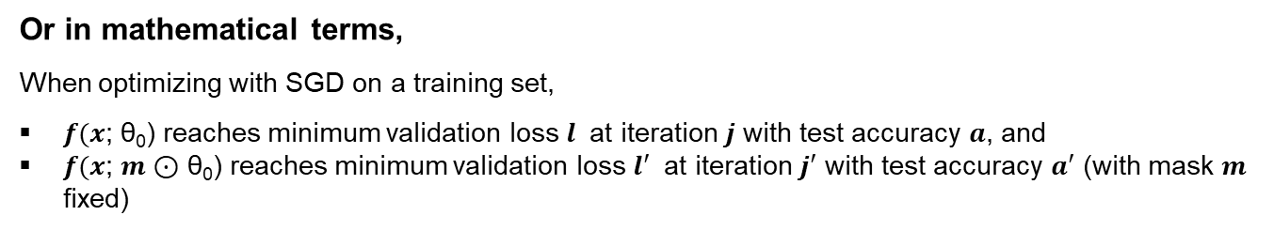



THE LOTTERY TICKET HYPOTHESIS
Based upon the experiments and the results they obtained, they concluded the following hypothesis :
“A randomly-initialized, dense neural network contains a subnetwork that is initialized such that—when trained in isolation—it can match the test accuracy of the original network after training for at most the same number of iterations.”
Or in mathematical terms,
When optimizing with SGD on a training set,
$f(x$; θ₀) reaches minimum validation loss $l$ at iteration $j$ with test accuracy $a$, and
$f(x$; $m$⊙ θ₀) reaches minimum validation loss $l′$ at iteration $j′$ with test accuracy $a′$ (with mask $m$ fixed)
Then, the Lottery Ticket Hypothesis predicts that ∃ $m$ for which,
$j′$ $≤j$ (commensurate training time)
$a′$ $≥a$ (commensurate accuracy)
|| $m$||₀ < |θ| (fewer parameters)

Slide 9
PROPOSED METHOD
For finding Winning Tickets, they have devised the following algorithm:
1
Randomly initialize a neural network $f(x\text{;} \text{θ}\text{0}\text{)} ;$where θ₀~ D_{θ}, D_{θ} is the parameter space
2
Train the network for $j$ iterations, arriving at parameters θ_{j}
3
Prune $p$% of the parameters in θ_{j}, creating a mask $m$. (Here, $m$𝜖 {0,1} ^{|𝜃|} )
4
Reset the remaining parameters to their values in θ₀, creating the winning ticket $f(x$; $m$⊙ θ₀)

Slide 10













METHOD EXPLAINED
Method at a glance
Initialisation
Train
Prune
Epoch 1
$$θ_{0}$$
$$θ_{1}$$
$${m^{(1)} \text{⊙} θ}_{1}$$
Train network
Prune Connections
Reset weights to initialization
$${m^{(1)} \text{⊙} θ}_{2}$$
$${m^{(n)} \text{⊙} θ}_{n}$$
$${m^{(n−1)} \text{⊙} θ}_{n}$$
$${m^{(2)} \text{⊙} θ}_{2}$$
$$m^{(n−1)}{\text{⊙} θ}_{0}$$
$$m^{(n−1)}{\text{⊙} θ}_{n}$$
$$m^{(n)}{\text{⊙} θ}_{n}$$
$$m^{(n)}{\text{⊙} θ}_{0}$$
$${m^{(1)} \text{⊙} θ}_{0}$$
$${m^{(n−1)} \text{⊙} θ}_{0}$$
Epoch n
Epoch 2
Winning Ticket!
Iterate

Slide 11
CONSIDERATIONS IN THE PROPOSED METHOD (PRUNING)
There are number of pruning strategies like structured and unstructured that are being practiced from a long time. In the research paper, they have considered low final weight based unstructured pruning.
There are two types of pruning – One-shot and iterative. In this paper, they focused on iterative pruning, which repeatedly trains, prunes, and resets the network over n rounds; each round prunes p^{1/n} % of the weights that survive the previous round.
Note: Iterative pruning gave better results that one-shot pruning technique.

Slide 12
EXPERIMENTS : DATASET, FRAMEWORKS
Datasets Studied
CIFAR -10: The CIFAR-10 dataset consists of 60000 32x32 colour images in 10 classes, with 6000 images per class. There are 50000 training images and 10000 test images.
MNIST: Database of handwritten digits, has a training set of 60,000 examples, and a test set of 10,000 examples.
Architectures
LeNet-300-100 (FC), Conv-2, Conv-4, Conv-6, Resnet-18, VGG-19
Framework
PyTorch
Implementation Repository
Jonathan Frankle Repository on LTH

Slide 13
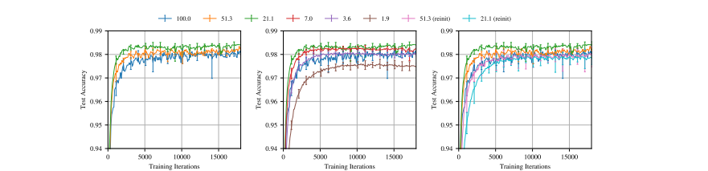
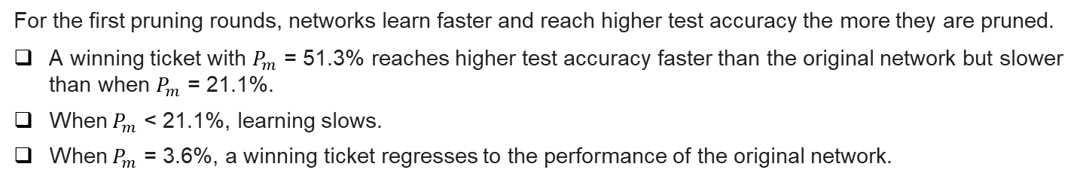
EXPERIMENTS : RESULTS
Results for LeNet-300-100 (FC)
For the first pruning rounds, networks learn faster and reach higher test accuracy the more they are pruned.
A winning ticket with $P_{m}$ = 51.3% reaches higher test accuracy faster than the original network but slower than when $P_{m}$ = 21.1%.
When $P_{m}$ < 21.1%, learning slows.
When $P_{m}$ = 3.6%, a winning ticket regresses to the performance of the original network.
Note: $P_{m}$ is percentage of weights remaining in the network after pruning for mask m.

Slide 14
EXPERIMENTS : IMPLICATION OF RESULTS
The results that were observed imply primarily the following:
Improve training performance: Fine-tuning the weights after training was not required for these new pruned networks, so we can hopefully design new training schemes to find these tickets and prune as early as possible.
Design better networks: Taking inspiration from winning tickets to design new architectures and initialization schemes with the same properties that are favorable to learning, and try to reuse the winning tickets on new tasks
Improve our theoretical understanding of neural networks: Their work has opened a new side to the study of neural networks with deeper understanding of the technical things and hence helping in making better networks.

Slide 15
IMPLEMENTATION : INITIAL SETUP AND EXPERIMENT STATUS
Framework: Pytorch
Dataset: MNIST
Prune type: Iterative unstructured pruning
Status of experiment: Implemented Lenet-5 and fc1 consulting this repository
Table of parameters:
Parameters | FC1 (28x28-300-100-10) | LeNet-5
Learning Rate | 1.2e-3 | 1.2e-3
Batch Size | 60 | 60
Epoch | 75 | 50
Pruning percent | 30 | 20
Prune iteration | 20 | 20

Slide 16
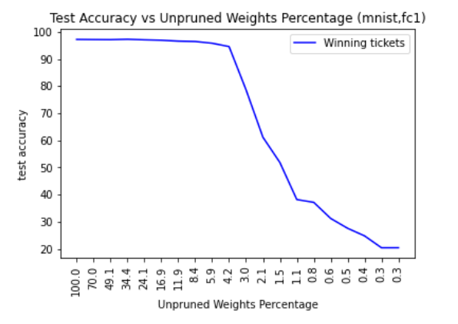
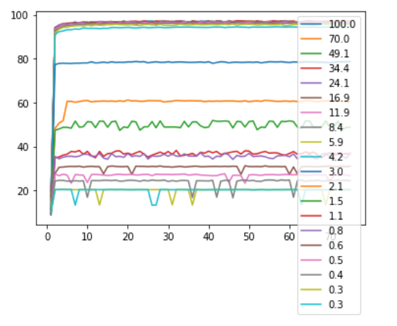
IMPLEMENTATION : RESULTS OBTAINED
Plots obtained for fc1
Test accuracy vs Training Iterations (mnist,fc1)
Test Accuracy
Training Iterations

Slide 17
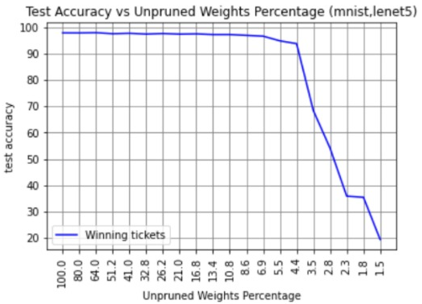
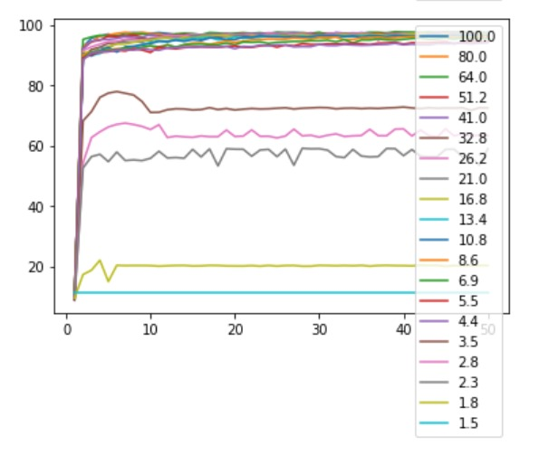
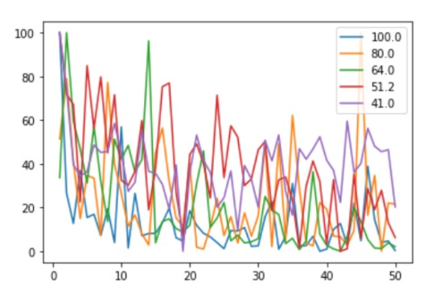
IMPLEMENTATION : RESULTS OBTAINED
Plots obtained for LeNet-5
Test accuracy vs Training Iterations (mnist,lenet5)
Test Accuracy
Loss vs Training Iterations (mnist,lenet5)
Loss
Training Iterations
Training Iterations

Slide 18
POSSIBLE FURTHER WORKS
Extending Frankle's work and side-stepping the costly train-prune-retrain process, researchers discovered that the winning tickets can be identified at a very early training stage, which we term as Early-Bird (EB) tickets. [4]
They have considered the main problem of lottery ticket hypothesis problem that is huge amount of time is needed to train fully then prune and then train again.
So they propose a practical, easy-to-compute mask distance as an indicator to draw EB tickets without accessing the “ground-truth” winning tickets.
The success of lottery ticket initializations suggests that small, sparsified networks can be trained so long as the network is initialized appropriately;
Finding these “winning ticket” initializations is computationally expensive.
Researchers [5] showed that when winning tickets were obtained for one training configuration (optimizer and dataset) and their performance evaluated on another configuration, they generalized over all datasets.
[4] Xiaohan Chen et. al., “Drawing Early-bird Tickets: Towards More Efficient Training Of Deep Networks”
[5] Ari S. Morcos, “One ticket to win them all: generalizing lottery ticket initializations across datasets and optimizers”

Slide 19
FURTHER WORK WE WOULD INVESTIGATE
Out of the two problems discussed in the previous slide, we plan to investigate further into the work done in [4], in finding the Early-Bird (EB) tickets.
Our focus will be on the limitation of Frankle’s work, to avoid the costly train-prune-retrain process and try to find sparser subnetworks drawn much earlier in training using large learning rates.
*Note: Due to computational and time constraints, we are unsure about the level of implementation possible.

Slide 20
REFERENCES
Papers
Reference [1] Yann Le Cun et. al., “Optimal Brain Damage”
Reference [2] Song Han et. al., “Learning Both Weights and Connections For Efficient Neural Networks”
Reference [3] Haoli et. al., “Pruning Filters For Efficient ConvNets”
Reference [4] Xiaohan Chen et. al., “Drawing Early-bird Tickets: Towards More Efficient Training Of Deep Networks”
Reference [5] Ari S. Morcos, “One ticket to win them all: generalizing lottery ticket initializations across datasets and optimizers”
Videos
Reference [6] ICLR 2019 presentation
Code Repositories
Reference [7] Code reference 1

Slide 21
CONTRIBUTION OF MEMBERS
Member | Abhishek | Subhadeep | Saptarshi
Task
Past Papers
Main Paper
Future Works
Code
Slides
Content Mining
Responsible
Support

