Slide 1
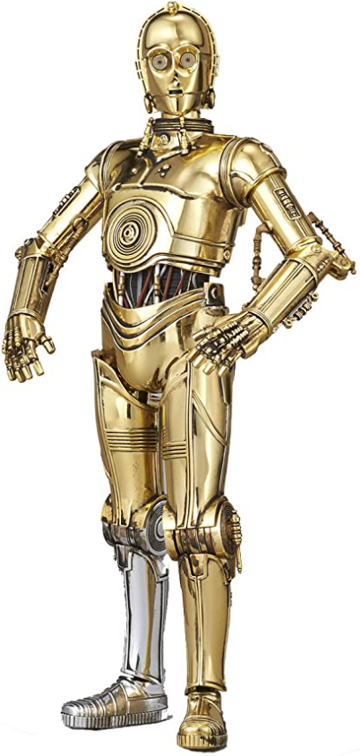
LOTTERY TICKET HYPOTHESIS
TRAINING SPARSE TRAINABLE NEURAL NETWORKS
IE643: DEEP LEARNING – THEORY AND PRACTICE
INSTRUCTOR: PROF. P. BALAMURUGAN
Team: C-3POs
MEMBERS:
ABHISHEK | 19I190005
SUBHADEEP | 19I190010
SAPTARSHI | 19I190011
WORK DONE AS PART OF COURSE PROJECT, IE 643, IIT BOMBAY

Slide 2
OVERVIEW
PRE-MIDSEM
POST-MIDSEM
PROBLEM STATEMENT
WORK DONE BEFORE MIDSEM
COMMENTS RECEIVED
ADDRESSING THE COMMENTS
WORK DONE AFTER MIDSEM
EXPERIMENTS
CONCLUSION
POSSIBLE FUTURE WORK
REFERENCES
CONTRIBUTION OF MEMBERS

Slide 3

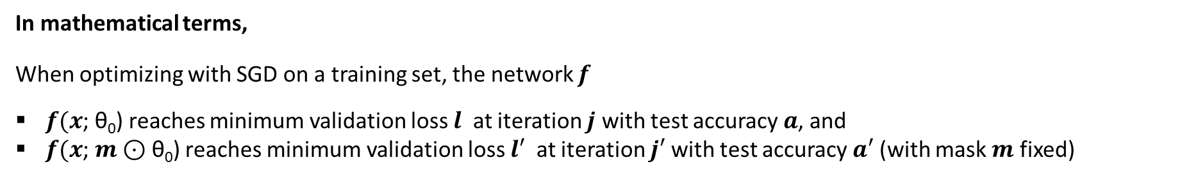


PROBLEM STATEMENT
Motivating Questions
Can we train sparsely pruned networks from scratch?
Do networks have to be overparameterized to learn?
Lottery Ticket Hypothesis :
“A randomly-initialized, dense neural network contains a subnetwork that is initialized such that—when trained in isolation—it can match the test accuracy of the original network after training for at most the same number of iterations.
Method at a glance
Train network
Prune Connections
In mathematical terms,
When optimizing with SGD on a training set, the network $f$
$f(x$; θ₀) reaches minimum validation loss $l$ at iteration $j$ with test accuracy $a$, and
$f(x$; $m$⊙ θ₀) reaches minimum validation loss $l′$ at iteration $j′$ with test accuracy $a′$ (with mask $m$ fixed)
Reset weights to initialization
Then, the Lottery Ticket Hypothesis predicts that ∃ $m$ for which,
$j′$ $≤j$ (commensurate training time)
$a′$ $≥a$ (commensurate accuracy)
|| $m$||₀ < |θ| (fewer parameters)

Slide 4
WHAT WE DID BEFORE MIDSEM
Framework: Pytorch
Dataset: MNIST
Prune type: Iterative unstructured pruning
Status of experiment: Implemented Lenet-5 and fc1 consulting this repository
Table of parameters
Parameters | FC1 (28x28-300-100-10) | LeNet-5
Learning Rate | 1.2e-3 | 1.2e-3
Batch Size | 60 | 60
Epoch | 75 | 50
Pruning percent | 30 | 20
Prune iteration | 20 | 20
Reference: Code repo [3]

Slide 5
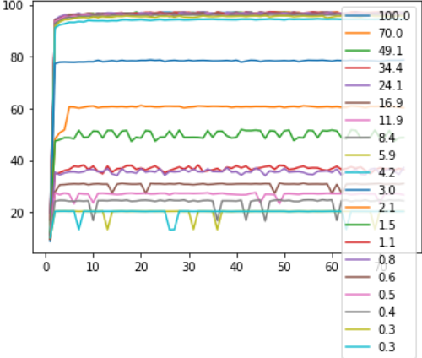
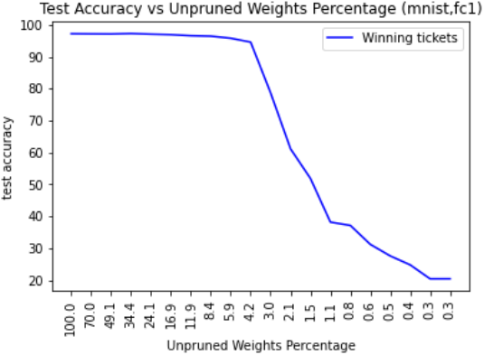
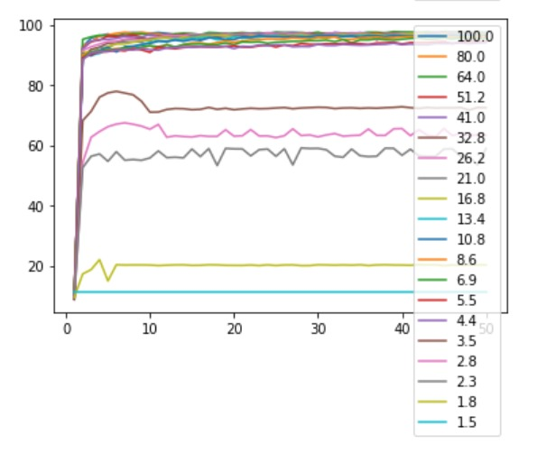
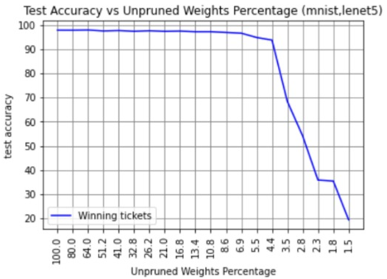
WHAT WE DID BEFORE MIDSEM
Test accuracy vs Training Iterations (mnist,fc1)
Plots obtained for FC1
Test Accuracy
Training Iterations
Test accuracy vs Training Iterations (mnist,lenet5)
Plots obtained for LeNet-5
Test Accuracy
Training Iterations

Slide 6
COMMENTS RECEIVED
NOT CHOSEN
NOT BAD
CHOSEN
NEEDS TO BE LOOKED INTO
The understanding of the paper seems to be clear.
The slides explained the motivation behind the work.
A thorough review of a related paper (previous/recent) would have been great.
The initial experiments conducted seem to be sufficient.
The results of the experiments could have been clearer if the plots contained lesser details.
For future work:
The proposed implementation of early bird ticket could be way ahead.
Another possible approach could be analyzing the performance of a lottery ticket (simple) architecture (trained on a particular dataset) on a different (similar) dataset and devising some algorithms to do the same.

Slide 7
ADDRESSING THE COMMENTS
Regarding Thorough Review of Related Paper :
Due to slide count constraints, we omitted thorough review of any paper, and instead focussed on introducing the ideas. A thorough review has been included in our submitted Report.
Regarding Clearer Results of the Experiments Conducted :
The comment has been duly noted and all the plots that follow have been made keeping in mind not to include too much details, and instead make them more interpretable.
Regarding Comment on Ideas for the Future (post-Midterm) Work :
We have tried to look into the idea of finding out a lottery ticket trained on a particular dataset, and evaluating this pruned network’s performance on a different but “similar” dataset.

Slide 8
MOTIVATION BEHIND POST-MIDTERM WORK
The success of lottery ticket initializations suggests that small, sparsified networks can be trained so long as the network is initialized appropriately. Unfortunately, finding these “winning ticket” initializations is computationally expensive.
One potential solution is to reuse the same winning tickets across a variety of datasets and optimizers. We can attempt to answer this question by generating winning tickets for one training configuration (optimizer and dataset) and evaluating their performance on another configuration.

Slide 9
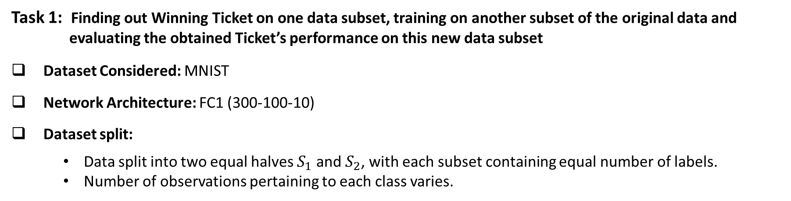
WORK DONE AFTER MIDSEM: TASK 1
Task 1: Finding out Winning Ticket on one data subset, training on another subset of the original data and evaluating the obtained Ticket’s performance on this new data subset
Dataset Considered: MNIST
Network Architecture: FC1 (300-100-10)
Dataset split:
Data split into two equal halves $S_{1}$ and $S_{2}$, with each subset containing equal number of labels.
Number of observations pertaining to each class varies.
Task Methodology:
1
Winning ticket ($T_{1}$) obtained from $S_{1}$ by performing iterative pruning for 50 training iterations, 5 pruning iterations with 50% prune in each iteration$.$ Weights of $T_{1}$ reset to their original initializations. $T_{1}$ trained on $S_{2}$.
2
Winning ticket ($T_{2}$) obtained from $S_{2}$ by performing iterative pruning for 50 training iterations, 5 pruning iterations with 50% prune in each iteration.
3
Performance evaluated comparatively for $T_{1}$ and $T_{2}$

Slide 10
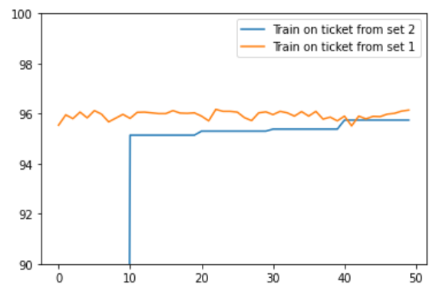
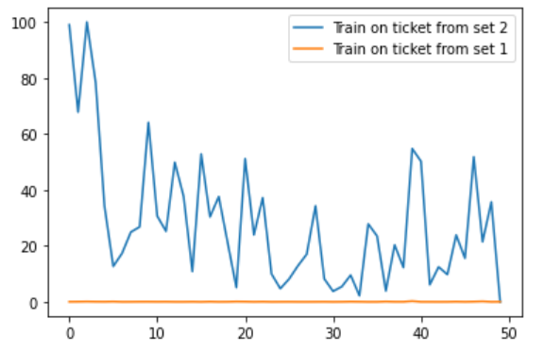
RESULTS OBTAINED FROM TASK 1
Test Accuracy vs. Training Iterations
Loss vs. Training Iterations
Test Accuracy
Loss
Training Iterations
Training Iterations
Plots obtained for FC1
Comments:
We observed better test loss and test accuracy on the same test dataset.
Observed Test Accuracy on $S_{1}$= 95.74, Observed Test Accuracy on $S_{2}$= 96.14
Ticket $T_{1}$trained over $S_{1}$generalized well when trained over the 2nd data set $S_{2}$

Slide 11
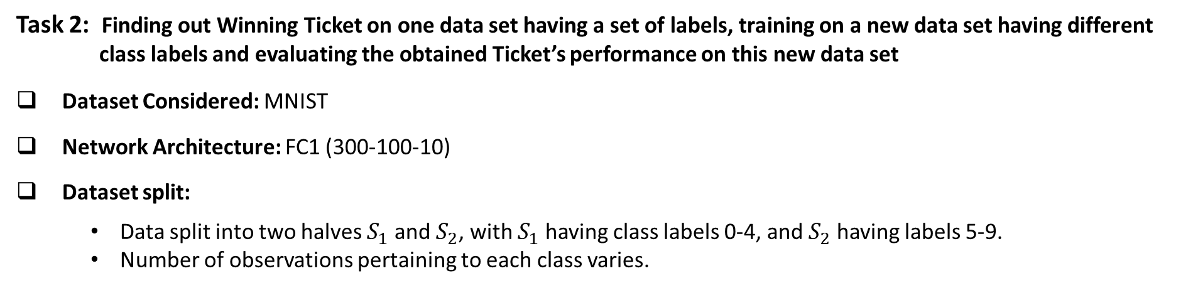
WORK DONE AFTER MIDSEM: TASK 2
Task 2: Finding out Winning Ticket on one data set having a set of labels, training on a new data set having different class labels and evaluating the obtained Ticket’s performance on this new data set
Dataset Considered: MNIST
Network Architecture: FC1 (300-100-10)
Dataset split:
Data split into two halves $S_{1}$ and $S_{2}$, with $S_{1}$ having class labels 0-4, and $S_{2}$ having labels 5-9.
Number of observations pertaining to each class varies.
Task Methodology:
1
Winning ticket ($T_{1}$) obtained from $S_{1}$ by performing iterative pruning for 50 training iterations, 15 pruning iterations with 35% prune in each iteration$.$ Weights of $T_{1}$ reset to their original initializations.
2
Winning ticket ($T_{1}$) now trained on $S_{2}$ for the same number of train iterations as in Step 1.
3
Performance evaluated comparatively for $S_{1}$ and $S_{2}$

Slide 12
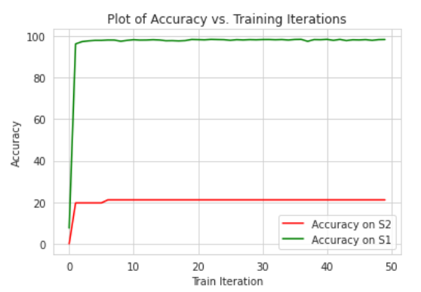
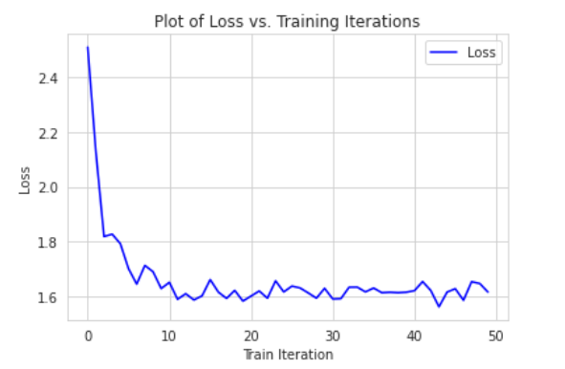
RESULTS OBTAINED FROM TASK 2
Plots obtained for FC1
Comments:
Test accuracy of winning ticket $T_{1}$ on $S_{1}$ (data set containing labels 0-4) = 97.23
Test accuracy of $T_{1}$ trained over $S_{2}$ (data set containing labels 5-9) = 21.1479
We believe that the model from $S_{1}$ being pruned significantly is not able to learn the features of the data set $S_{2}$ efficiently, and it results in such poor results

Slide 13
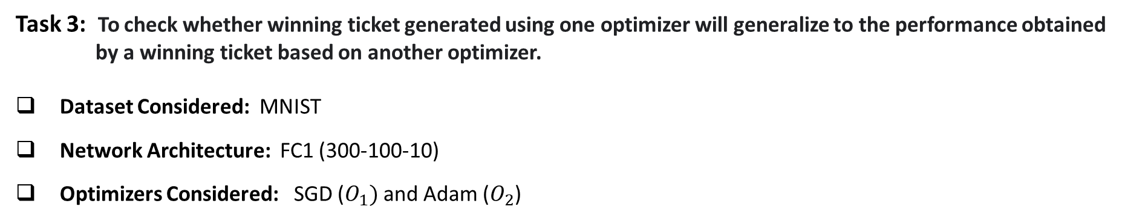
WORK DONE AFTER MIDSEM: TASK 3
Task 3: To check whether winning ticket generated using one optimizer will generalize to the performance obtained by a winning ticket based on another optimizer.
Dataset Considered: MNIST
Network Architecture: FC1 (300-100-10)
Optimizers Considered: SGD ($O_{1})$ and Adam ($O_{2}$)
Task Methodology:
1
Generated winning tickets $T_{1}$ and $T_{2}$ on optimizers $O_{1}$ and $O_{2}$ respectively, with iterative pruning performed for 50 training iterations, 10 pruning iterations with 50% prune in each iteration.
2
Performance evaluated comparatively for $T_{1}$ and $T_{2}$

Slide 14
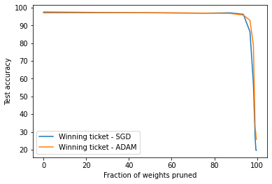
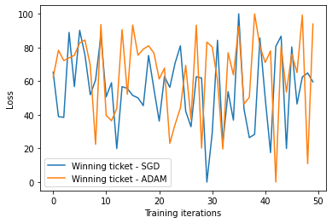
WORK DONE AFTER MIDSEM
RESULTS OBTAINED FROM TASK 3
Plots obtained for FC1
Comments:
Observed test accuracy of winning ticket on $O_{1}$ (SGD) = 97.52
Observed test accuracy of winning ticket on $O_{2}$ (ADAM) = 97.17
Winning tickets are not overfit to the particular optimizer and hence winning tickets are optimizer-independent.

Slide 15
IN CONCLUSION
From the Lottery Ticket Hypothesis, we conclude:
Improve training performance: Fine-tuning the weights after training was not required for these new pruned networks, so we can hopefully design new training schemes to find these tickets and prune as early as possible.
Design better networks: Taking inspiration from winning tickets to design new architectures and initialization schemes with the same properties that are favorable to learning, and try to reuse the winning tickets on new tasks
From the follow up paper (One Ticket to Win Them All), we conclude:
Winning tickets generated against datasets with more samples and more classes consistently transfer better, suggesting that larger datasets encourage more generic winning ticket
Winning tickets are capable of transferring across a variety of training configurations, suggesting that winning tickets drawn from sufficiently large datasets are not overfit to a particular optimizer or dataset, but rather feature inductive biases which improve training of sparsified models more generally.

Slide 16
POSSIBLE WORK FOR THE FUTURE
Drawing early-bird tickets: Towards more efficient training of deep networks
The identification of the winning tickets [1] still requires the costly train-prune-retrain process, limiting their practical benefits.
The winning tickets can be identified at a very early training stage, which they term as Early-Bird (EB) tickets, via low cost training schemes (e.g., early stopping and low-precision training) at large learning rates.
Furthermore, they propose a mask distance metric that can be used to identify EB tickets with a low computational overhead, without needing to know the true winning tickets that emerge after the full training.
Reference [1] Jonathan Frankle and Michael Carbin, “The lottery ticket hypothesis: Finding sparse, trainable neural networks”
Reference [3] Haoran You, Chaojian Li, Pengfei Xu, Yonggan Fu, Yue Wang, Xiaohan Chen, Richard G. Baraniuk,Zhangyang Wang, and Yingyan Lin, “Drawing early-bird tickets: Towards more efficient training of deep networks”

Slide 17
REFERENCES
Papers
Reference [1] Jonathan Frankle and Michael Carbin, “The lottery ticket hypothesis: Finding sparse, trainable neural networks”
Reference [2] Ari S. Morcos, “One ticket to win them all: generalizing lottery ticket initializations across datasets and optimizers”
Reference [3] Haoran You, Chaojian Li, Pengfei Xu, Yonggan Fu, Yue Wang, Xiaohan Chen, Richard G. Baraniuk,Zhangyang Wang, and Yingyan Lin, “Drawing early-bird tickets: Towards more efficient training of deep networks”
Code Repositories
Reference [3] Code reference 1

Slide 18
CONTRIBUTION OF MEMBERS
Member | Abhishek | Subhadeep | Saptarshi
Task
Past Papers
Main Paper
Future Papers
Code
Slides
Content Mining
Task 1 Post-Midterm
Task 2 Post-Midterm
Task 3 Post-Midterm
Responsible
Support

