Slide 1
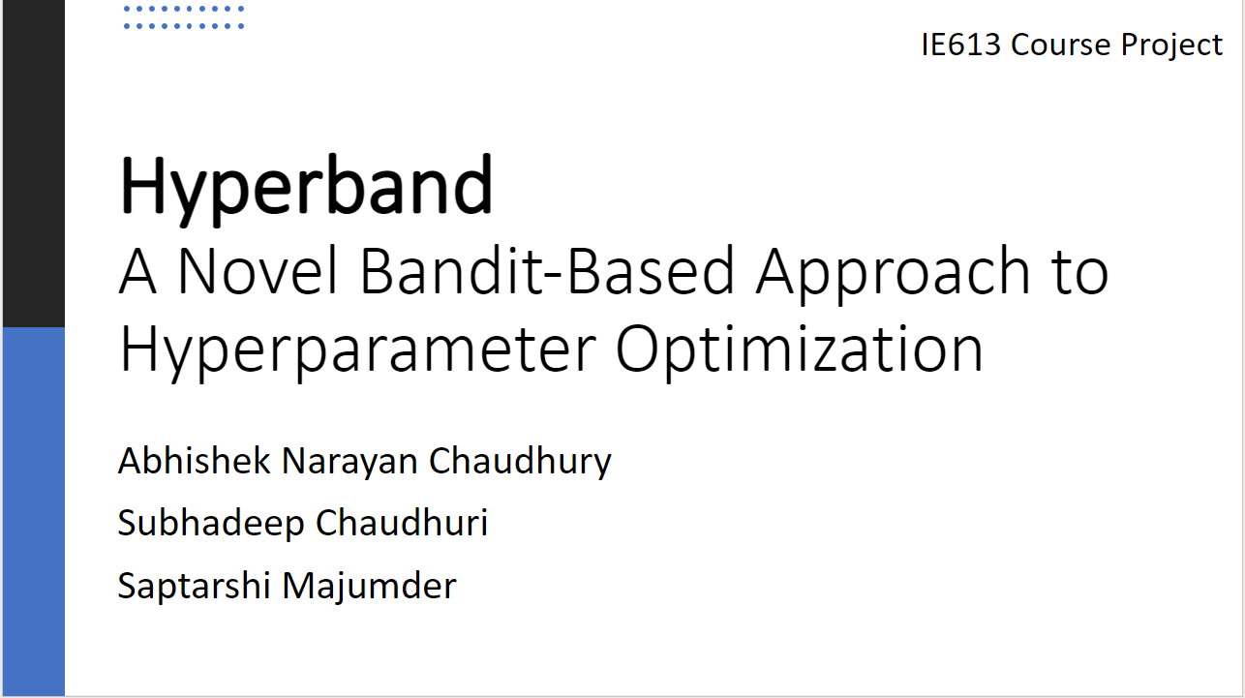

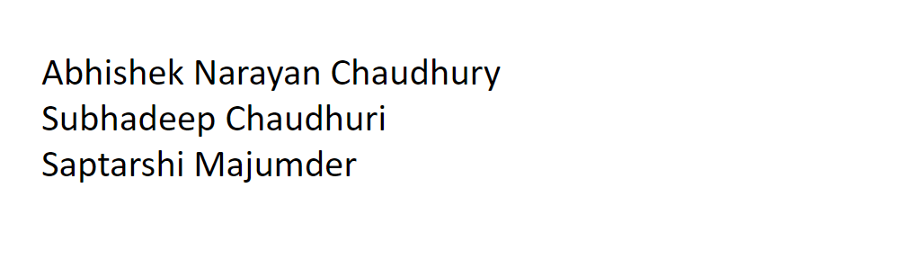

Slide 2
Stochastic Bandits
THE ACTUAL BANDIT
Each pull of the Lever (Arm) either gives you Rs. 1000 or Does Not Pay Off
Avg. Payoff for the Left Arm: Rs. 400
<
Avg. Payoff for the Right Arm: Rs. 600
$
$
$
If we want to play another 10 rounds, what will be our strategy?
• Should we keep pulling the Right Arm and ignore the Left Arm?
• Do we attribute the poor performance of the Left Arm to bad luck and try it a few more times?
• If so, how many more times?
NOT THE BANDIT

Slide 3


Non-Stochastic Bandits
A stochastic bandit with $K$ actions is completely determined by the distributions of rewards, $P_{1}$, …, $P_{K}$ of the respective actions
For many “real-world” problem,
No suitable distributions
Hard to argue the reward being truly randomly generated
Non-Stochastic Bandit
Rewards could be correlated over time
Assuming nothing about reward generation mechanism

Slide 4



Pure Exploration
Well… Not these

Slide 5

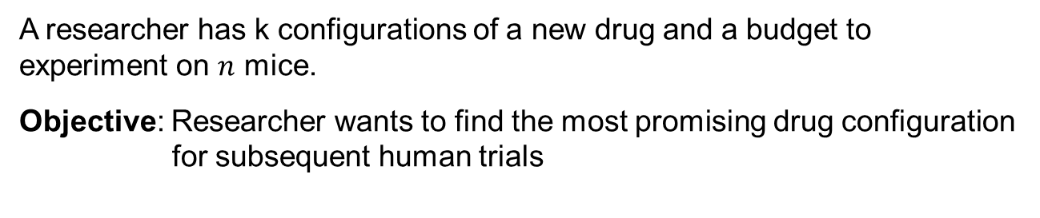
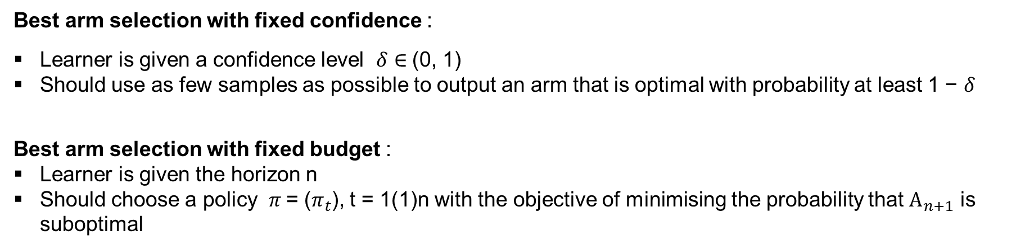
Pure Exploration
Till now, policies carefully balancing between exploration against exploitation
What happens if there is no price to be paid for exploring?
A researcher has k configurations of a new drug and a budget to experiment on $n$ mice.
Objective: Researcher wants to find the most promising drug configuration for subsequent human trials
But is not concerned with the outcomes for the mice
Best arm selection with fixed confidence :
Learner is given a confidence level $δ∈$(0, 1)
Should use as few samples as possible to output an arm that is optimal with probability at least 1 − $δ$
Best arm selection with fixed budget :
Learner is given the horizon n
Should choose a policy $π$= ($π_{t}$), t = 1(1)n with the objective of minimising the probability that $A_{n+1}$ is suboptimal

Slide 6
K- Armed and Infinite armed Bandit
Main challenges of the infinite armed bandits w.r.t. the multi-armed bandits (known as arm selection trade-off):
Need to find a good arm among the sampled ones.
Need to sample (at least once) enough arms to have (at least once) a reasonably good one.
It is different from the known exploration/exploitation trade-off and more linked to model selection principles:
Want to sample only from a small subsample of arms to decide, with enough accuracy, which one is the best one among them.
Want to sample as many arms as possible in order to have a higher chance to sample a good arm at least once.
This trade-off makes the problem of infinitely many armed bandits significantly different from the classical bandit problem.

Slide 7
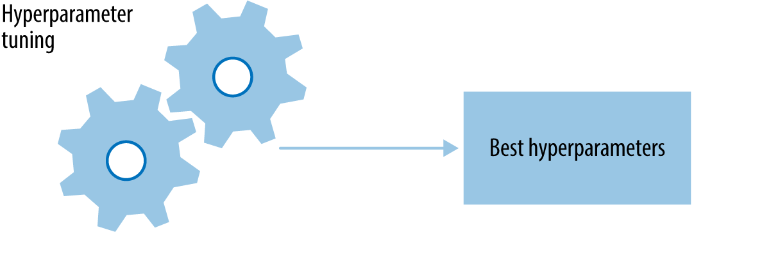
Hyperparameter Optimization
Hyperparameters: Inputs to a machine learning algorithm that govern how the algorithm's performance generalizes to new, unseen data
Examples: Amount of regularization, learning rates etc.
Quality of a predictive model critically depends on its hyperparameter configuration
Poorly understood how these hyperparameters interact with each other to affect the resulting model.
The growing number of tuning parameters associated with these models are difficult to set by standard optimization techniques

Slide 8
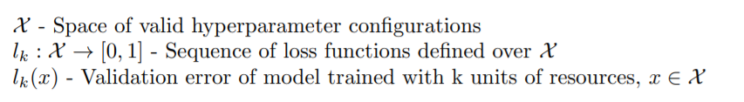

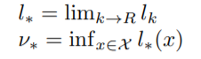
Hyperparameter Optimization

Slide 9
Successive Halving
Successive Halving is a robust, general-purpose solution to the Non-stochastic best arm identification problem
Given an input budget (for eg. training time)
Uniformly allocate the budget to a set of arms for a predetermined amount of iterations.
Evaluate performance.
Throw out the worst half
Repeat until just one arm remains
We might also remove the “budget” input by what authors call the “doubling trick”, as follows:
Set B ← n where n is the number of arms
Run the algo to completion with B
Set B ← 2B
Repeat to infinity

Slide 10

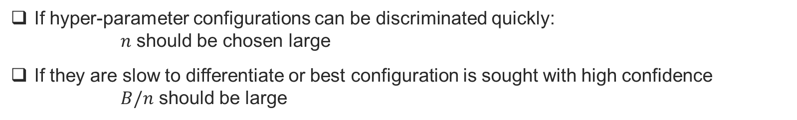
Drawback about the $n$ vs $B/n$trade-off
For a given budget, it is not clear whether to search for many configurations (large$n$) for a small time, or explore few configurations but allocating a lot of resources to them (large $B/n$)
If hyper-parameter configurations can be discriminated quickly:
$n$ should be chosen large
If they are slow to differentiate or best configuration is sought with high confidence
$B/n$ should be large
Drawbacks of these strategies
If $n$ is large :
Some good configurations which can be slow to converge at the beginning will be killed off early.
If $B/n$ is large:
Bad configurations will be given a lot of resources, even though they could have been stopped before.

Slide 11
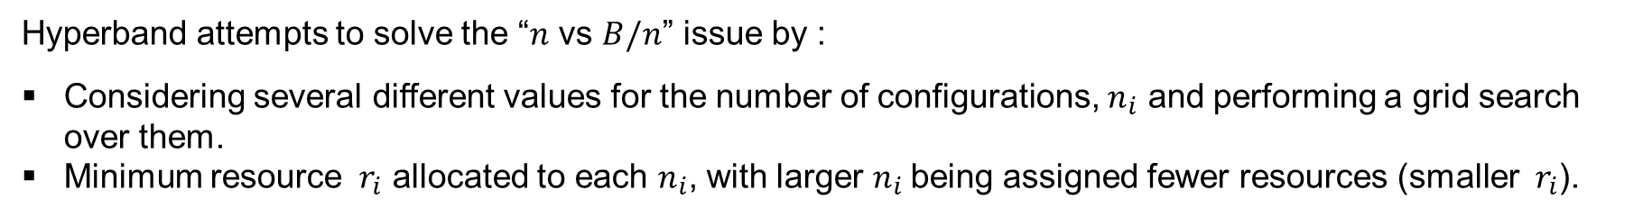
HyperBand
Hyperband is a variation of random search, but with some explore-exploit theory to find the best time allocation for each of the configurations
Framed the problem of hyperparameter optimization as a pure-exploration, non-stochastic, infinite armed bandit problem.
One selects a resource (e.g. iterations, data samples, or features) and allocates it to randomly sampled configurations.
One then trains the model with each configuration
Stops training configurations that perform poorly while allocating additional resources to promising configurations.
Hyperband attempts to solve the “$n$ vs $B/n$” issue by :
Considering several different values for the number of configurations, $n_{i}$ and performing a grid search over them.
Minimum resource $r_{i}$ allocated to each $n_{i}$, with larger $n_{i}$being assigned fewer resources (smaller $r_{i}$).

Slide 12
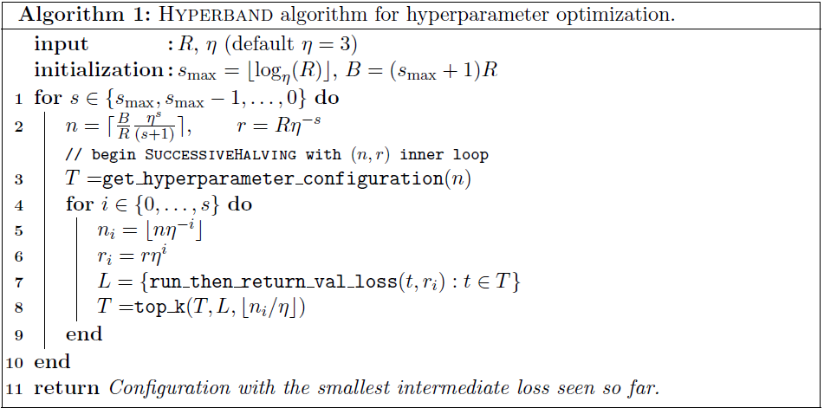
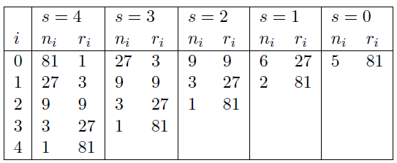
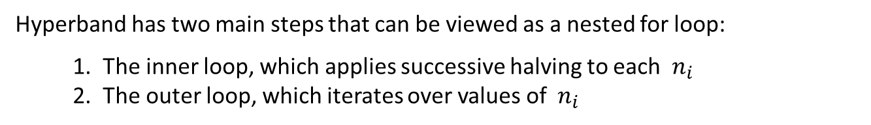


HyperBand
Hyperband has two main steps that can be viewed as a nested for loop:
The inner loop, which applies successive halving to each $n_{i}$
The outer loop, which iterates over values of $n_{i}$
$$R=81$$
$$η=3$$

Slide 13



HyperBand Regret Bounds
$\hat{v_{B}}$ : Mean of the empirically best arm output from the last fully completed round k,
$B$: Number of pulls (analogous to budget)
$δ$: Real number $∈(0,1)$
$β$: Positive constant such that a large $β$value implies that it is very rare to draw a limit close to the optimal value $ν_{∗}$
$$with probability 1−δ$$
(Proved in Sec. 5.3.3 Corollary 6 of [1])
$$Remarks:$$
Polylogarithm function is defined by a power series in $z$, which is also a Dirichlet series in $s$
[1] Lisha Li, Kevin Jamieson, Giulia DeSalvo, Afshin Rostamizadeh, and Ameet Talwalkar, “Hyperband: A novel bandit-based approach to hyperparameter optimization”, 2018.

Slide 14




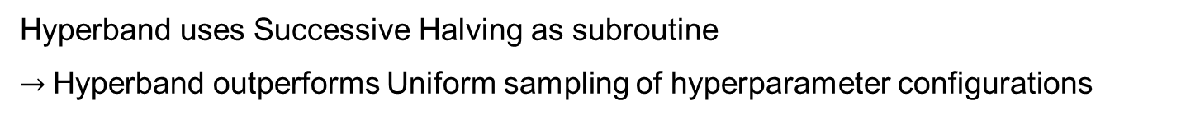
Successive Halving over Uniform Sampling
If the Successive Halving algorithm is run with any budget $B>z_{SH}$, then the best arm is guaranteed to be returned.
In Uniform strategy, it does not return best arm at time step $t,$where
Hyperband uses Successive Halving as subroutine
$→$Hyperband outperforms Uniform sampling of hyperparameter configurations
Kevin Jamieson and Ameet Talwalkar, “Non-stochastic best arm identification and hyperparameter optimization”, 19th International Conference on Artificial Intelligence and Statistics, 2016

Slide 15

Conclusion and Future Work
Hyperband is highly efficient for finding a good configuration
Tensorflow framework used Hyperband algorithm for hyperparameter optimization
However, it does not find an optimum fast enough.
Solution: HyperUCB
Modeling the hyperparameter optimization as a learning problem than a search algorithm (full exploration problem)
In HyperUCB, arm selection carried out by incorporating an Upper Confidence Bound (UCB) strategy
They further model the arms in a contextual setting
Finding from HyperUCB
Performance either better or at par with Hyperband

Slide 16
REFERENCES
Lisha Li, Kevin Jamieson, Giulia DeSalvo, Afshin Rostamizadeh, and Ameet Talwalkar, “Hyperband: A novel bandit-based approach to hyperparameter optimization”, 2018.
Kevin Jamieson and Ameet Talwalkar, “Non-stochastic best arm identification and hyperparameter optimization”, 19th International Conference on Artificial Intelligence and Statistics, 2016
Blog by Kevin Jamieson, “Hyperband: A novel bandit-based approach to hyperparameter optimization”
Lattimore, Bandit Algorithms

Slide 17

OUR FAVOURITE SLIDE

