Slide 1
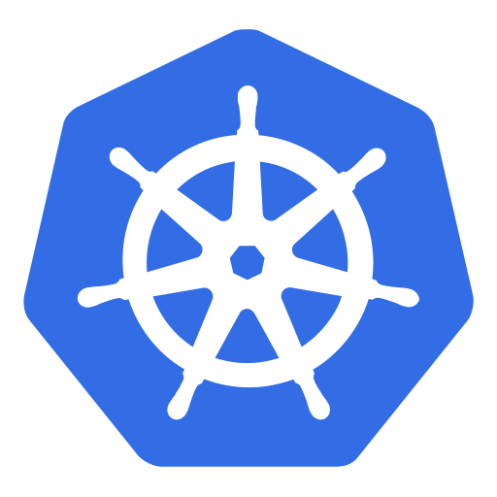
Kubernetes

Slide 2
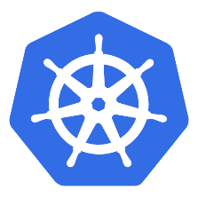
Introduction to Docker
VM Architecture vs. Container Architecture
app A
app B
app C
app A
app B
app C
Containers
bins libs
bins libs
bins libs
VMs
bins libs
bins libs
Guest OS
Guest OS
Guest OS
Docker Engine
Hypervisor
Host OS
Host OS
Hardware
Hardware
Container Architecture
VM Architecture
Heavy weight
More boot up time
light weight
Very less boot up time

Slide 3
Introduction to Docker
Common terminologies in Docker
Dockerfile
docker build
Docker Image
docker run
Container
A set of instructions to create the docker image
A complete package with you app and dependencies
A runtime instance of the docker image
Note: Create your docker image to use it in the subsequent Kubernetes tutorials

Slide 4
Introduction to Kubernetes
Open source docker container orchestration system
You can run 1 to N number of containers and it will manage the state of those containers: replication, auto scaling etc.
You can easily move containers from one node to another in a cluster and it makes the maintenance easy
Kubernetes clusters can start with one node to thousands of nodes until you have hardware resources available
Can be run any where: On-Premise, Public Cloud (AWS, GCP), Hybrid (Public & Private)
Other popular docker orchestrators are: Docker Swarm (default to Docker), Mesos

Slide 5
Introduction to Kubernetes
Tools required to run Kubernetes in local: > Docker > kubernetes cluster (minikube), minikube aslo comes with Docker embedded in it > kubectl command line interface
If you are using Windows 10, then you can download Docker Desktop and enable Kubernetes on it and can download kubectl command line interface

Slide 6
Introduction to Kubernetes
Let’s run our first Kubernetes Pod:
Get your docker image ready
Execute the following commands:
kubectl run <your pod name> --image=<your docker image>
kubectl get pods
kubectl describe pod <your pod name>
A Pod is the smallest deployable unit that runs container(s) inside it.

Slide 7
Basics of Kubernetes (Node Architecture)
kubelet
iptables
kube-proxy
Node 1
Pod 1
Pod 2
Pod 3
Docker
Service LB
Internet
kubelet
iptables
Node 2
kube-proxy
Pod 1
Pod 2
Pod 3
Docker
Node N

Slide 8
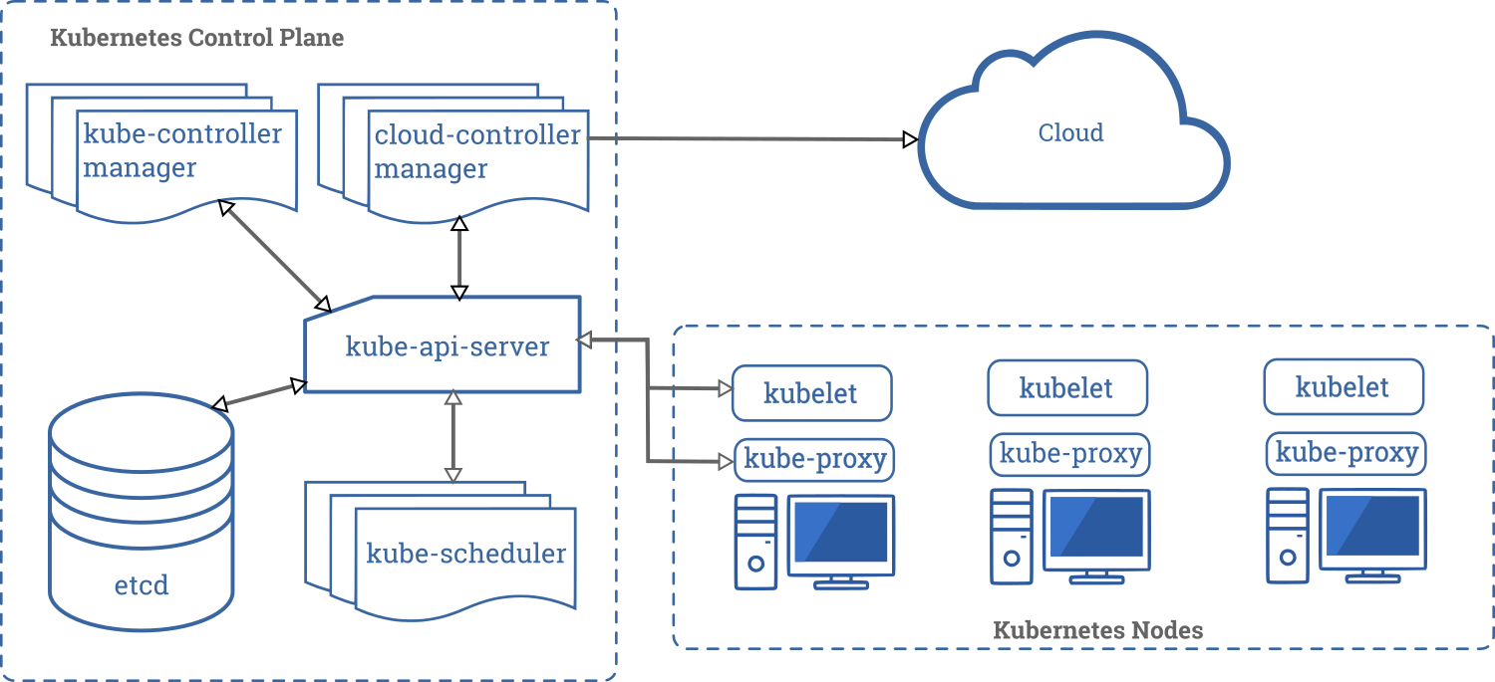
Basics of Kubernetes (Kubernetes Architecture)

Slide 9
Basics of Kubernetes (Pod)
Creating Pod with Pod Definition Yaml file
apiVersion: v1
kind: Pod
metadata:
name: nodejs-app
labels:
app: nodejs-app
spec:
containers:
- name: nodejs-app
image: node-app
ports:
- containerPort: 8080
imagePullPolicy: Never
kubectl create -f <your yml file>

Slide 10
Basics of Kubernetes (Pod Scaling)
Scaling Pod with ReplicationController
The ReplicationController will ensure that a specified number of Pod replicas are always running at all time
A Pod created with ReplicationController will automatically be replaced by new Pod if it fails, gets deleted or terminated

Slide 11
Basics of Kubernetes (Pod Scaling)
Scaling Pod with ReplicationController & Pod Definition Yaml file
apiVersion: v1
kind: ReplicationController
metadata:
name: nodejs-replication-controller
spec:
replicas: 3
selector:
app: nodejs-app-selector
template:
metadata:
labels:
app: nodejs-app-selector
spec:
containers:
- name: nodejs-app-container
image: node-app
ports:
- containerPort: 8080
imagePullPolicy: Never
kubectl create -f <your yml file>
kubectl delete pod <pod name>
kubectl get rc
kubectl scale --replica=5 rc/<rc name>
kubectl delete rc <rc name>

Slide 12
Basics of Kubernetes (Deployment)
Scaling & Deploying Pod with Deployments
ReplicaSet is the next generation ReplicationController which provides more features, e.g. selector for more complex filtering
ReplicaSet is internally used by Deployment object
Deployment object makes sure that the cluster matches the desired state
With deployment object you can: > create a deployment (e.g. deploying an app) > update a deployment (e.g. deploying a new version) > do rolling updates (zero downtime deployments) > rollback to previous version > pause/resume a deployment (e.g. to rollout a certain percentage)

Slide 13
Basics of Kubernetes (Deployment)
Scaling & Deploying Pod with Deployments
apiVersion: apps/v1
kind: Deployment
metadata:
name: nodejs-deployment
spec:
replicas: 3
selector:
matchLabels:
app: nodejs-app-selector
template:
metadata:
labels:
app: nodejs-app-selector
spec:
containers:
- name: nodejs-app-container
image: node-app
ports:
- name: nodejs-port
containerPort: 8080
imagePullPolicy: Never
kubectl create -f <your yml file>
kubectl get deploy
kubectl describe deploy <DEP_NAME>
kubectl edit deployment/<DEP_NAME>
kubectl rollout status deployment/<DEP_NAME>
kubectl rollout history deployment/<DEP_NAME>
kubectl rollout undo deployment/<DEP_NAME>
kubectl rollout undo deployment/<DEP_NAME> --to-revision=N

Slide 14
Basics of Kubernetes (Service)
Expose an deployment or Pod as a Service to out side world
Pods are very dynamic, they come and go in the cluster
New Pods are created due to scaling operation when any Pod gets terminated
When updating the deployment, old Pods get terminated and new Pods come up
Hence Pods should never be accessed directly, but always through a service. When you create a service, an endpoint is created for the end users
ClusterIP
a virtual IP address only reachable from within the cluster (default)
Service
NodePort
a port that is same as the port of a Node and externally reachable. (default: 30000-32767)
LoadBalancer
LoadBalancer created by the cloud provider that will route external traffic to every node on the NodePort (ELB on AWS)

Slide 15
Basics of Kubernetes (Service)
Expose an deployment or Pod as a Service to out side world
apiVersion: v1
kind: Service
metadata:
name: nodejs-service
spec:
ports:
- port: 31001
nodePort: 31001
targetPort: nodejs-port
protocol: TCP
selector:
app: nodejs-app-selector
type: NodePort
kubectl create -f <your yml file>
kubectl get service
kubectl describe service <SVC_NAME>

Slide 16
Basics of Kubernetes (Labels)
Labels
Labels are key/value pairs, can be used to label Kubernetes objects
Labels are not unique and multiple labels can be added to one object
Label selector can used to filter results
Labels can be used tag Nodes and you can use label selector to let pods only run on specific Nodes
kubectl label nodes <NODE_1> hardware=high-spec
kubectl label nodes <NODE_2> hardware=low-spec

Slide 17
Basics of Kubernetes (Labels)
Labels
apiVersion: v1
kind: Pod
metadata:
name: nodejs-app
labels:
app: nodejs-app
spec:
containers:
- name: nodejs-app
image: node-app
ports:
- containerPort: 8080
imagePullPolicy: Never
nodeSelector:
hardware: high-spec
kubectl get nodes --show-labels
kubectl get pods --show-labels
kubectl get pods -l app=node-app1

Slide 18
Basics of Kubernetes (Healthchecks)
Healthchecks in Kubernetes
Health checks help to make sure the app is up and running
Can be done by running a in the container periodically
Can be done with periodic checks on an HTTP URL

Slide 19
Basics of Kubernetes (Healthchecks)
Healthchecks in Kubernetes
apiVersion: v1
kind: Pod
metadata:
name: nodejs-healthcheck
labels:
app: nodejs-app
spec:
containers:
- name: nodejs-app
image: node-app
ports:
- containerPort: 8080
imagePullPolicy: Never
livenessProbe:
httpGet:
path: /
port: 8080
initialDelaySeconds: 10
timeoutSeconds: 30
kubectl describe pods <POD_NAME>

Slide 20
Basics of Kubernetes (Secrets)
Secrets in Kubernetes
Secrets provides a way to distribute credentials, keys, password or secret data to the Pods
Kubernetes itself uses this secrets mechanism to provide the credentials to access the internal APIs
Secrets can used as Environment Variable or File with volume mount
$ echo -n “myUsername” > ./username.txt
$ echo -n “myPassword” > ./password.txt kubectl create secret generic <SEC_NAME> --from-file=./username.txt --from-file=./password.txt

Slide 21
Basics of Kubernetes (Secrets)
Secrets in Kubernetes
apiVersion: v1
kind: Secret
metadata:
name: db-credentials
type: Opaque
data:
username: dXNlcm5hbWU=
password: cGFzc3dvcmQ=
kubectl get secrets

Slide 22
Basics of Kubernetes (Secrets)
Secret as Environment Variable
spec:
containers:
- name: nodejs-app
image: node-app
ports:
- containerPort: 8080
imagePullPolicy: Never
env:
- name: DB_USERNAME
valueFrom:
secretKeyRef:
name: db-credentials
key: username
- name: DB_PASSWORD
valueFrom:
secretKeyRef:
name: db-credentials
key: password
kubectl exec –it <POD_NAME> -- env

Slide 23
Basics of Kubernetes (Secrets)
Secret as Volume Mount
spec:
containers:
- name: nodejs-app
image: node-app
ports:
- containerPort: 8080
imagePullPolicy: Never
volumeMounts:
- name: db-cred-volume
mountPath: /etc/creds
readOnly: true
volumes:
- name: db-cred-volume
secret:
secretName: db-credentials
kubectl exec –it <POD_NAME> -- /bin/bash
$ cd /etc/creds
$ ls

Slide 24
Kubernetes Advanced (Resource Requirement)
Container’s Resource
You can optionally specify how much of each resource a Container needs. The most common resources to specify are CPU and memory (RAM)
Request : If the requested resource criteria is met, the only Pod will be scheduled
Limit : It restricts a container’s resource usage, if it hits the limit then it will be terminated by scheduler.

Slide 25
Kubernetes Advanced (Resource Requirement)
Container’s Resource
apiVersion: v1
kind: Pod
metadata:
name: nodejs-app
labels:
app: nodejs-app
spec:
containers:
- name: nodejs-app
image: node-app
ports:
- containerPort: 8080
imagePullPolicy: Never
resources:
requests:
cpu: 50m
memory: 256Mi
limits:
cpu: 100m
memory: 512Mi
kubectl describe pod <POD_NAME>

Slide 26
Kubernetes Advanced (Multi Containers Design Pattern)
Multi containers Pod design patterns
Single container pods are the most common use case
There are some reasons to put containers into a single pod.
One of the reasons is simpler communication between containers through the network space and shared volumes
There are three ways that containers in the pod communicate with each other: > Shared Network Namespace > Shared Storage Volumes > Shared Process Namespace

Slide 27
Kubernetes Advanced (Multi Containers Design Pattern)
Multi containers Pod design patterns
Container 1
port 3075
Container 2 port 3058
Container 1
Container 2
Container 1
Container 2
localhost
Storage Volume
Pod
Pod
Pod
Shared Network Space
Shared Storage Volumes
Shared Process Namespace

Slide 28
Kubernetes Advanced (Multi Containers Design Pattern)
Multi containers Pod design patterns
There are three commonly used multi-container design patterns: > Sidecar pattern > Adaptor pattern > Ambassador pattern/Proxy Pattern

Slide 29
Kubernetes Advanced (Multi Containers Design Pattern)
Multi containers Pod design patterns
apiVersion: v1
kind: Pod
metadata:
labels:
app: busybox
name: busybox
spec:
containers:
- name: busybox-ls
image: busybox
command: ["bin/sh", "-c", "ls"]
- name: busybox-echo-1
image: busybox
command: ["bin/sh", "-c", "echo Hello from echo 1"]
- name: busybox-echo-2
image: busybox
command: ["bin/sh", "-c", "echo Hello from echo 2"]
kubectl logs <POD_NAME> -c <CON_NAME>

Slide 30
Header
content

Slide 31
Header
content

