Slide 1
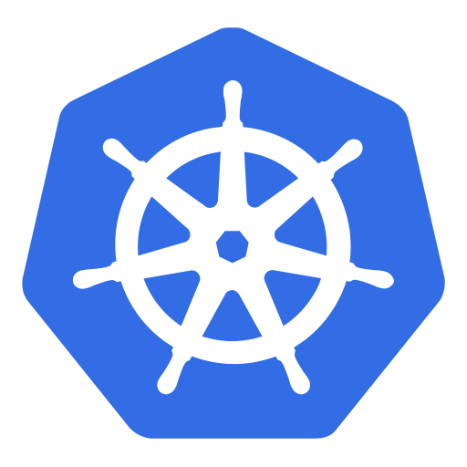
Kubernetes

Slide 2
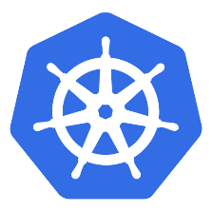
Introduction to Docker
VM Architecture vs. Container Architecture
app A
app B
app C
app A
app B
app C
Containers
bins libs
bins libs
bins libs
VMs
bins libs
bins libs
Guest OS
Guest OS
Guest OS
Docker Engine
Hypervisor
Host OS
Host OS
Hardware
Hardware
Container Architecture
VM Architecture
Heavy weight
More boot up time
light weight
Very less boot up time

Slide 3
Introduction to Docker
Common terminologies in Docker
Dockerfile
docker build
Docker Image
docker run
Container
A set of instructions to create the docker image
A complete package with you app and dependencies
A runtime instance of the docker image
Note: Create your docker image to use it in the subsequent Kubernetes tutorials

Slide 4
Introduction to Kubernetes
Open source docker container orchestration system
You can run 1 to N number of containers and it will manage the state of those containers: replication, auto scaling etc.
You can easily move containers from one node to another in a cluster and it makes the maintenance easy
Kubernetes clusters can start with one node to thousands of nodes until you have hardware resources available
Can be run any where: On-Premise, Public Cloud (AWS, GCP), Hybrid (Public & Private)
Other popular docker orchestrators are: Docker Swarm (default to Docker), Mesos

Slide 5
Introduction to Kubernetes
Tools required to run Kubernetes in local: > Docker > kubernetes cluster (minikube), minikube aslo comes with Docker embedded in it > kubectl command line interface
If you are using Windows 10, then you can download Docker Desktop and enable Kubernetes on it and can download kubectl command line interface

Slide 6
Introduction to Kubernetes
Let’s run our first Kubernetes Pod:
Get your docker image ready
Execute the following commands:
kubectl run <your pod name> --image=<your docker image>
kubectl get pods
kubectl describe pod <your pod name>
A Pod is the smallest deployable unit that runs container(s) inside it.

Slide 7
Basics of Kubernetes
kubelet
iptables
kube-proxy
Node 1
Pod 1
Pod 2
Pod 3
Docker
Service LB
Internet
kubelet
iptables
Node 2
kube-proxy
Pod 1
Pod 2
Pod 3
Docker
Node Architecture
Node N

Slide 8
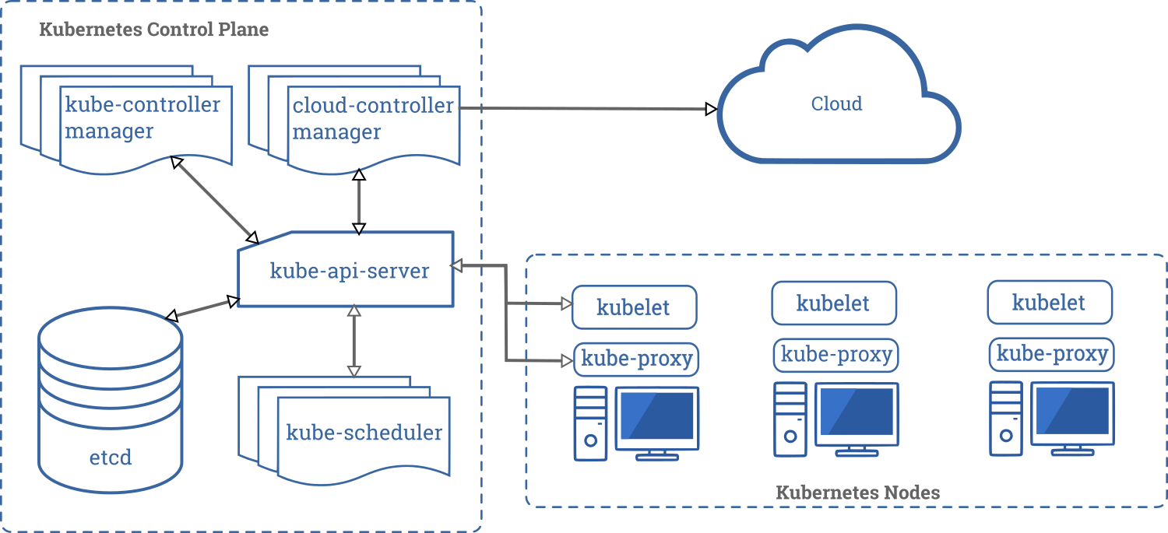
Basics of Kubernetes
Kubernetes Architecture

Slide 9
Basics of Kubernetes
Creating Pod with Pod Definition Yaml file
apiVersion: v1
kind: Pod
metadata:
name: nodejs-app
labels:
app: nodejs-app
spec:
containers:
- name: nodejs-app
image: node-app
ports:
- containerPort: 8080
imagePullPolicy: Never
kubectl create -f <your yml file>

Slide 10
Basics of Kubernetes
Scaling Pod with ReplicationController
The ReplicationController will ensure that a specified number of Pod replicas are always running at all time
A Pod created with ReplicationController will automatically be replaced by new Pod if it fails, gets deleted or terminated

Slide 11
Basics of Kubernetes
Scaling Pod with ReplicationController & Pod Definition Yaml file
apiVersion: v1
kind: ReplicationController
metadata:
name: nodejs-replication-controller
spec:
replicas: 3
selector:
app: nodejs-app-selector
template:
metadata:
labels:
app: nodejs-app-selector
spec:
containers:
- name: nodejs-app-container
image: node-app
ports:
- containerPort: 8080
imagePullPolicy: Never
kubectl create -f <your yml file>
kubectl delete pod <pod name>
kubectl get rc
kubectl scale --replica=5 rc/<rc name>
kubectl delete rc <rc name>

Slide 12
Basics of Kubernetes
Scaling & Deploying Pod with Deployments
Deploying Pod

Slide 13
Header
content

Slide 14
Header
content

