Slide 1
Master
Programming in C
| Day - 16 |
presented by - Subhadip Roy

Slide 2
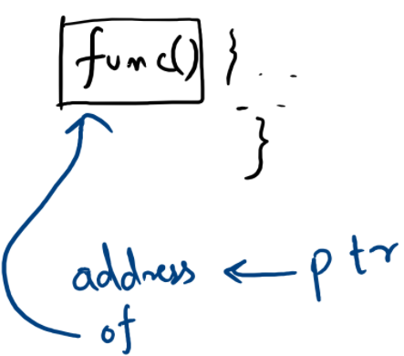
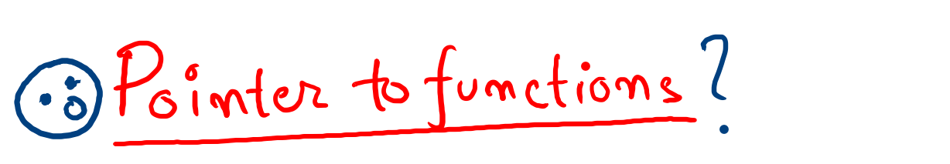

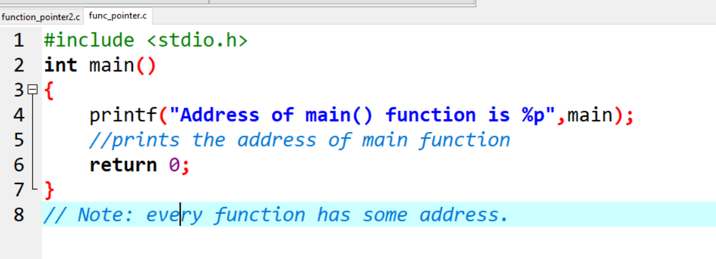

Slide 3
