Slide 1
Master
Programming in C
| Day - 23 |
presented by - Subhadip Roy

Slide 2


Slide 3
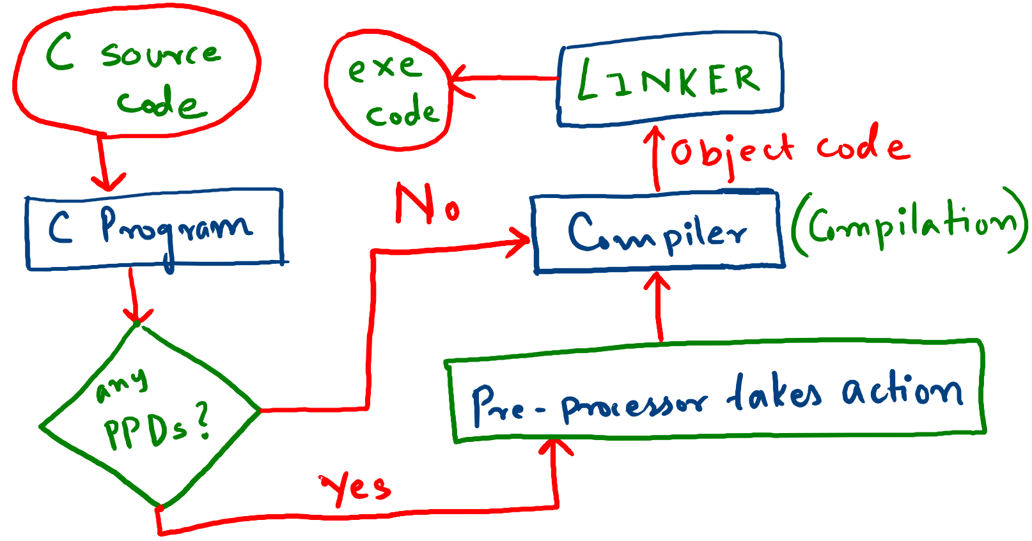

Slide 4
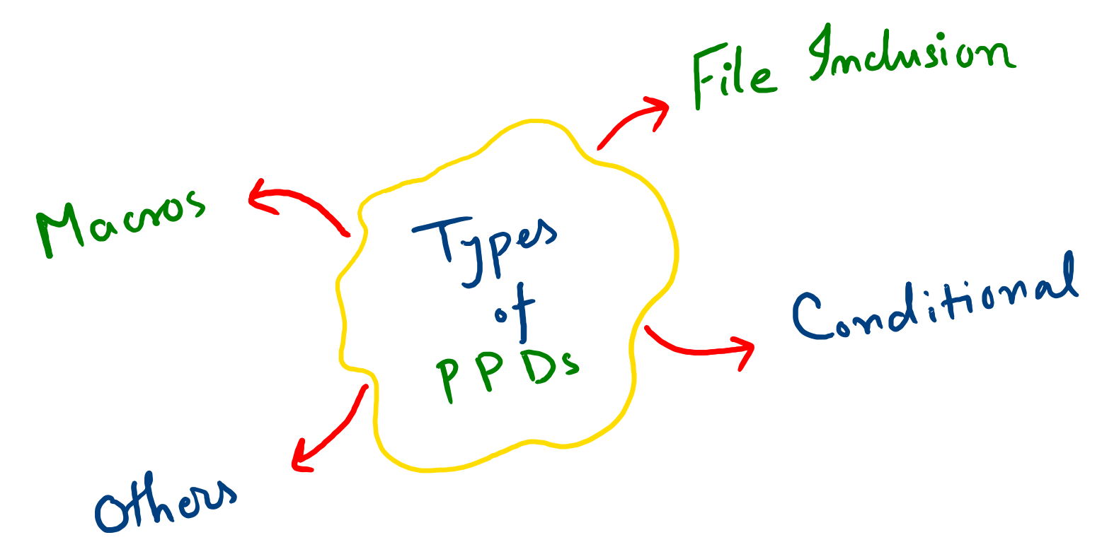

Slide 5


Slide 6
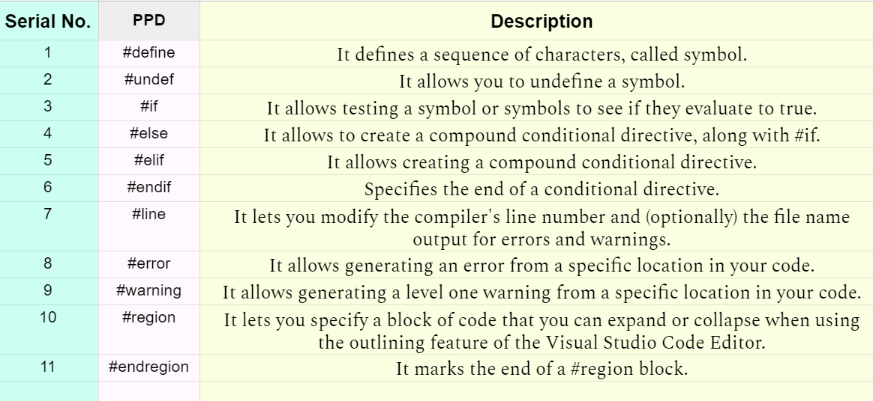
Chart for reference

Slide 7

Thank You !

