Slide 1
Master
Programming in C
| Day - 4 |
presented by - Subhadip Roy

Slide 2

Ranges
Overflows
Type Casting

Slide 3
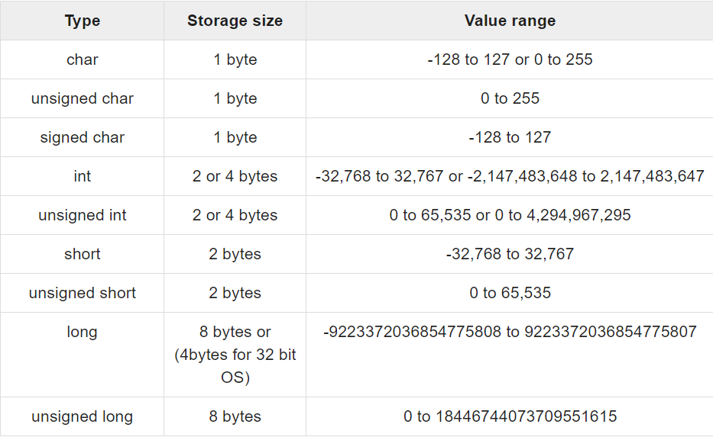
Ranges

Slide 4
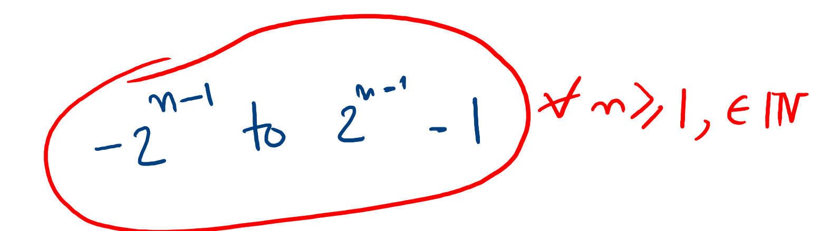
Generalising…

Slide 5

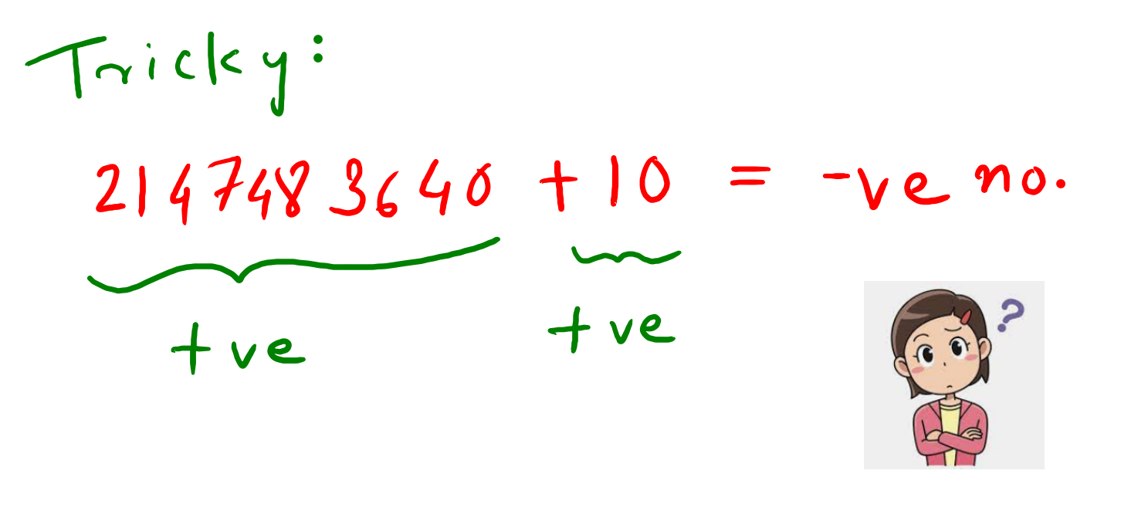
Overflows

Slide 6


Type Casting

Slide 7
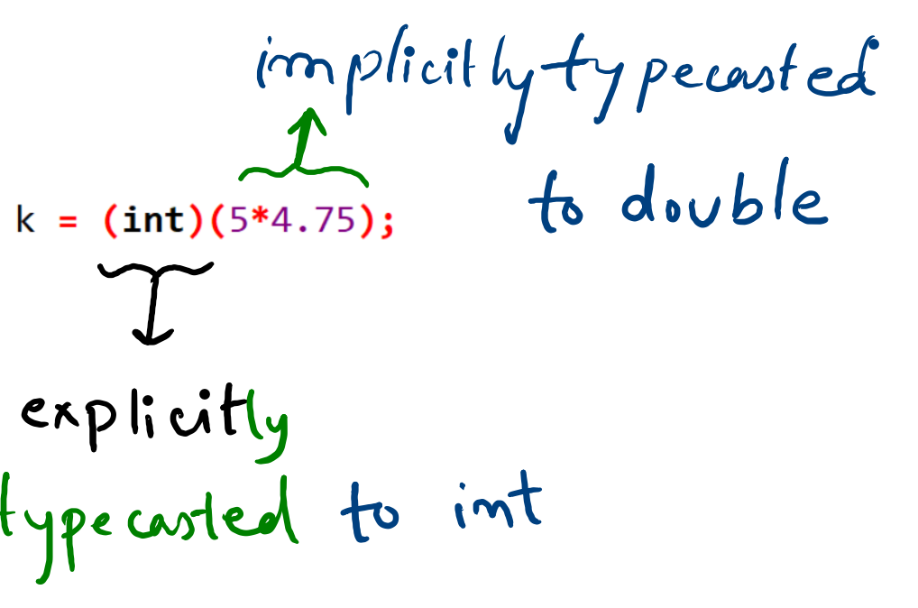
Type Casting

