Slide 1
Master
Programming in C
| Day - 5 |
presented by - Subhadip Roy

Slide 2


Streams
Buffers
I/O

Slide 3

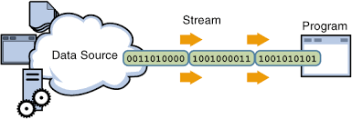
Streams

Slide 4

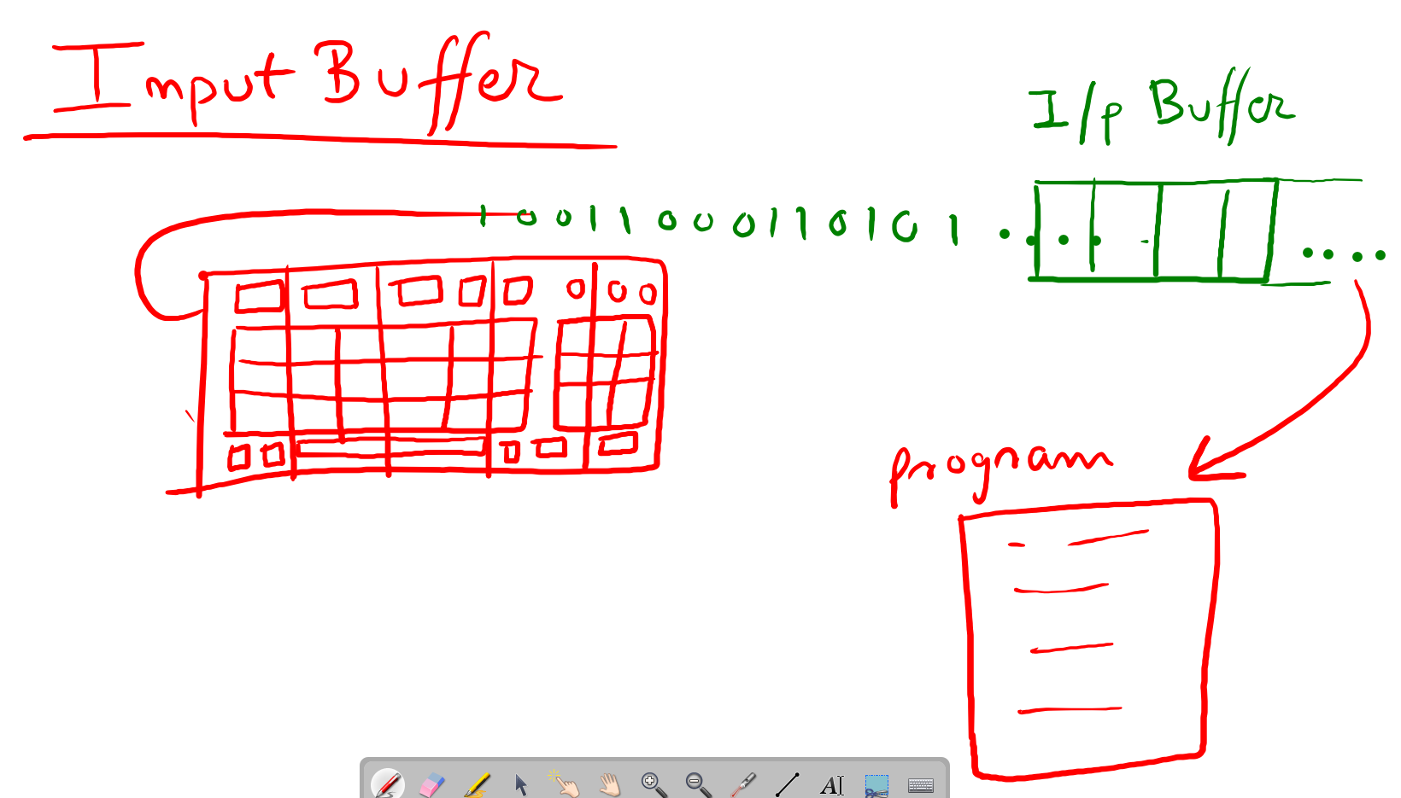
Buffers
For Input

Slide 5
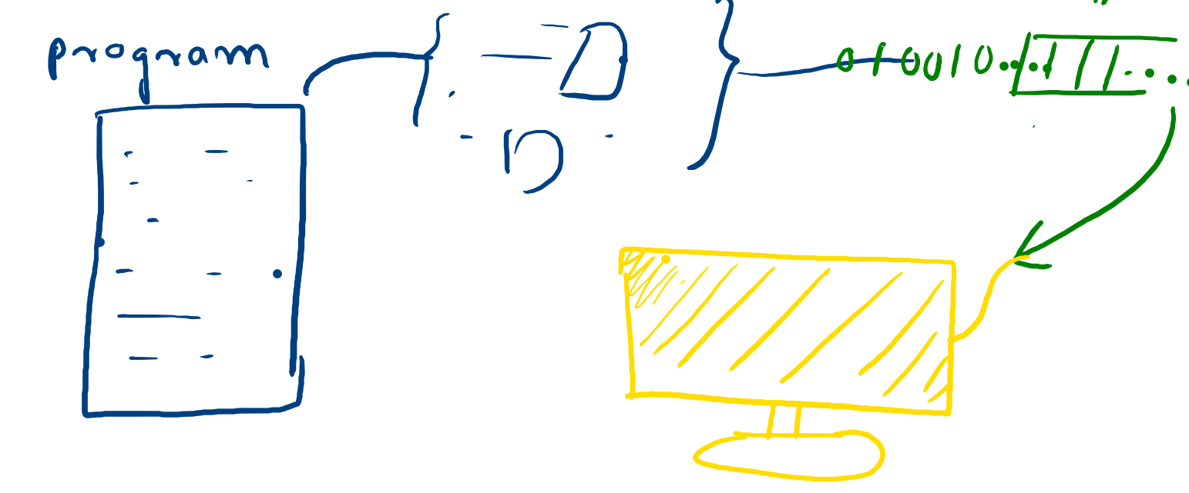
For Output

Slide 6
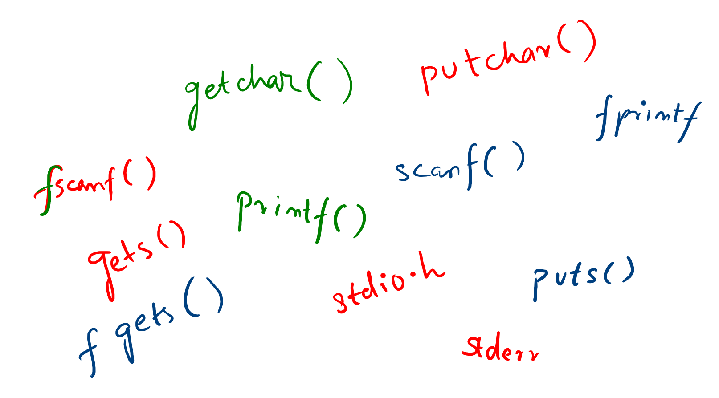

Input / Output

