Slide 1
Master
Programming in C
| Day - 3 |
presented by - Subhadip Roy

Slide 2

Literals
Constants
Tokens
ASCII

Slide 3




Constants
As the name suggests, they are values(data) that like to remain “constant”.
Don’t try to change them or else compile gives an error :(

Slide 4
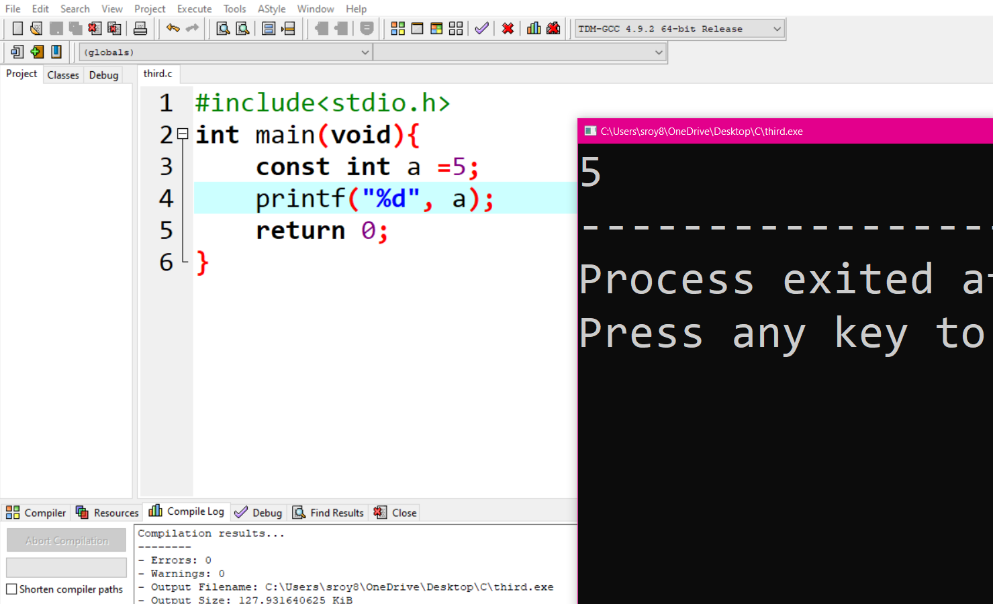

Slide 5

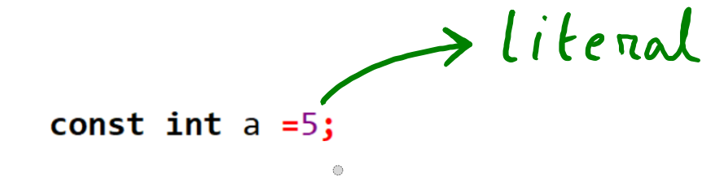
Literals

Slide 6
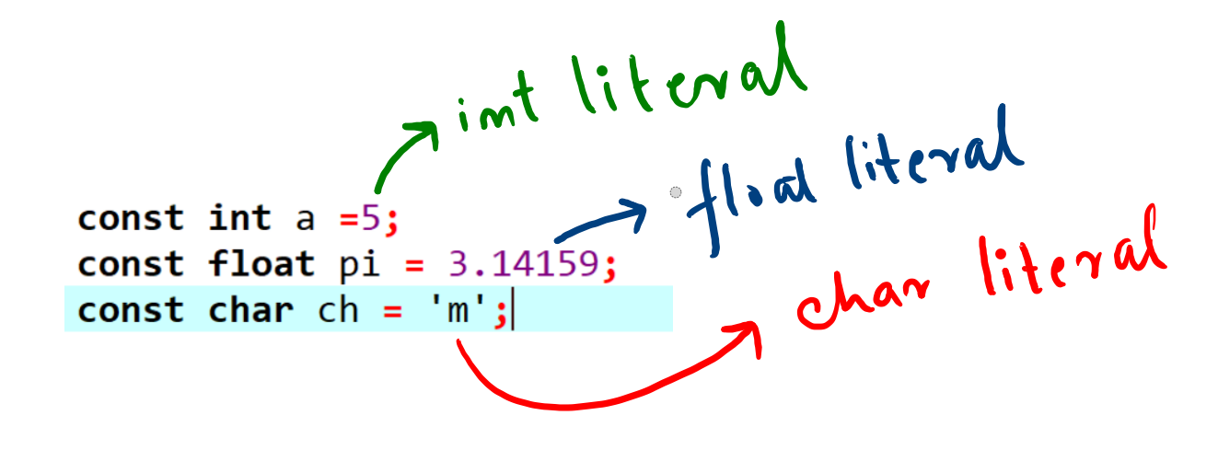

Slide 7
FUN with LiteRaLs

Slide 8
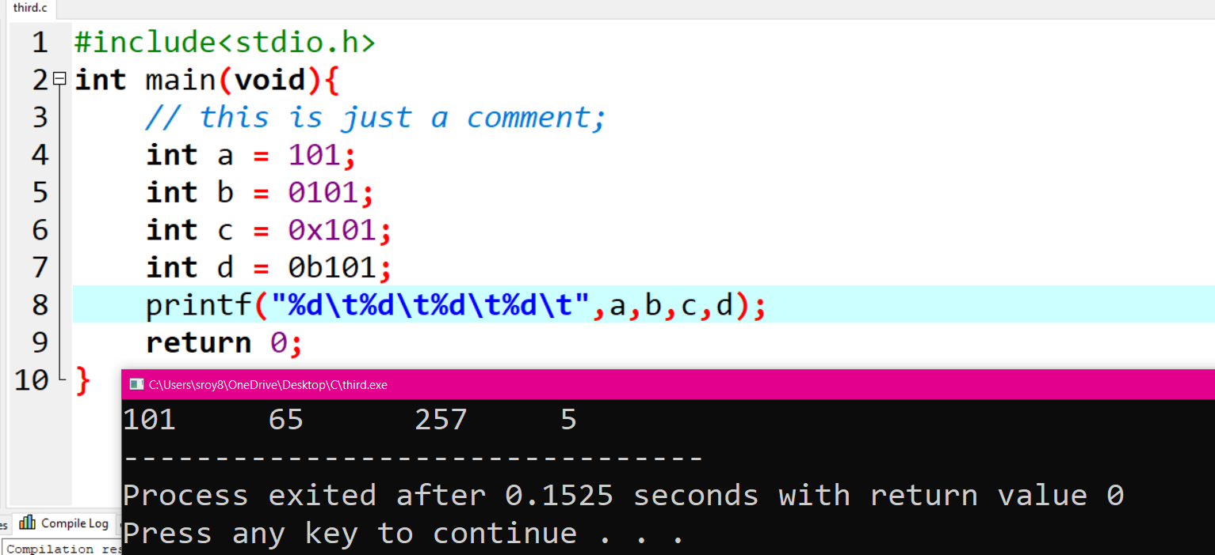

Slide 9
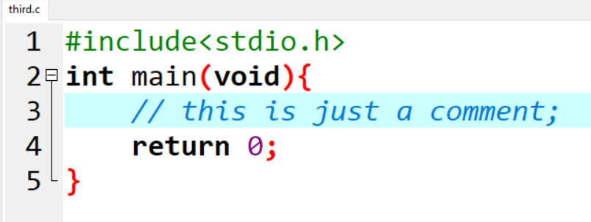
Tokens

Slide 10
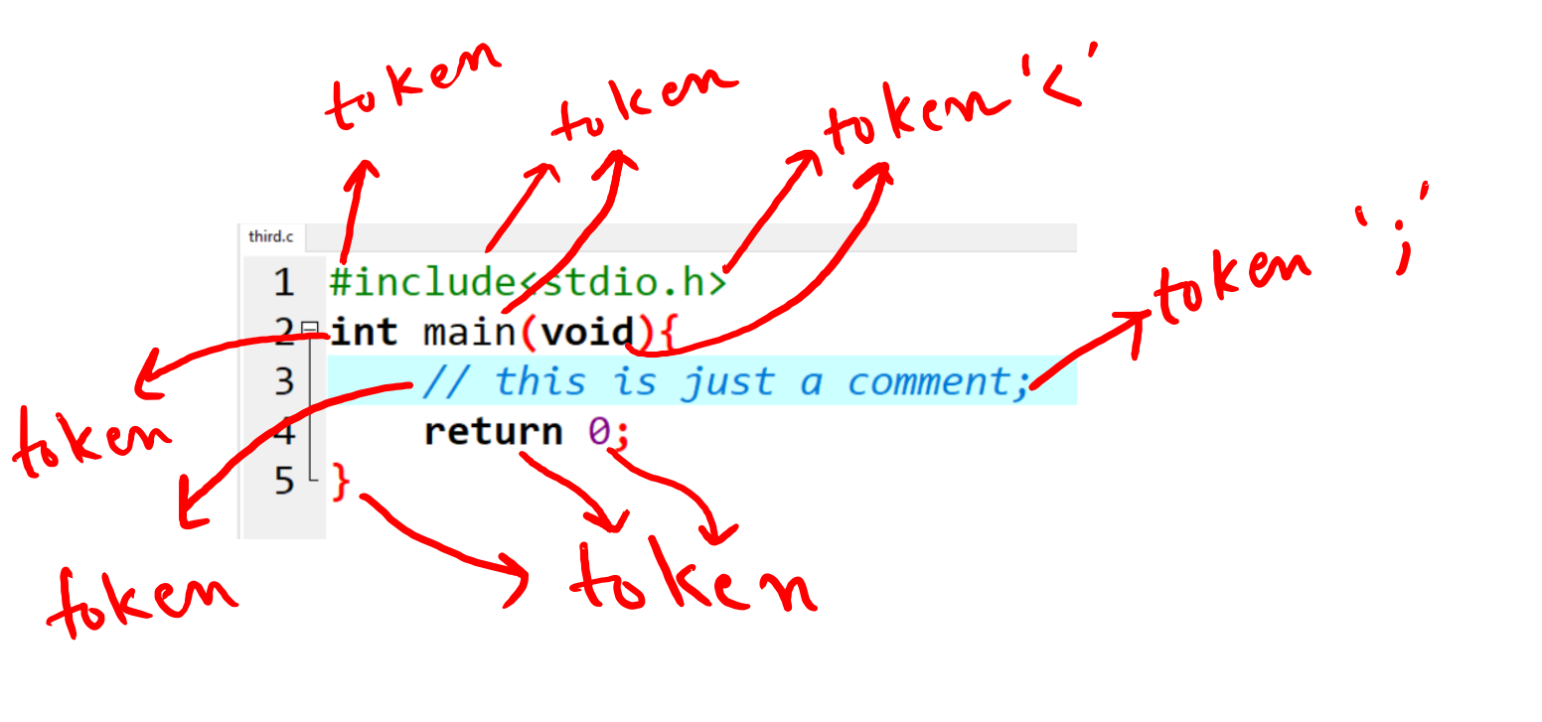
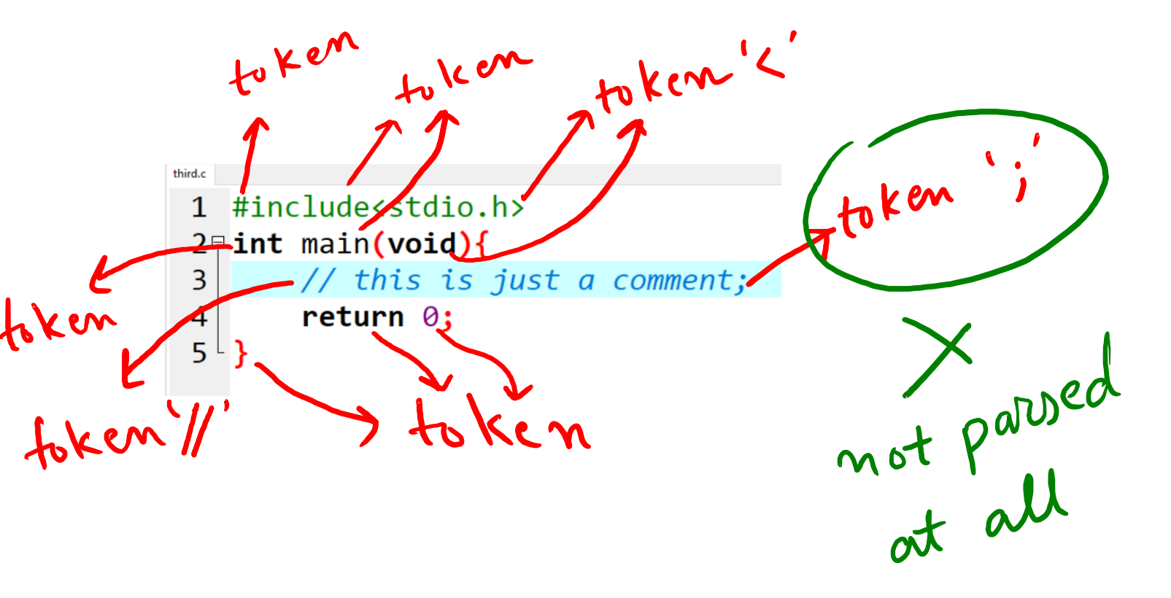

Slide 11
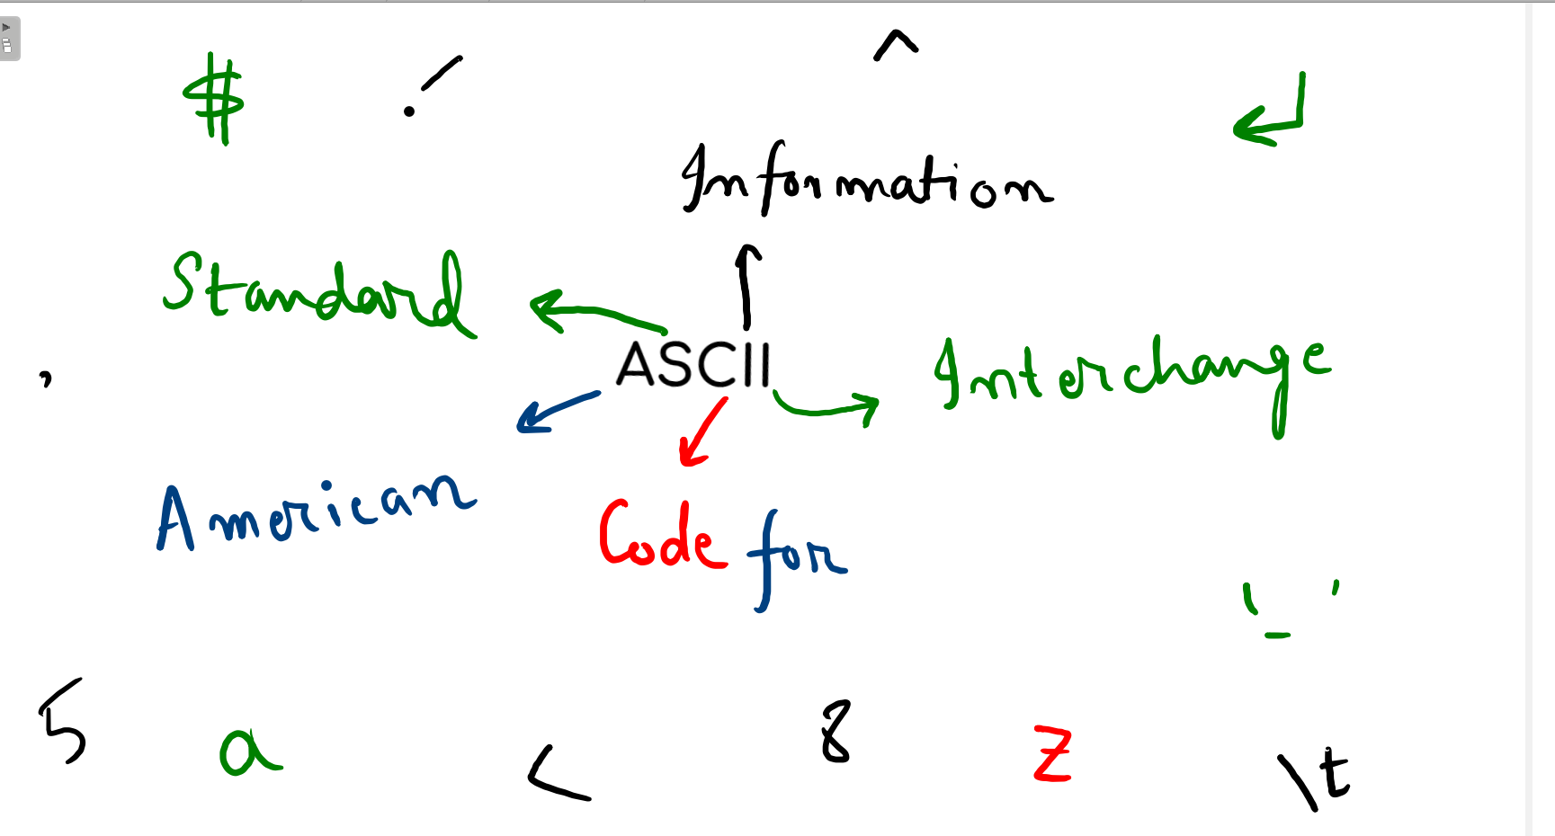
ASCII

