Slide 1
Master
Programming in C
| Day - 6 |
presented by - Subhadip Roy

Slide 2



Debugging
Errors in C

Slide 3
Runtime Errors
Syntax Errors
Logical Errors

Slide 4
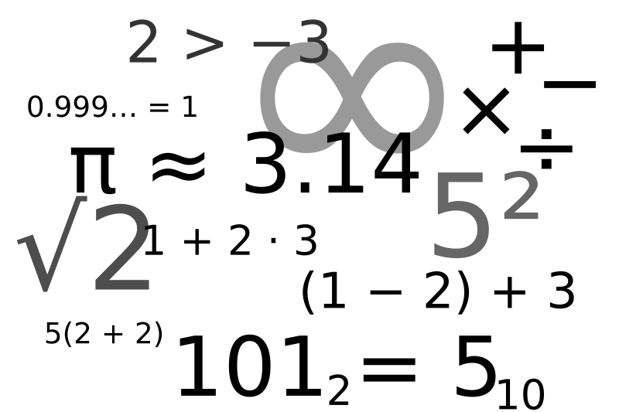

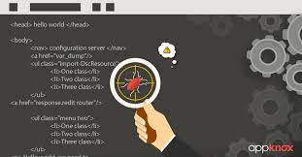
Debugging Programs

