Slide 1
Master
Programming in C
| Day - 7 |
presented by - Subhadip Roy

Slide 2
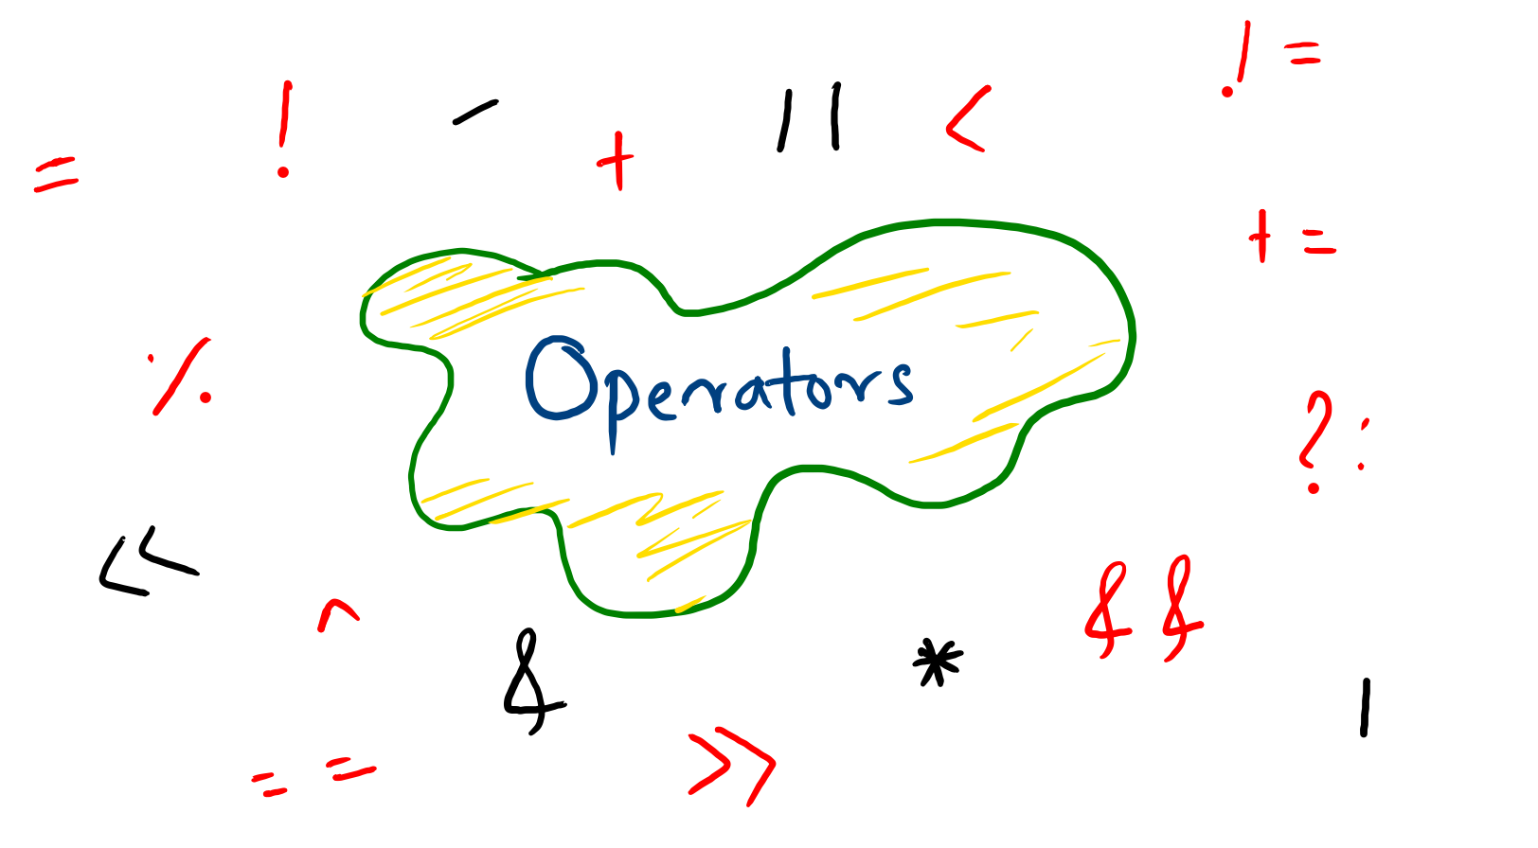

Slide 3

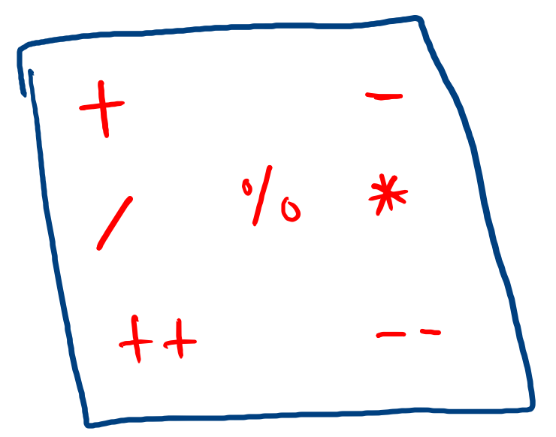
Arithmetic

Slide 4
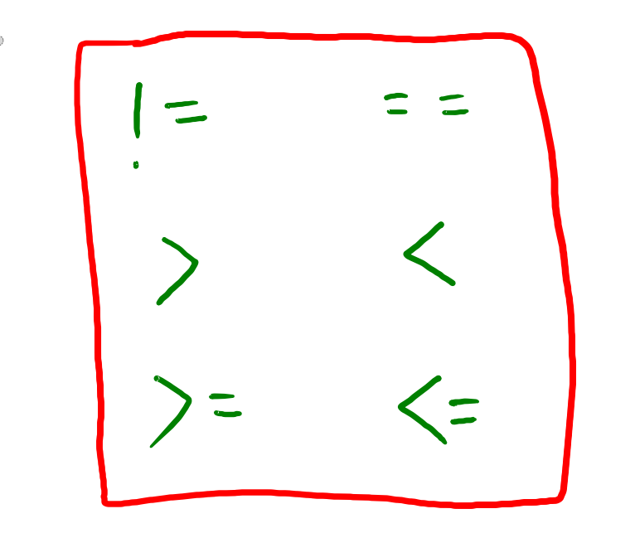
Relational

Slide 5

Logical

Slide 6
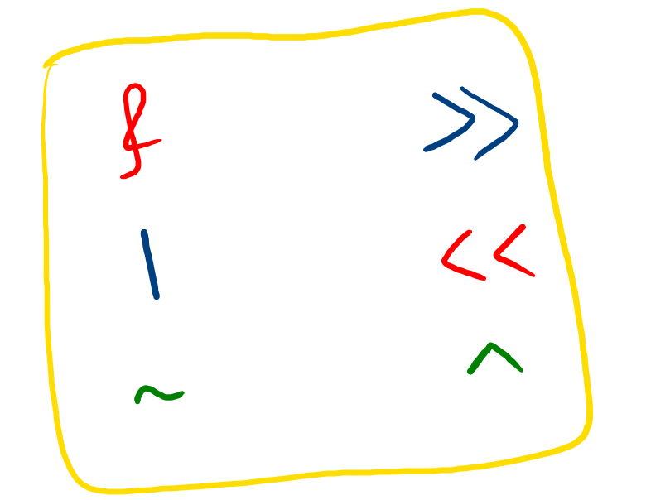
Bitwise

Slide 7
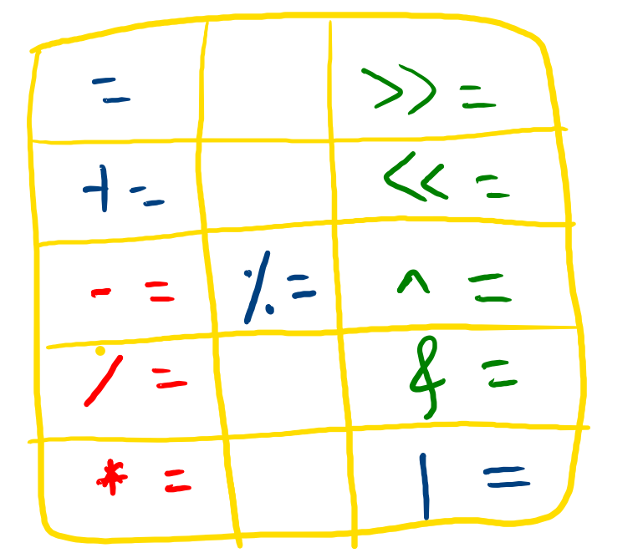
Assignment

Slide 8
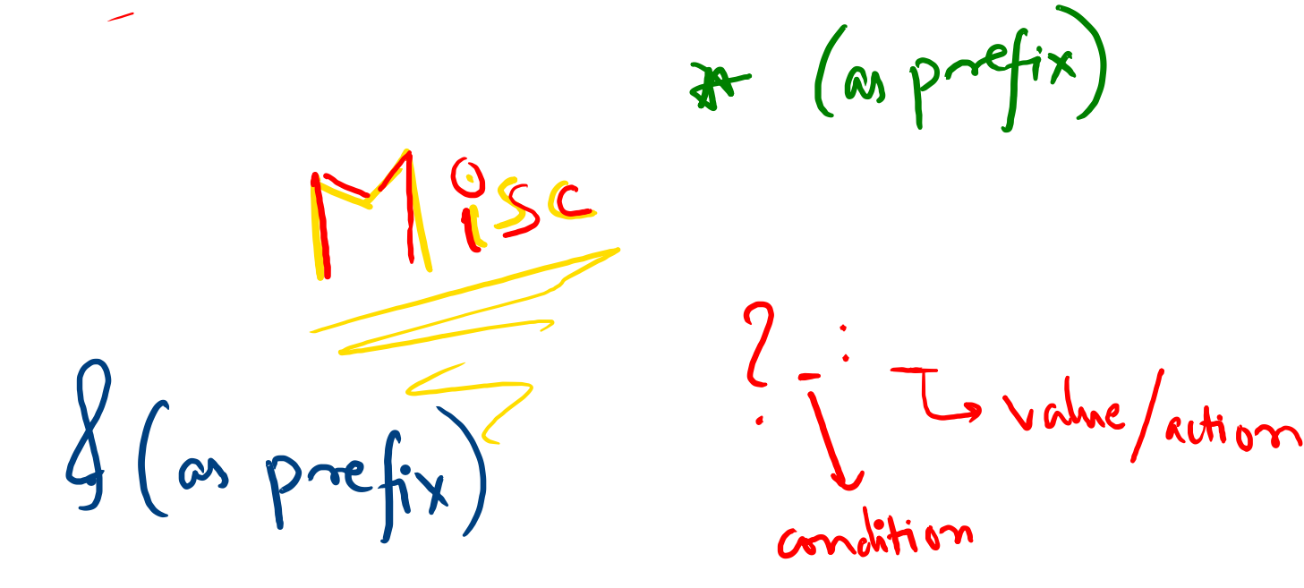

Slide 9
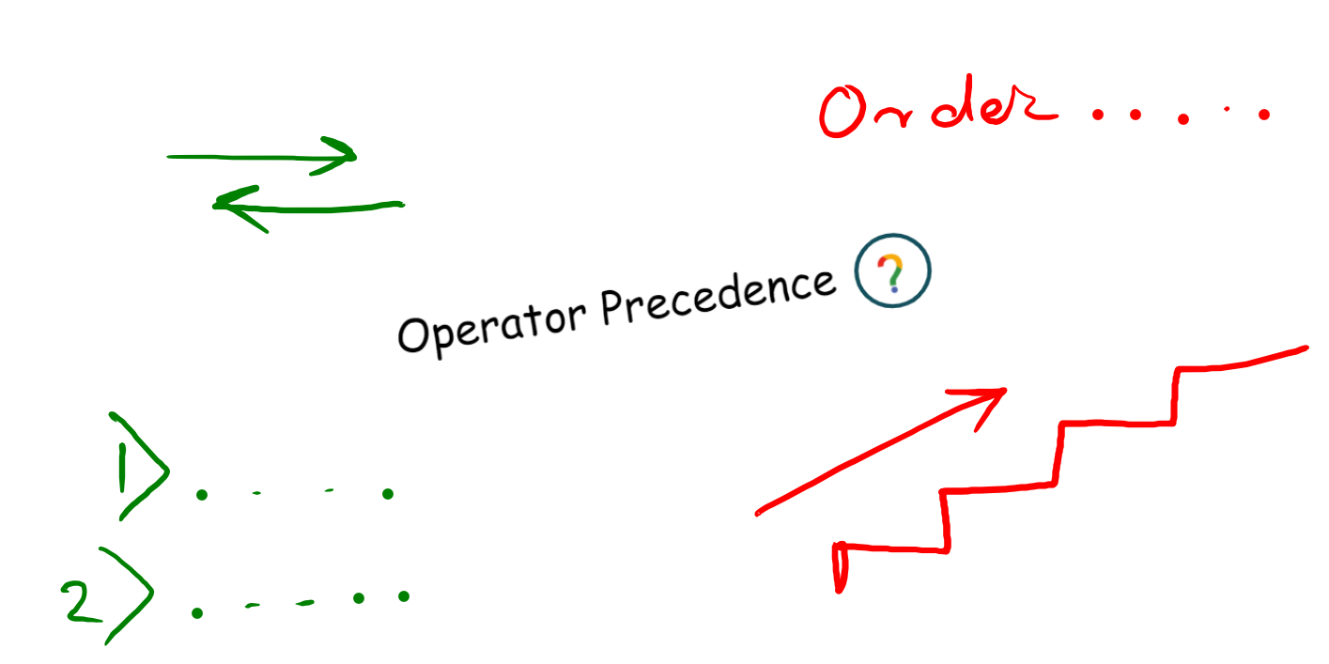

Slide 10
