Slide 1
Master
Programming in C
| Day - 9 |
presented by - Subhadip Roy

Slide 2
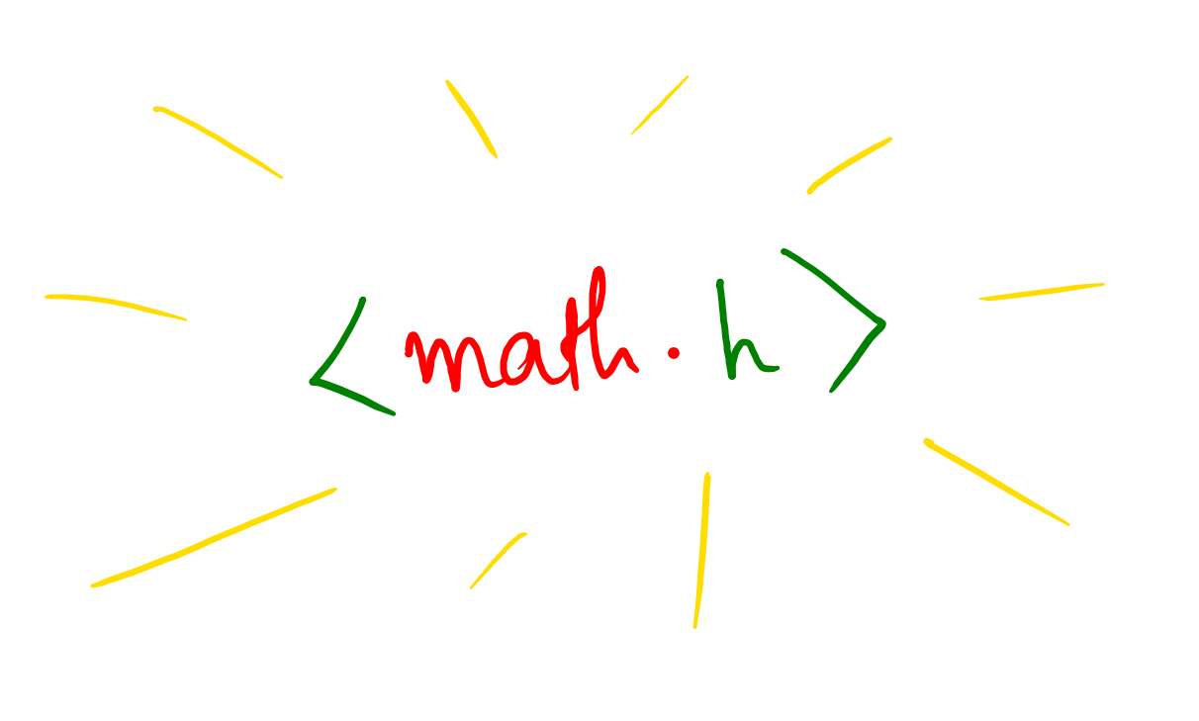

Slide 3
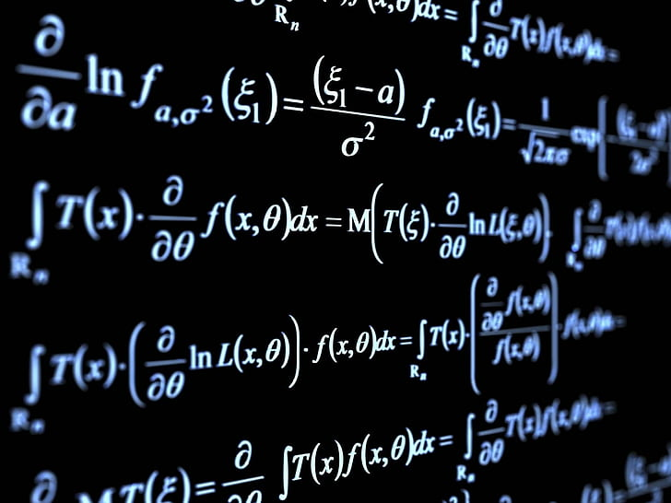
ceil()
abs()
floor()
sqrt()
pow()
exp()
fabs()
log()
sin()
tanh()
etc...

