Slide 1
Master
Programming in C
| Day - 21 |
presented by - Subhadip Roy

Slide 2
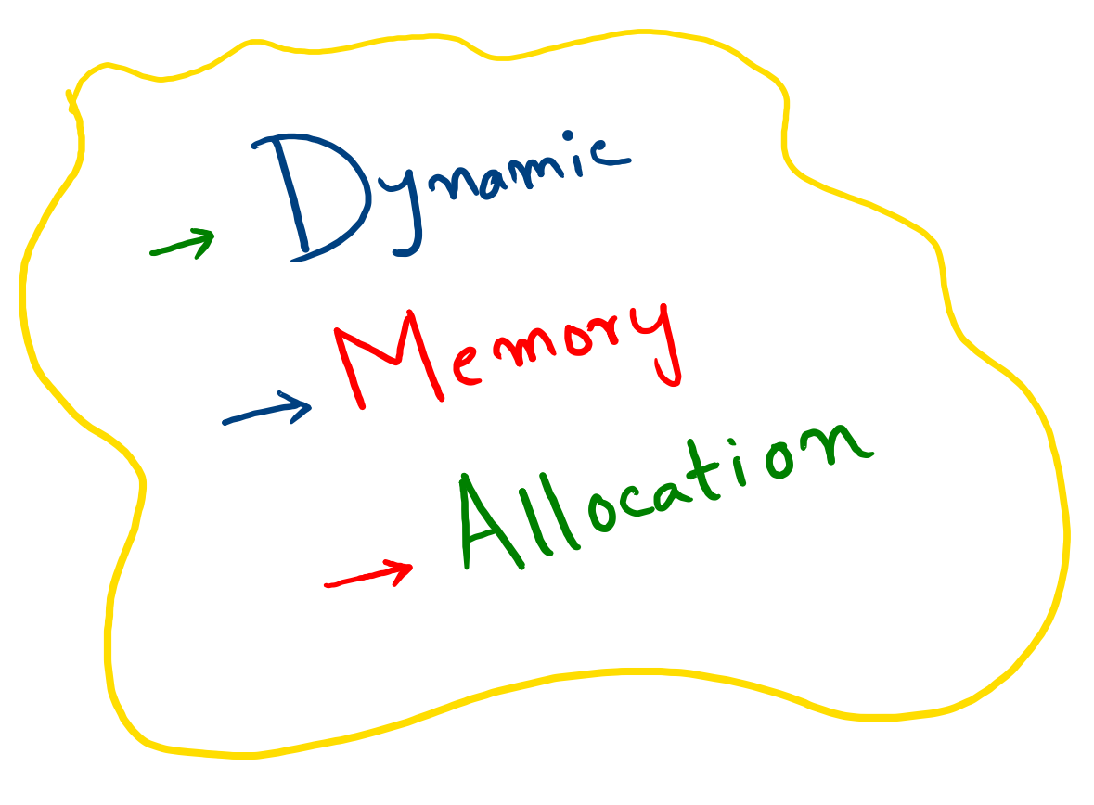

Slide 3
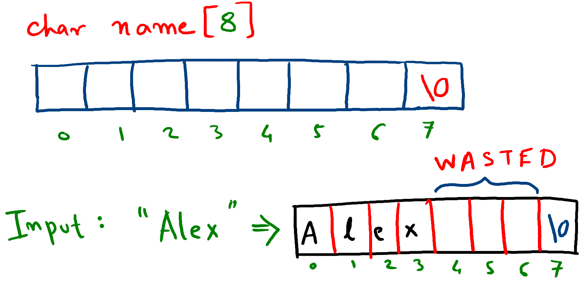

Slide 4
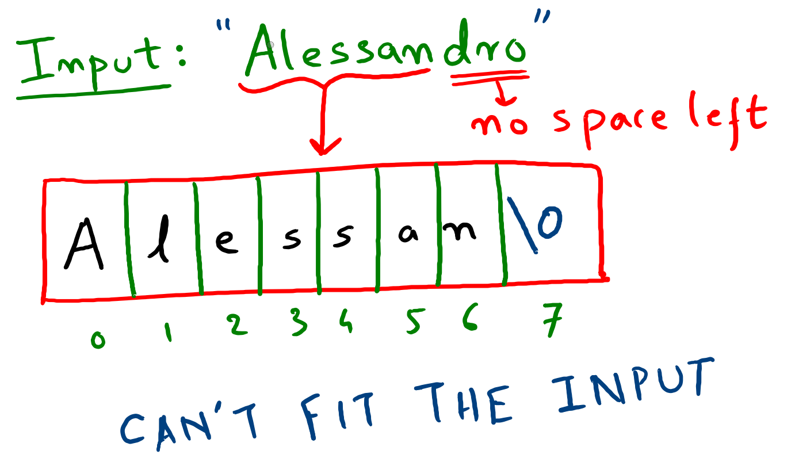

Slide 5


What’s The
Common PROBLEM

Slide 6

H W TO
Solve the Problem ?

