Slide 1
Master
Programming in C
| Day - 24 |
presented by - Subhadip Roy

Slide 2
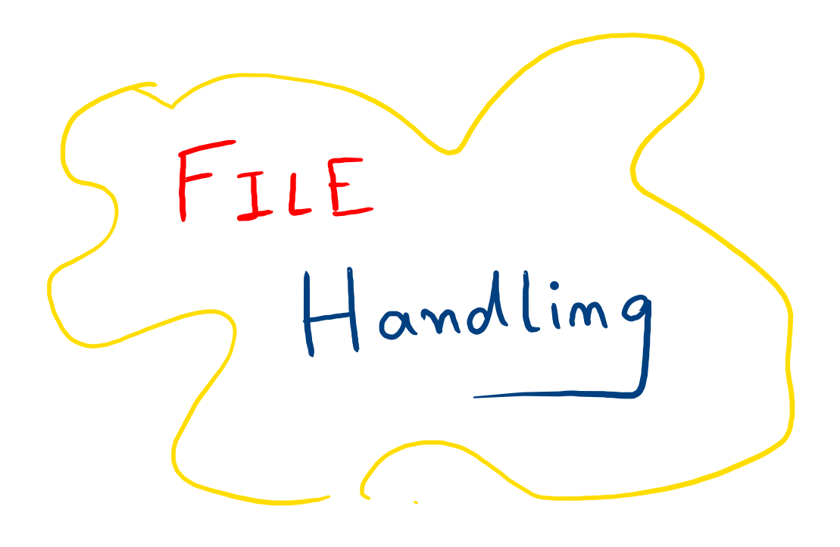

Slide 3


Need for files
When we terminate a program, its entire data is lost. To preserve that, let’s store them in a file!
Easy transfer of data from one computer to another via files without altering any of its contents.
To deal with huge data takes a lot of hustle and time. But store them in files and enjoy easy access in just a few commands!

Slide 4
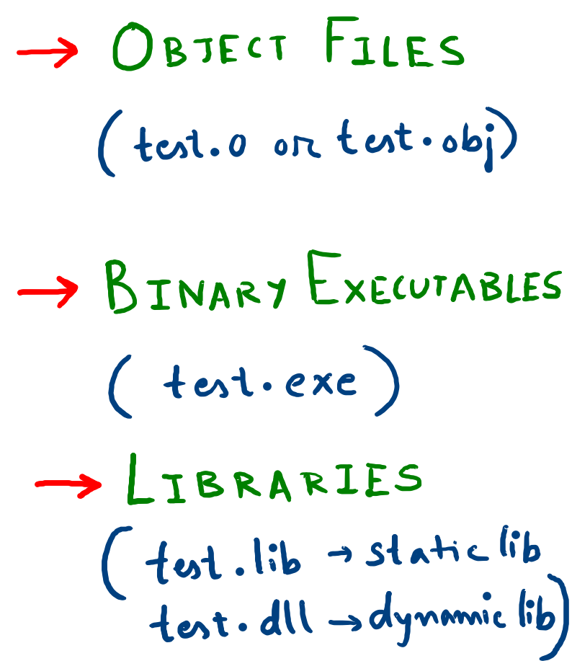
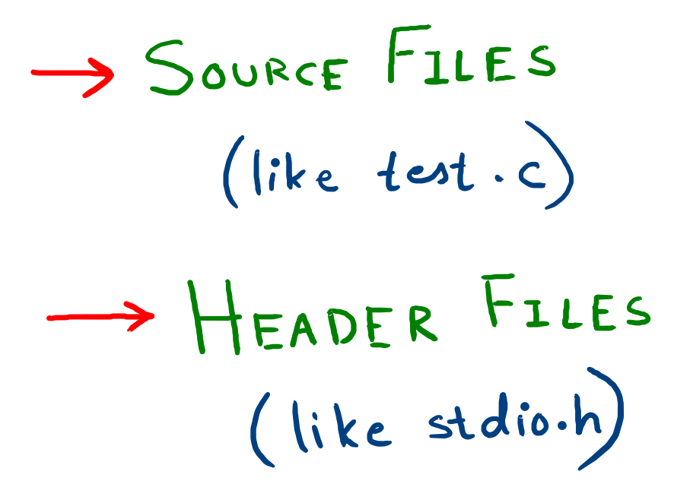
Types of Files

Slide 5
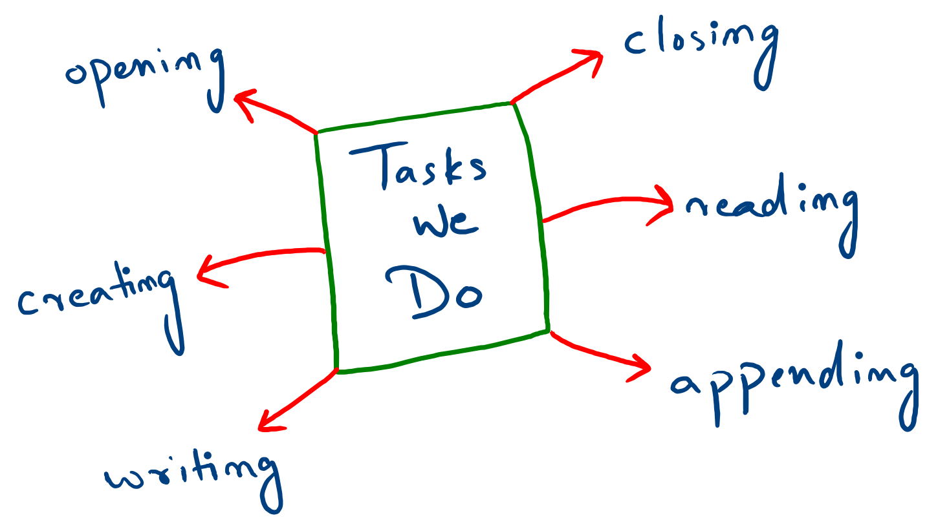

Slide 6

Thank You !

Slide 7
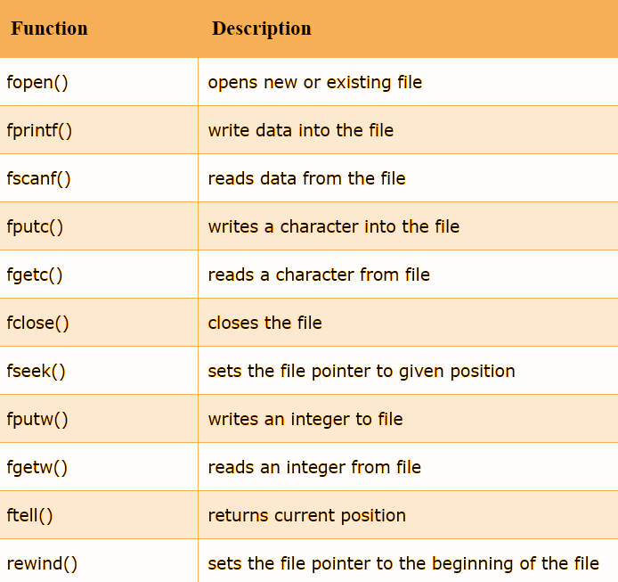

Slide 8
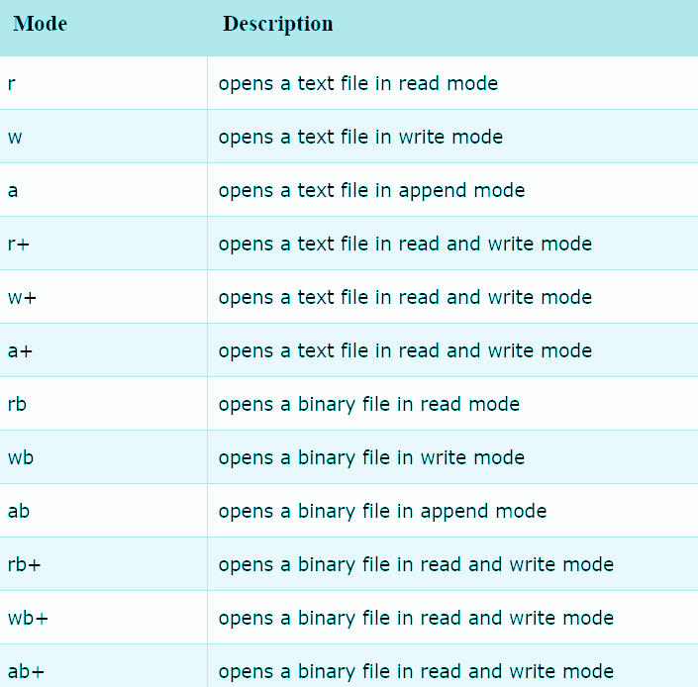

Slide 9
