Slide 1
Mutable and Immutable in Java
One object-based concept is mutable and immutable in Java.
Objects in Java are either mutable or immutable; it depends on how the object can be iterated.
What are Mutable Objects
The mutable objects are objects whose value can be changed after initialization.
We can change the object's values, such as field and states, after the object is created. For example, Java.util.Date, StringBuilder, StringBuffer, etc.
When we made a change in existing mutable objects, no new object will be created; instead, it will alter the value of the existing object.
These object's classes provide methods to make changes in it.
The Getters and Setters ( get() and set() methods ) are available in mutable objects. The Mutable object may or may not be thread-safe.
What are Immutable Objects
The immutable objects are objects whose value can not be changed after initialization. We can not change anything once the object is created. For example, primitive objects such as int, long, float, double, all legacy classes, Wrapper class, String class, etc.

Slide 2
In a nutshell, immutable means unmodified or unchangeable. Once the immutable objects are created, its object values and state can not be changed.
Only Getters ( get() method) are available not Setters ( set() method) for immutable objects.
How to Create a Mutable Class
The following two things are essential for creating a mutable class:
Methods for modifying the field values
Getters and Setters of the objects

Slide 3
Consider the below example of the mutable class: public class JtpExample { private String s; JtpExample(String s) { this.s = s; } public String getName() { return s; } public void setName(String coursename) { this.s = coursename; } public static void main(String[] args) { JtpExample obj = new JtpExample("JavaTpoint"); System.out.println(obj.getName()); // Here, we can update the name using the setName method. obj.setName("Java Training"); System.out.println(obj.getName()); } }
JavaTpoint Java Training

Slide 4
How to Create an Immutable Class
The following things are essential for creating an immutable class:
Final class, which is declared as final so that it can't be extended.
All fields should be private so that direct access to the fields is blocked.
No Setters
All mutable fields should be as final so that they can not be iterated once initialized.
public class JtpExample1 {
private final String s;
JtpExample1(final String s) {
this.s = s;
}
public final String getName() {
return s;
}
public static void main(String[] args) {
JtpExample obj = new JtpExample("Core Java Training");
System.out.println(obj.getName());
}
}

Slide 5
Mutable | Immutable
We can change the value of mutable objects after initialization. | Once an immutable object is initiated; We can not change its values.
The state can be changed. | The state can not be changed.
In mutable objects, no new objects are formed. | In immutable objects, a new object is formed when the value of the object is altered.
It provides methods to change the object. | It does not provide any method to change the object value.
It supports get() and set() methods to dela with the object. | It only supports get() method to pass the value of the object.
Mutable classes are may or may not be thread-safe. | Immutable classes are thread-safe.
The essentials for creating a mutable class are methods for modifying fields, getters and setters. | The essentials for creating an immutable class are final class, private fields, final mutable objects.

Slide 6
Why are Strings in Java Immutable
String in Java is a very special class, as it is used almost in every Java program. That's why it is Immutable to enhance performance and security. Let's understand it in detail:
In Java, strings use the concept of literals. Suppose we have an object having many reference variables. In such a scenario, if we will change the value of a reference variable, it will affect the entire object and all of its values.
Apart from the above reasons, the following reasons are also responsible for making the String immutable:
Immutable objects are very simple; there is no need for synchronization and are inherently thread-safe. But, Immutable objects make good building blocks for other objects, so we have to provide them special care.
Most Developers make the String the final object so that it can not be altered later.

Slide 7
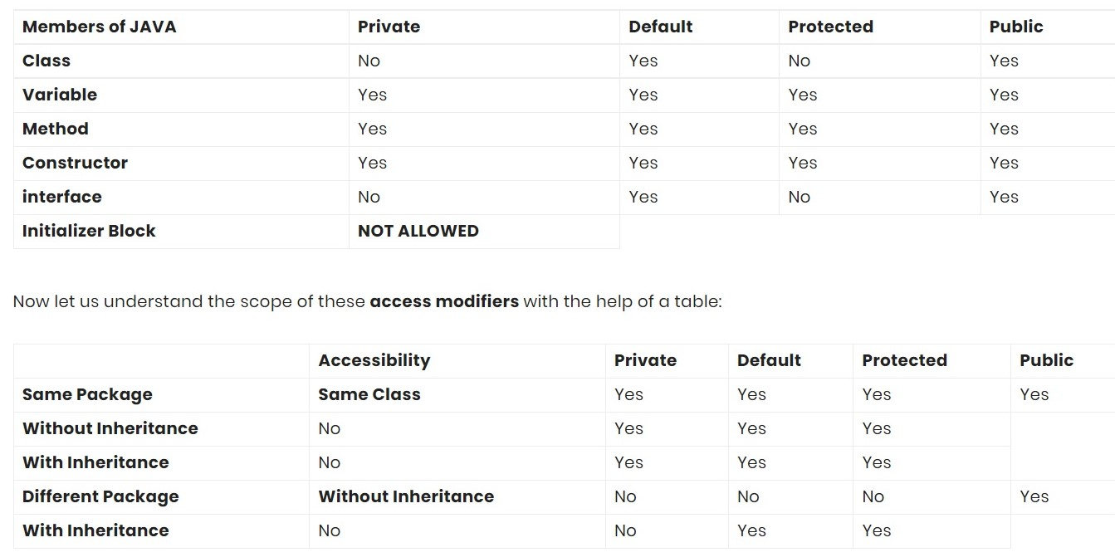
https://www.w3schools.com/JAVA/java_modifiers.asp

