Slide 1
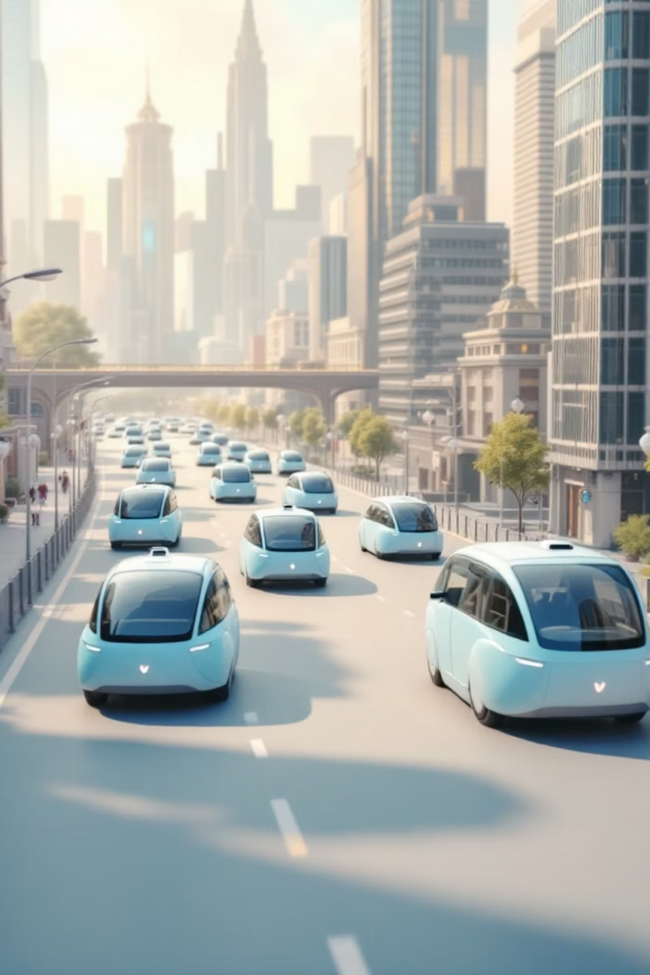

NeuroFleetX
AI-Driven Urban Mobility Optimization System
Transforming urban transport through intelligent fleet management, predictive analytics, and real-time optimisation for sustainable, efficient mobility solutions.
Notes:
1

Slide 2



Problem Statement
Urban Mobility Challenges
Modern cities face unprecedented transport demands with increasing congestion, inefficient fleet utilisation, and environmental concerns requiring immediate attention.
Traffic Inefficiency
Reactive Maintenance
Poor route planning increases journey times by 30-40%
Unexpected breakdowns cause service disruptions
Traditional fleet management systems lack predictive capabilities, resulting in reactive maintenance, suboptimal routing, and poor resource allocation that impacts operational efficiency.
Asset Underutilisation
Vehicles remain idle whilst demand goes unmet
Notes:
2

Slide 3

The NeuroFleetX Solution
NeuroFleetX is a next-generation AI-driven platform that revolutionises urban mobility through intelligent automation. By leveraging artificial intelligence, IoT connectivity, and geospatial analytics, the system delivers real-time vehicle tracking, intelligent routing, predictive maintenance, and dynamic fleet allocation.
99.8%
40%
25%
System Uptime
Cost Reduction
Efficiency Gain
Reliable platform availability
In operational expenses
In fleet utilisation rates
Notes:
3

Slide 4
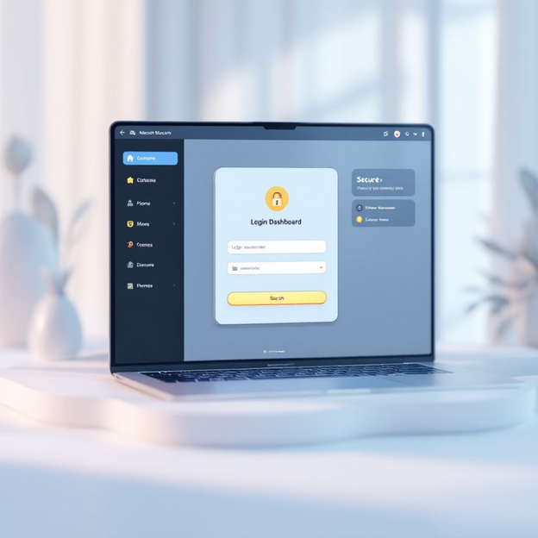
Module 1: Authentication & Role Management
Secure Multi-Role Access Control
Robust authentication system supporting four distinct user roles: Admin, Fleet Manager, Driver, and Customer. Each role receives tailored dashboard access with appropriate permissions and functionality.
01
Design Interfaces
Create intuitive login and registration screens with role selection
02
Implement Security
Deploy Spring Security with JWT-based authentication tokens
03
Build Dashboards
Expected Output
Develop role-specific interfaces with relevant metrics and controls
Clean login screen with role selector dropdown
Dashboard tiles displaying key metrics
Secure session management
Notes:
4

Slide 5




Module 2: Fleet Inventory & Vehicle Telemetry
Comprehensive vehicle management system providing real-time status monitoring, location tracking, and telemetry data simulation. Track every vehicle's operational state, battery levels, fuel consumption, and maintenance requirements.
CRUD Operations
Real-Time Status
Telemetry Simulation
Complete vehicle management: add, update, remove, and configure fleet assets with detailed specifications and capabilities.
Monitor vehicle availability: idle, in use, or requiring maintenance with instant status updates and automated alerts.
Track speed, battery charge, fuel levels, GPS location, and engine diagnostics through IoT sensor integration.
Location Tracking
Status Chips
Battery/Fuel Icons
GPS coordinates with accuracy indicators
Available, In Use, or Needs Service states
Visual percentage bars and alerts
Notes:
5

Slide 6




Module 3: AI Route & Load Optimisation
Intelligent Journey Planning
Advanced AI-powered routing engine that dynamically suggests optimal paths considering real-time traffic conditions, energy consumption, and journey time. The system balances multiple variables to recommend the most efficient route.
Map Integration
Google Maps API or OpenStreetMap connectivity for accurate geospatial data
AI Algorithm
Machine learning-based ETA prediction with traffic pattern analysis
Route Visualisation
Interactive polyline routes with colour-coded traffic zones and waypoints
Notes:
6

Slide 7



Module 4: Predictive Maintenance & Health Analytics
85%
60%
95%
Reduction in unexpected breakdowns through predictive alerts
Decrease in maintenance costs via optimised scheduling
Fleet health monitoring accuracy with AI-driven diagnostics
Proactive vehicle health monitoring system that tracks engine performance, tyre condition, fuel efficiency, battery health, and mileage. Advanced algorithms predict maintenance requirements and alert fleet managers before issues become critical, minimising downtime and extending vehicle lifespan.
1
2
3
Simulate Parameters
Configure Thresholds
Visualise Analytics
Generate realistic vehicle health data across multiple systems
Set intelligent warning triggers based on operational patterns
Create comprehensive dashboards with trend analysis and alerts
Notes:
7

Slide 8




Module 5: Customer Booking & Smart Recommendations
Search & Filter
AI Recommendations
Select vehicle type, location, and time with advanced filters.
Machine learning suggests best-fit vehicles based on past behaviour.
Calendar Integration
Interactive calendar shows real-time availability and dynamic pricing.
Notes:
8

Slide 9


Module 6: Admin Dashboard & Urban Mobility Insights
Comprehensive administrative control centre providing real-time fleet visibility, urban mobility analytics, and actionable insights. Interactive heatmaps reveal trip density patterns whilst customisable reports enable data-driven decision-making for strategic planning.
KPI Monitoring
Heatmap Visualisation
Activity Analytics
Total fleet, daily trips, and active routes tracked in real-time
Geographic distribution overlaid on city layouts with density indicators
Bar charts showing hourly rental patterns and usage trends
Exportable Reports
Chart.js Integration
CSV and PDF formats for compliance and analysis
Dynamic visualisations with ApexCharts and Recharts
Notes:
9

Slide 10

Technology Stack
Frontend Layer
Mapping Services
React for responsive, modern user interfaces with component-based architecture
Google Maps API and Leaflet.js for geospatial visualisation and routing
Backend Services
Security Layer
Java Spring Boot providing robust REST APIs with scalable microservices architecture
Spring Security with JWT tokens ensuring encrypted, role-based access control
Database Layer
Data Visualisation
MySQL for reliable relational data storage with optimised query performance
Chart.js, ApexCharts, Recharts for interactive analytics and reporting dashboards
AI & ML Engine
Additional APIs
Python Flask microservice or Java ML for intelligent predictions and analytics
SMTP for email notifications and WebSocket for real-time live updates
Notes:
10

Slide 11
Team Members ( Role ) :
Subhadhip - Frontend & AI & Some backend module ( 4 , 5 , 6)
Inban - Email-SMTP for Registration and Reset Password & Dashboard
Hepsiba - Backend module (1 , 2 , 3)
UdayKumar - Login & Payment Gateway

Slide 12

Thank You
Notes:
11

