Slide 1
T3.4: Automatic generation of AI solutions
1st GA
TU/e
AutoML Framework

Slide 2
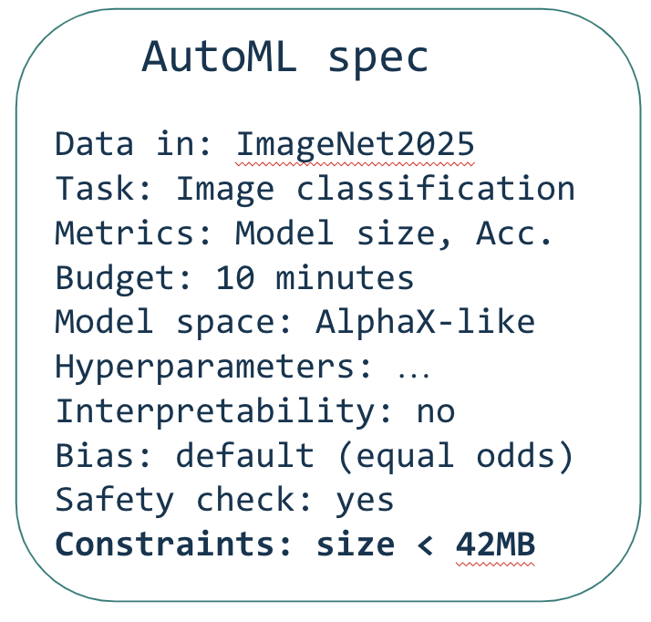


Overview
I need more information
Designer User
Chat
compute
AutoML Engine
Data store
Model store
Best model
Processed files
What next?
Key

Slide 3
AutoML Engine - Working Parts
Input types
“Give me a model for X with Y data”
“Here is file/code X, I want it to do Y”

Slide 4
Note on generated models
We do not always want to train a model from scratch
We will not use an LLM to generate a model
We do not always want to generate a model in the first place

Slide 5
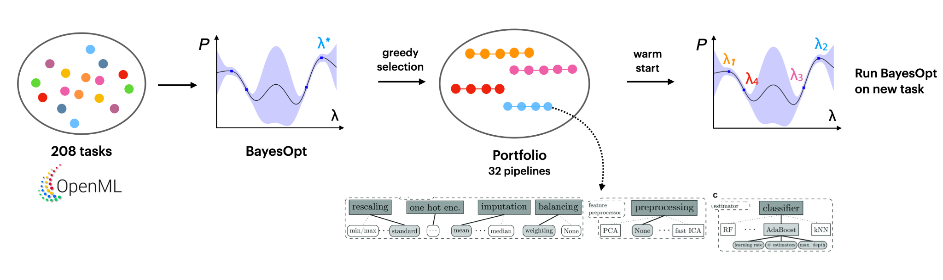
“Give me a model for X with Y data” (Part 1/4)
Use AutoML -> best pipelines/models on all our datasets beforehand (priority)
Create a portfolio of best pipelines/models per task
When the user/LLM requests a model, find the best models within the portfolio and finetune them to the new task
If new task -> Find the most relevant pipeline

Slide 6
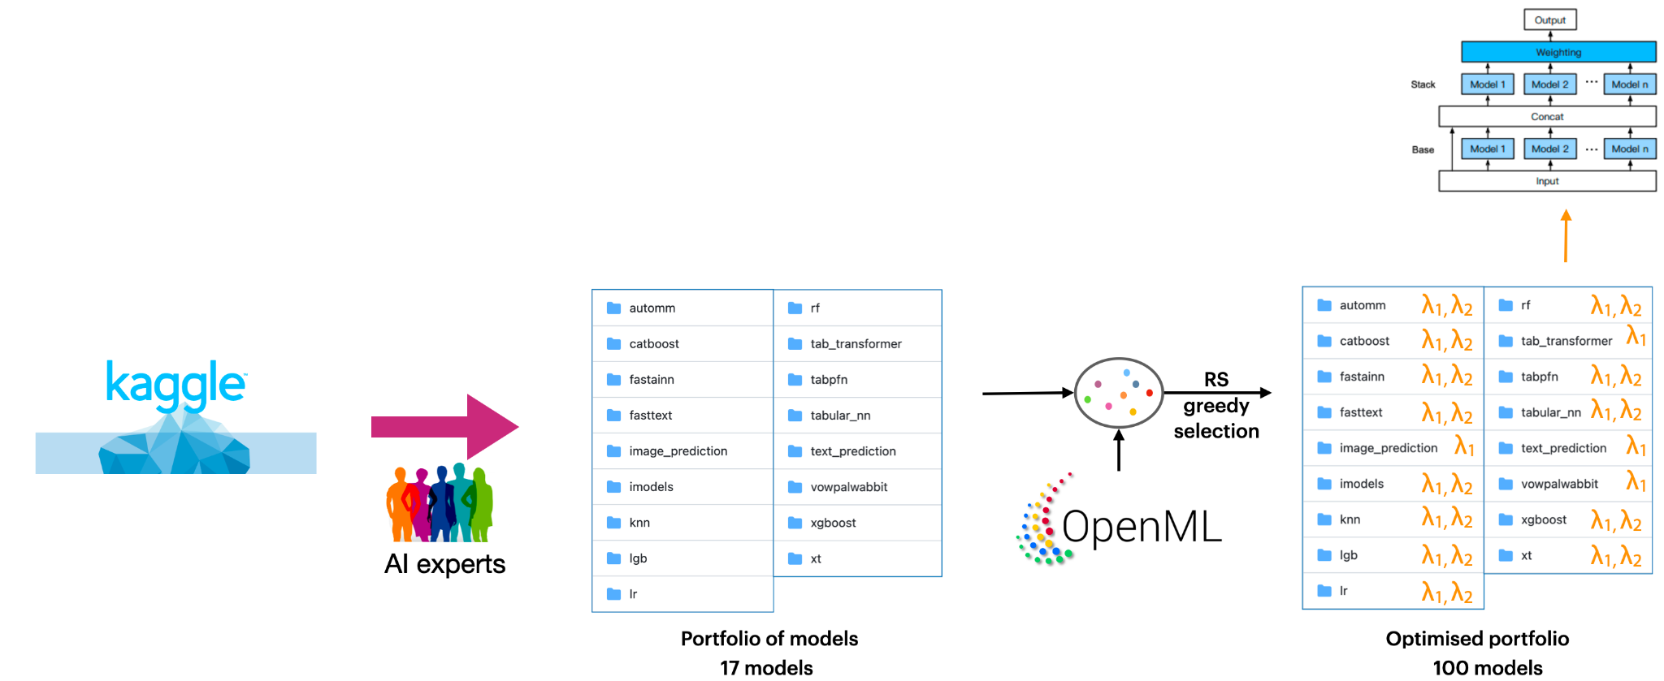
“Give me a model for X with Y data” (Part 2/4)
AutoGluon approach: source the best models from many different problems, tune them beforehand on all datasets we have
Given a new dataset, tune the best models and build ensembles
Proven to yield good models in very little time

Slide 7
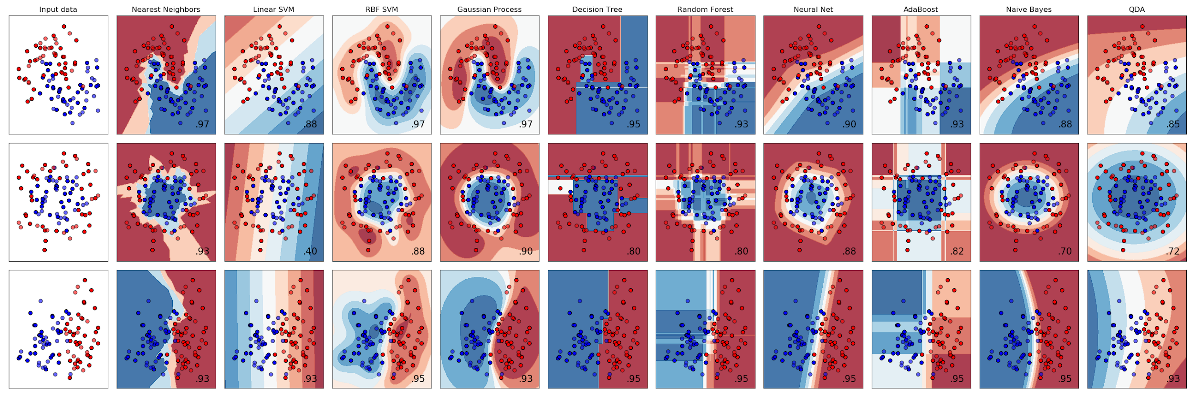
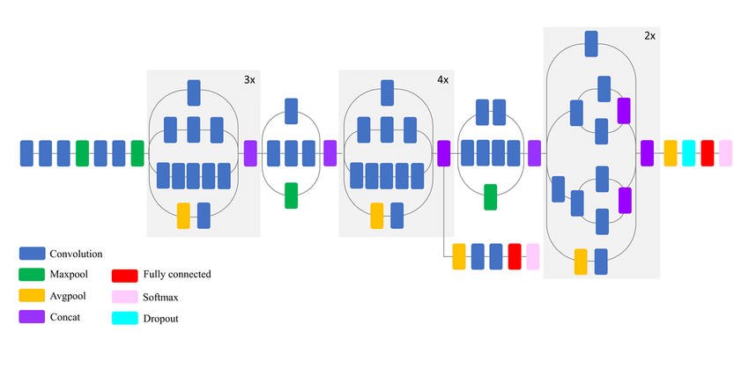
“Give me a model for X with Y data” (Part 3/4)
Design a new architecture based on the task (Future)
Template Model selection
cleaning,
preprocessing,
featurization,
selection,…
Neural architecture design
Data
pretrain
Transfer / continual learning
Small data, few-shot learning

Slide 8
“Give me a model for X with Y data” (Part 4/4)
Search space
Warm Start
Training with constraints
Best model
Transfer Learning
Architecture search space: represent relevant models
Meta-learning, transfer learning: transfer experience from previous tasks
Warm start: start from promising architectures/configurations/initializations

Slide 9
“Here is file/code X, I want it to do Y”
File : X
Type : Excel sheet
Required : Add a column to compute a magic formula
Query + Files
Requirements analysis
Formatted requirements
Processed files
Designer User
I need more information

Slide 10
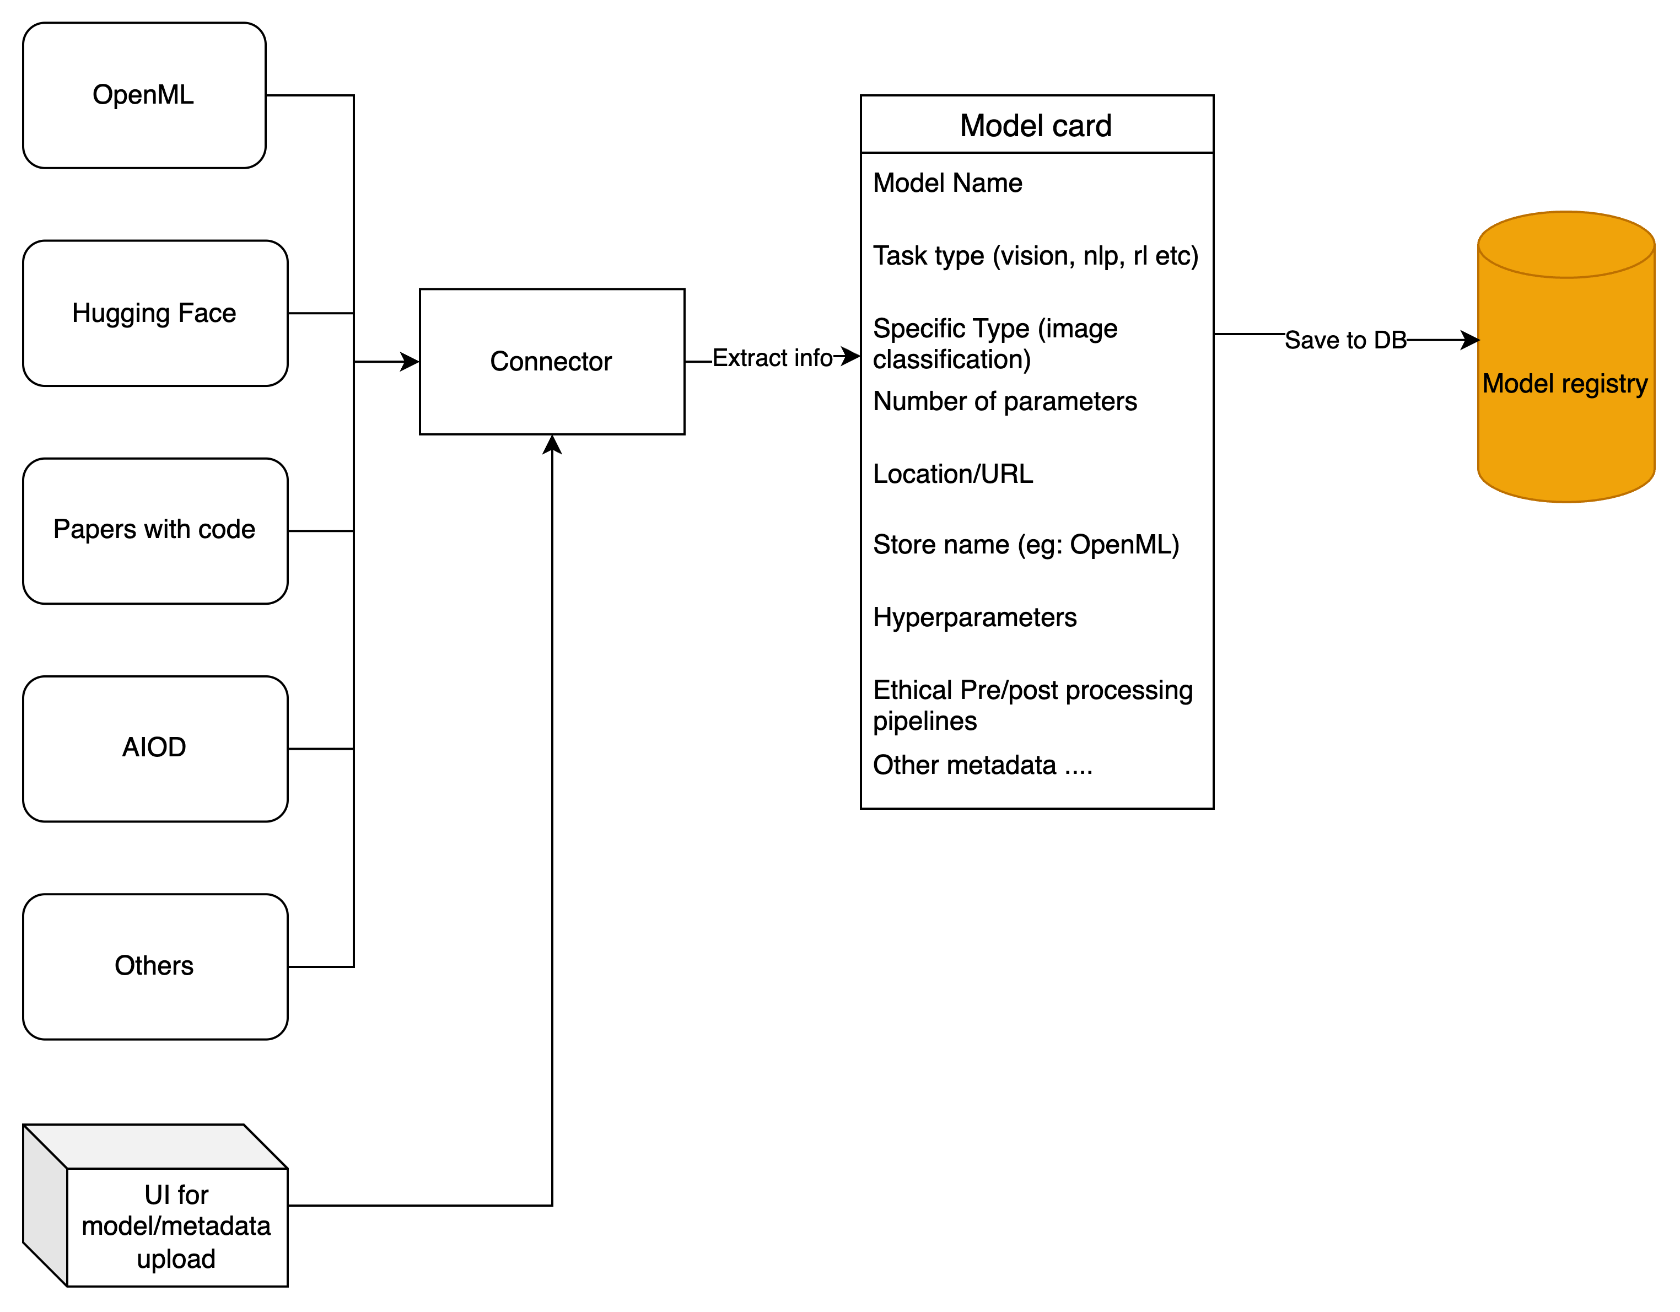
Model Card : Combining information from multiple sources
Similarly for datasets…

Slide 11
Benchmarking (Part 1/2)
Model registry
Metrics
Some task
Best model
Runs linked to task, dataset
Designer User

Slide 12
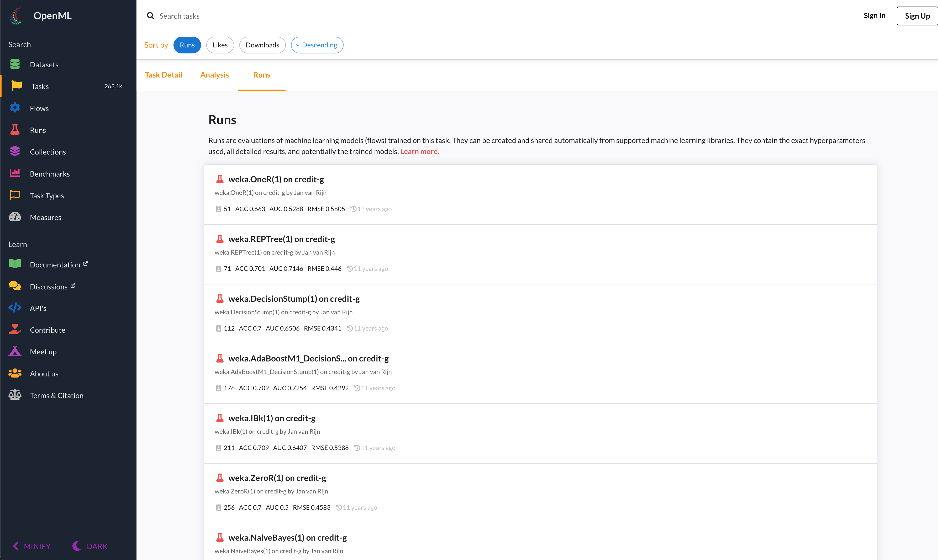
Benchmarking (Part 2/2)

Slide 13
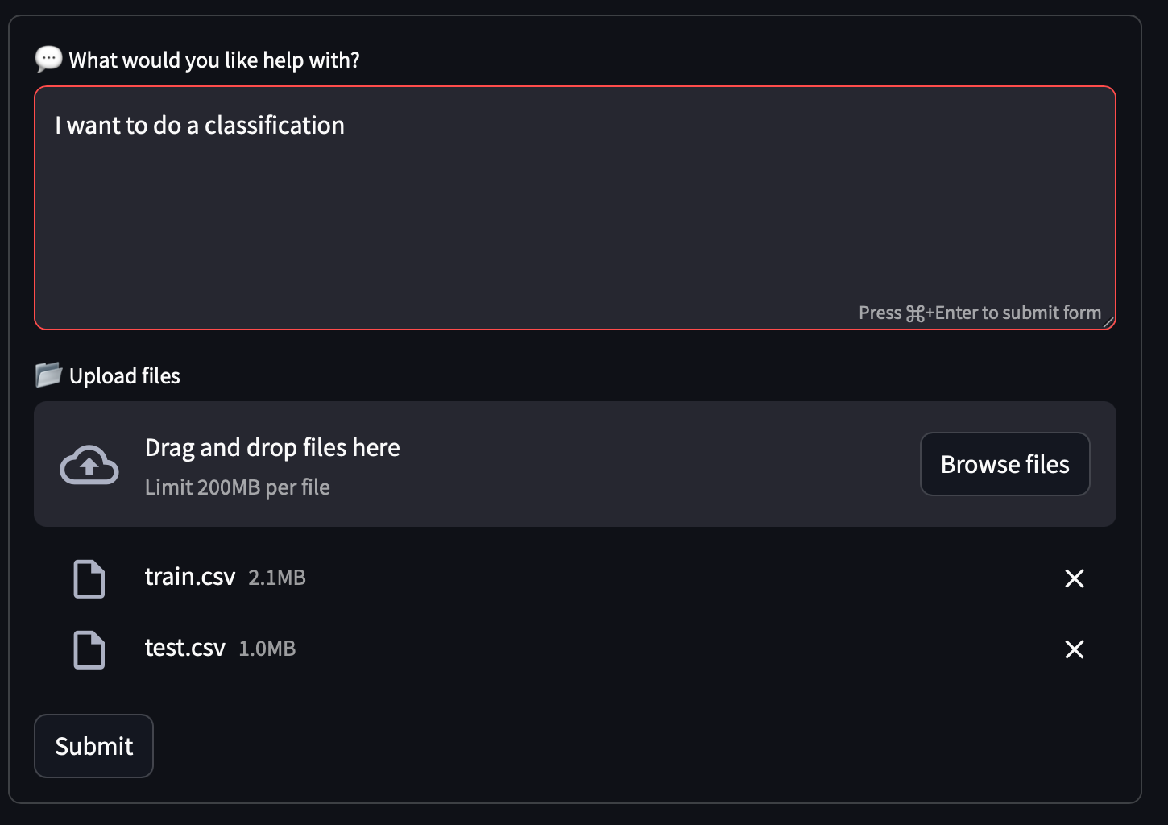
Initial Steps (Part 1/2)
Task type : TabularSupervisedClassificationTask
Do we need to train: Yes
Train file : train.csv
Test file : test.csv
Target column : ?
Extract
Missing information Chat

Slide 14
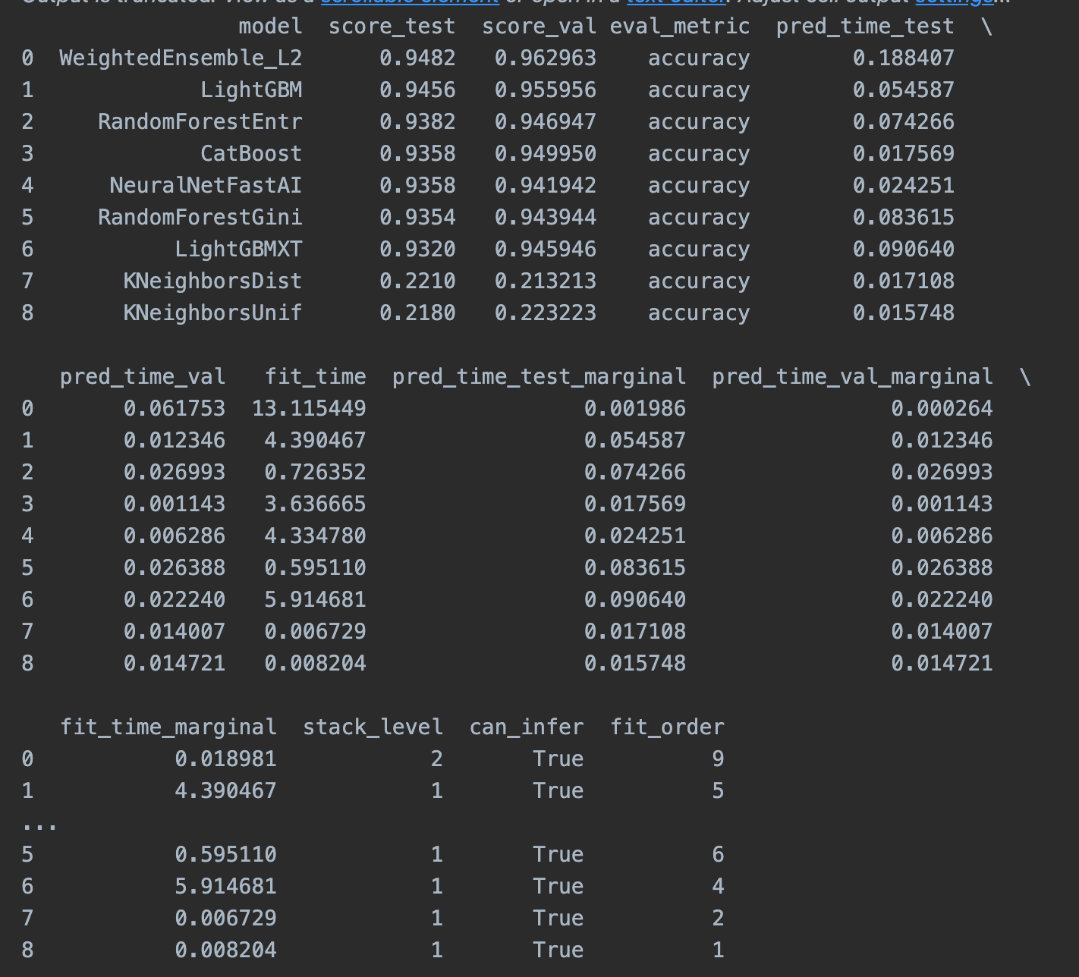
Initial Steps (Part 2/2)

Slide 15

Questions?

