Slide 1
T4.2 : User-centric platform design of system architecture and orchestration layer
1st GA
TU/e
AutoML Framework

Slide 2
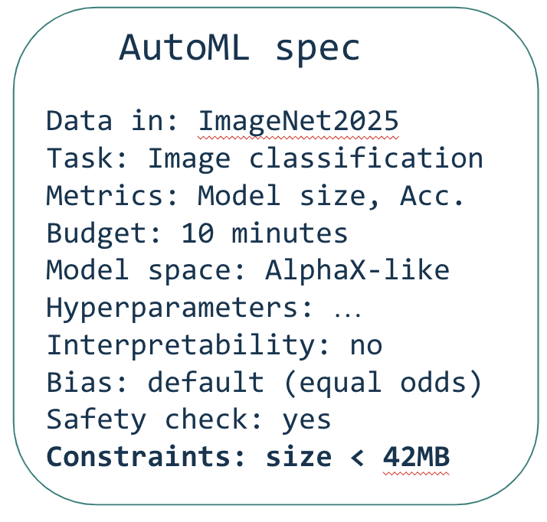


Overview (Part 1/2)
I need more information
Designer User
Chat
compute
AutoML Engine
Data store
Model store
Best model
Processed files
What next?
Key

Slide 3
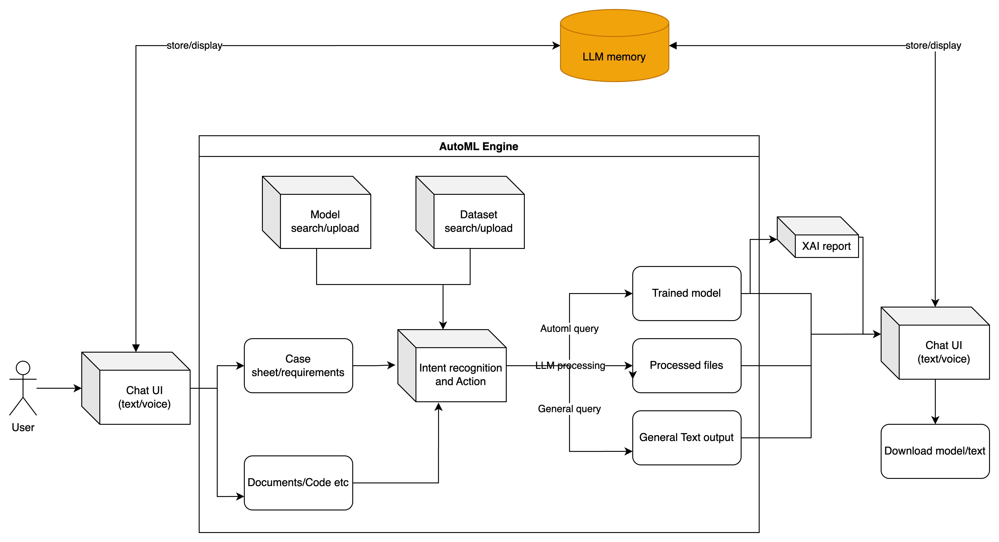
Overview (Part 2/2)

Slide 4

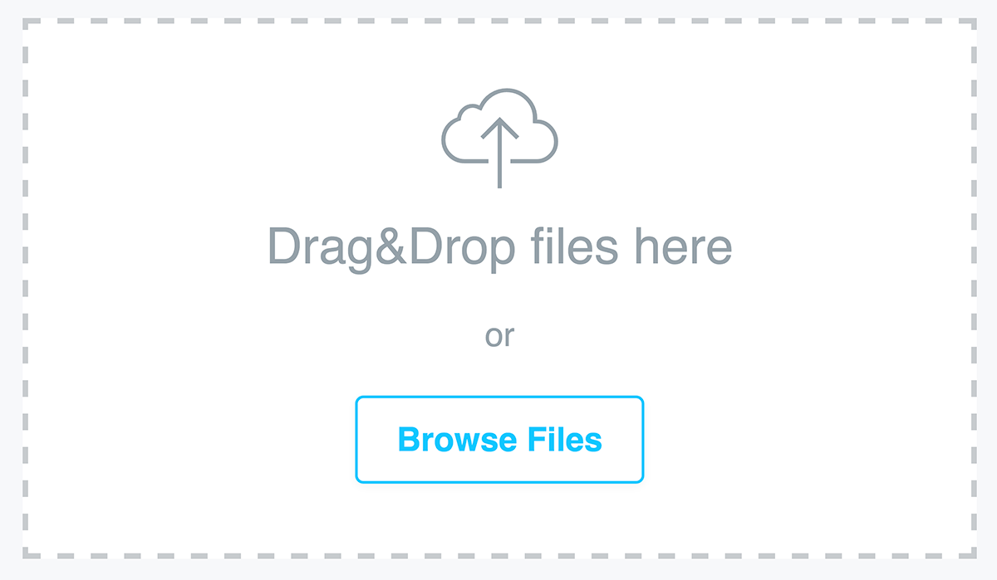
I/O
We want to make ALFIE usable to everyone
Chosen Language
Designer User
Chat

Slide 5
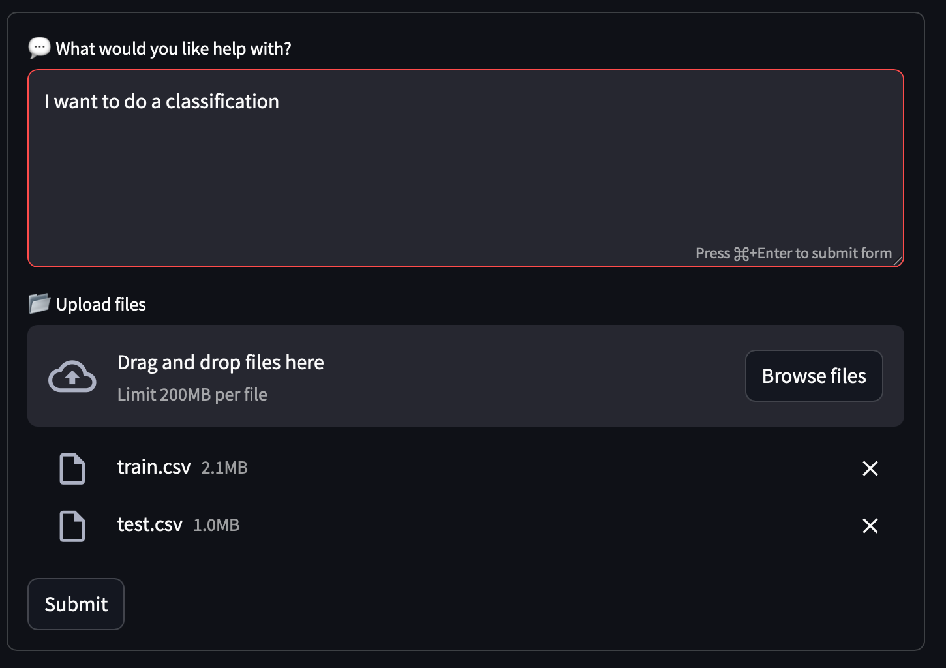
Intent Recognition (Part 1/2)
Task type : TabularSupervisedClassificationTask
Do we need to train: Yes
Train file : train.csv
Test file : test.csv
Target column : ?
Extract
Missing information chat

Slide 6
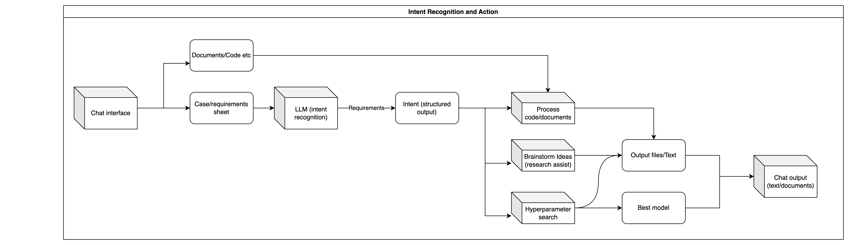
Intent Recognition Flow (Part 2/2)

Slide 7
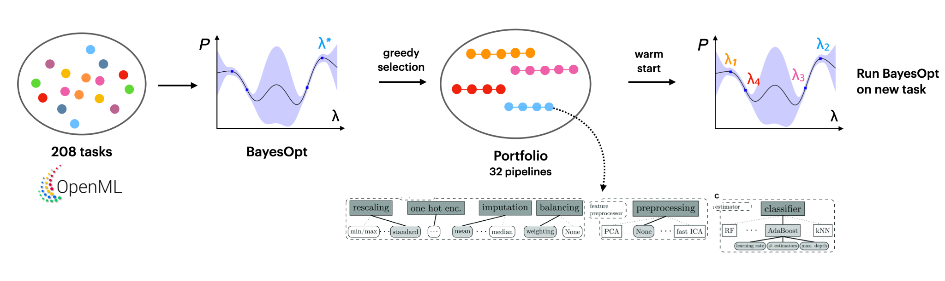
AutoML
Use AutoML -> best pipelines/models on all our datasets beforehand
Create a portfolio of best pipelines/models per task
When the user/LLM requests a model, find the best models within the portfolio and finetune them to the new task
If new task -> Find the most relevant pipeline

Slide 8
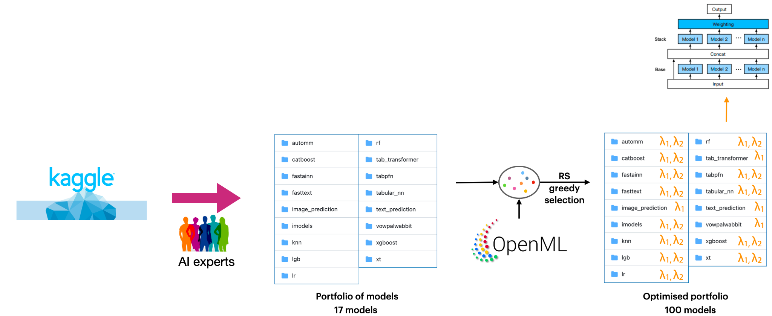
AutoGluon for Tabular data
AutoGluon approach: source the best models from many different problems, tune them beforehand on all datasets we have
Given a new dataset, tune the best models and build ensembles
Proven to yield good models in very little time

Slide 9
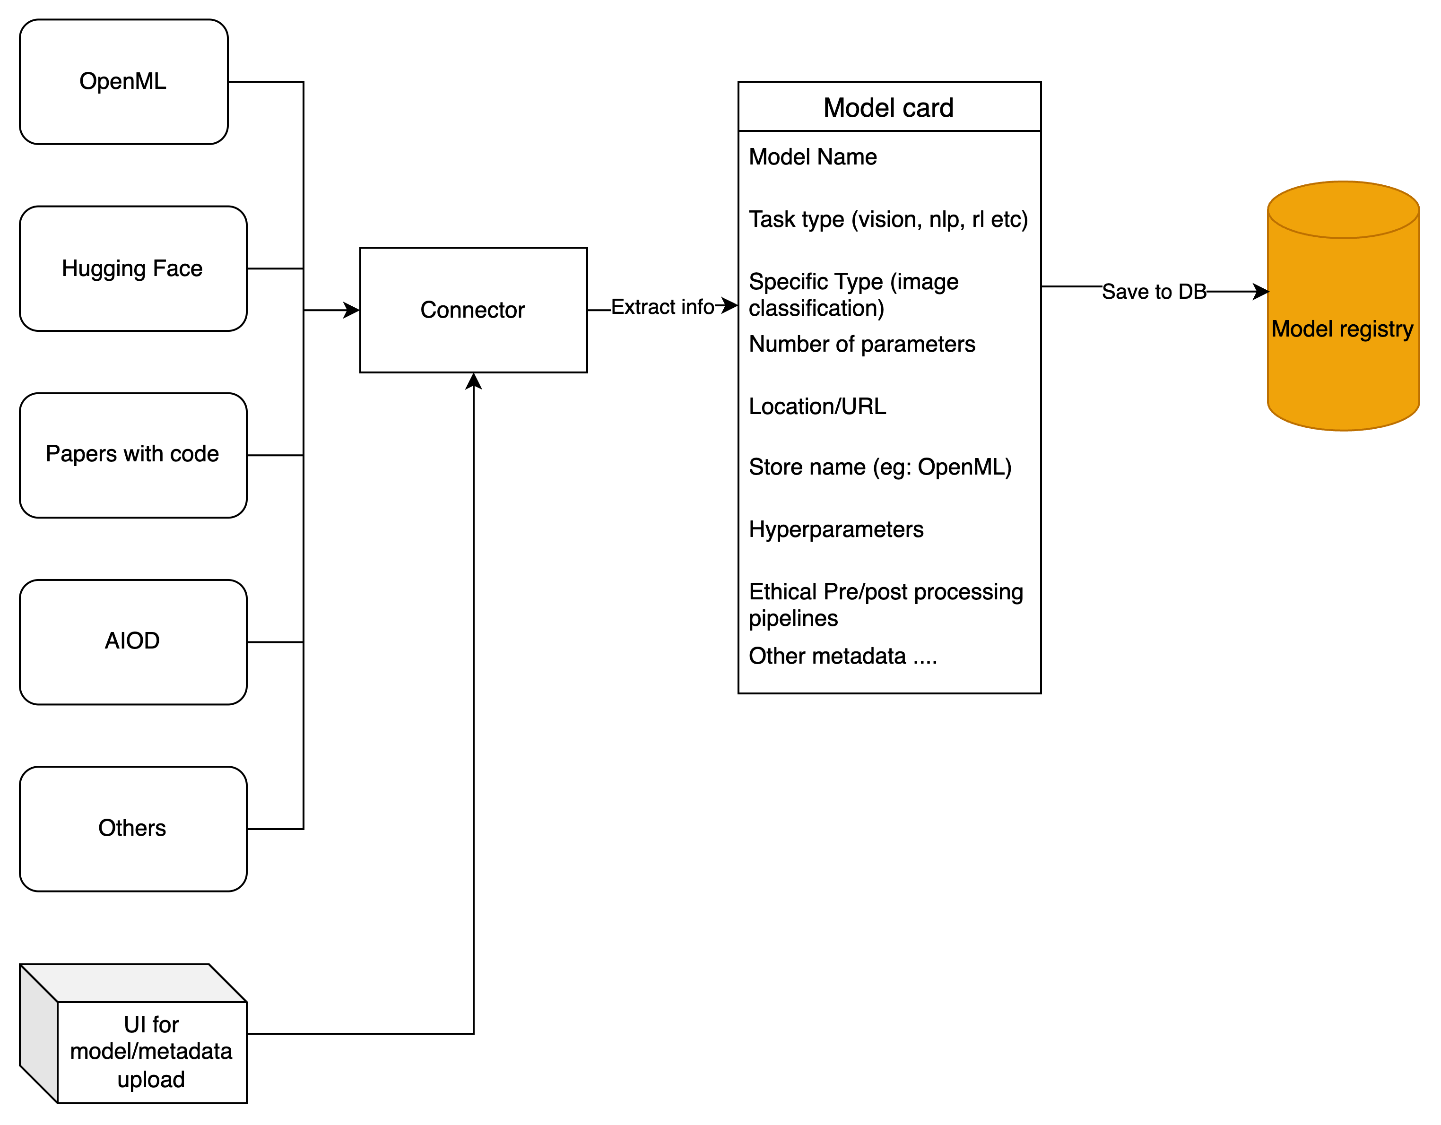
Model Store

Slide 10
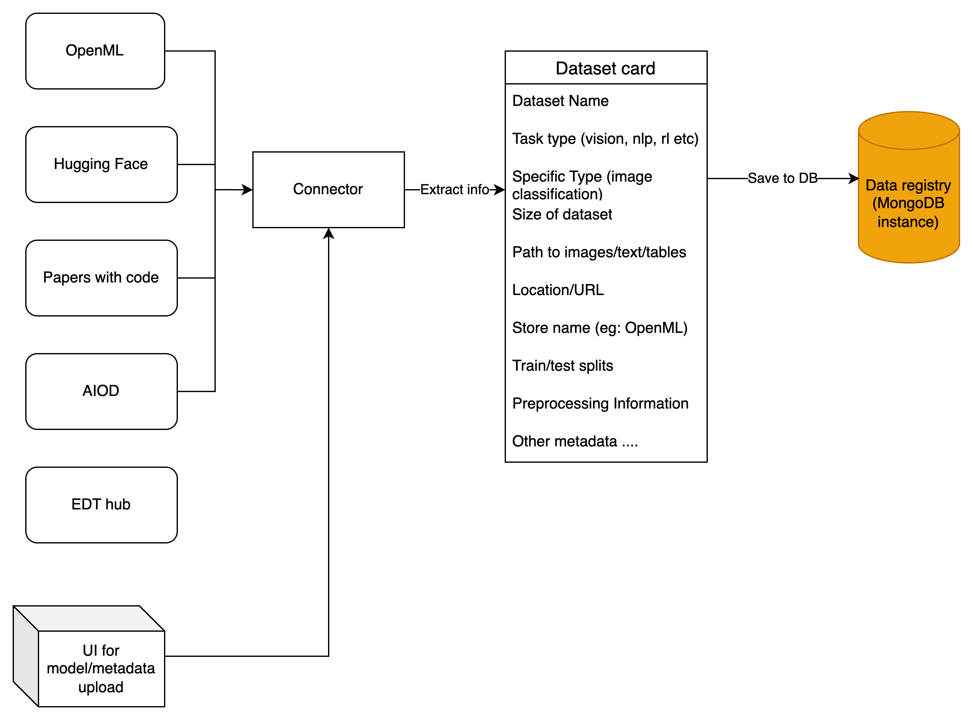
Datasets Store

Slide 11
Runs
Model ID
Model registry
Runs
Runs DB
Dataset registry
Dataset ID

Slide 12

Questions?

