Slide 1
The AutoML Platform
Workshop
1st GA
TU/e
AutoML Framework

Slide 2
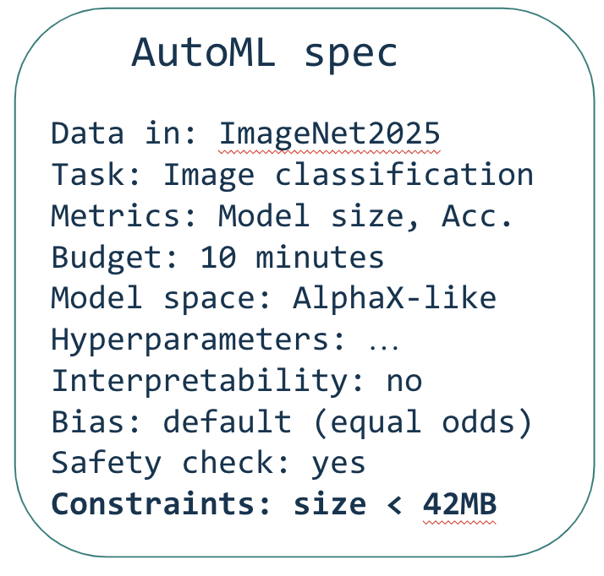


Overview
I need more information
Designer User
Chat
compute
AutoML Engine
Data store
Model store
Best model
Processed files
What next?
Key

Slide 3
AutoML Engine - Working Parts
Input types
“Give me a model for X with Y data”
“Here is file/code X, I want it to do Y”

Slide 4

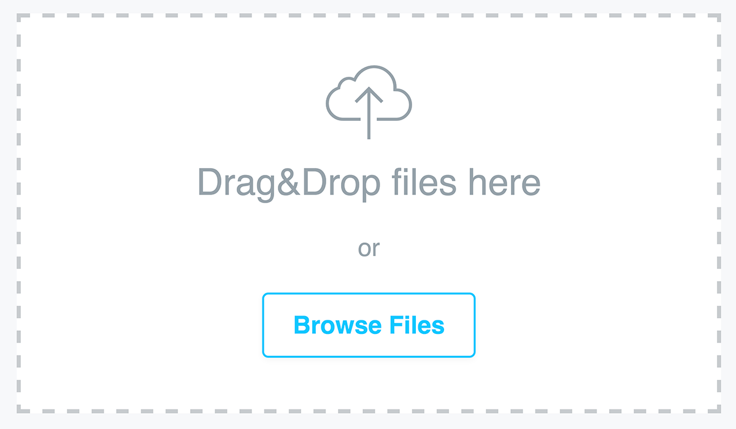
I/O
We want to make ALFIE usable to everyone
Chosen Language
Designer User
Chat

Slide 5
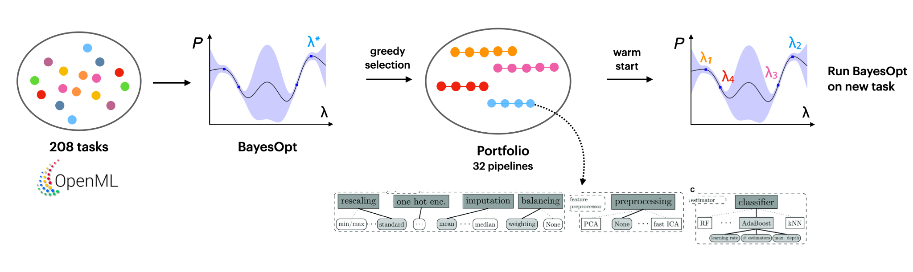
“Give me a model for X with Y data”
Use AutoML -> best pipelines/models on all our datasets beforehand
Create a portfolio of best pipelines/models per task
When the user/LLM requests a model, find the best models within the portfolio and finetune them to the new task
If new task -> Find the most relevant pipeline

Slide 6
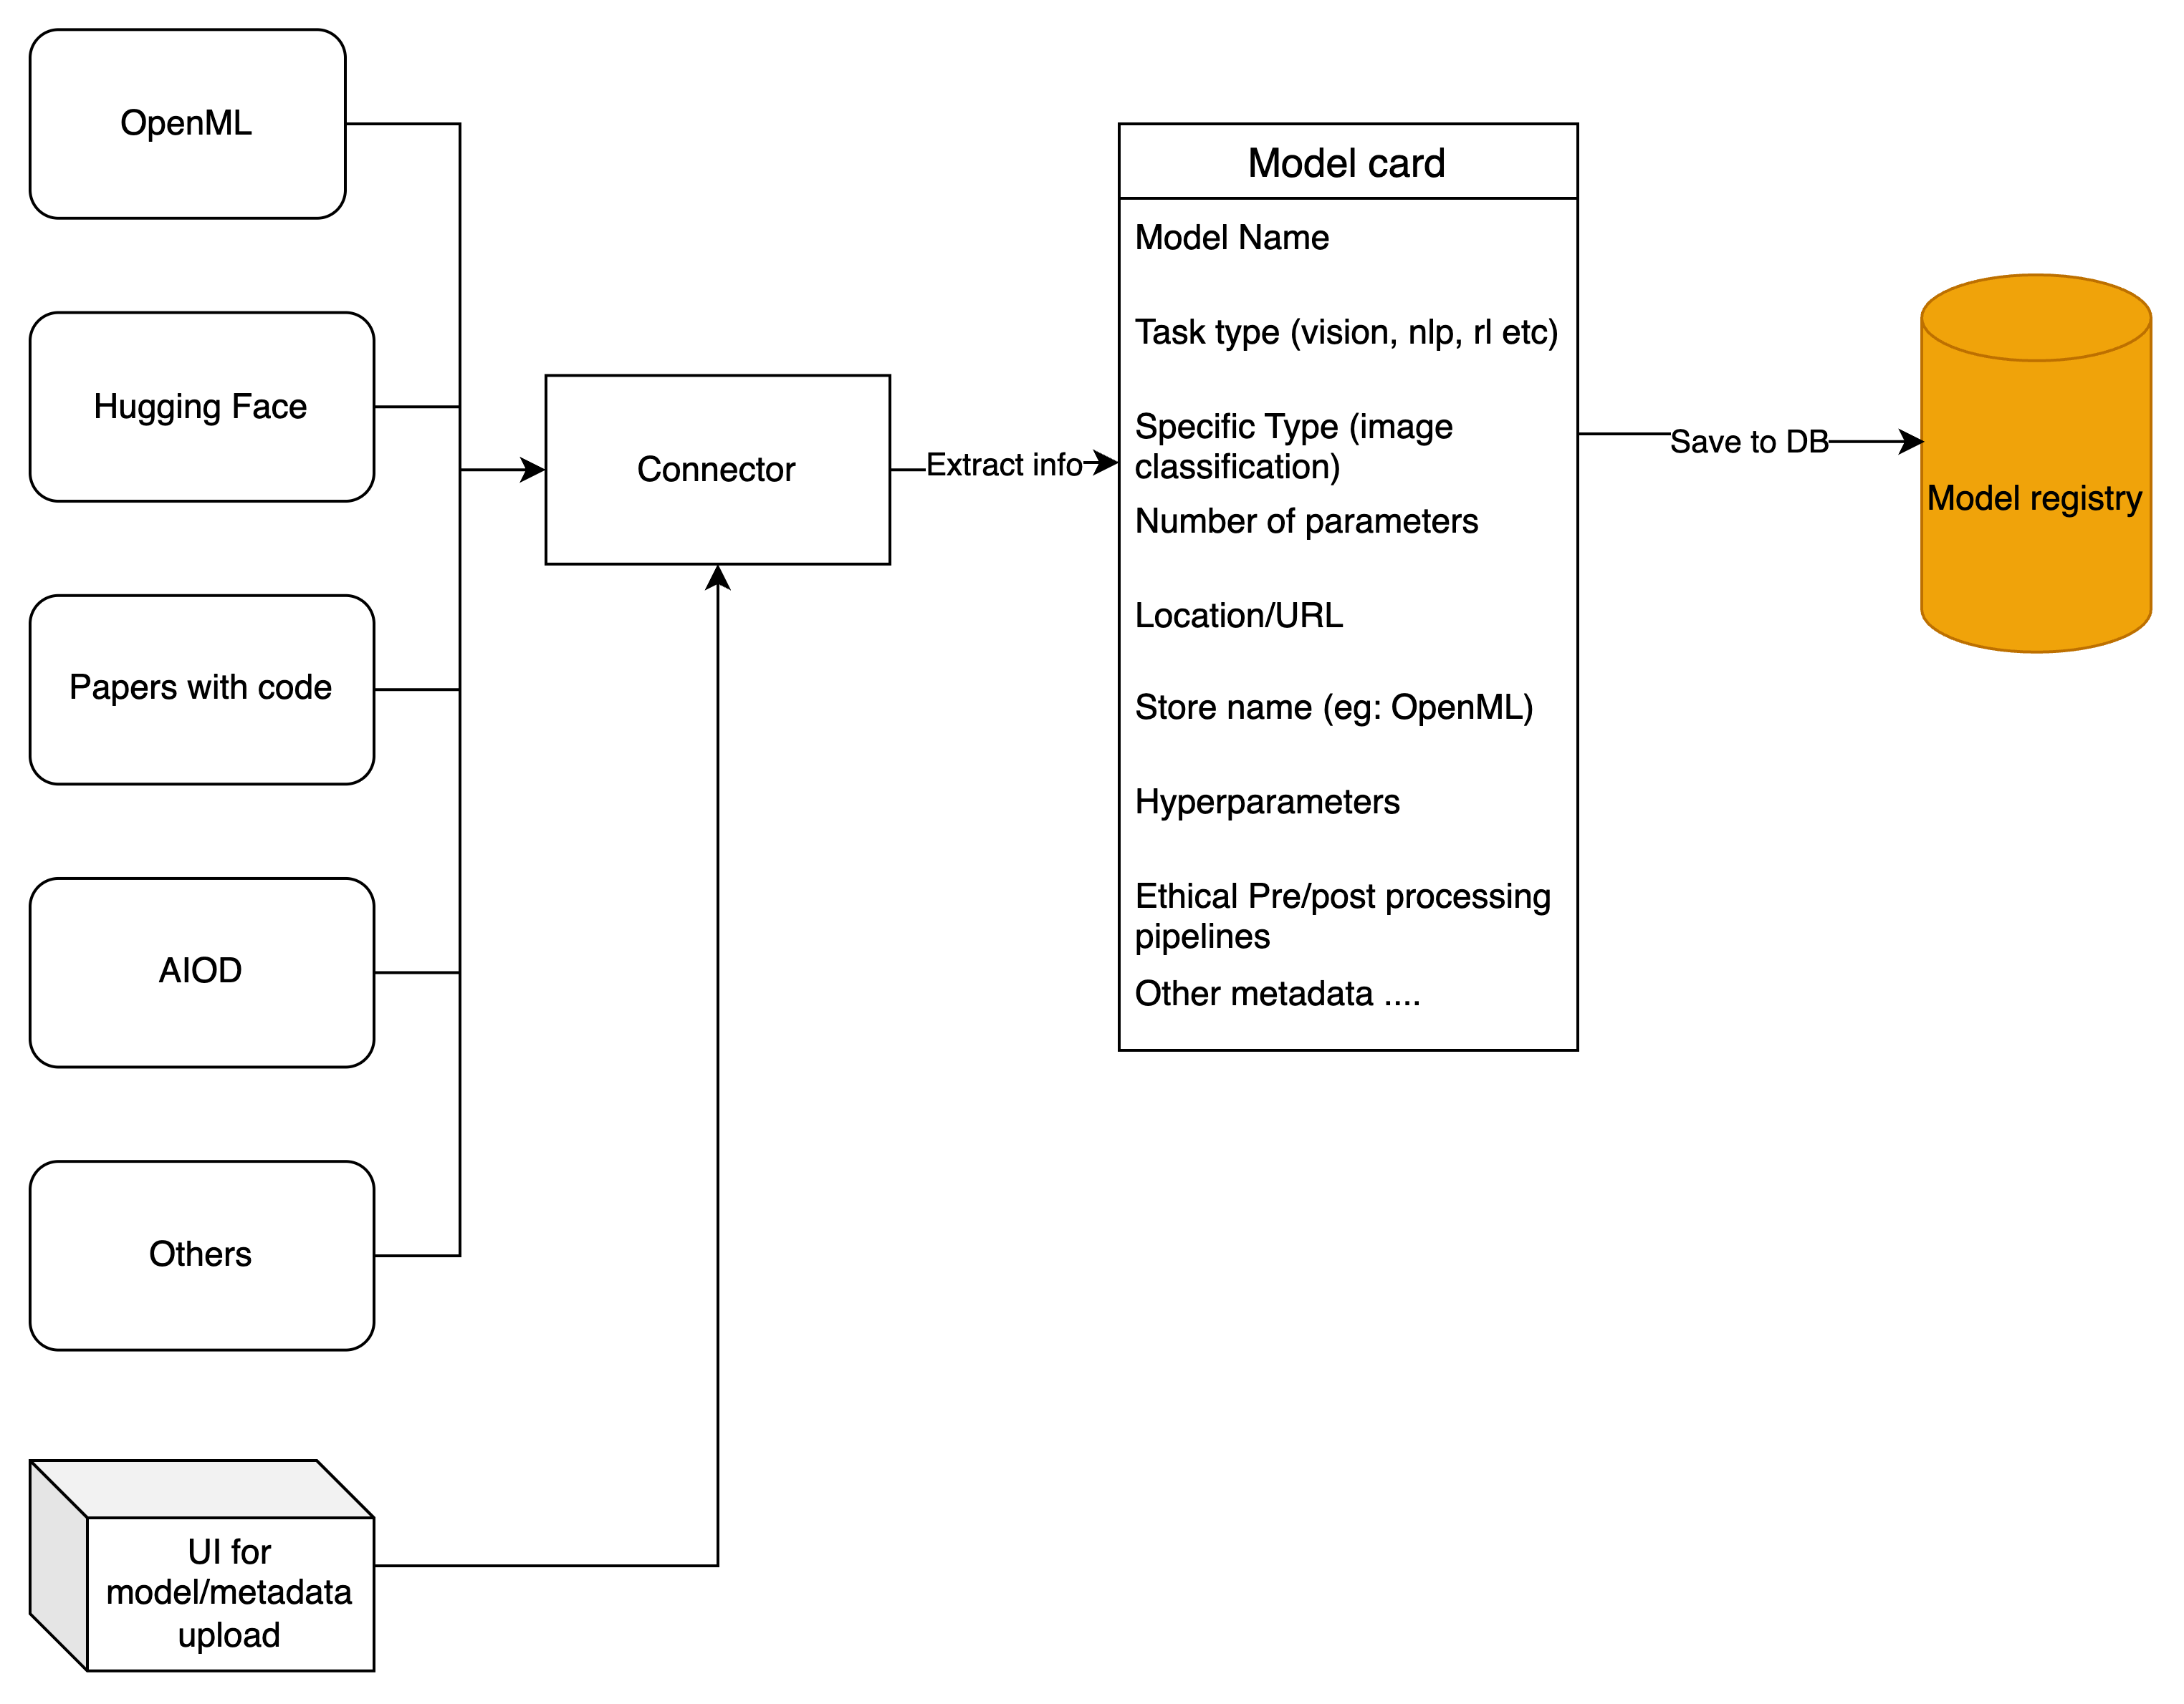
Model Card
Similarly for datasets…

Slide 7
Design choices
Search space
Warm Start
Training with constraints
Best model
Transfer Learning
Architecture search space: represent relevant models
Meta-learning, transfer learning: transfer experience from previous tasks
Warm start: start from promising architectures/configurations/initializations

Slide 8
“Here is file/code X, I want it to do Y”
File : X
Type : Excel sheet
Required : Add a column to compute a magic formula
Query + Files
Requirements analysis
Formatted requirements
Processed files
Designer User
I need more information

Slide 9
“Ethical concerns”
Dataset registry
Data type ethics
Chosen data type
XAI module
Model
Dashboard
Designer User
Model
Information
Ethically informed model
Chosen task
Ethical information for the user
Model registry

Slide 10

Questions?

