Slide 1

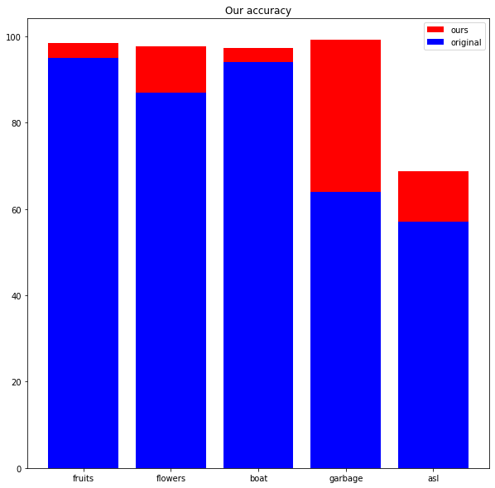
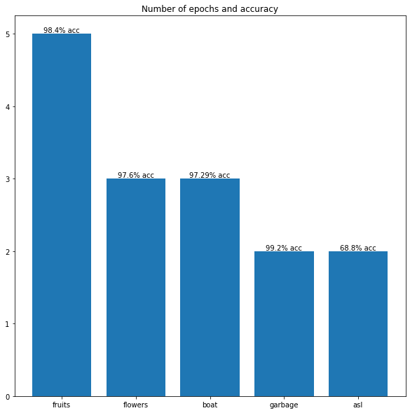
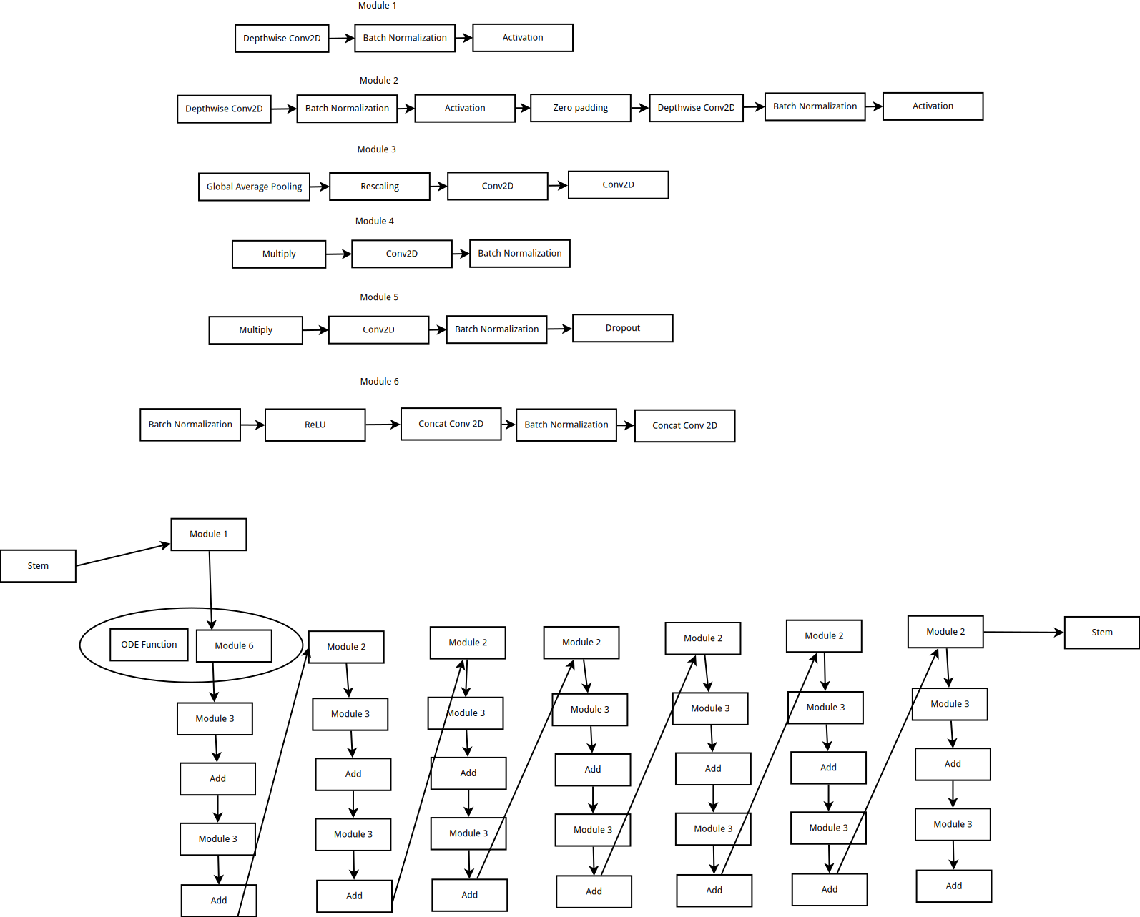
Rule Discovery Using EODNet for Image Classification
Subhaditya Mukherjee, Supratim Sarkar | Professor Vijayarajan V| School of Computer Science & Engineering
Introduction
EOD net is an effort to improve the state of the art in deep learning using the technique of neural ODEs[5]. This is because they offer means of faster and better neural network architectures for lesser energy costs. The research was conducted on multiple Kaggle challenges to prove the effectiveness of the model. The results show that EODNet performs fairly well and beats the leaderboard of multiple challenges. Some by a very large margin in only a few epochs of training. This poster will present the main ideas of the paper.
Motivation
Incorporating aspects of other domains into our code has always proved to be of utmost benefit. In that spirit, using the principles of physics in the form of ODEs has also shown to be of interest over the past two years.[1,2,3]. This inspired us to perform a research project to identify a novel architecture which combines the best of both worlds and also performs well at existing challenges better than the previous models. Thus EOD net was created. In our experiments, as tabulated and explained below, it outperforms the previous leaderboard for every challenge that we tested it on.
SCOPE of the Project
Results
The network was tested on multiple datasets taken from Kaggle and results were compared using tensorboard logging. The datasets used were:
1. Fruits 360 | 131 classes | (kaggle datasets download -d moltean/fruits)
2. Flowers recog |5 classes | kaggle datasets download -d alxmamaev/flowers-recognition
3. Boat recog| 9 classes | kaggle datasets download -d clorichel/boat-types-recognition
4. Garbage classification | 12 classes | kaggle datasets download -d mostafaabla/garbage-classification
5. ASL | 29 classes | kaggle datasets download -d mostafaabla/garbage-classification
The results we obtained are summarized below.
It is to be noted that due to resource constraints, these results could be further improved if the networks were trained for longer with larger image and batch sizes.
Accuracy
Number of epochs and accuracy
Methodology
The simplest way to explain the workings of the model is as follows. Every neural network aims to map one feature space to another, namely the input space to the output feature space.[4,6] This mapping is generally solved by our artificial neurons. In most cases, that does a very good job. But it is not explainable nor can be directly understood by humans, that makes it entirely a blackbox. ODEs on the other hand can be solved and proved at every point that it gives results for. Since we can combine both, we can take the power of neural networks and add the power of neural ODEs to it for maximum benefit.
The architecture used is as follows:
There are many tricks that were used in this project to make use of recent research and the most useful techniques. These were all chosen from SOTA papers. The first was stratifying the data to ensure that the total number of classes while training does not influence the outcome. It basically involves using sampling to scale the number of classes so that the data loader gets an equal distribution of each class. The second trick used was learning rate scheduling which basically involves using multiple changing learning rates throughout the training process. This is done in contrast with other methods that require a fixed single learning rate and essentially improves training.The third was a change in optimizers, instead of using RMSProp or ADAM, we use ADAMW which is a new optimizer that relies on finding learning rates dynamically. Other important things to mention is that we are using transfer learning. This would reduce our training time drastically. Since our network is a custom one, we can only load the weights for the EfficientNet [7] backbone and the rest of the network cannot have pretrained weights since we just created it.
The above graph shows the results that we obtained for each of the datasets in terms of the accuracy measure.
Conclusion
Architectural diagram
The experiments conclude that EODNet along with a better training strategy does infact give state of the art results on many datasets.
Future directions of research would involve trying to dig deeper into the network using visualization of gradients to see if it could be improved. More datasets could also be tested and for much longer. Due to constraints on resources, this was currently not possible.
It would be of further use if a larger dataset such as imagenet could be tested eventually to have some more comprehensive results.
References
[1] Rackauckas, C., Ma, Y., Martensen, J., Warner, C., Zubov, K., Supekar, R., ... & Ramadhan, A. (2020). Universal differential equations for scientific machine learning. arXiv preprint arXiv:2001.04385.
[2] Filici, C. (2008). On a neural approximator to ODEs. IEEE transactions on neural
networks, 19(3), 539-543.
[3] Jianyu, L., Siwei, L., Yingjian, Q., & Yaping, H. (2003). Numerical solution of elliptic partial differential equation using radial basis function neural networks. Neural Networks, 16(5-6), 729-734.
[4] Avelin, B., & Nyström, K. (2019). Neural ODEs as the deep limit of ResNets with constant weights. arXiv preprint arXiv:1906.12183.
[5] Chen, R. T., Rubanova, Y., Bettencourt, J., & Duvenaud, D. (2018). Neural ordinary differential equations. arXiv preprint arXiv:1806.07366.
[6] Liu, Z., Yang, Y., & Cai, Q. (2019). Neural network as a function approximator and its application in solving differential equations. Applied Mathematics and Mechanics,
[7] Tan, M., & Le, Q. (2019, May). Efficientnet: Rethinking model scaling for
convolutional neural networks. In International Conference on Machine Learning (pp.

