Slide 1
Information Retrieval Evaluation

Slide 2
Outline
• Background and Problem
• Evaluation Methods
— User Study
— Cranfield Paradigm (Test Collections)
— Implicit Feedback
• Summary

Slide 3
Outline
• Background and Problem
• Evaluation Methods
— User Study
— Cranfield Paradigm
— Implicit Feedback
• Summary

Slide 4

Commercial Search Engines

Slide 5
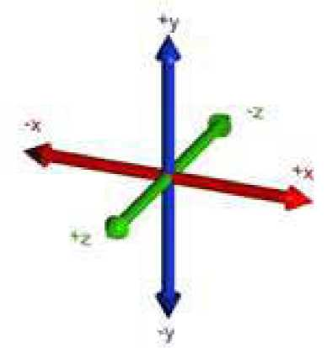
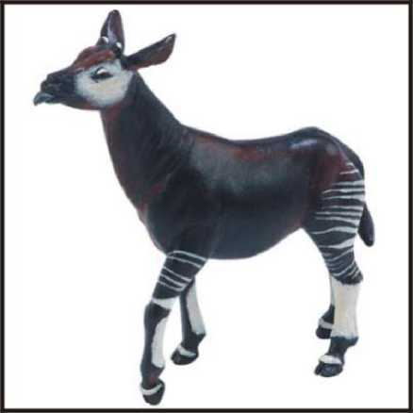
information Retrieval Algorithms
text 0.2 mining 0.1 association 0.01 clustering 0.02
food 0.00001
probabilistic model
vector space model
language model

Slide 6

Problem
What is a better search engine (IR system) ?

Slide 7

Wait......Better?
What do you mean?

Slide 8
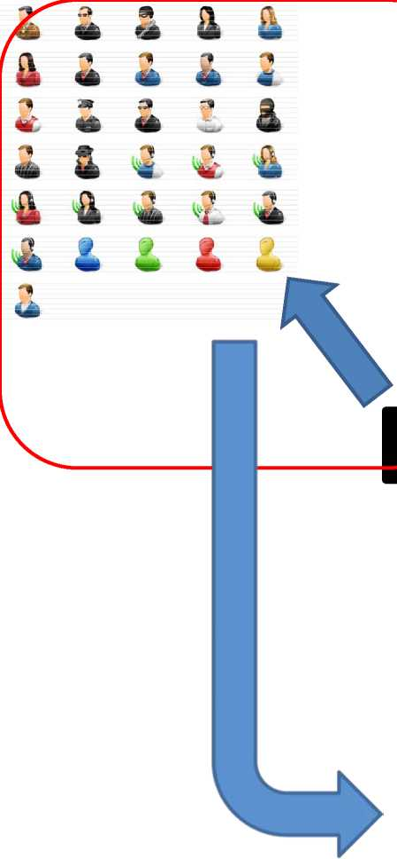
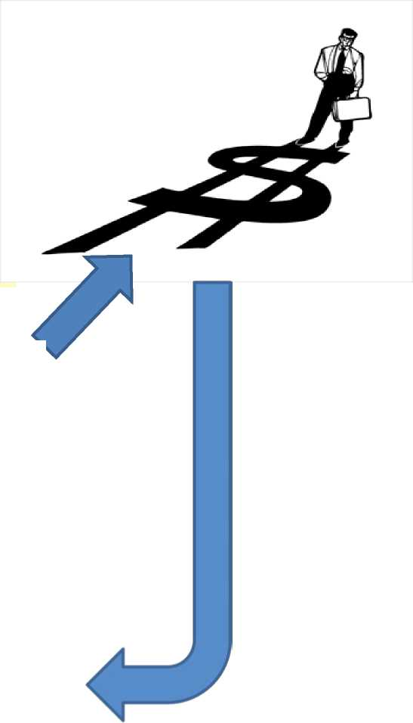


Three different parties have different needs for a good system
aluation

Slide 9
Outline
• Background and Problem
• IR Evaluation
— User Study
— Cranfield Paradigm
— Implicit Feedback
• Summary

Slide 10
Outline
• Background and Problem
• IR Evaluation
— User Study
— Cranfield Paradigm
— Implicit Feedback
• Summary

Slide 11
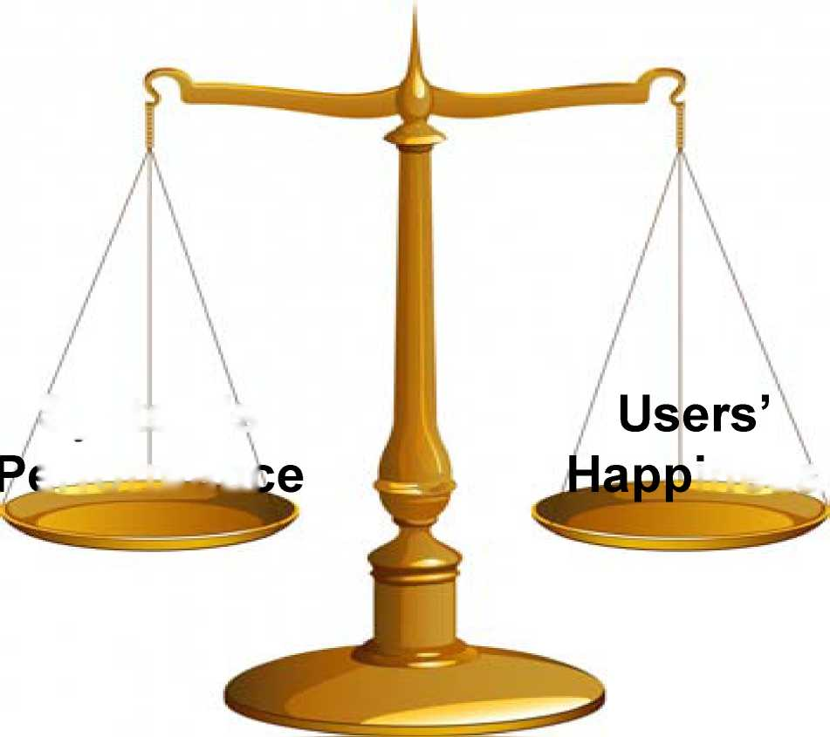
User Study
Assumption
System’s
erforman
iness

Slide 12
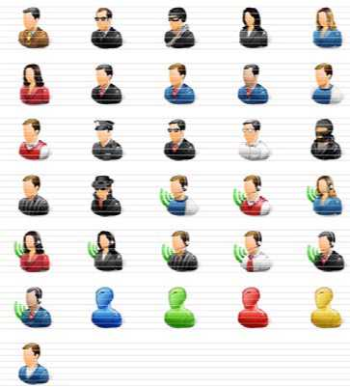
User Study
• Process
-Actual users are hired
- They use the systems to complete some tasks
- They report their subjective feeling

Slide 13
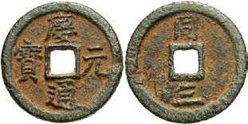
User Study
• Strength
- Close to real
• Weakness
- Too subjective
- Too expensive Small Scale ^ Bias

Slide 14
User Study
• Strength
- Close to real
• Weakness
- Too subjective
- Too expensive ^ Small Scale ^ Bias

Slide 15
[Kagolovsky et al.# 03]
• Process
-Actual users are hired - They use the systems to finish a task -Their performance is measured
• # of relevant documents found in a given time .© of finding required answers
4* 4* 11 «
^
m m «
1 a» » » 3
«£ <0 <6 &
2 ft ⁷ ** A
a a * a
a i i i a

Slide 16
IR Evaluation; User Study
• Strength
- Close to real
• Weakness
— Too expensive Small Scale ^ Bias

Slide 17
Outline
• Background and Problem
• IR Evaluation
— User Study
— Cranfield Paradigm (Test Collection)
— Implicit Feedback
• Summary

Slide 18
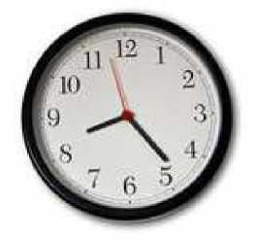
Satisfaction/Happiness; Divide and Conquer
• Efficiency
- Response Time
information retrieval
Web 1+1 Show options.,.
Scholarly articles for information retrieval
- Throughput
Information retrieval: data structures and algorithms - Frakes - Cited I Modern information retrieval - Baeza-Yates - Cited by 6656 Information storage and retrieval - Korfhage - Cited by 612
Information retrieval - Wikipedia the free encyclopedia - 2 visits -. Information retrieval (IR) is the science of searching for documents, for infori
documents and for metadata about documents, as well as that of...
• Effectiveness
History - Overview - Performance measures - Model types en.wikipedia.org/wiki/lnformation_retrieval - Cached - Similar - (? '
Introduction to Information Retrieval - 3 visits - Jun 14
The book aims to provide a modern approach to information retrieval from a c
science perspective. It is based on a course we have been teaching in ...
www-csli.stanford.edu/. /information-retrieval-boek.html - Cached - Similar -
Information Retrieval Resources
- Quality of the returned list
Introduction to Information Retrieval C D. Manning. P. Raghavan, H. 5 UP, 2008. Classical and web information retrieval systems: ... www-csli.stanford.edu/~hinrich/information-retrieval.htinl - Cached - Si
Information Retrieval -⁷ visits - Aug 26
Information Retrieval - The Journal of Information Retrieval is an internatior
• Interface
- e.g. faceted search
- Usually rely on the user study

Slide 19
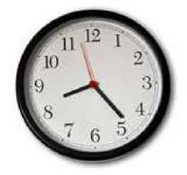

Efficiency
• Same as any database/Architecture/Software
• benchmark/test collection
— Document collection
- Query set
• Because the test collection is reusable, so
- Cheap
— Easy for Error Analysis

Slide 20
Effectiveness
• A reusable test collection for effectiveness ?

Slide 21
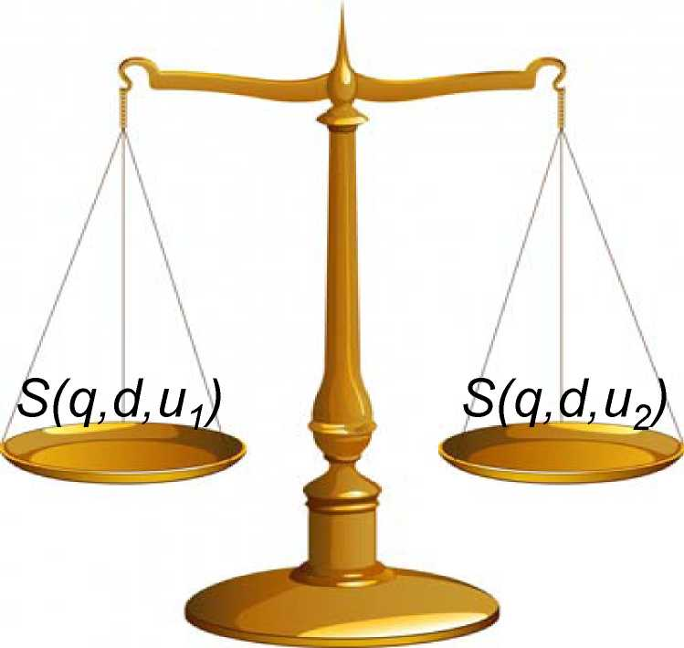
Effectiveness Evaluation
Assumption
• information need q
• Document d
• Useru
• Satisfaction S(q,d/u)

Slide 22

Cranfield Paradigm
• A test collection
— Document collection D
— Topic set T
— Relevance Judgments R
• A retrieval system runs
— Retrieve lists L from D for topic T
• A measure is used to score the system
— score = f(R, L)

Slide 23
Cranfield Paradigm; Process
• Given
a) A test collection (T, D, R)
b) A retrieval run for the test collection ; a doc-list L_{t} for each topic t in T
• For each topic t in T
• Use a measure (e.g. P@10) to compute the quality of L_{t}
• Combine scores
• e.g., arithmetic average

Slide 24


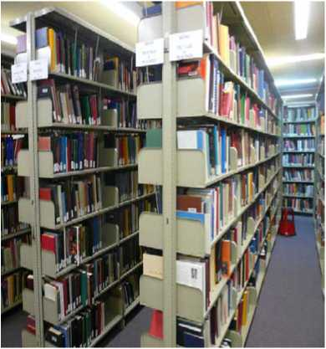
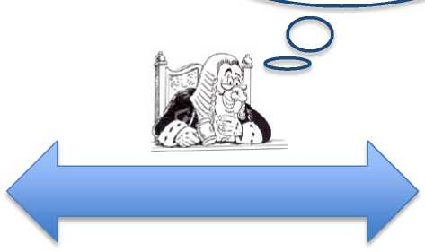
Test Collection/Benchmark
R(d,q)=True?
Relevance Judgments
Document Collection
Query Set
Assumption R(d, q, u 1) == R(d, q, u2)

Slide 25
Organizations for Standard Test
Collections
• Cranfield
— Cranfield College, UK, 1950s
• TREC (Text REtrieval Conference)
— by U.S. National institute of Standards and Technology
— 1992-now
• NTCIR (Nii Test Collection for IR Systems)
— East Asian languages
• CLEF (Cross Language Evaluation Forum)
— European languages

Slide 26
Cranfield Paradigm; Process
• Given
a) A test collection (T, D, R)
b) A retrieval run for the test collection ; a doc-list L_{t} for each topic t in T
• For each topic t in T
• Use a measure (e.g. P@10) to compute the quality of L_{t}
• Combine scores
• e.g., arithmetic average

Slide 27
Measures
• Binary Judgment Measures
— Unranked Results
— Ranked Results Measures
• Graded Judgment Measures
J: Q X D ^ {0,1}
J: Q X D ^ {0,1,2,3}

Slide 28
Measures
• Binary Judgment Measures
— Unranked Results: a document set
— Ranked Results: a document list
• Graded Measures

Slide 29
Measures
• Binary Judgment Measures
— Unranked Results: a document set
• Precision
• Recall
• F-score
— Ranked Results: a document list
• Graded Measures

Slide 30
Measures; Precision and Recall
• Precision (P) is the fraction of retrieved documents that are relevant
_ . . ^(relevant items retrieved) __{y} . .
Precision = —¹-----¹ = Pfrelevant retrieved)
#{retrieved items)
• Recall (R) is the fraction of relevant documents that are retrieved
^(relevant items retrieved)
Recall = --7---= Pfretrieved relevant)
#( relevant items)

Slide 31
Measures; Precision and Recall
 | Relevant | Nonrelevant
Retrieved | true positives (TP) | false positives (FP)
Not retrieved | false negatives (FN) | true negatives (TN)
P = TP / ( TP + FP ) = TP / ( TP + FW )
• Trade-off between precision and recall
• Return more docs -> higher recall, (usually) lower precision

Slide 32
Measures; Combining Precision
and Recall
• Combine precision and recall in F-score
_{f} 1 (/3² - 1 )PR
,_{v}i ₊ (l_₀)i ffP + R
• a e [0, 1] is used to control the relative importance of precision/recall
• Precision is more important for Web search
• Recall is more important for patent search
• When a=0.5, it is the harmonic mean

Slide 33
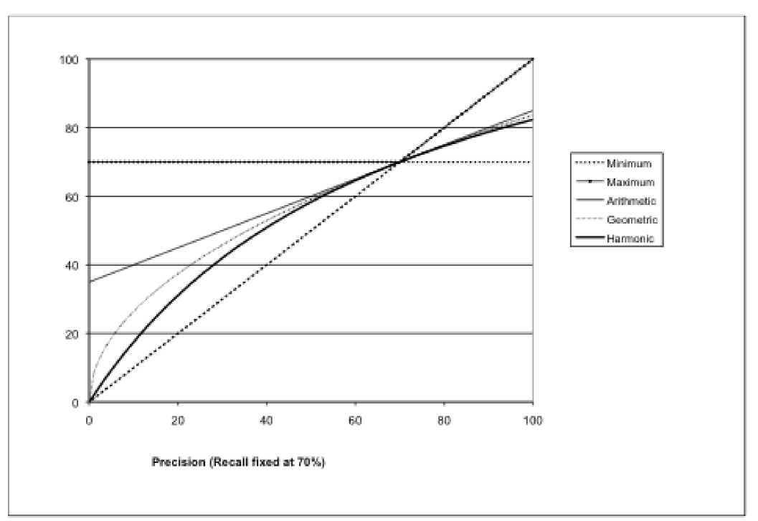
Why harmonic average?
• A kind of soft-minimum

Slide 34
Measures; a Example
 | relevant | not relevant
retrieved | 20 | 40 | 60
not retrieved | 60 | 1,000,000 | 1,000,060
 | 80 | 1,000,040 | 1,000,120
■P = 20/(20 + 40) = 1/3 ■R = 20/(20 + 60) = 1/4
" Fi = 2^ = 2/7
4 4

Slide 35
Measures; a Example
 | relevant | not relevant
retrieved | 20 | 40 | 60
not retrieved | 60 | 1,000,000 | 1,000,060
 | 80 | 1,000,040 | 1,000,120
Why not using accuracy?

Slide 36
Measures
• Binary Judgment Measures
— Unranked Results: a document set
— Ranked Results: a document list
• P@n, R@n, precision-recall curve, MRR, MAP
• Graded Measures

Slide 37
Measures; P@n and R@n
• For each cutoff n, take top n docs as a set
• Drawback
— Only contains incomplete information of a list
— Insensitive to the rank of relevant docs
— e.g. P@5 values are identical for the following lists
• i,i,0,0,0
• o,o,o,i,i
• P-R curve
— Contains complete information

Slide 38
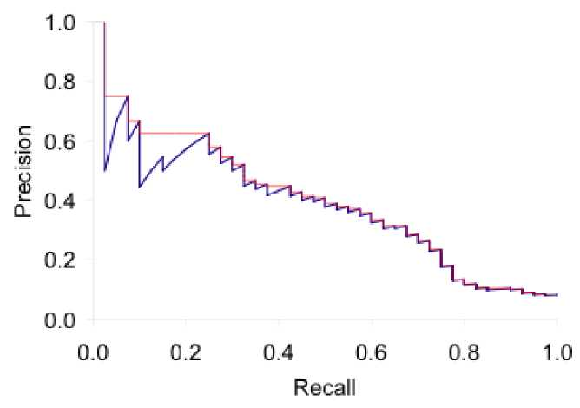
Measures; P-R curve
For each cut off n, get a (R@n, P@n) pair
Take R@n as x-axis, and P@n as y-axis, we get
the P-R curve
Interpolation (in red): Take maximum of all future points
P-R curve is usually only plotting for Recall (0.0, 0.1,..., 0.9, 1.0) - for easy combination

Slide 39
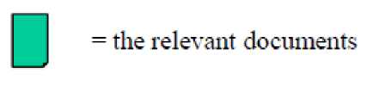
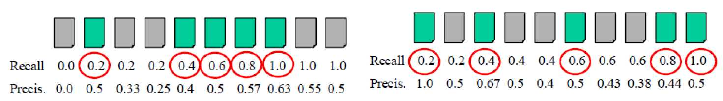
Measures; Average Precision
• Not easy to compare systems by P-R curves
• Approximate area under the P-R; Average Precision • Average the precision at the positions of relevant docs
AvgPrec= 62.2%
AvgPrec= 52.0%

Slide 40
Measures; MRR
• Mean Reciprocal Rank
— Reciprocal of rank of the first relevant doc
• Used for some kinds of queries
— Navigational Queries
• "glassdoor"
— Specific Informational Queries
• "when was the first Olympic Game?"

Slide 41
Measures
• Binary Judgment Measures
— Unranked Results: a document set
— Ranked Results: a document list
• Graded Judgment Measures
— nDCG

Slide 42
Measures; nDCG
• Graded Judgment
— Relevant documents can provide different amount of useful information
— Highly relevant doc vs. Marginal relevant doc
• Gain from a doc (G)
— Determined by its relevance degree

Slide 43
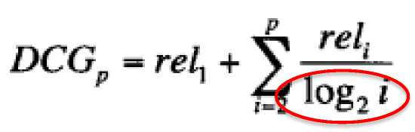
Measures; nDCG
• Cumulated Gain (CG)
— Sum of gain from docs in the list
• Discounted Cumulated Gain (DCG)
— Top ranked docs are more important for users
— Top ranked docs should be weighted highly

Slide 44

Measures; nDCG
• Gain
• Discounted Gain
3, 2/1,3/1.59, 0, 0, 1/2.59,2/2.81,2/3, 3/3.17, 0
• Discounted Cumulated Gain
3,5, 6.89, 6.89, 6.89, 7.28, 7.99, 8.66, 9.61,9.61

Slide 45
Measures; nDCG
• Normalized Discounted Cumulated Gain (nDCG)
- Why normalizing?
- Value ranges for queries are quite different
- e.g.
• ql has only 1 relevant doc in D
• q2 has 1000 relevant docs in D
• The average score of DCG will be dominated by q2
• Normalized Factor
- DCG value for an ideal (best) doc list

Slide 46
Measures; nDCG
• G and DCG (assume it contains all rel docs)
3,2, 3,0,0, 1,2, 2, 3,0
3,5, <5.89, 6.89, 6.89, 7.28, 7.99,8.66, 9.61,9.61
• Ideal G and DCG
3, 3, 3,2,2, 2, 1,0,0,0
3, 6, 7.89, 8.89, 9.75, 10.52, 10.88, 10.88, 10.88, 10.88
• nDCG

Slide 47
Measures
• Binary Judgment Measures
— Unranked Results: a document set
• Precision, Recall, F
— Ranked Results: a document list
• P@n, R@n, P-R curve, Average Precision, MRR
• Graded Judgment Measures
— nDCG

Slide 48
Cranfield Paradigm; Process
• Given
a) A test collection (T, D, R)
b) A retrieval run for the test collection ; a doc-list L_{t} for each topic t in T
• For each topic t in T
• Use a measure (e.g. P@10) to compute the quality of L_{t}
• Combine scores
• e.g., arithmetic average

Slide 49
Combine Scores and Compare
• Two systems (A and B), which is better?
• Compare the arithmetic average score?
• Difference between scores
• Sample size
• Principle Comparison: Significant Test
• For comparison: One-sided test
• Widely used: t-test, Wilcoxon signed-rank test

Slide 50

Cranfield Paradigm
• Strength
— Cheap
— Easy for Error Analysis
— Large Sample for More Confidence
— Repeatable

Slide 51
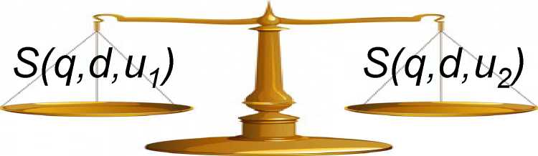
Cranfield Paradigm; Weakness
• test collection
— Document collection D
— Topic set T
— Relevance Judgments R
• Weakness
— Relevance Judgments are expensive incomplete -Assumption C

Slide 52
Problem of Relevance Judgments
Collect Relevance Judgments from Real User?

Slide 53
Outline
• Background and Problem
• IR Evaluation
— User Study
— Cranfield Paradigm
— Implicit Feedback
• Summary

Slide 54


implicit Feedback
User Behavior -> Relevance Judgments

Slide 55
implicit Feedback
• Strength
— Real User
— Cheaper than cranfield paradigm
— Much Larger sample size
• Challenge
— User behavior noise
— Long-tail search

Slide 56
implicit Feedback
• A/B test
— Use a small proportion of traffic (1%) for evaluation
— Option 1: Show results from different retrieval methods alternatively
— Option 2: Merge results in a doc list
— Compare the clickthrough-rate of two results

Slide 57
Outline
• Background and Problem
• IR Evaluation
— User Study
— Cranfield Paradigm
— Implicit Feedback
• Summary

Slide 58

Summary
• Real users are ground-truth
• Evaluation of methods can be decomposed
• Reusable test collection is useful
• User behavior (log) is really a kind of wealth

Slide 59

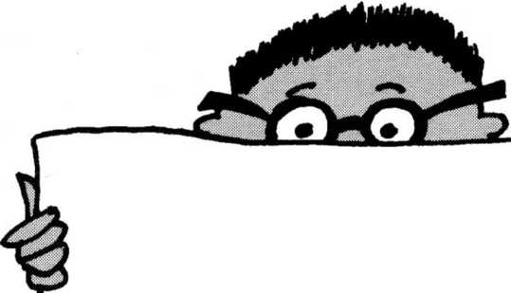

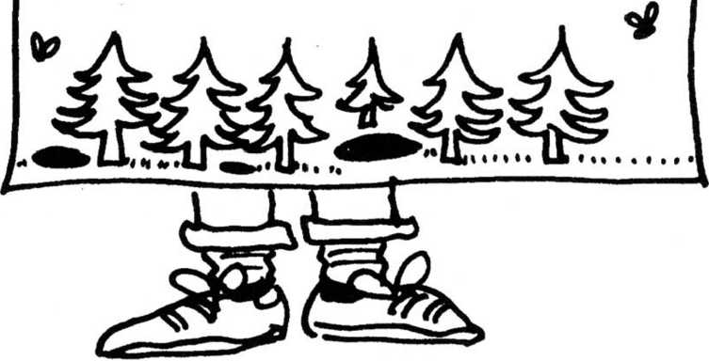

Thank You!

