Slide 1

Machine Learning
Project on
Insurance Data
By Subhadwip Manna
Guided by Dr. Aakansha Gupta
“Predicting the future is not magic , it’s Artificial Intelligent”

Slide 2


Introduction
An insurance premium refers to the amount of money an individual or business pays to an insurance company in exchange for an insurance policy that covers health insurance, vehicle insurance , home insurance, life insurance etc. It is a regular payment made by the policyholder to maintain the coverage provided by the insurance policy. Insurance companies calculate premiums based on their assessment of the potential risks involved and use actuarial data and statistical models to estimate the probability of claims and determine the appropriate pricing for coverage. Premiums are typically paid monthly, quarterly, or annually, depending on the terms of the insurance policy.
Here , we used “Jupyter Notebook, Python Language and its certain libraries” to train and build the different machine learning models and to show some visualisation graph.

Slide 3
-:Steps:-
Data collection
Exploring data
Visualizations
EDA
Understanding relations
Data exploration
Missing value treatment
Feature engineering and reduction
Splitting data
Feature scaling
Data Preprocessing
Multi-linear regression
Decision tree regression
Random forest regression
Adaboost regression
K-Nearest neighbour regression
Stacked regression
Building Model
Best Model Selection

Slide 4
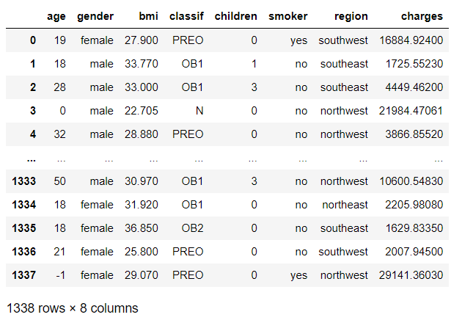
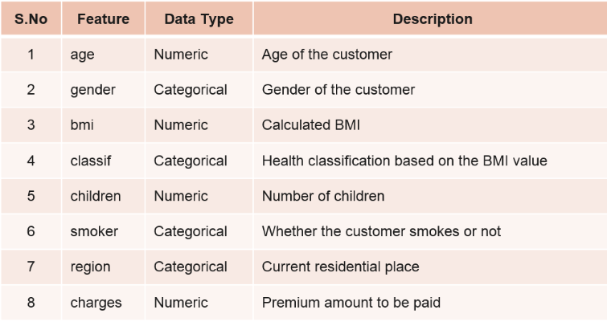







-:Data Overview:-
Target feature
Number of records :1338.
Number of independent features : 7
Multi dimensional data
Need to avoid Multi-collinearity
Supervised Learning method
Regression Model
Continuous values

Slide 5
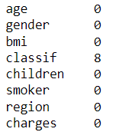
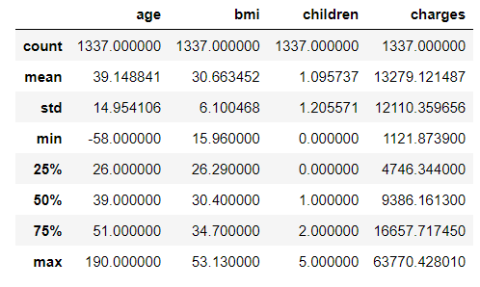





-:Data Cleaning:-
Null values in data:
Replaced by mode value:- “ OB1 ”
One duplicate record was there in the data and dropped that record.
Outliers in Age:
5>Age>100 =mode value of age(39)

Slide 6
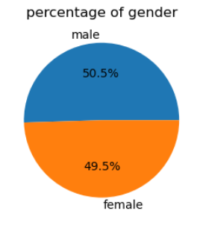
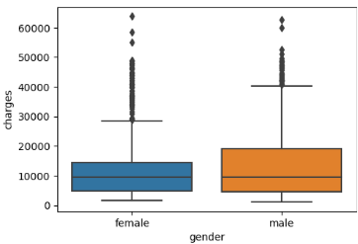
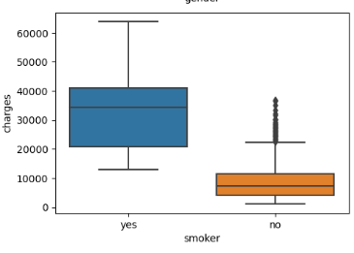
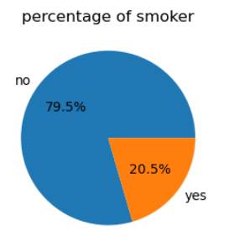
-:Data Exploration:-
Data is balanced based on Gender
Male give charges more than female
Gender wise charges distribution:
80% person don’t smoke
Person who smokes pays high charges, more than 20k.
Non smoker persons generally pays less than 15k.
Smoker wise charges distribution:

Slide 7
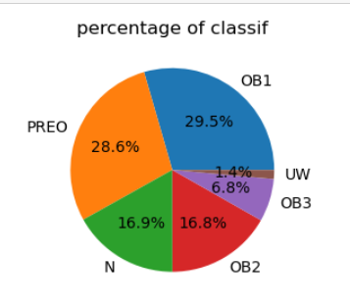
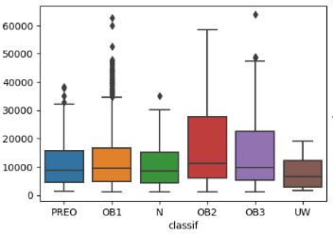
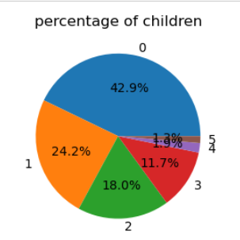
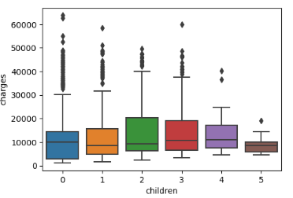
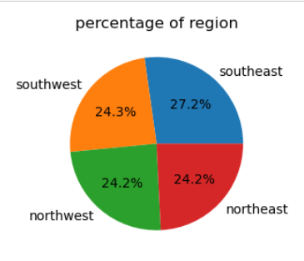
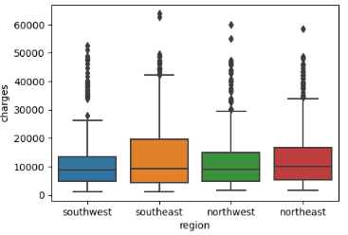
-:Data Exploration:-
OB1 and PREO category have 60% occurrence in the data.
OB2 and OB3 pay higher than other classes.
Classif wise charges distribution:
Persons with zero children are 40% of the data.
More the number of children have to pay more.
Number of children wise charges distribution:
Data is well balanced based on region
Southeast region pays more than others.
Region wise charges distribution:

Slide 8
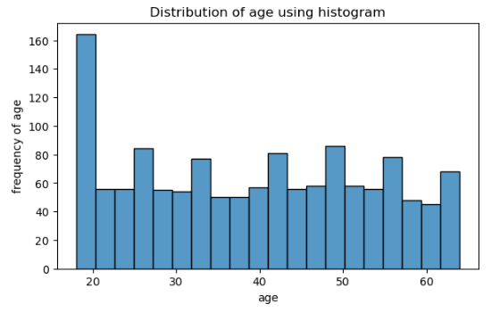
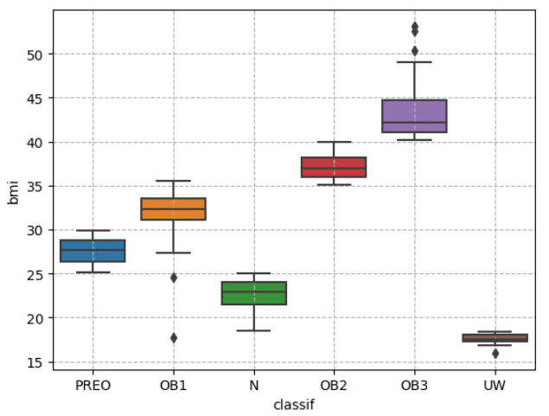
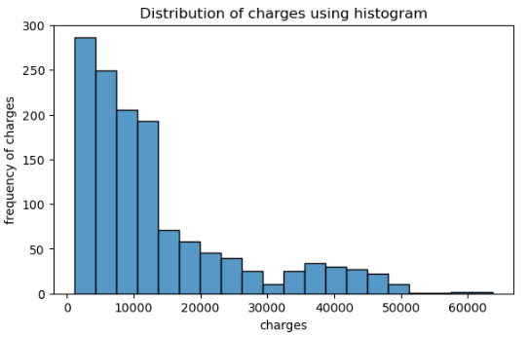
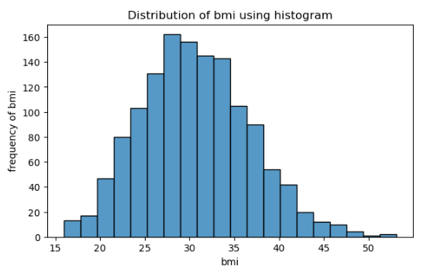
-:Data Exploration:-
Age distribution
charges distribution
Different classes based on bmi
class
bmi
UW = 15 to 20
N = 20 to 25
PREO = 25 to 30
OB1 = 30 to 35
OB2 = 35 to 40
OB3 = 40 to 45
High concentration
Bmi distribution

Slide 9
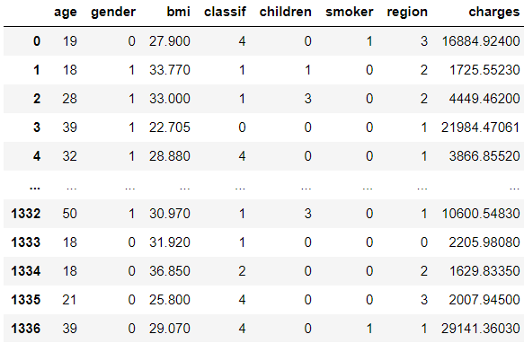
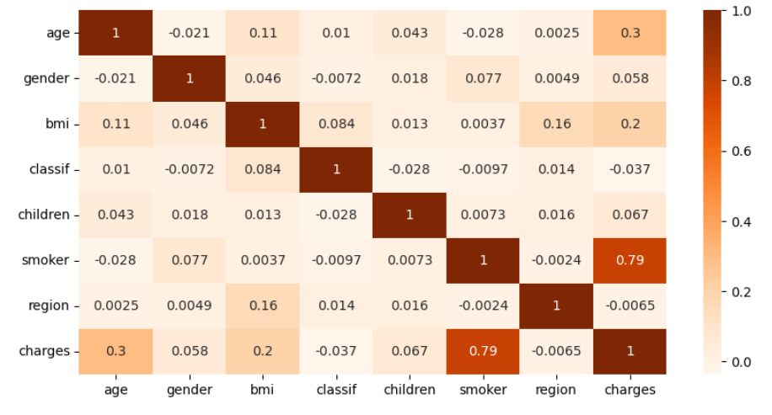
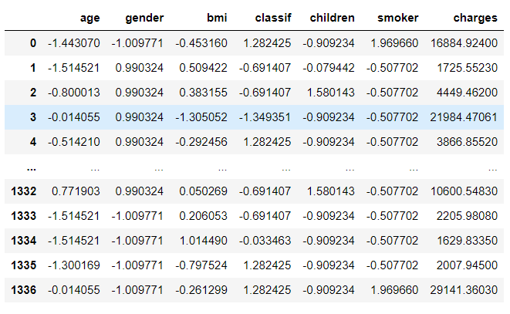
-:Data Preprocessing:-
Label encoding data
Scaling data
Correlation between charges and region is less

Slide 10
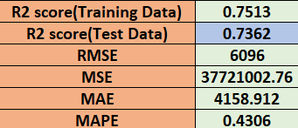
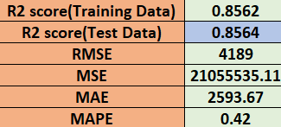
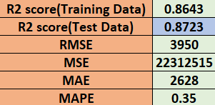
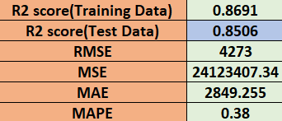
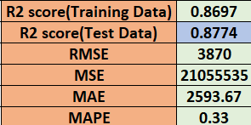
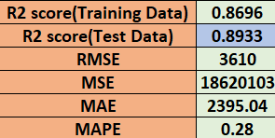
Results
Multi-Linear Regression
Adaboost Regression
Decision Tree Regression
K-Nearest Neighbors Regression
Random Forest Regression
Stacked Regression

Slide 11
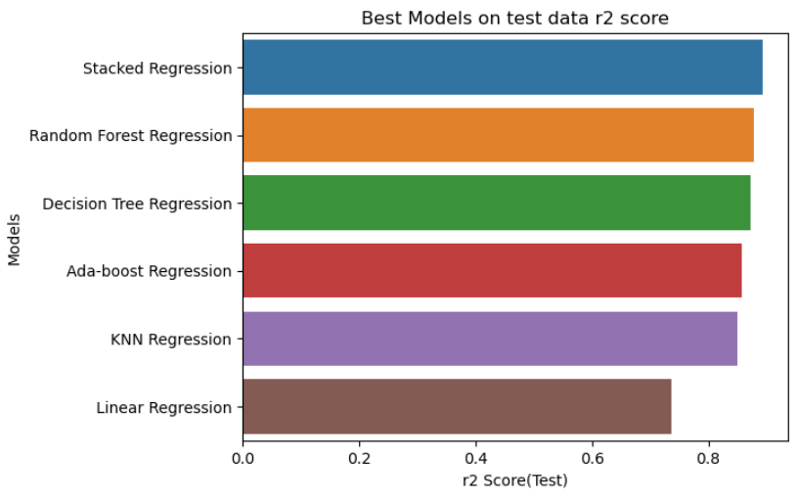
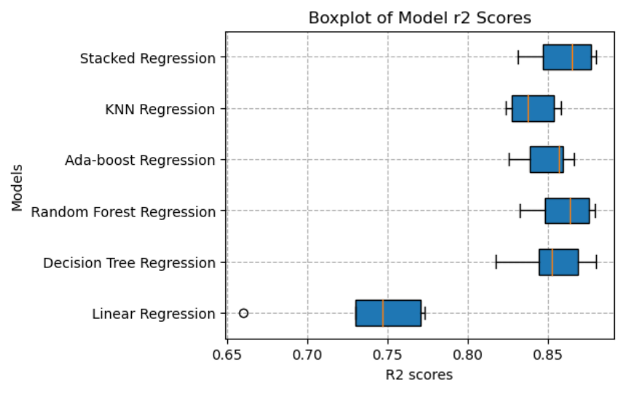
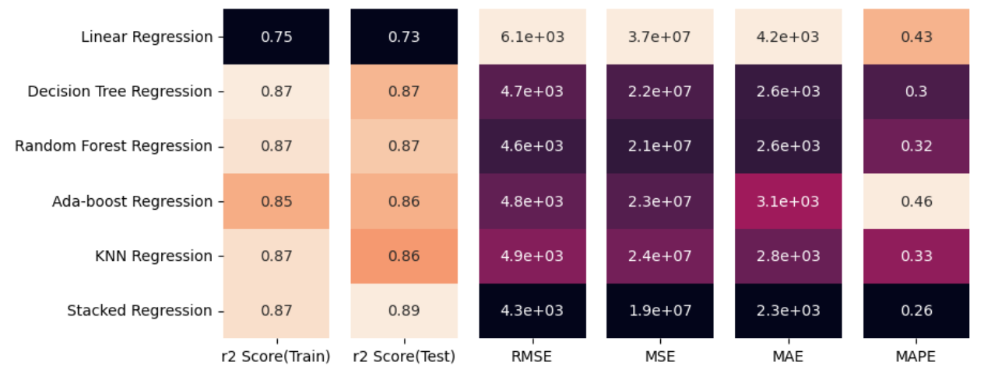







Final Results
R2 Score = Good Fit
Errors = Bad Fit
-:Best Model :-
Stacked Regression Model

Slide 12
Conclusion :
After conducting a comprehensive regression project, it was determined that the stacked regression model outperformed other models and consistently delivered impressive metrics. Through the combination of multiple regression algorithms, the stacked regression model demonstrated superior predictive capabilities, providing a higher level of scores and less errors in forecasting the target variable.
The stacked regression model outperformed other models due to its diverse predictions, error correction, feature combination, ensemble learning, hyperparameter optimization, and ability to capture nonlinear relationships.

Slide 13

THANK YOU
?
Any questions

