Slide 1


Employee Absenteeism Analysis
using
Machine Learning Techniques
By subhadwip Manna
Guided by Dr. Aakansha Gupta

Slide 2


Introduction
In this unsupervised learning project, we will be analyzing an employee dataset that contains records of employees and their leave patterns. Using unsupervised learning techniques such as clustering algorithms, our objective is to identify patterns and group employees based on their leave-taking behaviors. This analysis can provide valuable insights for human resources departments to understand employee preferences and optimize leave management strategies. By uncovering hidden structures within the data, we aim to make data-driven decisions and enhance organizational efficiency.
Here , we used “Jupyter Notebook, Python Language and its certain libraries” to train and build the different machine learning models and to show some visualisation graph.

Slide 3
-:Steps:-
Data collection
Exploring data
Visualizations
EDA
Understanding relations
Data exploration
Missing value treatment
Duplicate record treatment
Feature engineering and reduction
Feature scaling
Dimensionality reduction
Data Preprocessing
Building Model
Kmeans clustering
Hierarchical clustering
DBSCAN
Best Model Selection
Best Features Selection

Slide 4
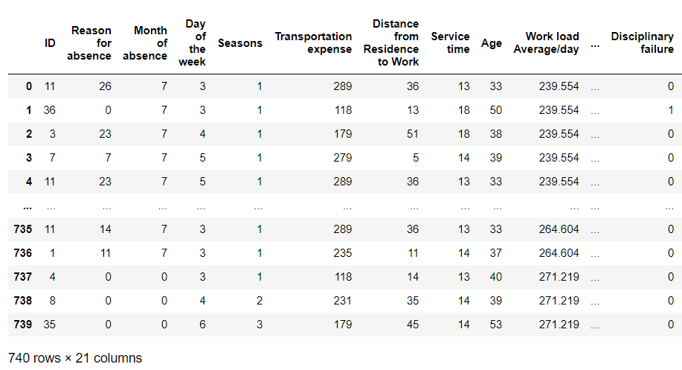
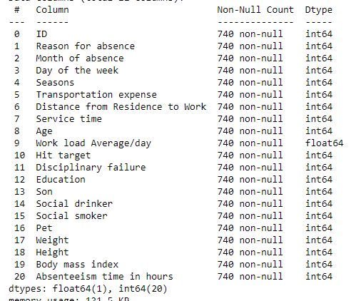
-:Data Overview:-
Number of records :740.
Multi dimensional data
Need to avoid Multi-collinearity
Unsupervised Learning method

Slide 5
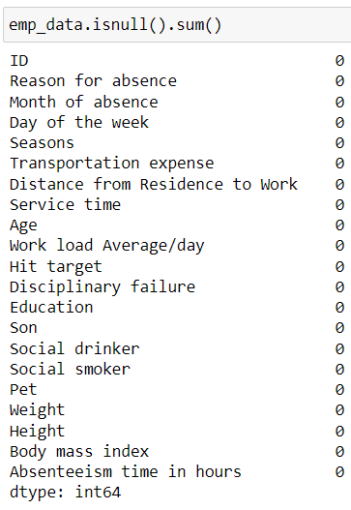

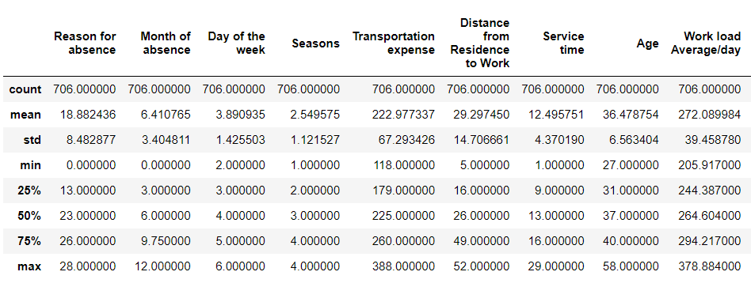
-:Data Cleaning:-
No null records.
34 Duplicate records found and dropped.
Outliers treatment is not required.

Slide 6
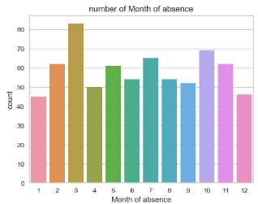
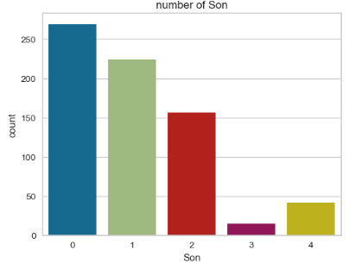
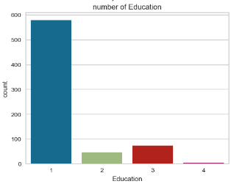
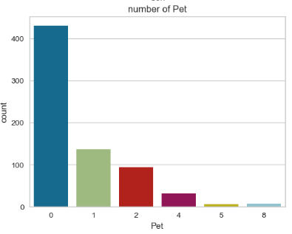
-:EDA:-
In march employees take more leaves.
More the number of children less chances of leave.
1st category education type employees take more leaves.
Most of the employees who does not have pets takes more leaves.

Slide 7
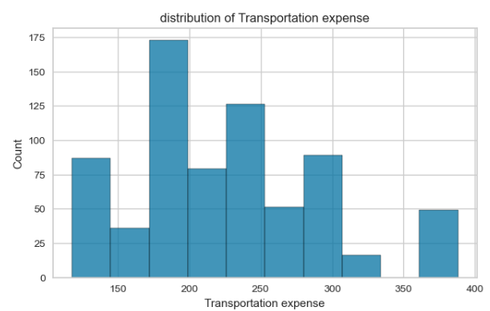
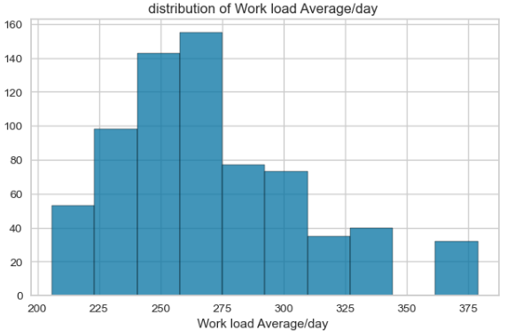
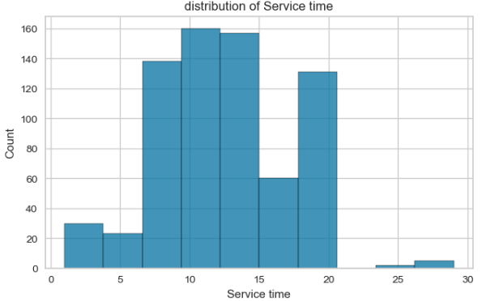
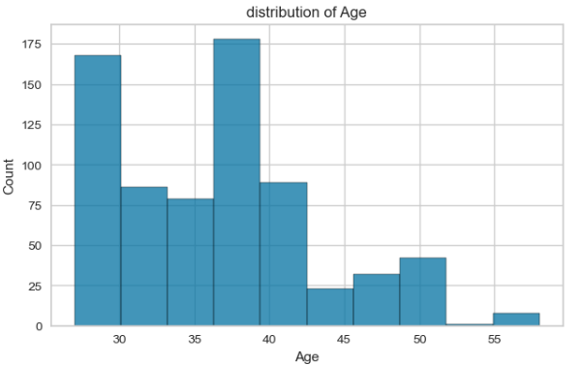
-:EDA:-
Employees take more leaves whose transportation expense is 180 to 250
Wok load between 225 to 275 takes more leave
Employees take more leaves whose service time is around 7 to 15.
Less aged employees take more leaves

Slide 8
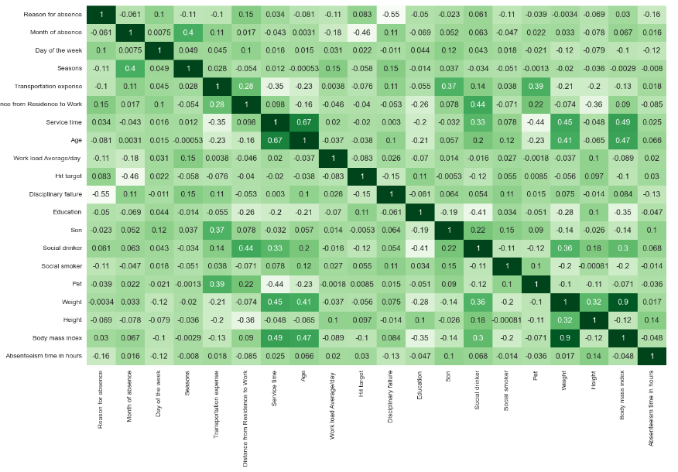
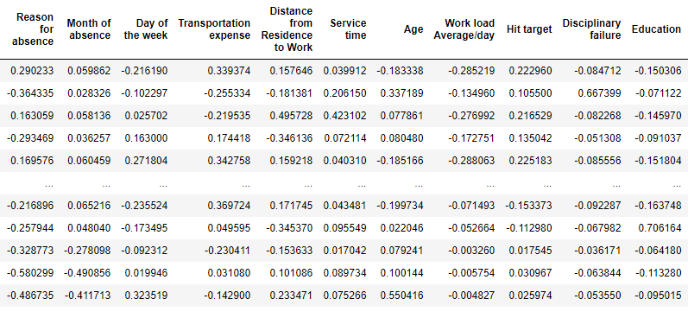
-:Data Preprocessing:-
No multi-collinearity
Feature selection
Data scaling and transformation
Normalization

Slide 9
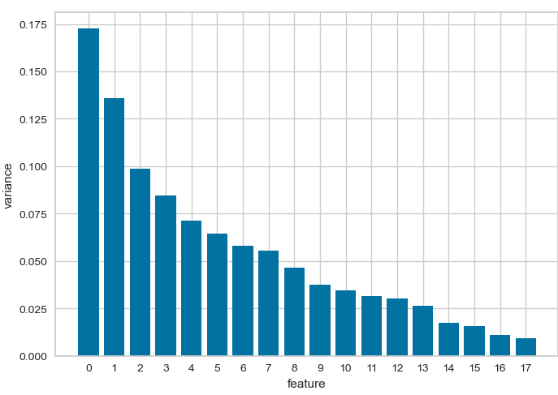
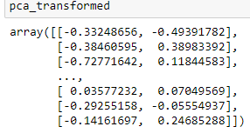
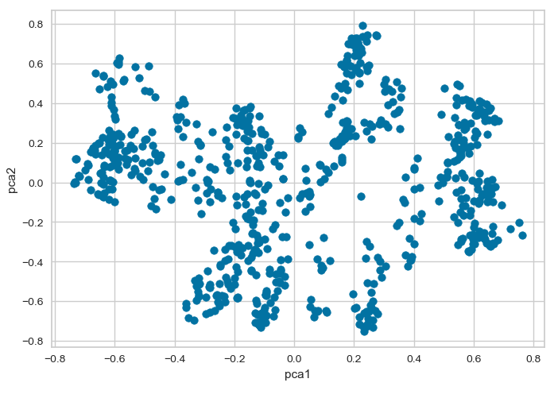
-:Dimensionality Reduction:-
No multi-collinearity
Curse of dimensionality
Data transformation
Visualization

Slide 10
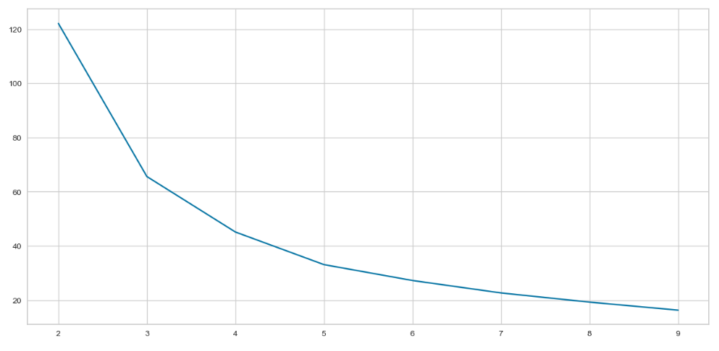
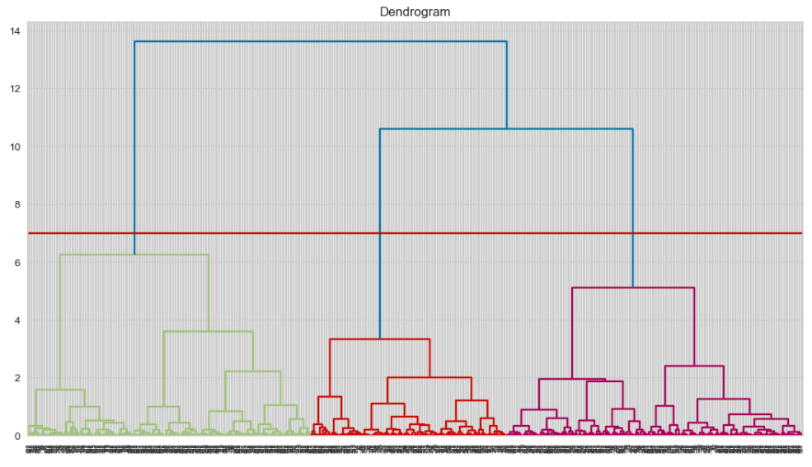
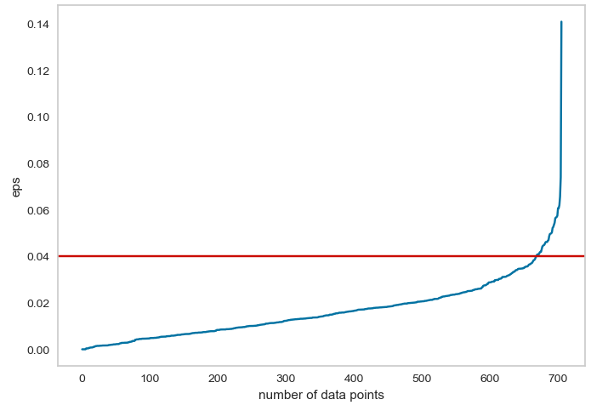
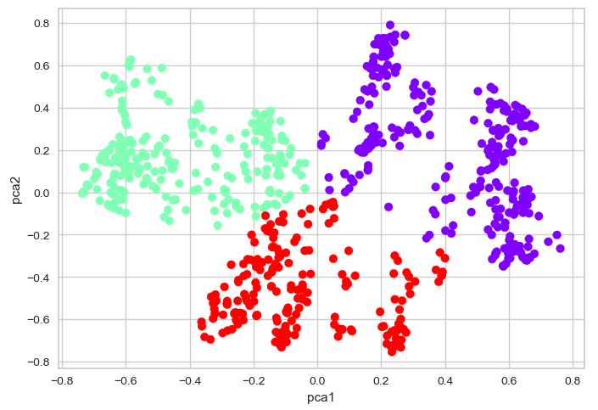
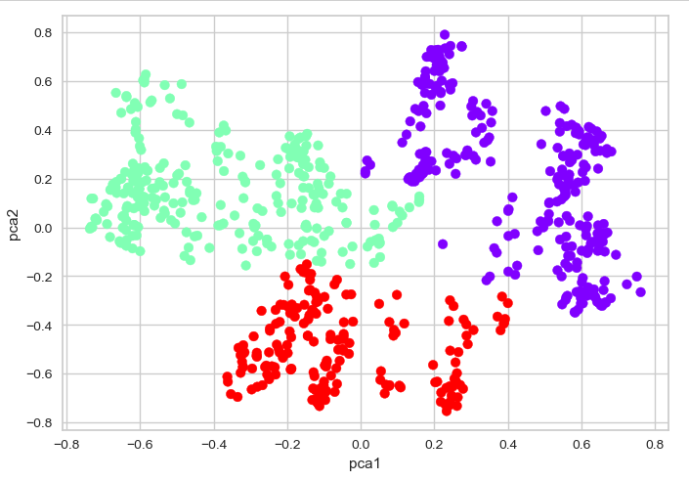
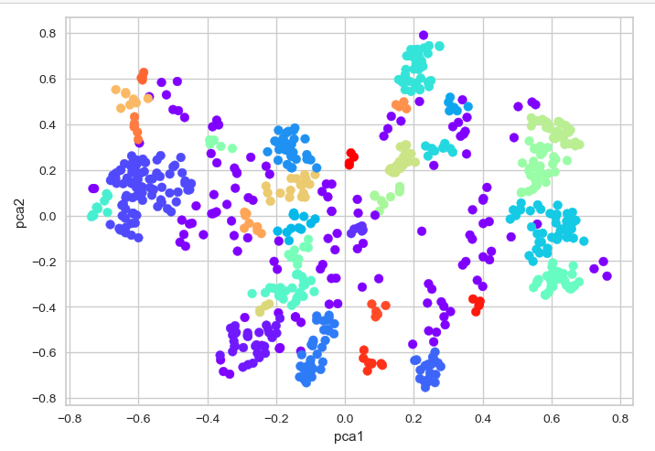
-:Results:-
KMeans Clustering
hierarchical Clustering
DBSCAN
Model score : 0.485
Model score : 0.479
Model score : 0.22
Best Model

Slide 11
Cluster 2 do not contain 0 number of son, cluster 0 and 1
do not contain employees who have more than 2 sons.
2. Social drinkers are only in cluster 1 & 2
Cluster 0 do not contain much number of pet , cluster 1
contains employees who have no pets
4. Cluster 1 contains different number of pets
Cluster 1 and 2 contains education category 1 only
Weight is high in cluster 2.
Overload is less in cluster 2.
Cluster 3 containing higher ages.
Distance is less in cluster 0, high in cluster 1 and well distributed in cluster 2.
10. Cluster 3 contains the employees who have high hours of absents
Transportation expense is higher in cluster 1 ,less in cluster 0 and well distributed in cluster 2.
Interpretations:
Best Model: Kmeans clustering
Number of clusters : 3
Important features:
Son
Social drinker
Pet
Education
Weight
Overload
Ages
Distance
Transportation expenses

Slide 12

THANK YOU
?
Any questions

