Slide 1
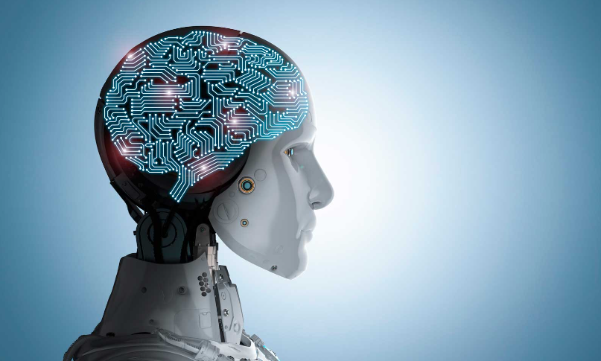
“Machine intelligence is the last invention that humanity will ever need to make”
- Nick Bostrom
Bank churn
Analysis
using
Machine Learning Techniques
By subhadwip Manna
Guided by Dr. Aakansha Gupta

Slide 2


Introduction
This project focuses on conducting a churn analysis for a bank to address the issue of customer attrition. By leveraging data analytics and machine learning techniques, the project aims to identify patterns and factors associated with churn. The objectives include data collection and preprocessing, exploratory data analysis, feature engineering, model development, and model interpretation. Through these steps, the project intends to build a predictive churn model that accurately identifies customers likely to churn. The insights derived from the analysis can assist the bank in implementing effective retention strategies and minimizing revenue loss.
Here , we used “Jupyter Notebook, Python Language and its certain libraries” to train and build the different machine learning models and to show some visualisation graph.

Slide 3
-:Steps:-
Data collection
Exploring data
Visualizations
EDA
Understanding relations
Data exploration
Missing value treatment
Feature engineering and reduction
Splitting data
Feature scaling
Data Preprocessing
Logistic regression
Naïve Bayes' Gaussian classification
Decision tree classification
Random forest classification
Ada-boost classification
K-Nearest neighbour classification
Stacked classification
Building Model
Best Model Selection

Slide 4
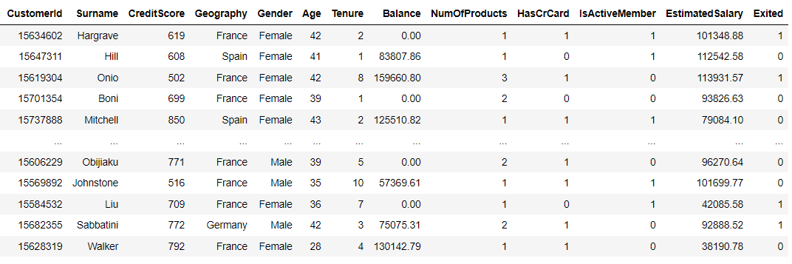
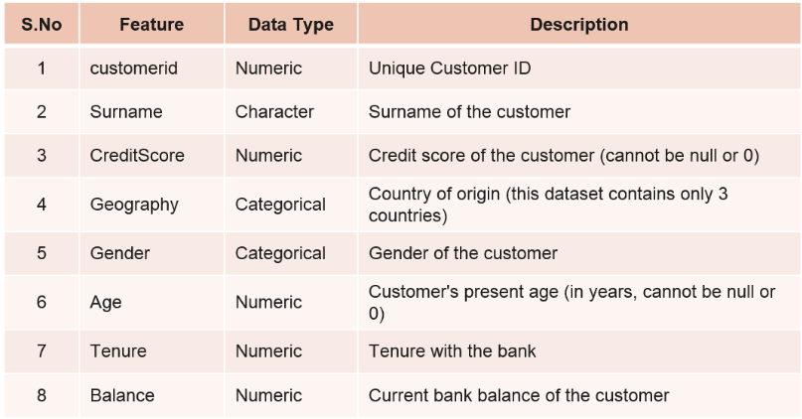
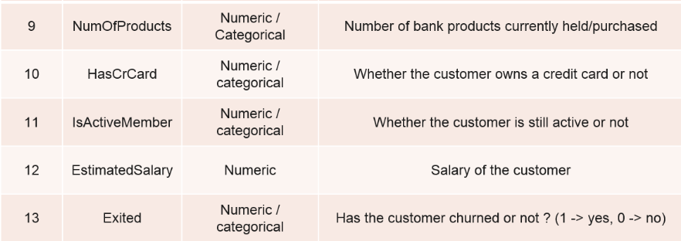

-:Data Overview:-
Target feature
Number of records :10000
Number of independent features : 11
Multi dimensional data
Need to avoid Multi-collinearity
Supervised Learning method
Classification Model
Binary feature : Only 0 & 1

Slide 5
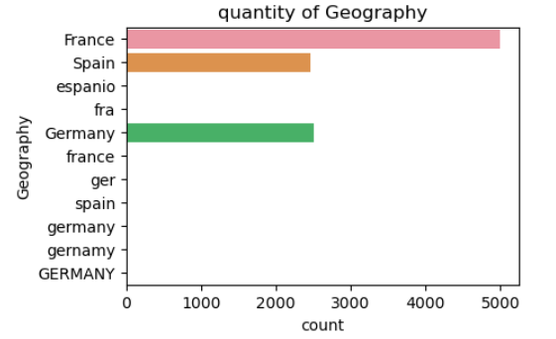
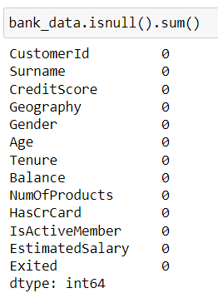
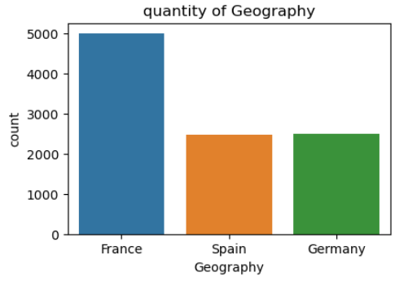

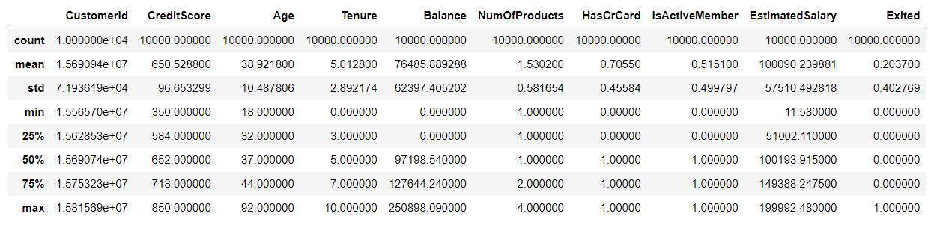
-:Data Cleaning:-
data transformation
No null records.
No Duplicate records.
Outliers treatment is not required.

Slide 6
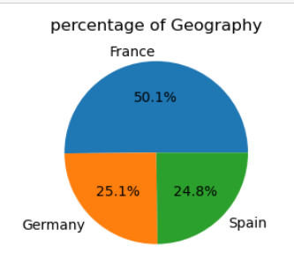
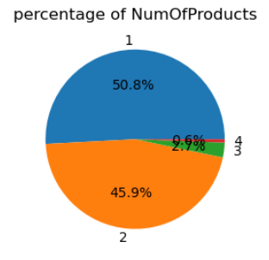
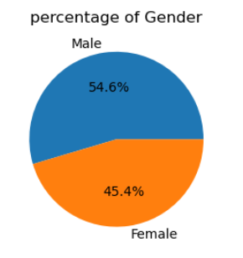
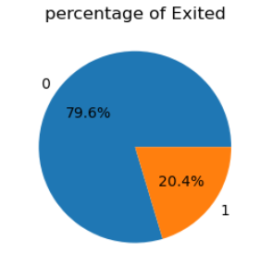
-:Data Exploration:-
50% of the records are from France
Data from Germany and Spain are almost same
Most of the customers purchased 1 to 2 bank products
Male and females are holding almost same number of records.
Imbalance data

Slide 7
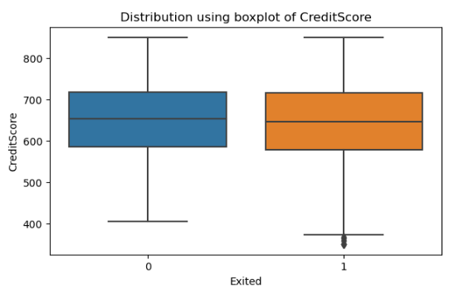
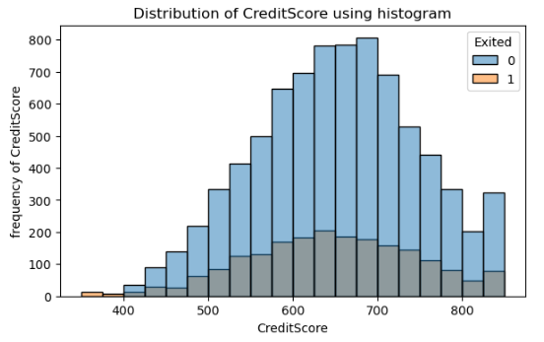
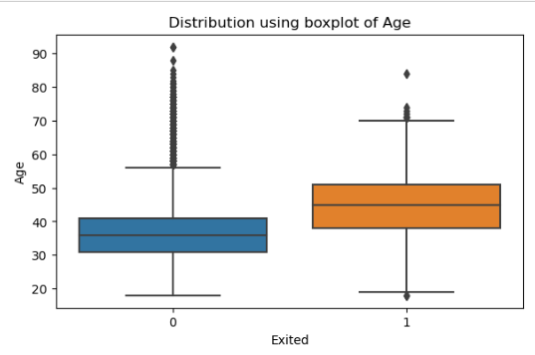
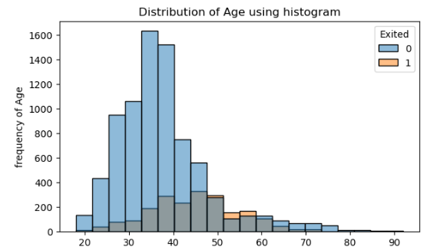
-:Data Exploration:-
Customer’s attrition is not very much depends on credit score
Credit score distribution
Customers with more than 40 years of age are more likely to exit from bank.
Age distribution

Slide 8
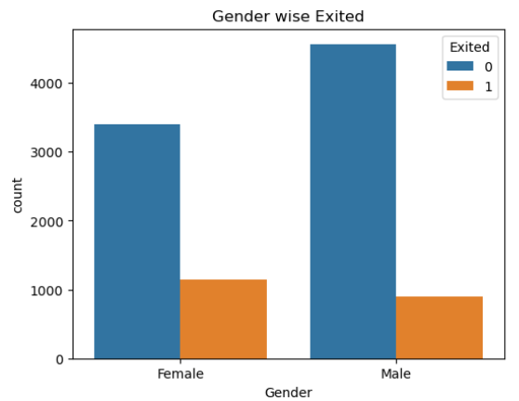
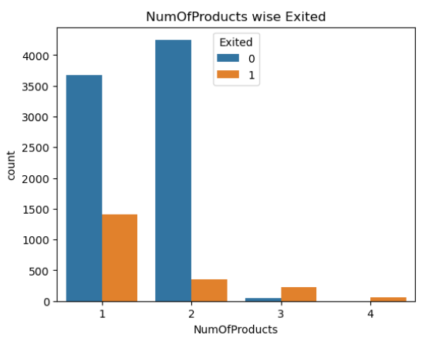
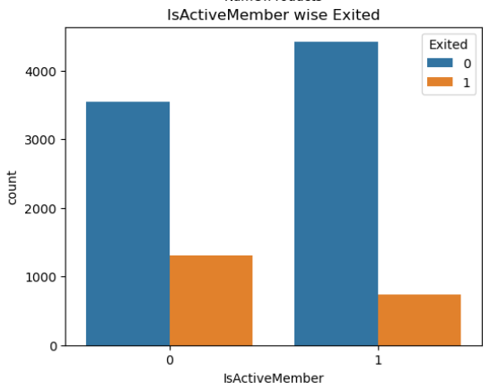
-:Data Exploration:-
Females are leaving bank more than male.
Customers who purchased more than 2 bank products are likely to exit from bank.
Who purchased 2 bank products have less chances to leave bank
Customers who become inactive have high chance to exit from bank.
Gender wise attrition of customers
Attrition of customers based on number of bank product purchased
Attrition of customers based of their activeness in bank

Slide 9
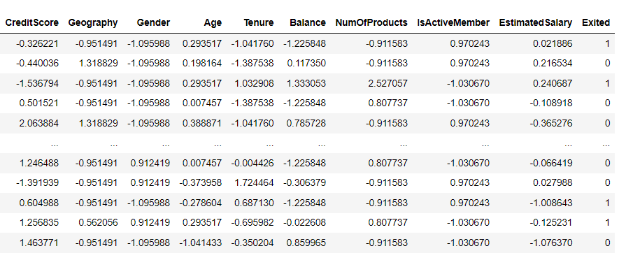
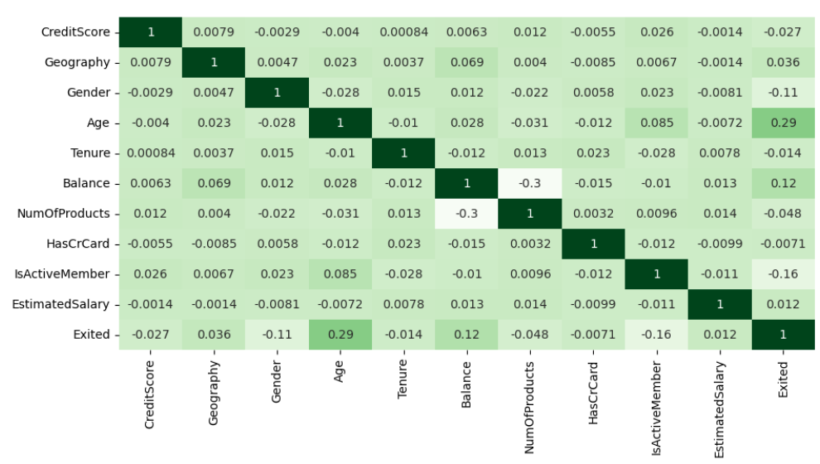
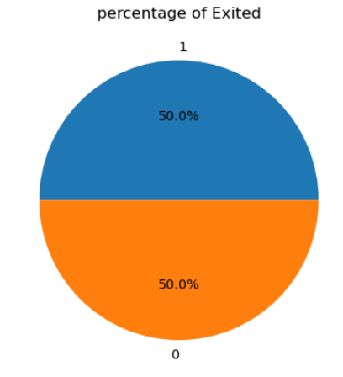
-:Data Preprocessing:-
Label encoding and Scaling data
Re-sampling (SMOTE)
New number of records: 15,926
Dropped feature: HasCrCard (whether customers have credit card or not)

Slide 10
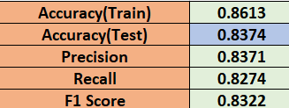
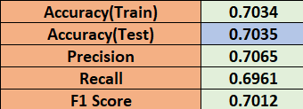
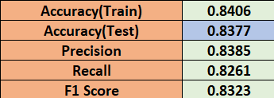
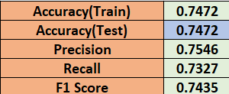
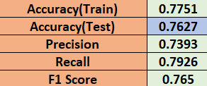
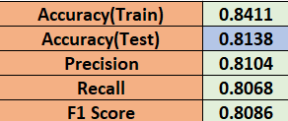
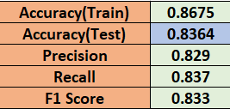
Results
Random Forest Classification
Logistic Regression
Adaboost Classification
Naïve Bayes' method
K-Nearest Neighbors Classification
Decision Tree Classification
Stacked Classification

Slide 11
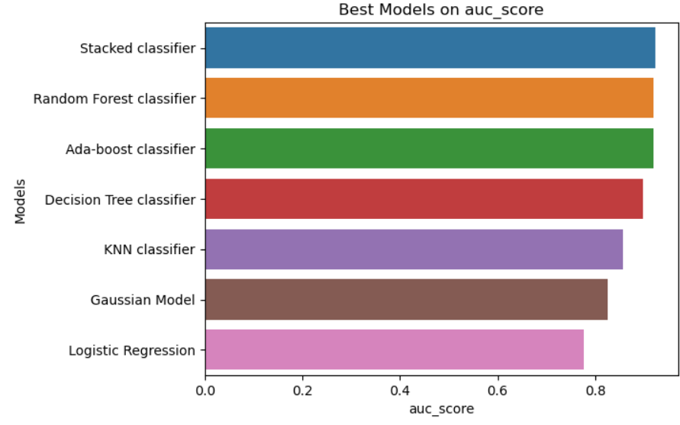
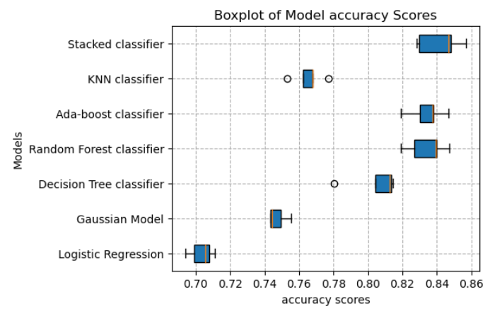
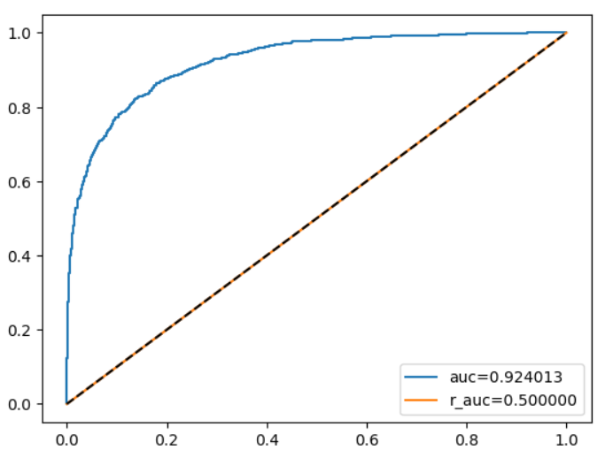
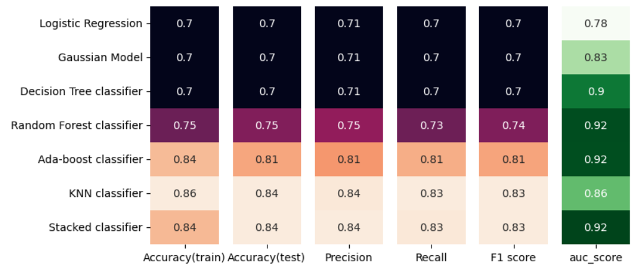
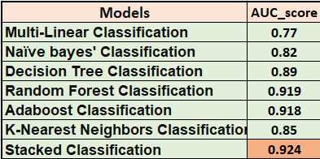





Final Results
Scores = Good Fit
Best model selected based on AUC score
-:Best Model:-
Stacked Classification

Slide 12
Conclusion :
After conducting a comprehensive Classification project, it was determined that the Stacked Classification model outperformed other models and consistently delivered impressive metrics. Though all the metrics are quiet same with other ensemble learning methods but based on AUC score Stacked is better. Through the combination of multiple Classification algorithms, the Stacked Classification model demonstrated superior predictive capabilities, providing a higher level of scores and less errors in forecasting the target variable.
The Stacked Classification model outperformed other models due to its diverse predictions, error correction, feature combination, ensemble learning, hyperparameter optimization, and ability to capture nonlinear relationships.

Slide 13

?
Any questions

