Slide 1

This project is Based on JAVA Classes, Interfaces, SWING, JDBC, My SQL Concept
ľechnologies Used: Coíe Java (Swing & AWľ) Database Used: MQSQL IDE used: NetBeans
PROJECT NAME:- ONLINE TRANSPORT TICKET BOOKING SYSTEM (BUS)
Online Transport Ticket Booking System in Java is an integrated Desktop based Application developed for travelers. The main aim of this project is to help the tourist, Travelers to manage book ticket, destinations and check sites. It makes all operations of the tourist, Travelers easy and accurate

Slide 2
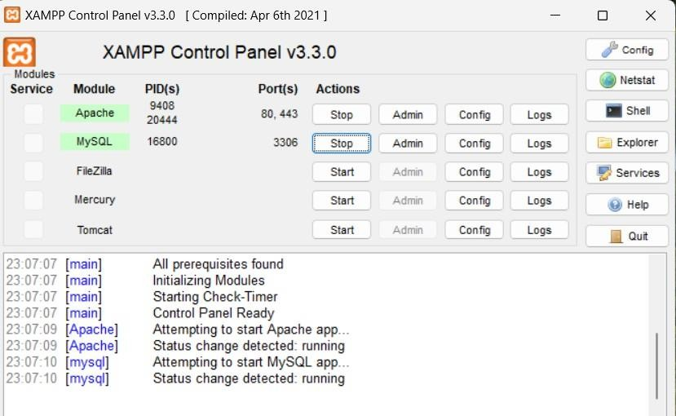
_{JAVA SWING:-} It’s a Platform Independent light weight Component used to Create Desktop Based Applications, Windows based so Output will not Seen in Console panel
I use this Wave Server to Do task in JDBC,MY SQL Connectivity,
XAMP:- It’s act as local Wave Server, We Can Communicate With This by Our DATABASE
DATABASE:- its means Organized Collection of Structured data

Slide 3
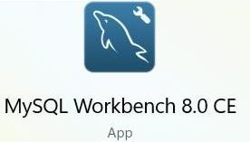
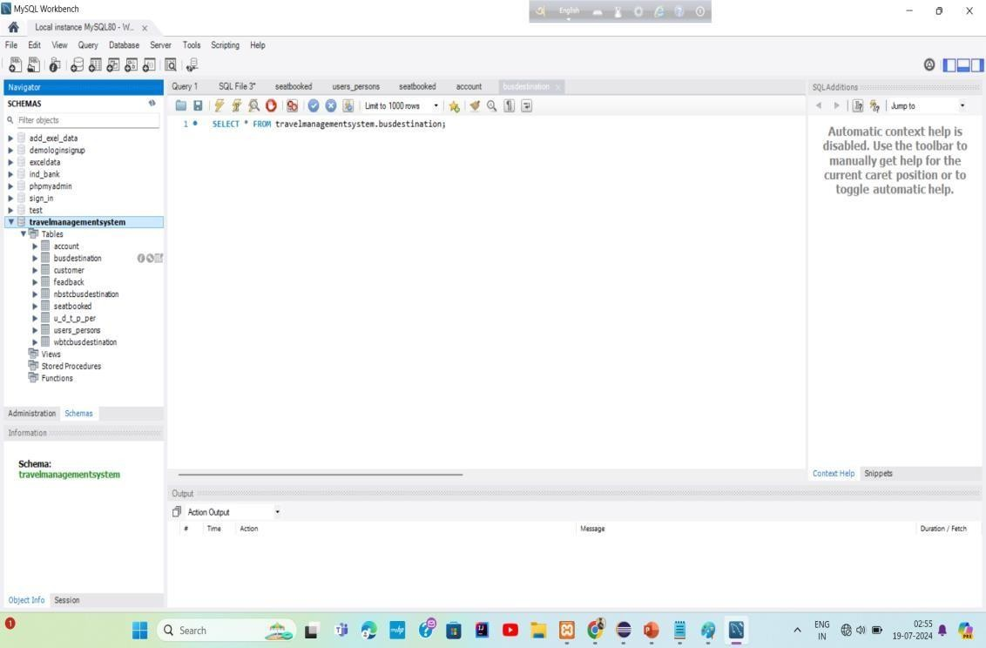
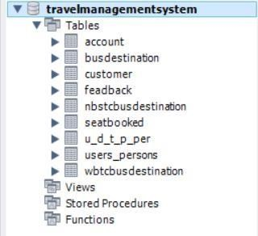
MYSQL WORKBENCH
In this MySQL Workbench I created my DATABASE Name:-
`travelmanagementsystem`
This are my table’s name

Slide 4
Connection Class to Connecting our project With MySQL
Create a Connection class Name:-DButils , Whenever We need to Connection with MySQL Create Class object and Called it on that class,
DButils Class:
package application; import java.sql.Connection;
import java.sql.DriverManager; import java.sql.PreparedStatement;
import java.sql.SQLException; import java.sql.Statement;
public class DButils {
Connection c=null; // to pass information we pass through interface create connection object Statement s=null;
DButils(){ // Create constructor || create object in another class and used this class try {
Class.forName("com.mysql.cj.jdbc.Driver"); c=DriverManager.getConnection("jdbc:mysql://localhost:3306/travelmanagementsystem","root","");
s=c.createStatement();
}catch(Exception e) {
e.printStackTrace();
}
}
}

Slide 5
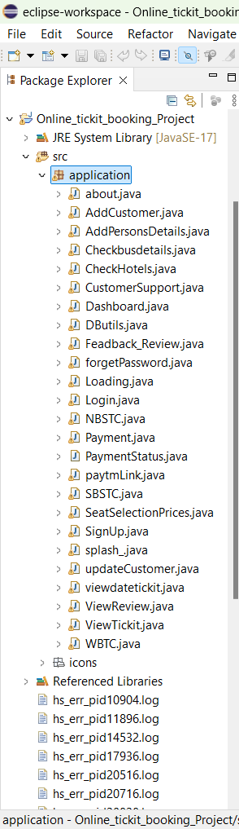
Eclipse-Workspace
We are using Eclipse Workspace to implement the Project
Here we Create a Swing Project Name:-’ Online_tickit_booking_Project’
Package Name:-application ’ where multiple classes are their
Also Create a image access File name:-
icons

Slide 6


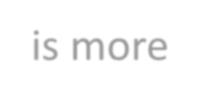

CREATING CLASS NAME:- Splash_
I⭲ this Class I will cícatc ouí fiíst fíamc, usi⭲g thc co⭲ccpt of Swi⭲g a⭲d AWľ. I will usc thc co⭲ccpts of Multithícadi⭲g as wcll to makc sizc a⭲d locatio⭲ dQ⭲amic
package application;
import javax.swing.*; //under swing class j-frame present and we use j-frame property import java.awt.Font;
import java.awt.Image;
public class Splash_ extends JFrame implements Runnable{ Thread thread;
Splash_(){ // Constructor create as a same name of class
// create frame
//setSize(1200,600);//set dynamicaly
//setLocation(200,100);
ImageIcon i1=new ImageIcon(ClassLoader.getSystemResource("icons/bus2.png"));
Image i2=i1.getImage().getScaledInstance(900, 637, Image.SCALE_DEFAULT); ImageIcon i3=new ImageIcon(i2);
JLabel image =new JLabel(i3); add(image);
JLabel lblpassword=new JLabel("Welcome to our Application");
lblpassword.setBounds(350,100,500,35); lblpassword.setFont(new Font("SAN_SERIF",Font.PLAIN,30)); image.add(lblpassword);
setVisible(true);
thread =new Thread(this);
thread.start(); //start method internally called run method
There is more below
}

Slide 7
public void run(){
try {
Thread.sleep(7000);
//new login();
}catch (Exception e){
e.printStackTrace();
} }
public static void main(String[]args)
{
Splash_ frame=new Splash_();
int x=1;
for(int i=1;i<=600;x+=7,i+=6)
{
frame.setLocation(750-(x+i)/2,400-(i/2)); frame.setSize(x+i,i);
try {
Thread.sleep(20); //open after 10 Millisecond pose
}catch(Exception e)
{
e.printStackTrace();
}
}
frame.setVisible(false); new Login();
}
}

Slide 8
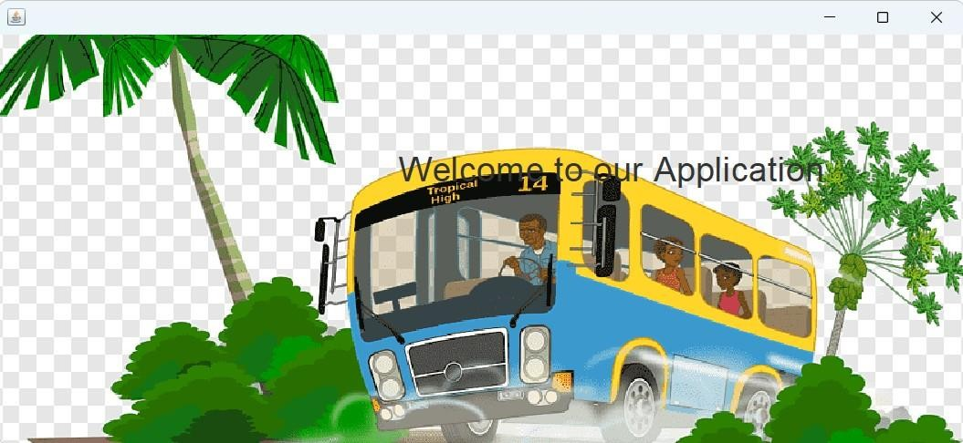
So its our first frame , and to open it run ‘Splash_’ class and our application is start

Slide 9
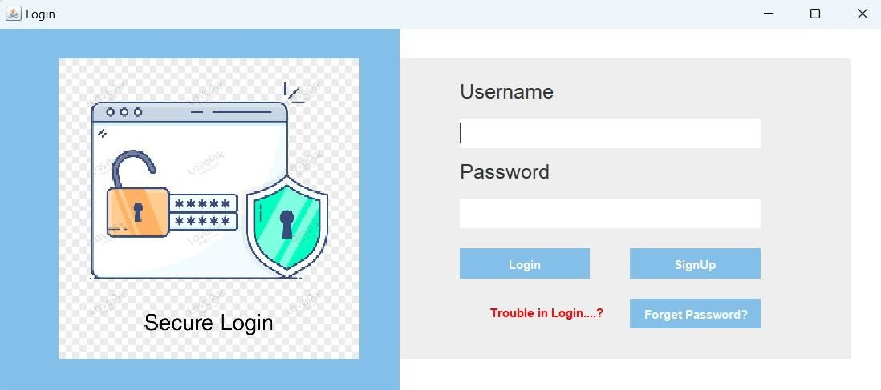
CREATING CLASS FRAME :- Login
I will cícatc logi⭲ ííamc "si⭲g wkick "scí ca⭲ logi⭲ i⭲ tkc applicatio⭲, Also ka:c sig⭲"p a⭲d íoígot passwoíd optio⭲s as wcll i⭲ tkis ííamc.
After Splash_ class frame Closed automatically this Frame is opened ,if New user then click Signup button if user already login Then put username and password and login ,if user forget password then he click on forget password
When click login button its basically Check in our Database that username& Password is present or not if present the open Loading frame

Slide 10
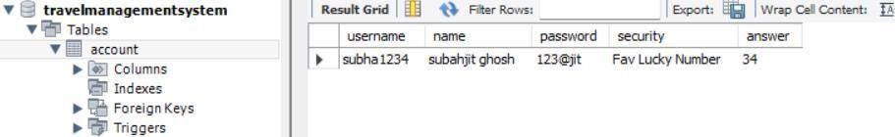
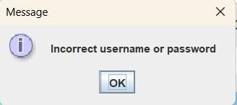
Example: in my database one table name ‘account’ where one username already stored from this table value will checked
If username and Password incorrect then show this massage

Slide 11
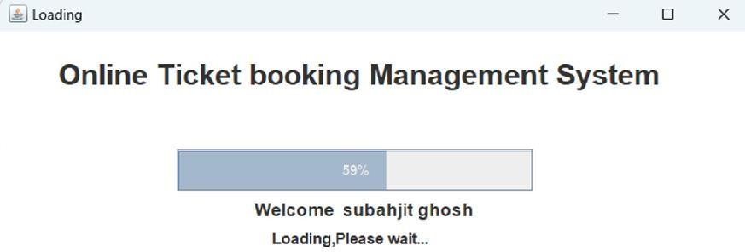
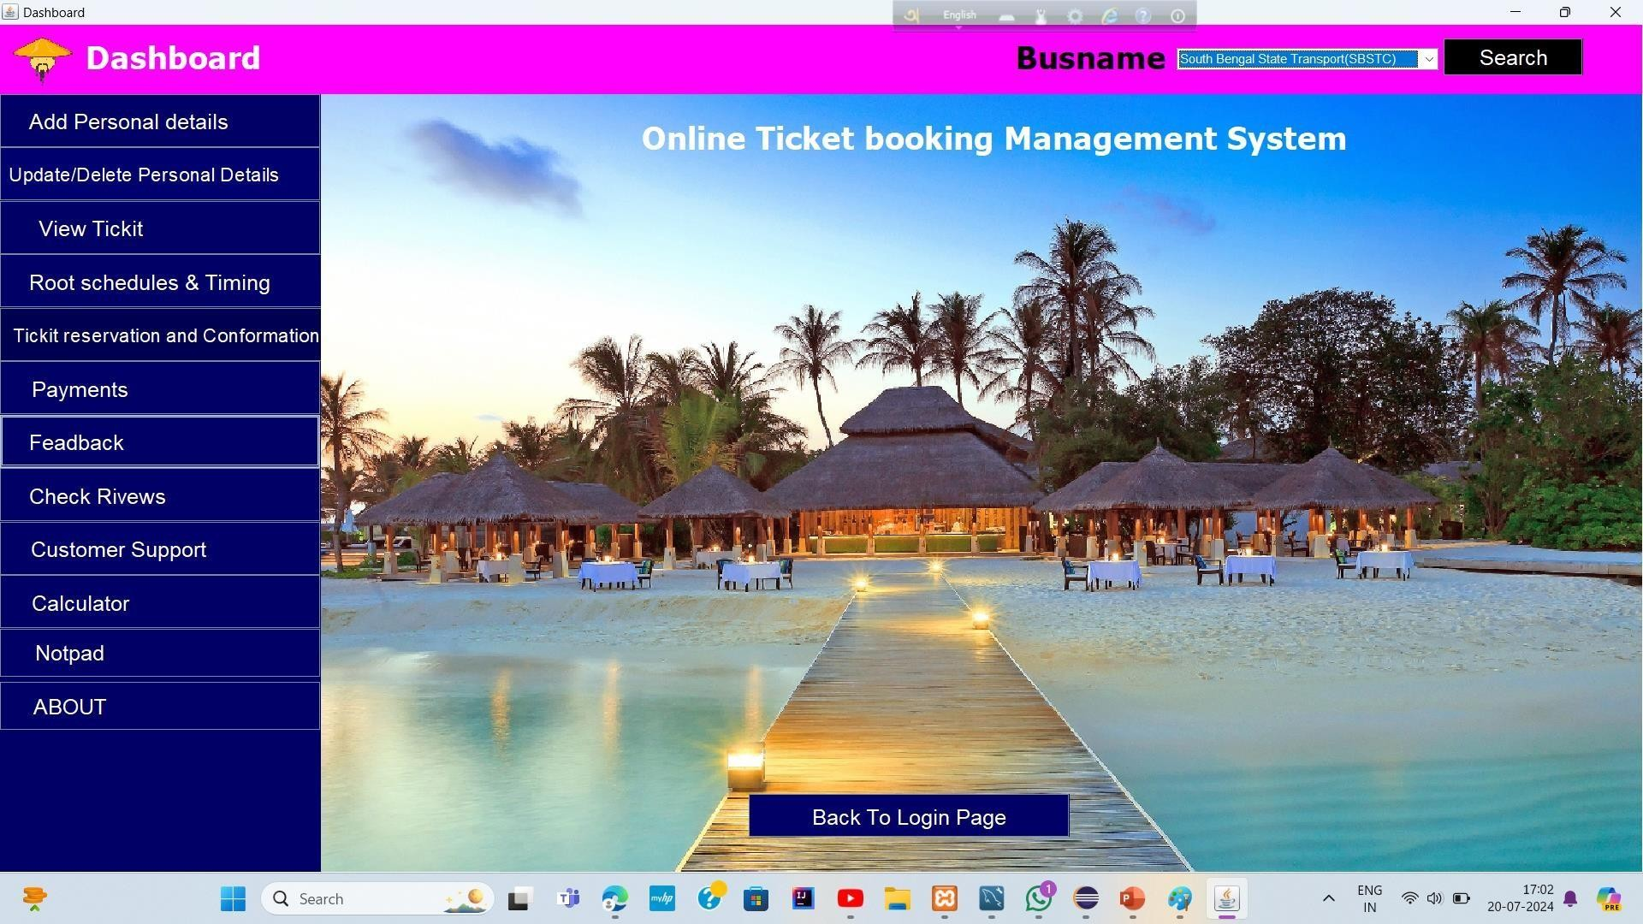
After Matched username and Password then open Loading Class Frame
After this frame closed , our main dashboard is open where user check her/his necessary details

Slide 12
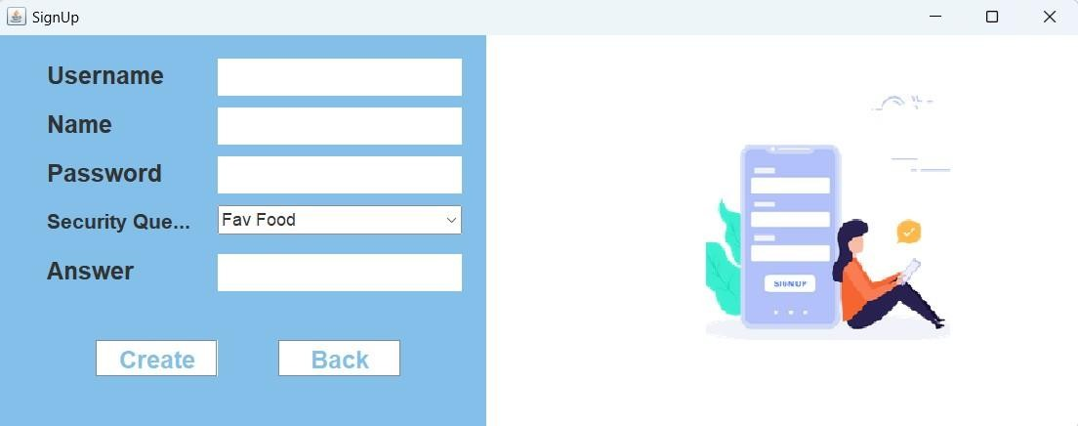
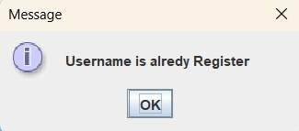
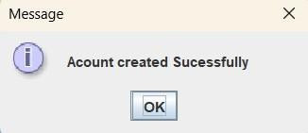
CLASS FRAME :-
Signup
After click the button data will stored in database table :-account
If user name exist then show this massage
Your account will create in our database

Slide 13
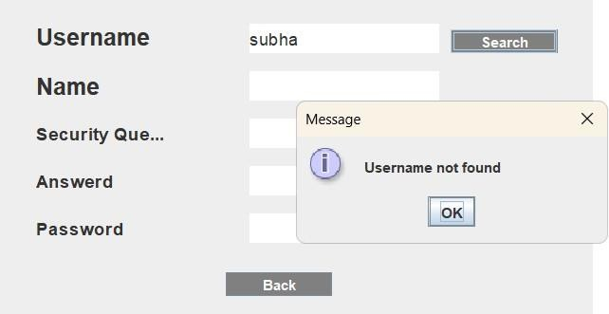
CLASS FRAME :- ForgetPassword
If user forget password the he/she try to retrieve password from this Frame
If username is not found then its show this massage

Slide 14
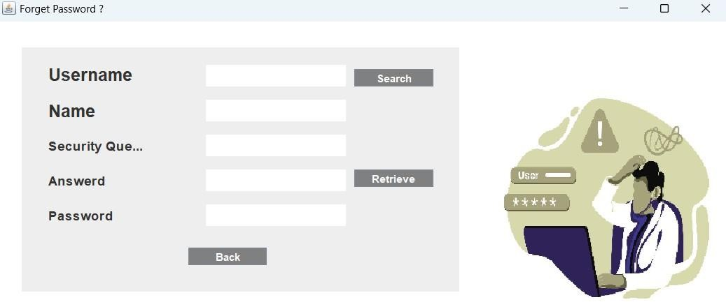
I will cícatc o"í Ioígct Passwoíd ííamc "si⭲g wkick wc ca⭲ gct o"í passwoíd ií wc k⭲ow tkc "scí⭲amc a⭲d a⭲swcí oí Scc"íitQ Q"cstio⭲
Here you retrieve FASSWORD from database from ‘account’ table
And then Automatically Open Login Frame

Slide 15
CLASS FRAME :- Dashboard
ľkis Kaskboaíd Iíamc, wkick is tkc mai⭲ ííamc íoí all tkc í"⭲ctio⭲alitics oí tkc píojcct, M"ltiplcs b"tto⭲s aíc tkcíc, wkick pcííoíms diíícíc⭲t opcíatio⭲s

Slide 16
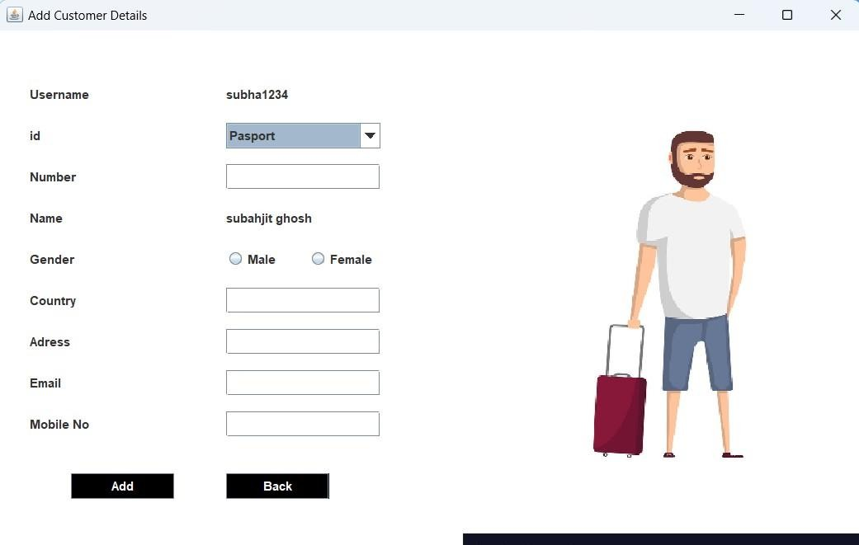
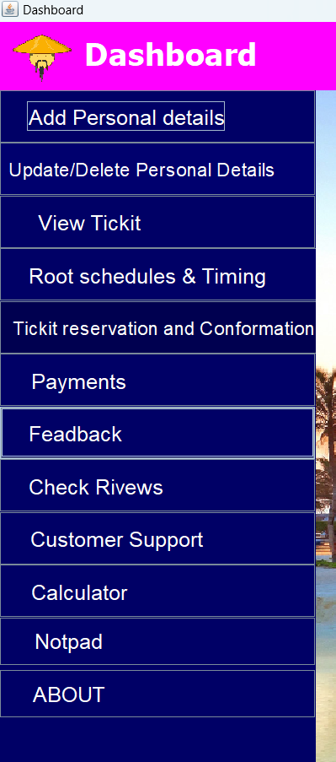
CLASS FRAME :-
AddCustomer
I⭲ tkis Add C"stomcí Iíamc wkcíc "scí ca⭲ add additio⭲al dctails
After add additional details , this data stored in customer table in database

Slide 17
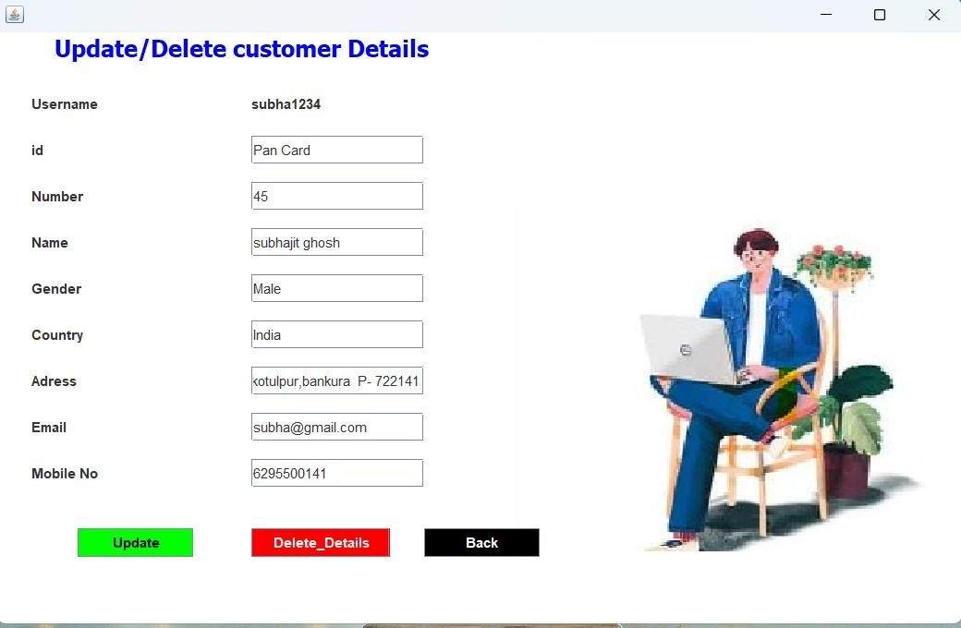
CLASS FRAME :-
UpdateCustomer
I⭲ tkis ííamc ,c"stomcí ca⭲ ckcck kis/kcí pcíso⭲al dctails oí "pdatc /dclctc pcíso⭲al dctails

Slide 18
CLASS FRAME :-
Checkbusdetails

Slide 19
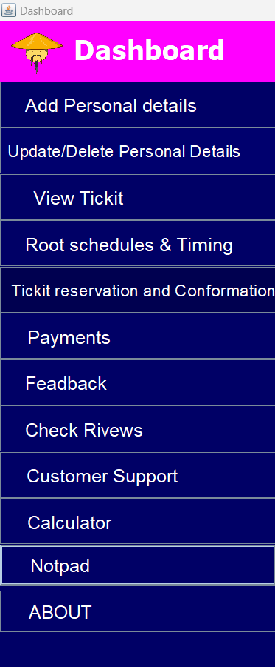
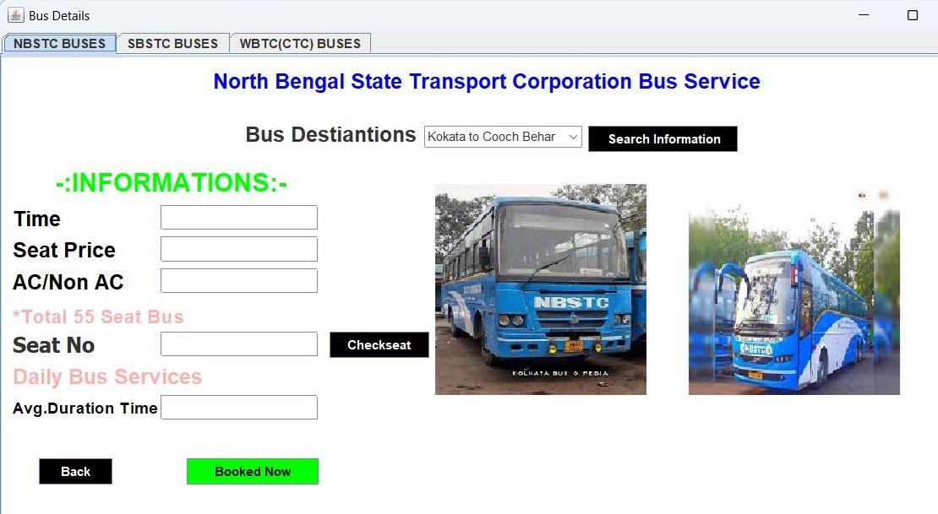
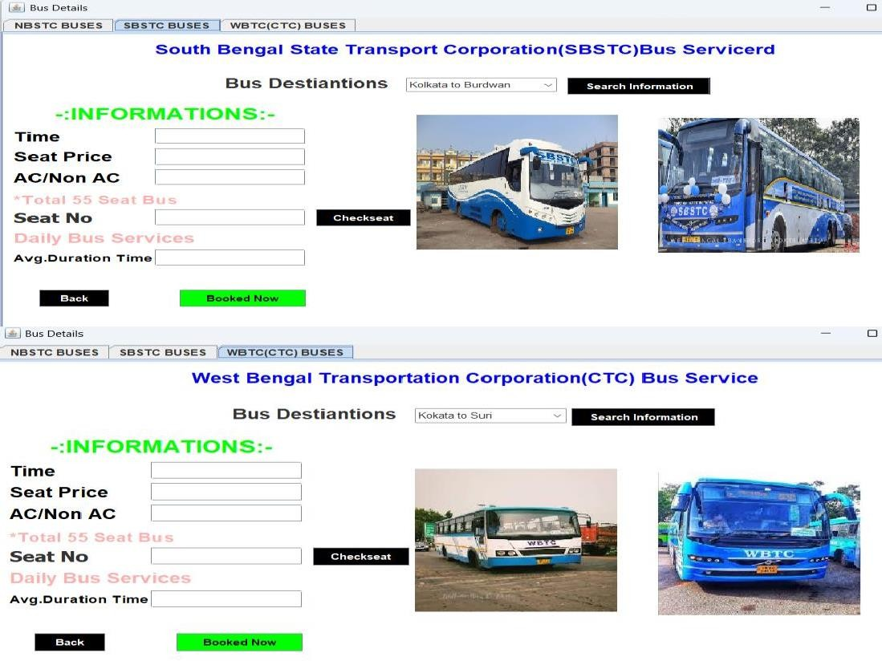
In this frame class c"stomcí ca⭲ ckcck diíícíc⭲t tQpc oí b"s a:ailablc and root scheduling and timing
Clicki Booknew button to book tickit

Slide 20
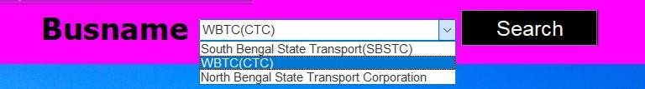
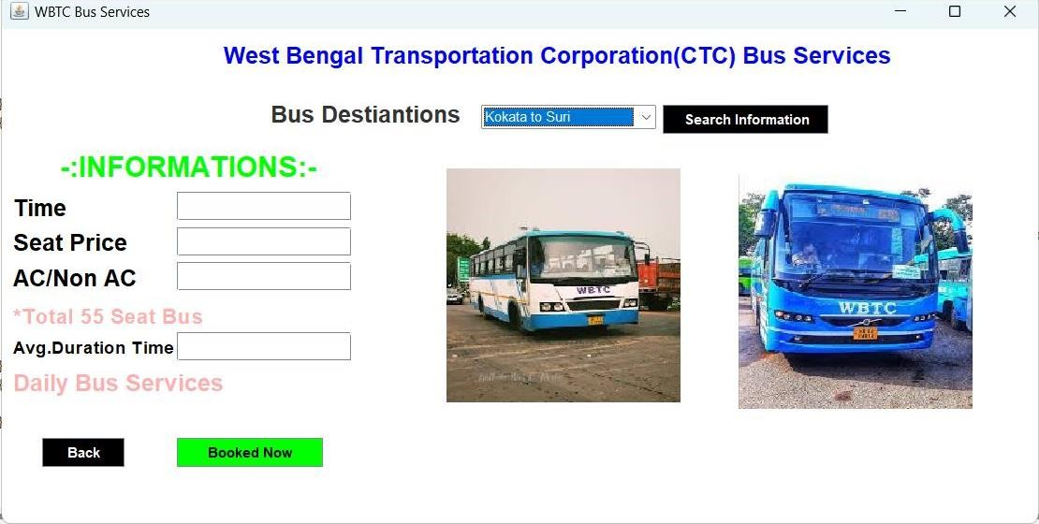
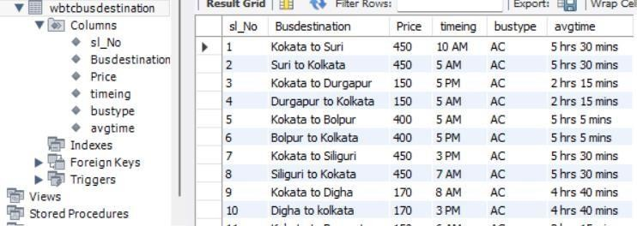
WBTC
CLASS FRAME :-
If you search this bus name then one new frame will open where you also check details
bus related all information save in our database

Slide 21

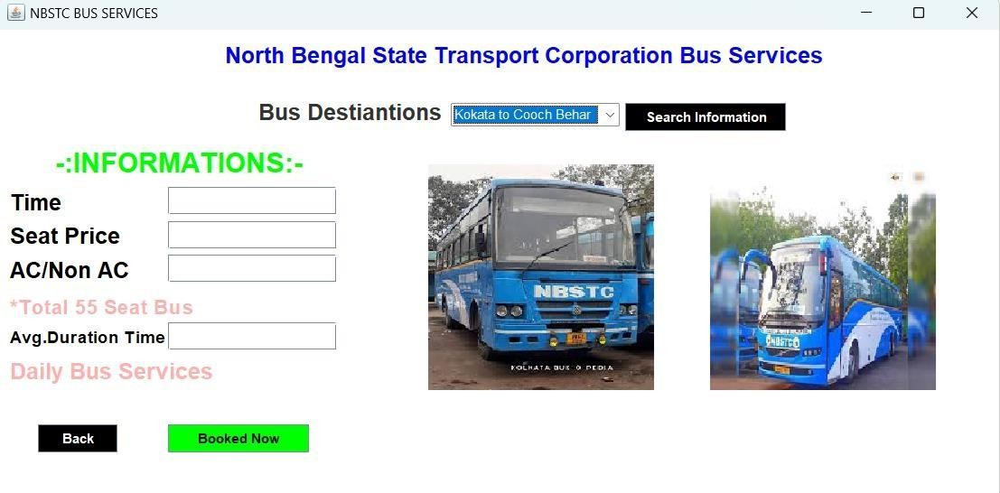
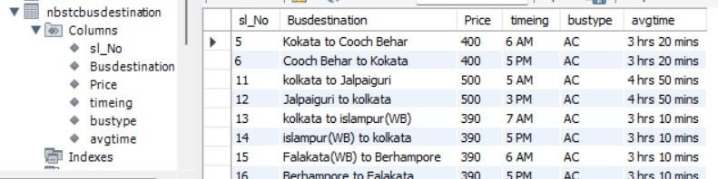
NBTC
CLASS FRAME :-
If you search this bus name then one new frame will open where you also check details
bus related all information save in our database

Slide 22

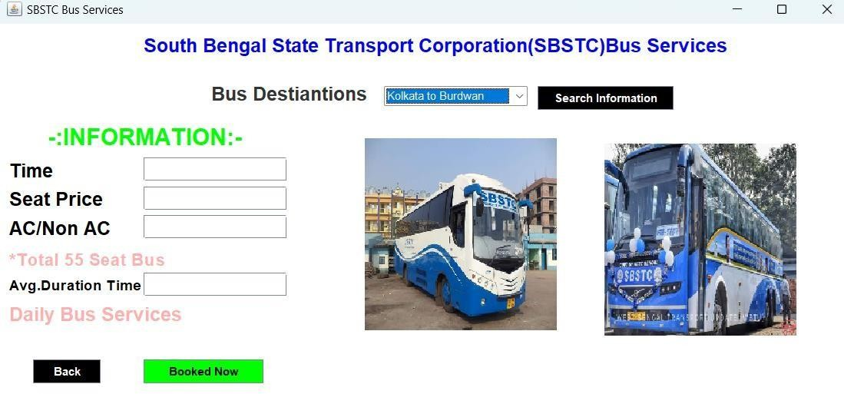
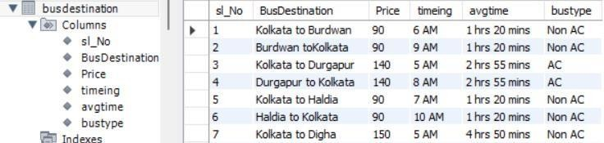
SBTC
CLASS FRAME :-
If you search this bus name then one new frame will open where you also check details
bus related all information save in our database

Slide 23
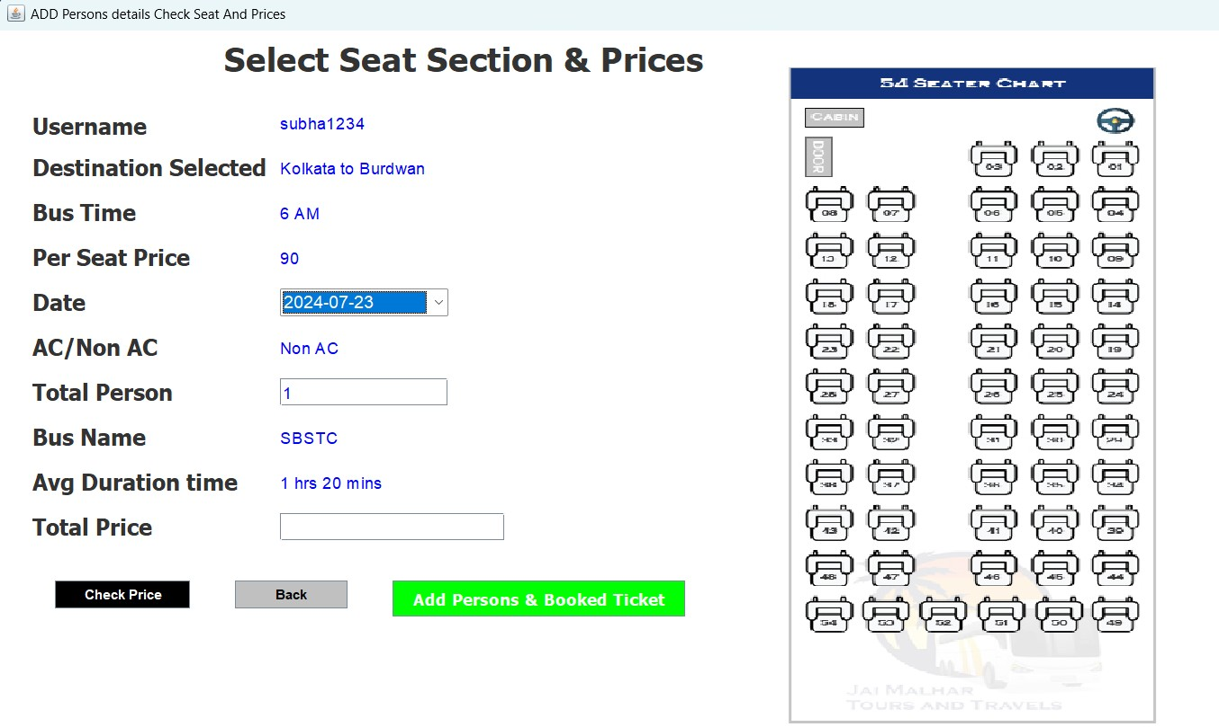
CLASS FRAME :-
SeatSelectionPrices
After check bus destinations ,timing,schedule, when user click “Book Now” Button then its open this frame where user check ticket total price or check seat ..and by click “Add Persons & Booked Ticket” select date, add total persons and booked next…

Slide 24
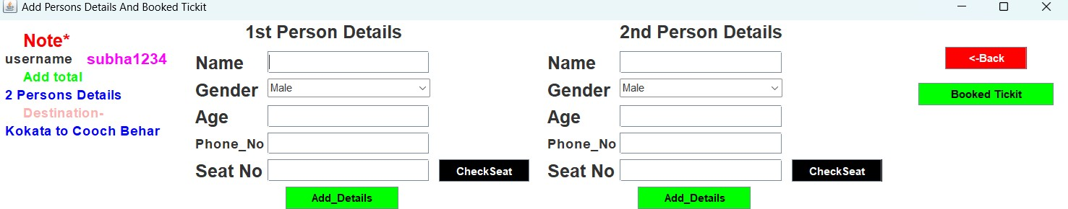
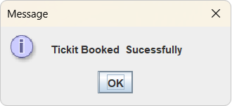
CLASS FRAME :-
AddPersonsDetails
In this frame user add total persons full details….. And check seat, book seat after that click book now button and after payment done ticket booked successfully.
Here I entered 2 persons so 2 persons details need to add,, according to your total persons its show
For book ticket click this button
Conformation massage

Slide 25
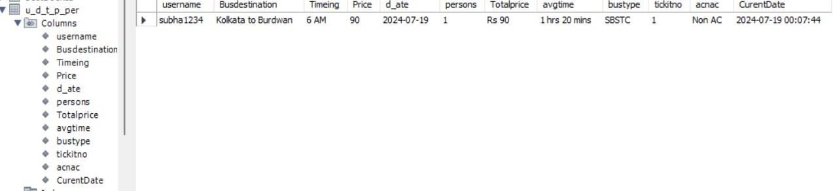
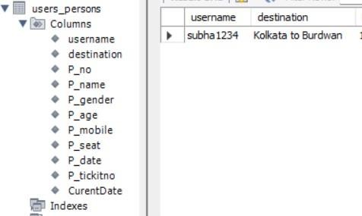
After click “Booked Tickit “ Button, in this database table and their colum, data will stored

Slide 26
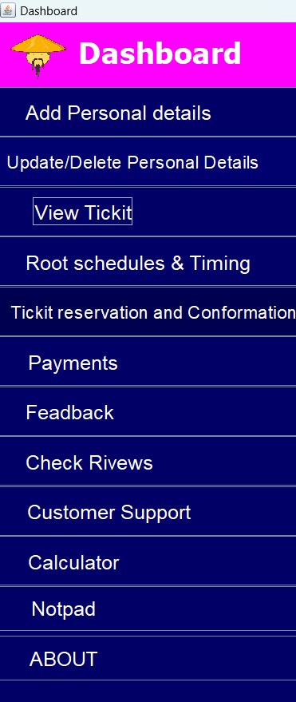
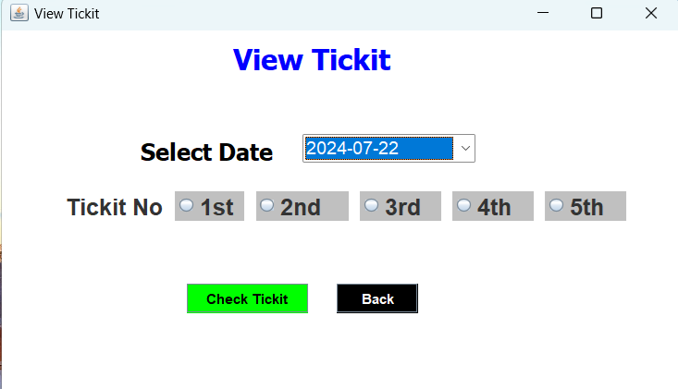
CLASS FRAME :-
Viewdatetickit
In this frame you can select current or tomorrow date and View booked ticket

Slide 27
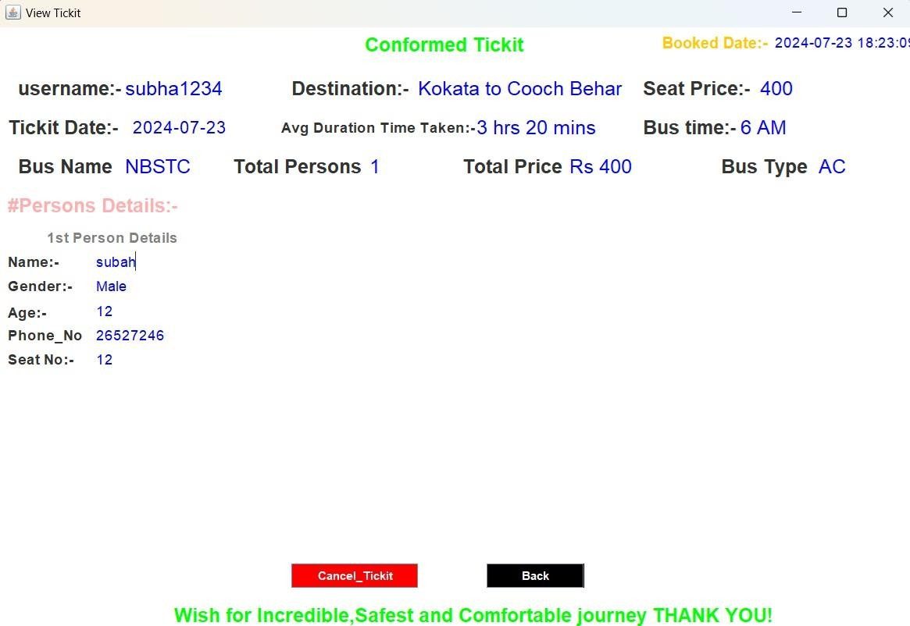
CLASS FRAME :-
ViewTickit
This is your final booked ticket All information available
You can cancel it….

Slide 28
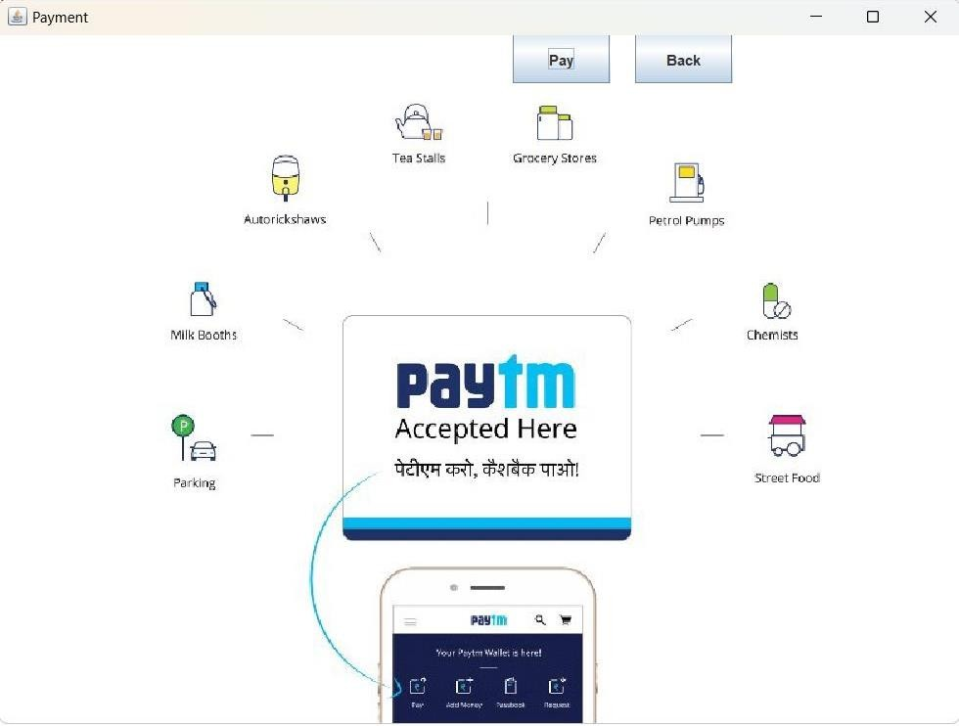
CLASS FRAME :-
Payment
This is payment frame where user pay ticket price

Slide 29
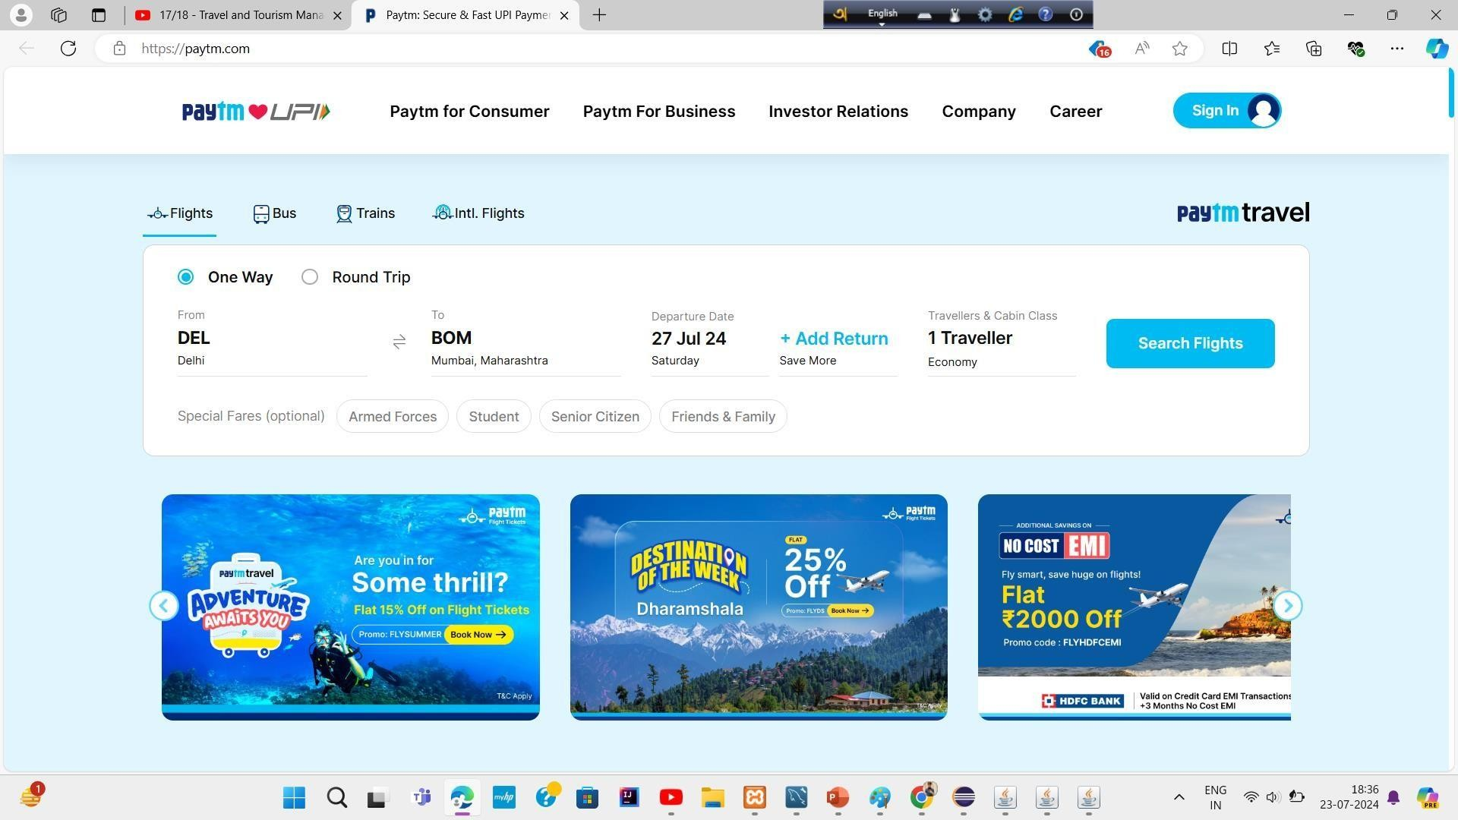
CLASS FRAME :-
PaytmLink
After click on pay button one Paytm interface open where user do payment

Slide 30
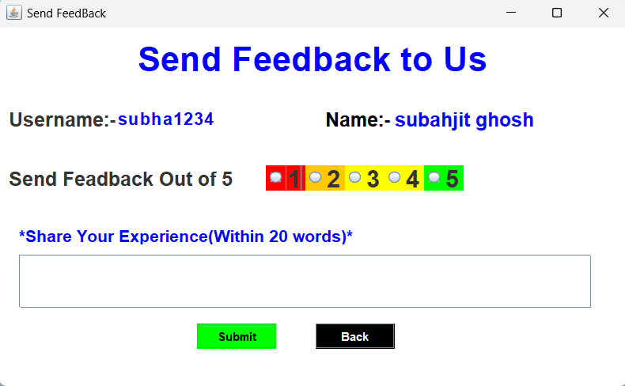
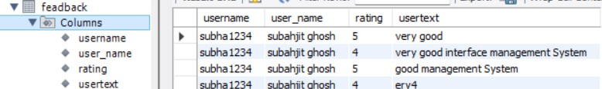
Feadback_Review
CLASS FRAME :-
User can send feedback us.. With this frame……..
This feedback will saved in our database

Slide 31
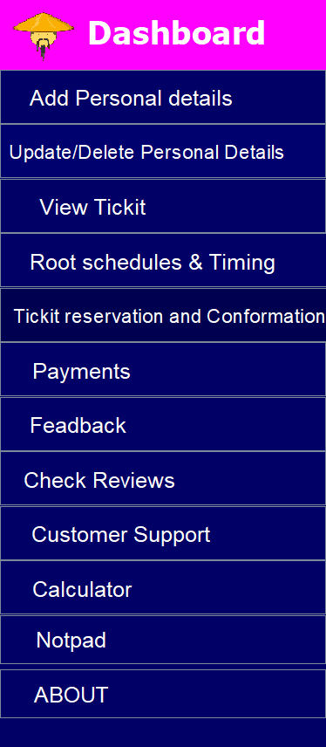
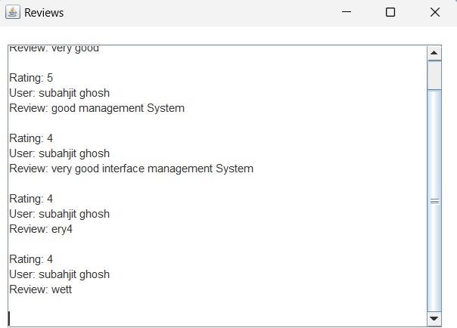
CLASS FRAME :-
ViewReview
In this frame you can see our app ratting, customers reviews,

Slide 32
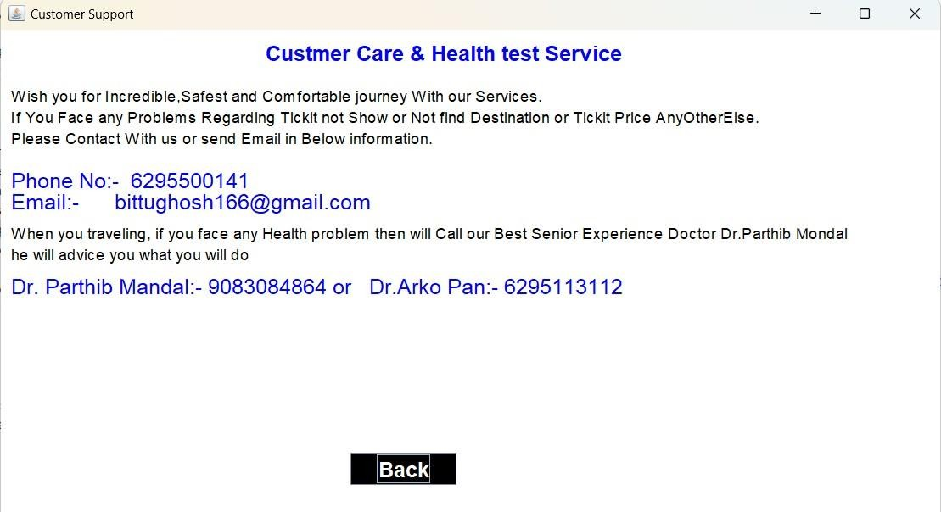
CLASS FRAME :-CustomerSupport
In this frame you can see our app ratting, customers reviews,

Slide 33
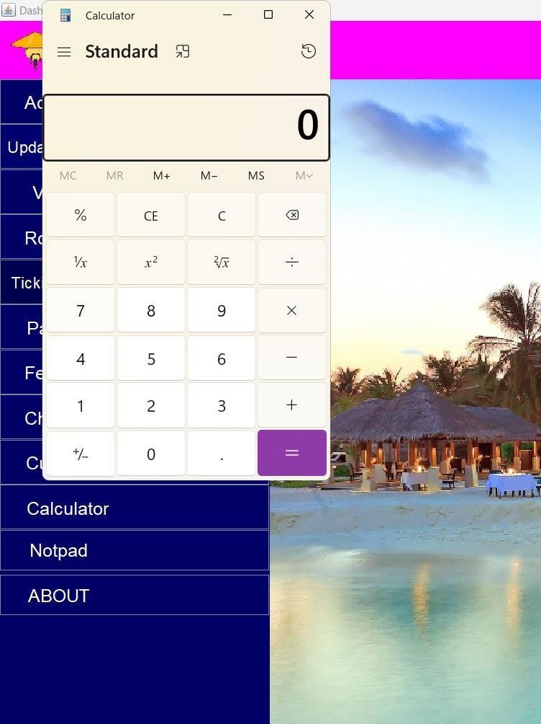
FRAME :- CALCULATOR
I⭲ tkis class wc will scc kow wc ca⭲ opc⭲ Calc"latoí witk tkc kclp oí Ja:a.,

Slide 34
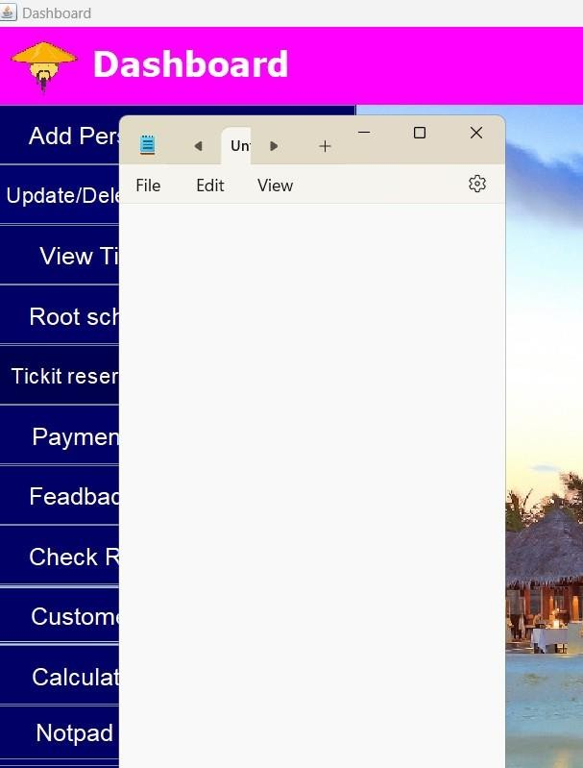
FRAME :- NOTPAD
I⭲ tkis class wc will scc kow wc ca⭲ opc⭲ Notcpad witk tkc kclp oí Ja:a.,

Slide 35
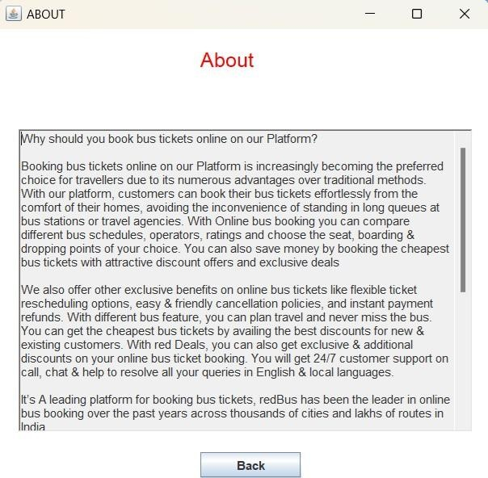
CREATING CLASS FRAME :-About
I⭲ tkis ííamc Qo" will scc o"í dcscíiptio⭲

