Slide 1
Semantic Retrieval and Multi-Temporal
Change Analysis of Satellite Imagery
Using a Shared Foundation-Model Embedding Space
Project Review • BCSE407L – Computer Vision
Research Integrated Learning (RIL)
Aligned to SIH 2026 · PS SIH26227 · Ministry of Defence (Indian Army, DGIS)
Akanksha Bharti • 23BCE0257
Arjun Pratap Singh • 23BCE2027
Gontla Venkata Siva Sai Nikhil • 23BCE0318
Subhajit Masanta • 23BCE0292
1

Slide 2
Abstract
Domain: Semantic Search and Change Analysis for Earth Observation
Earth-observation archives now hold multi-temporal, multi-spectral and multi-sensor imagery at a scale that defeats manual review. Conventional catalogues index only metadata — coordinates, date, platform — so an analyst must already know where and when to look before examining any imagery.
This project proposes a training-free pipeline that makes a satellite archive queryable both by meaning and by change over time. Every tile is encoded once by a frozen remote-sensing foundation model and indexed for similarity search. The same embedding space then does double duty: it ranks tiles against a free-text or image query, and it supplies the change signal between two acquisition dates for the same location.
Detected changes are refined at pixel level, classified into construction, clearance, water-extent and vegetation change, and passed through a false-alarm suppression stage that treats season, illumination, cloud, shadow and radiometric drift as confounds rather than as change.
Evaluation uses the public LEVIR-CD and OSCD benchmarks, with qualitative demonstration on open Copernicus Sentinel-2 and NRSC/ISRO Bhuvan imagery. All models are pretrained and used for inference only — nothing is trained or fine-tuned.
2

Slide 3
Introduction I — The Archive Problem
Why metadata search is no longer enough
Archive scale
Metadata-only search
Discovery gap
Copernicus, Landsat and Bhuvan publish vast, growing, freely available archives.
Catalogues filter by coordinates, date, platform and product type — never by content.
An analyst must already know where to look; the archive cannot suggest locations.
Change gap
Confounds dominate
Precision matters
Determining what changed means manually locating, aligning and comparing scenes.
Season, illumination, cloud, shadow and registration error mimic real change.
A detector that flags everything is operationally useless — false alarms bury real signal.
Downstream impact: intelligence analysis, infrastructure monitoring, disaster assessment and urban-expansion tracking all stall at the same bottleneck — finding the relevant imagery inside an archive too large to inspect by hand.
3

Slide 4
Introduction II — Problem, Motivation & Novelty
Problem
Motivation
Satellite archives are searched only by coordinates, date and sensor — never by image content
Retrieval systems and change-detection systems are always built separately — doubling cost and storage
Existing change detectors optimise for finding everything (Recall), flooding analysts with false alarms
Seasonal shifts, clouds and shadows are wrongly flagged as real ground changes
Let analysts type plain English to find relevant imagery — no need to know exact locations in advance
One unified system for both search and change detection — less storage, less compute
Prioritise Precision: only flag changes that are actually real and actionable
Use frozen pre-trained models — no training cost, no labelled data needed, works immediately
Novelty
Single shared embedding space serves both tasks — the same image vector used for search is also used to detect change
False-alarm suppression built-in — cloud, shadow, season and illumination are treated as noise, not change
Evaluated by False-Alarm Suppression — our system is judged on its ability to ignore fake changes like weather and lighting, ensuring only real physical changes are reported
No new model invented — contribution is the coupling of two tasks in one representation
4

Slide 5
Literature Review 1/3
Foundation models and shared embedding spaces
#
Paper
Methodology
Pros / Cons • Key Finding
1
CLIP — Radford et al. (2021)
Contrastive image–text pretraining
+ Zero-shot text search − Natural-image domain gap • One shared space enables retrieval without training
2
RemoteCLIP — Liu et al. (2024)
Continued pretraining on remote-sensing image–text data
+ Closes EO domain gap − Weights must be staged • Large gains on EO retrieval quality
3
DINOv2 — Oquab et al. (2023)
Self-supervised distillation at scale
+ Strong frozen dense features − No native text alignment • Features transfer across visual domains
5

Slide 6
Literature Review 2/3
Change detection — learned and classical
#
Paper
Methodology
Pros / Cons • Key Finding
4
Siamese FCN for Change Detection (OSCD) — Daudt et al. (2018)
Siamese fully-convolutional nets on Sentinel-2 pairs
+ Established baseline + benchmark − Supervised, recall-oriented • Feature differencing is an effective formulation
5
STANet / LEVIR-CD — Chen & Shi (2020)
Spatial-temporal attention over bitemporal pairs
+ Large annotated benchmark − Supervised, building-specific • Attention improves change localisation
6
Change Vector Analysis — Malila (1980)
Vector difference across spectral bands
+ Simple, interpretable, training-free − Sensitive to illumination drift • Remains a standard classical baseline
6

Slide 7
Literature Review 3/3
Vector search and current EO foundation-model work
#
Paper
Methodology
Pros / Cons • Key Finding
7
FAISS — Johnson et al. (2019)
Quantisation and indexing for approximate NN search
+ Scales to very large archives − Approximate indexes trade recall for speed • Makes embedding search tractable
8
EO foundation-model & semantic retrieval work (2024–2026)
Large pretrained encoders adapted to EO tasks
+ Strong transfer, less labelling − Single-task; retrieval and change stay separate • The gap this project targets
Across all eight: retrieval and change analysis are consistently treated as separate systems, and change is consistently evaluated by recall rather than by precision under confounds.
7

Slide 8
Overall Literature Review — Research Gap
Existing Research
Proposed Project
• Vision-language models enable semantic retrieval without task-specific training
• Siamese and attention networks dominate change detection
• Most change methods require supervised training on annotated pairs
• Retrieval and change detection use separate representations
• Evaluation emphasises change recall and overall accuracy
• Confounds are handled implicitly, if at all
• One shared embedding space serves retrieval AND change analysis
• Frozen pretrained encoders only — no training, no fine-tuning
• Explicit suppression of season, illumination, cloud, shadow, radiometric drift
• Precision under confound stress as the primary evaluation target
• Geospatial provenance preserved end to end
• Honest scope declaration against the six PS capabilities
The gap: no existing system couples both tasks in one representation while evaluating change by whether it is real rather than by how much of it is found.
8

Slide 9
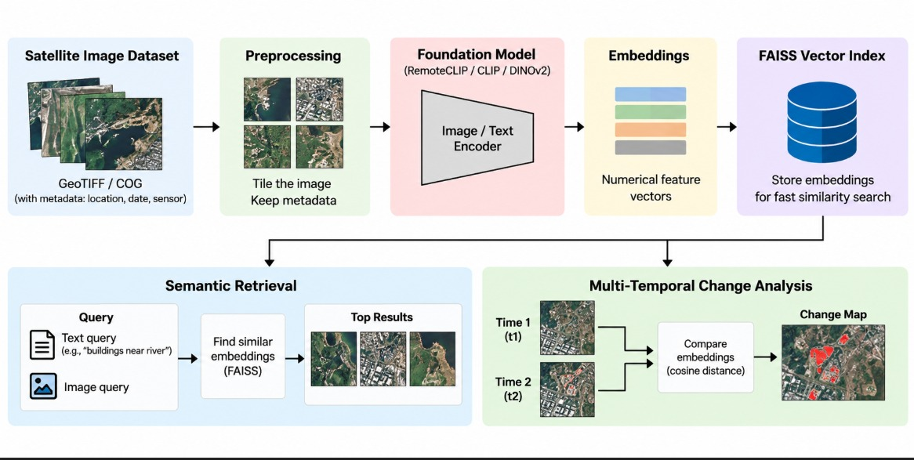
Architecture — Shared-Embedding Workflow
9

Slide 10
Scope Declaration — What We Build, What We Don't
PS SIH26227 specifies six capabilities. We state honestly which we deliver.
PS §
Capability
Our scope
2.2.1
Semantic + image-to-image retrieval
FULL BUILD — text query, image search, ranked results, metadata filters
2.2.2
Multi-temporal change analysis + typing
FULL BUILD — change mask + construction / clearance / water / vegetation
2.2.3
False-alarm suppression & quality handling
PARTIAL — cloud/shadow mask, radiometric normalisation, confidence; stated subset of confounds
2.2.4
Discovery & clustering
STRETCH GOAL — embedding-based grouping over the existing index
2.2.5
Analyst workflow, provenance, audit trail
OUT OF SCOPE — documented as future work
2.2.6
Offline / incremental / production indexing
OUT OF SCOPE — static index; GeoTIFF read demonstrated, not productionised
Declaring scope is a strength, not a weakness — it is what separates a research prototype from an overclaim.
10

Slide 11
Technologies to be Used
Pretrained models, inference only — nothing is trained or fine-tuned
Python 3.10+
PyTorch + open_clip
Primary implementation language
Frozen RemoteCLIP / CLIP / DINOv2 encoders — inference only
FAISS
rasterio / GDAL
Vector indexing and nearest-neighbour similarity search
GeoTIFF & COG reading, CRS and geo-metadata preservation
NumPy + OpenCV + scikit-image
scikit-learn
Distance maths, masking, morphology, SSIM, radiometric normalisation
Clustering for site discovery, metric computation
Matplotlib
Google Colab
Before/after/mask panels, ranked-result grids, comparison charts
Free tier sufficient; GPU optional, CPU workable at our dataset size
Model provenance — name, version, source URL and licence — is recorded for every pretrained weight, as the problem statement requires.
11

Slide 12
Datasets — Sources & Validity
All public. No classified, operational or service-generated imagery.
Dataset
Size
Labels
Role in this project
LEVIR-CD
637 pairs, 1024×1024, 0.5 m
Pixel-level change masks
PRIMARY — all headline Precision@k, mAP, F1, IoU numbers
OSCD (Onera)
24 pairs, real Sentinel-2 MSI
Pixel-level change masks
SECONDARY — proves transfer to genuine Sentinel-2 data
Copernicus Sentinel-1/2
Hand-picked AOI tiles
None
QUALITATIVE demo only — the PS's own named source
USGS Landsat C2
Hand-picked AOI tiles
None
QUALITATIVE demo only (optional)
NRSC / ISRO Bhuvan
Hand-picked AOI tiles
None
QUALITATIVE demo only — Indian EO source coverage
Metric validity rule
Quantitative results are reported ONLY where annotated ground truth exists — LEVIR-CD and OSCD. Sentinel-2 / Landsat / Bhuvan tiles appear as qualitative figures and never enter a metrics table.
12

Slide 13
Evaluation — Metrics & Baselines
Precision-first, as PS §2.2.3 requires
Retrieval
Change Detection
Method
P@5
mAP
Method
Prec.
F1
FP↓
Random ranking
—
—
Pixel diff + Otsu
—
—
—
Metadata-only filter
—
—
Change Vector Analysis
—
—
—
Generic CLIP
—
—
SSIM differencing
—
—
—
RemoteCLIP (Ours)
—
—
Embedding Δ + suppression
—
—
—
Three validation gates — pass/fail, run early
Gate A — Retrieval works
Gate B — Shared space beats pixels
Gate C — Suppression suppresses
5 held-out text queries over a 200-tile index.
PASS: ≥3 of 5 return a relevant tile in the top-5.
5 labelled LEVIR-CD pairs, F1 of embedding Δ vs. pixel diff + Otsu.
PASS: ours wins on ≥3 of 5.
3 NO-CHANGE pairs with seasonal / illumination shift.
PASS: our false-positive area lower on ≥2 of 3.
Gate C validates the novelty claim directly. If it fails, the contribution is unsupported — so it runs in Week 2, not Week 6.
13

Slide 14
Expected Outcome & Project Direction
Expected Outcome
Success Criteria
Core Contribution
A fully operational, training-free satellite analysis system.
Analysts can search archives using plain English text (Semantic Retrieval).
System automatically detects physical changes between two dates (Change Analysis).
High precision achieved through automated cloud and shadow suppression.
Retrieval: Higher search accuracy than standard metadata filters.
Change Detection: Outperforms basic pixel differencing on the LEVIR-CD benchmark dataset.
False-Alarm Test (Gate C): Successfully ignores fake changes caused by weather or seasons.
Moving away from two separate, disconnected AI systems.
Coupling both search and change analysis into one shared mathematical space.
Evaluating success by whether a reported change is real, rather than just finding every pixel shift.
Deliverables
Working end-to-end software pipeline (~600 lines of code).
Live demonstration using real Copernicus Sentinel-2 and ISRO Bhuvan satellite imagery.
Reproducible evaluation report detailing system latency and accuracy.
• Index build time, latency, storage, hardware
• Live demo + individual contribution statement
14

