Slide 1
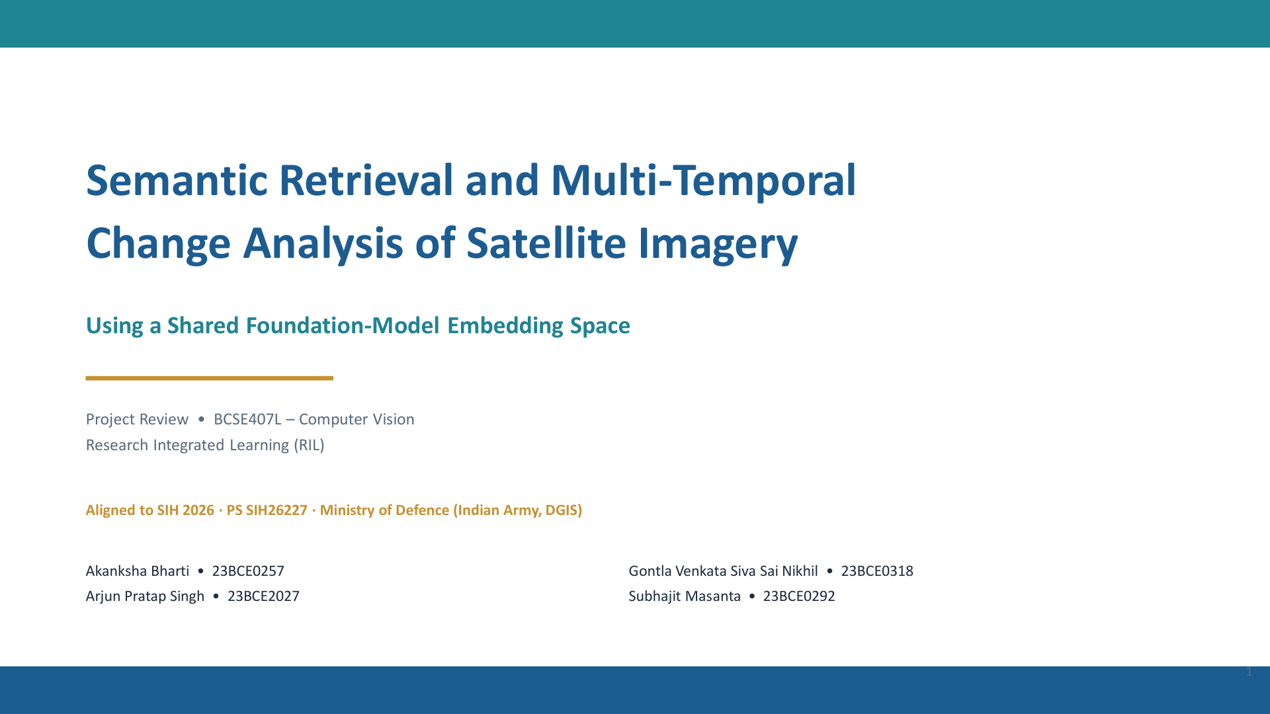

Slide 2
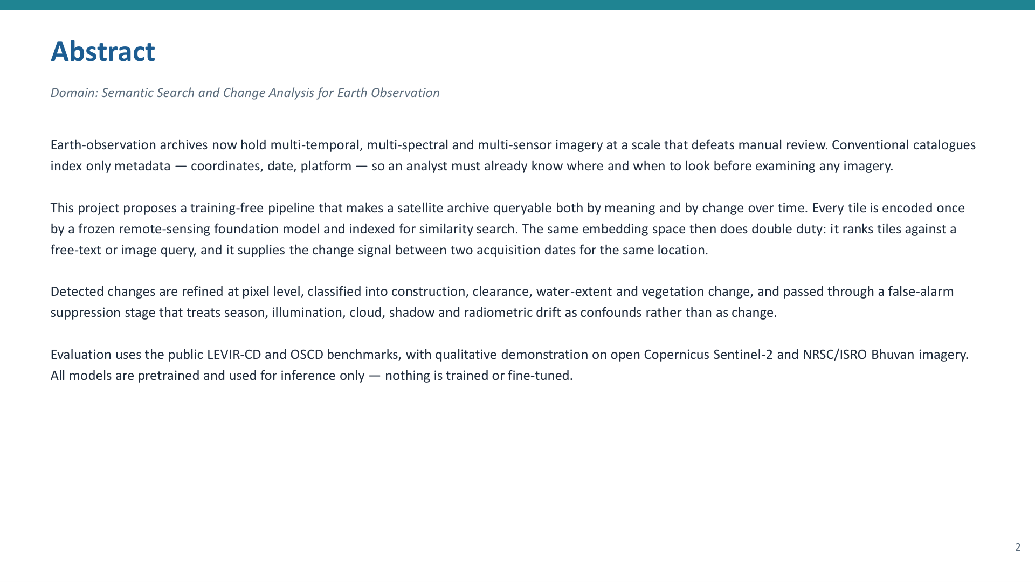
Our project addresses this problem by making satellite imagery searchable by meaning as well as by metadata.
So instead of manually going through thousands of images, an analyst could ask a query such as “find newly built structures near a river”, and our system can retrieve visually and semantically relevant satellite images.
But finding an image is only one part of the problem. We also want to understand what has changed at a particular location over time. For example, if we have an image from 2022 and another from 2025, our system should be able to identify meaningful changes such as construction, clearance, water or vegetation changes.
The interesting part of our approach is that we use a shared foundation-model embedding space for both tasks—retrieval and change analysis.

Slide 3
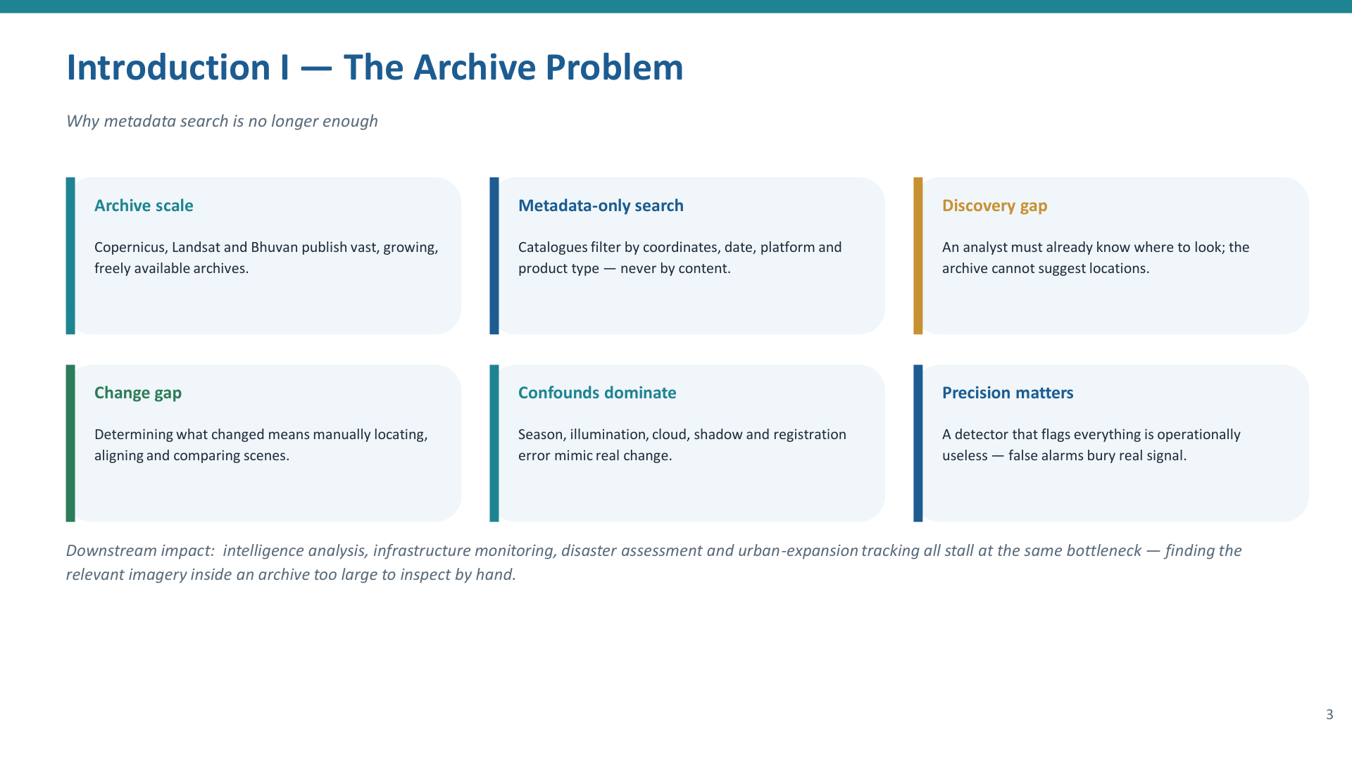

Slide 4
Introduction II — Problem, Motivation & Novelty
Problem
Motivation
Satellite archives are searched only by coordinates, date and sensor — never by image content
Retrieval systems and change-detection systems are always built separately — doubling cost and storage
Existing change detectors optimize for finding everything (Recall), flooding analysts with false alarms
Seasonal shifts, clouds and shadows are wrongly flagged as real ground changes
Let analysts type plain English to find relevant imagery — no need to know exact locations in advance
One unified system for both search and change detection — less storage, less compute
Prioritize Precision: only flag changes that are actually real and actionable
Use frozen pre-trained models — no training cost, no labelled data needed, works immediately
Novelty
Single shared embedding space serves both tasks — the same image vector used for search is also used to detect change
False-alarm suppression built-in — cloud, shadow, season and illumination are treated as noise, not change
Evaluated by False-Alarm Suppression — our system is judged on its ability to ignore fake changes like weather and lighting, ensuring only real physical changes are reported
No new model invented — contribution is the coupling of two tasks in one
4

Slide 5
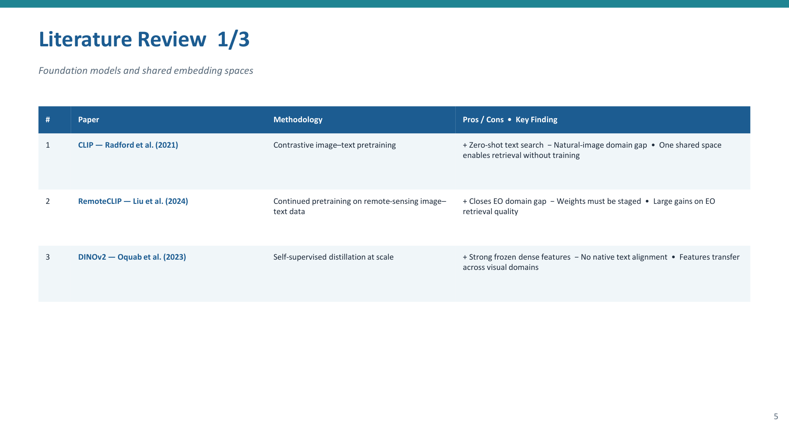

Slide 6


Slide 7
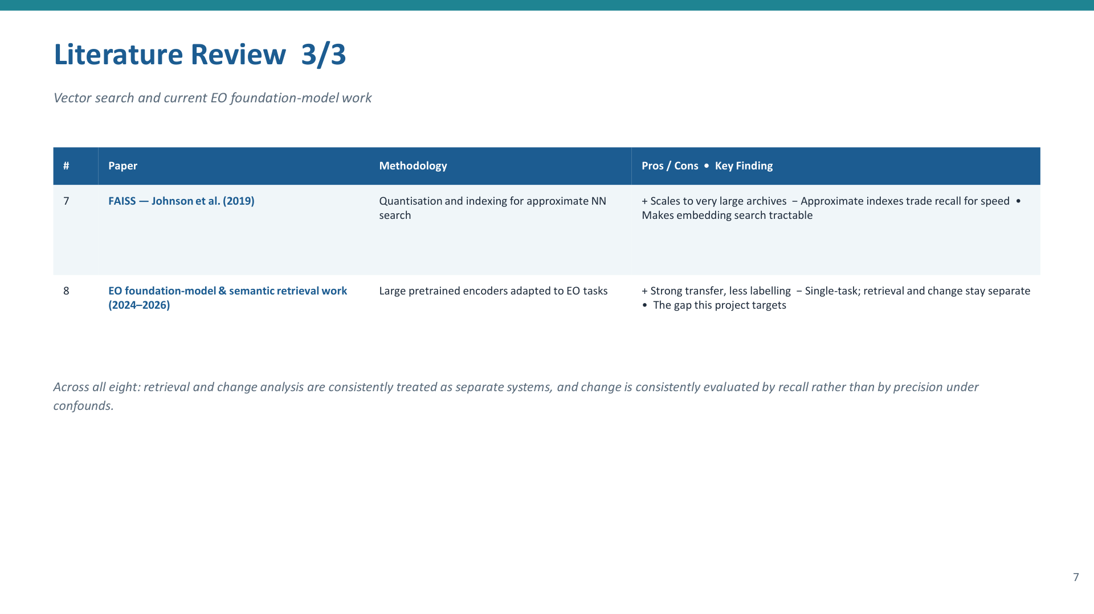

Slide 8
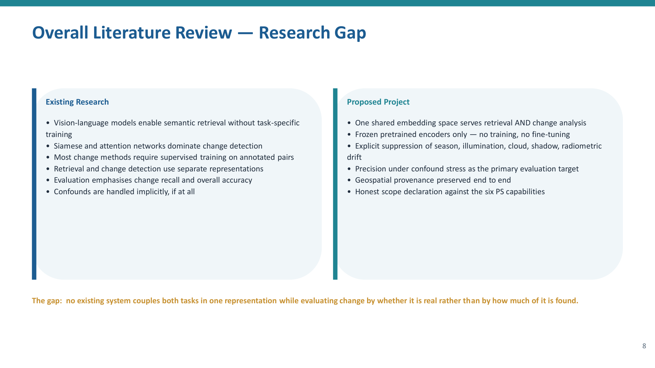

Slide 9
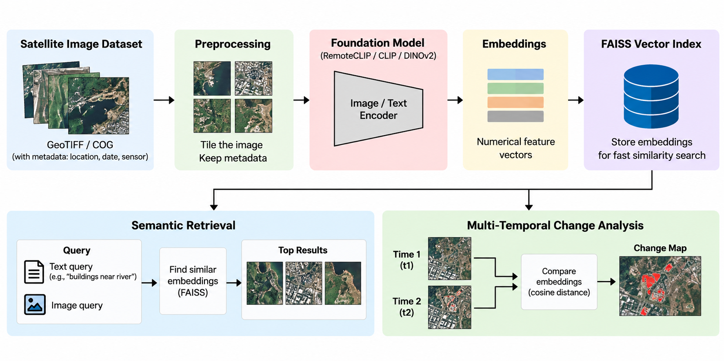
Architecture — Shared-Embedding Workflow

Slide 10
Technologies Used
A compact, training-free stack covering embeddings, geospatial data, search and image processing
Python
Implementation
RemoteCLIP / CLIP
Embeddings
FAISS
Vector Search
Rasterio + OpenCV
Image Processing
Google Colab
Development
1 Foundation Models
2 Vector Search
RemoteCLIP / CLIP → converts image and text into embeddings
DINOv2 → optional visual representation
Frozen pretrained models; inference only, no fine-tuning.
FAISS → stores high-dimensional embeddings
Nearest-neighbour search → retrieves similar satellite tiles
Supports fast similarity ranking at archive scale.
3 Geospatial Processing
4 Image Processing
Rasterio / GDAL → reads GeoTIFF and COG imagery
Preserves CRS, location, date and sensor metadata
Tiling prepares large scenes for embedding.
NumPy → vector and numerical operations
OpenCV / scikit-image → masking, morphology, SSIM and radiometric processing
Supports pixel-level change refinement.
Key design choice: pretrained models are used only for inference — the project does not train or fine-tune a new model.

Slide 11
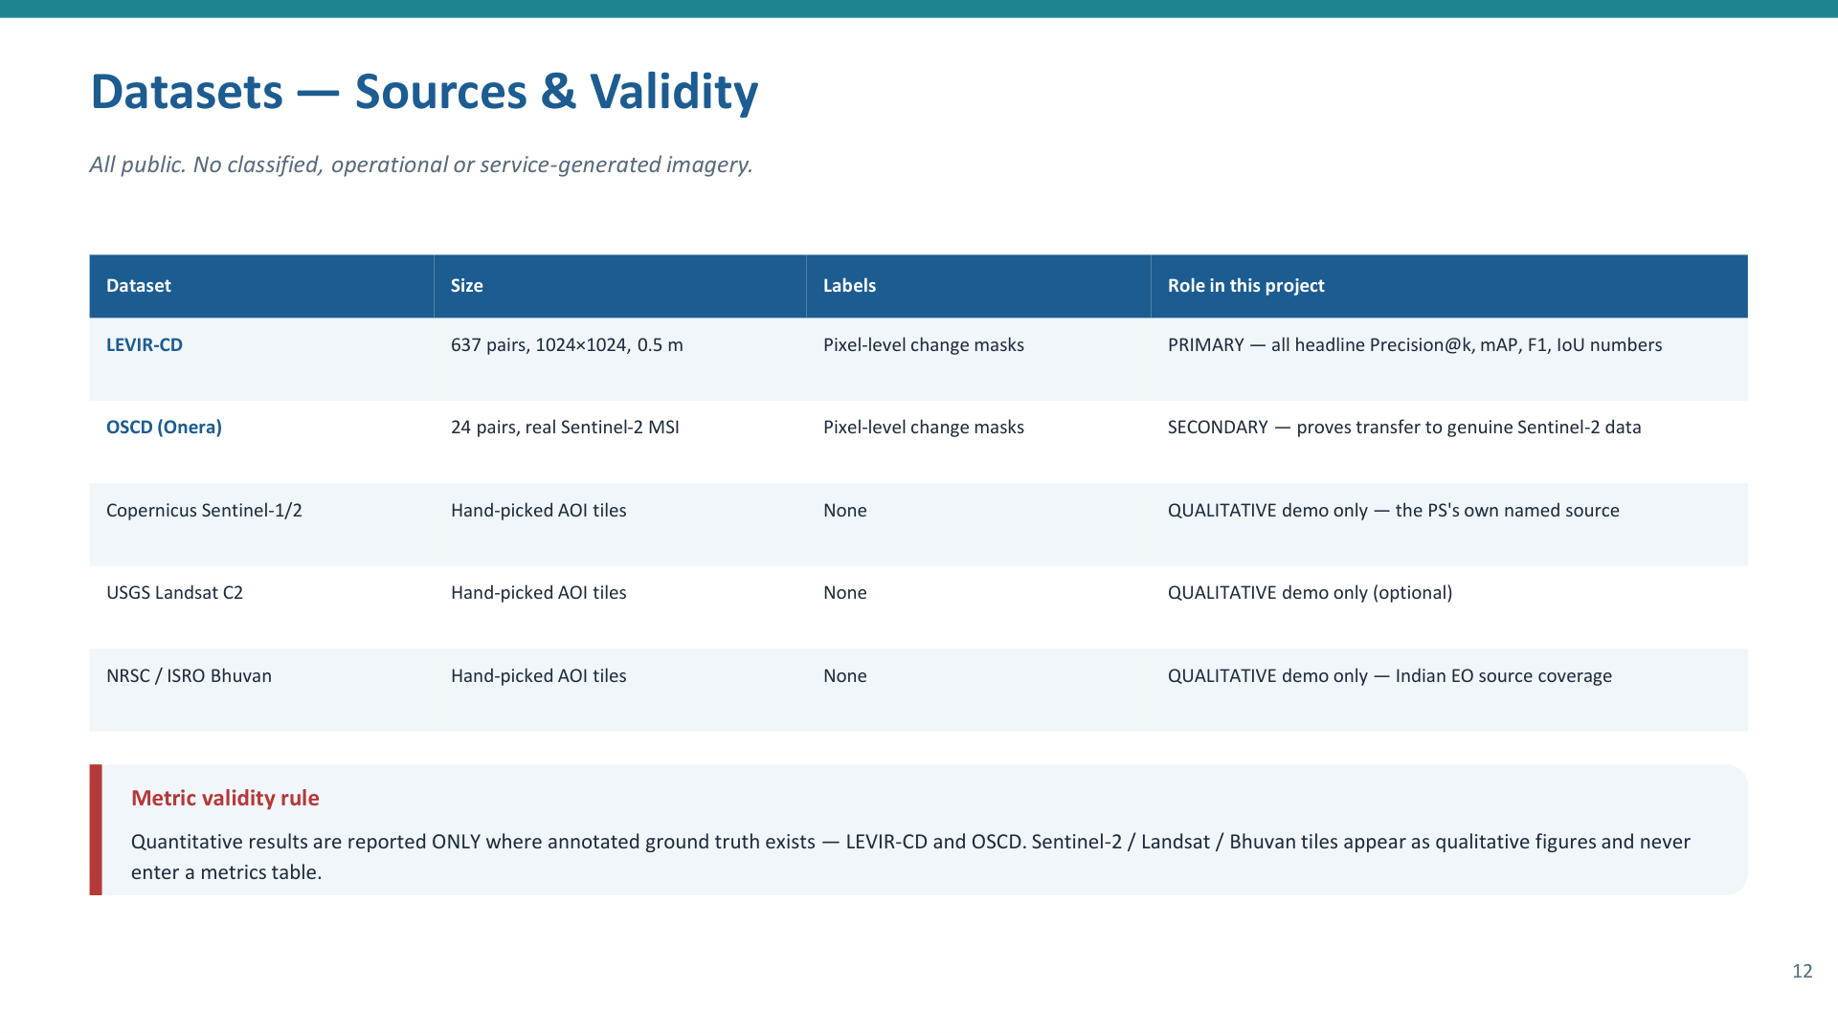

Slide 12
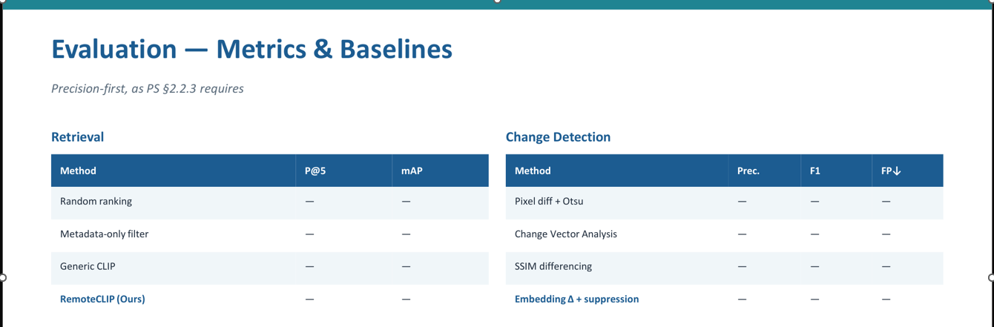

Slide 13
Expected Outcome & Project Direction
Expected Outcome
Success Criteria
Core Contribution
A fully operational, training-free satellite analysis system.
Analysts can search archives using plain English text (Semantic Retrieval).
System automatically detects physical changes between two dates (Change Analysis).
High precision achieved through automated cloud and shadow suppression.
Retrieval: Higher search accuracy than standard metadata filters.
Change Detection: Outperforms basic pixel differencing on the LEVIR-CD benchmark dataset.
False-Alarm Test : Successfully ignores fake changes caused by weather or seasons.
Moving away from two separate, disconnected AI systems.
Coupling both search and change analysis into one shared mathematical space.
Evaluating success by whether a reported change is real, rather than just finding every pixel shift.
Deliverables
Working end-to-end software pipeline .
Live demonstration using real Sentinel-2 and ISRO Bhuvan satellite imagery.
Reproducible evaluation report detailing system latency and accuracy.
• Index build time, latency, storage, hardware
• Live demo + individual contribution statement
14

