Slide 1
Adaptive Image Quality Assessment and Enhancement for Long-Range Optical Surveillance
Using Classical Computer Vision
Project Review 1 • BCSE407L – Computer Vision
Research Integrated Learning (RIL)
Akanksha Bharti • 23BCE0257
Arjun Pratap Singh • 23BCE2027
Gontla Venkata Siva Sai Nikhil • 23BCE0318
Subhajit Masanta • 23BCE0292

Slide 2
Abstract
Domain: Image Enhancement for Long-Range Optical Surveillance
Long-range surveillance imagery is frequently degraded by haze, low illumination, noise, motion/atmospheric blur, and low contrast.
The proposed framework first measures image quality, then dynamically selects parameters for Dark Channel Prior dehazing, CLAHE, bilateral filtering, and unsharp masking.
Adaptation is driven by five image features: contrast, haze, brightness, sharpness, and noise.
The primary evaluation target is downstream computer-vision usefulness, using ORB keypoint count/location as a proxy; entropy, edge preservation, runtime, and PSNR/SSIM (where valid) are secondary metrics.
The complete approach is classical, lightweight, interpretable, and training-free.

Slide 3
Introduction I — Background & Degradation
Why long-range optical imagery needs adaptive enhancement
Haze
Low illumination
Noise
Scatters light and suppresses scene contrast.
Reduces visibility and weakens feature responses.
Introduces false texture and unstable local details.
Blur
Low contrast
Downstream impact
Motion/atmospheric blur suppresses edges and keypoints.
Hides object boundaries and structural information.
Feature detection, localization, edges and tracking can all degrade.

Slide 4
Introduction II — Problem, Motivation & Novelty
Problem
Motivation
Novelty
Fixed enhancement parameters do not generalize across images. A CLAHE clip limit, dehazing strength, denoising level, or sharpening amount that works for one scene can underperform or introduce artifacts in another.
Existing algorithms (CLAHE, Dark Channel Prior, Bilateral Filter) are good but use fixed parameters. We enhance these existing methods by adding an intelligent quality-analysis layer in front of them that tunes parameters per image.
Automatically tune enhancement to the input image, preserve structural information, reduce operator effort, and avoid the training cost and complexity of deep enhancement networks.
Optimize enhancement for computer-vision usefulness rather than appearance alone. ORB feature detection is used as the primary proxy for increased information content after enhancement.

Slide 5
Literature Review 1/3
# | Paper | Objective | Methodology | Pros / Cons • Key Finding
1 | CoA: Towards Real Image Dehazing via Compression-and-Adaptation (2025) | Efficient and adaptable real-image dehazing | Model compression + adaptation | Efficient and adaptive; requires training Improved adaptability across real-world dehazing conditions
2 | PHATNet: Physics-guided Haze Transfer Network (2025) | Dehazing under unseen real-world haze | Physics-guided haze transfer + domain adaptation | Handles unseen haze; deep-learning based Improved real-world dehazing performance
3 | Adaptive Image Dehazing Network with Multi-Color Feature (2026) | Handle different real-world haze conditions | Multi-color features + attention-based feature fusion | Handles diverse haze; computationally complex Effective for homogeneous and non-homogeneous haze
4 | AFE-Dehaze: Adaptive Feature Enhancement (2025) | Improve dehazing under non-uniform haze | Adaptive feature enhancement + contrastive learning | Handles varying haze; requires training Better reconstruction under different haze concentrations

Slide 6
Literature Review 2/3
# | Paper | Objective | Methodology | Pros / Cons • Key Finding
5 | Fine-scale Perception Network for Image Dehazing (2025) | Recover fine details from hazy images | Fine-scale multi-branch feature extraction | Good detail preservation; deep model Improved restoration of fine structures
6 | Deep Transfer Learning + Local Mean Adaptation (2025) | Improve visibility in hazy images | Transfer learning + local mean adaptation | Adaptive processing; training required Improved visibility and local enhancement
7 | DMNet: Dual-Domain Modulation for Dehazing (2025) | Recover texture and structural details | Spatial adaptation + dual-domain feature modulation | Better detail recovery; high complexity Improved dehazing and texture reconstruction

Slide 7
Literature Review 3/3
# | Paper | Objective | Methodology | Pros / Cons • Key Finding
8 | Real-time Efficient Image Enhancement in Low-light Conditions (2025) | Enhance low-light images efficiently | Lightweight deep enhancement network | Real-time focus; training required Improved low-light enhancement with efficiency
9 | Retinex + Vision Transformer for Low-light Enhancement (2026) | Improve visibility and preserve details | Retinex decomposition + Vision Transformer | Strong detail/color recovery; high computational cost Improved illumination, noise and detail handling
10 | Nighttime Image Dehazing for Urban Monitoring (2026) | Improve nighttime visibility for monitoring | Mixed-norm variational optimization | Suitable for nighttime scenes; optimization complexity Improved visibility under haze + low-light conditions

Slide 8
Overall Literature Review — Research Gap
Existing Research
Proposed Project
• Increasing use of deep-learning enhancement
• Adaptation to varying haze/illumination
• Most methods require training
• Higher computational complexity
• Strong focus on perceptual quality / fidelity
• Classical computer vision only
• No training required
• Adaptive parameter tuning per input image
• ORB as proxy for CV usefulness
• Entropy, edge preservation & runtime as secondary metrics
• PSNR/SSIM only with paired ground truth

Slide 9
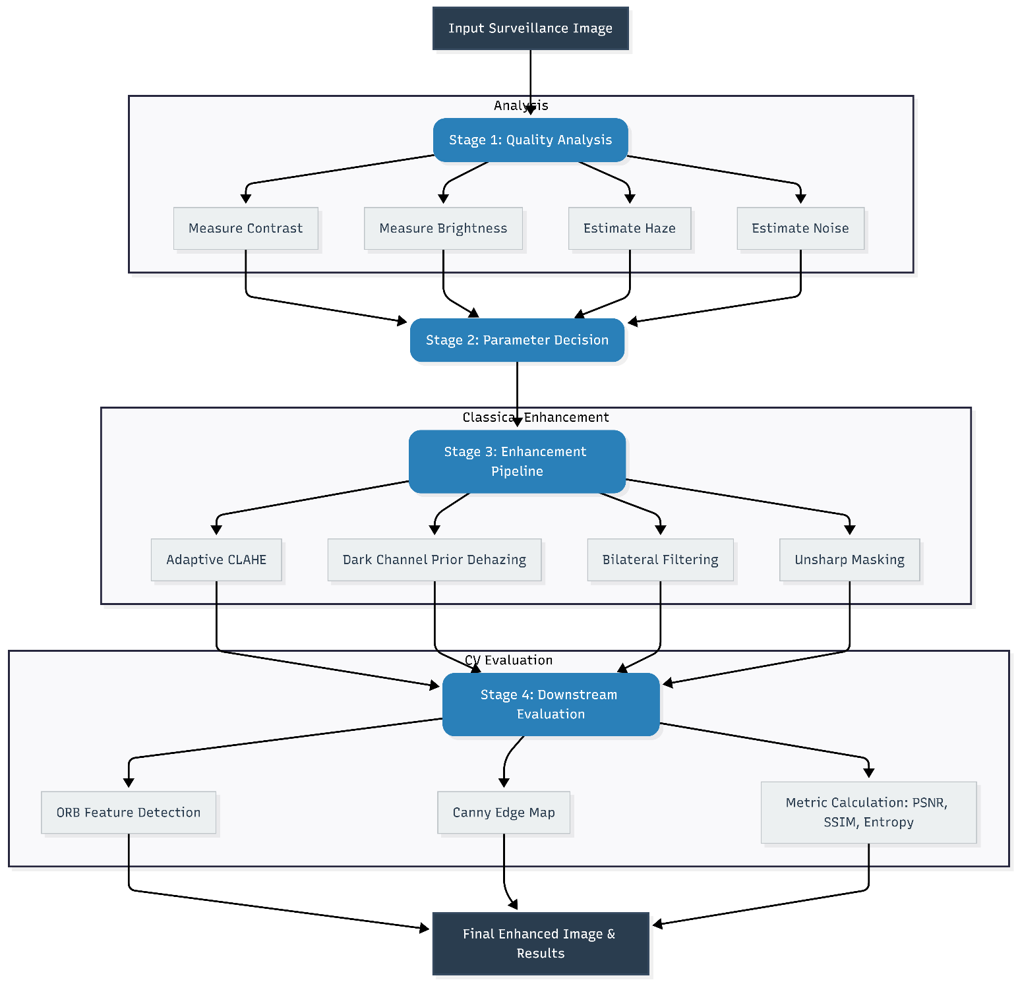
Architecture Diagram — Adaptive Enhancement Workflow
ORB + Metric
Evaluation

Slide 10
Technologies to be Used
Classical computer vision stack — no deep-learning frameworks
Python 3.10+
OpenCV (cv2)
Primary programming language
Image I/O, CLAHE, bilateral filtering, ORB, Canny, DCP implementation
NumPy
Scikit-image
Array operations, pixel math, RMS contrast, Laplacian variance, noise estimation
PSNR and SSIM on paired-reference datasets
Matplotlib
Google Colab
Visual comparisons, ORB bar charts and metric plots
Browser-based environment; no GPU required

Slide 11
Datasets — URLs & Numerical Size
O-HAZE | Size: 45 image pairs
Real outdoor haze; paired clean ground truth
https://data.vision.ee.ethz.ch/cvl/ntire18//o-haze/
ExDark | Size: 7,363 images
12 classes; extremely low-light indoor/outdoor scenes
https://github.com/cs-chan/Exclusively-Dark-Image-Dataset
RESIDE — ITS/SOTS | Size: ≈1,000 image pairs
Synthetic haze with clean reference images
https://sites.google.com/view/reside-dehaze-datasets

Slide 12
Evaluation Metrics & Dataset Validity
Dataset | PSNR | SSIM | ORB Count | Entropy
O-HAZE | YES | YES | YES | YES
RESIDE ITS/SOTS | YES | YES | YES | YES
ExDark | NO | NO | YES | YES
PSNR/SSIM are reported only when a paired clean ground-truth image is available.
For ExDark, use no-reference metrics: entropy, Edge Preservation Index, ORB feature count, and runtime.

Slide 13
Expected Outcome & Project Direction
Expected Outcome
Success Criteria
Core Contribution
An adaptive, training-free enhancement pipeline that improves visibility while preserving useful structural information across haze, low-light, noise and blur conditions.
Higher ORB feature usefulness after enhancement, supported by entropy, edge preservation and runtime; PSNR/SSIM used only on paired-reference data.
Move from fixed enhancement settings and appearance-only evaluation toward image-aware parameter tuning optimized for downstream classical computer vision.

