Slide 1
WIREMOCK
By
Subhajit Saha software engineer, Capgemini

Slide 2
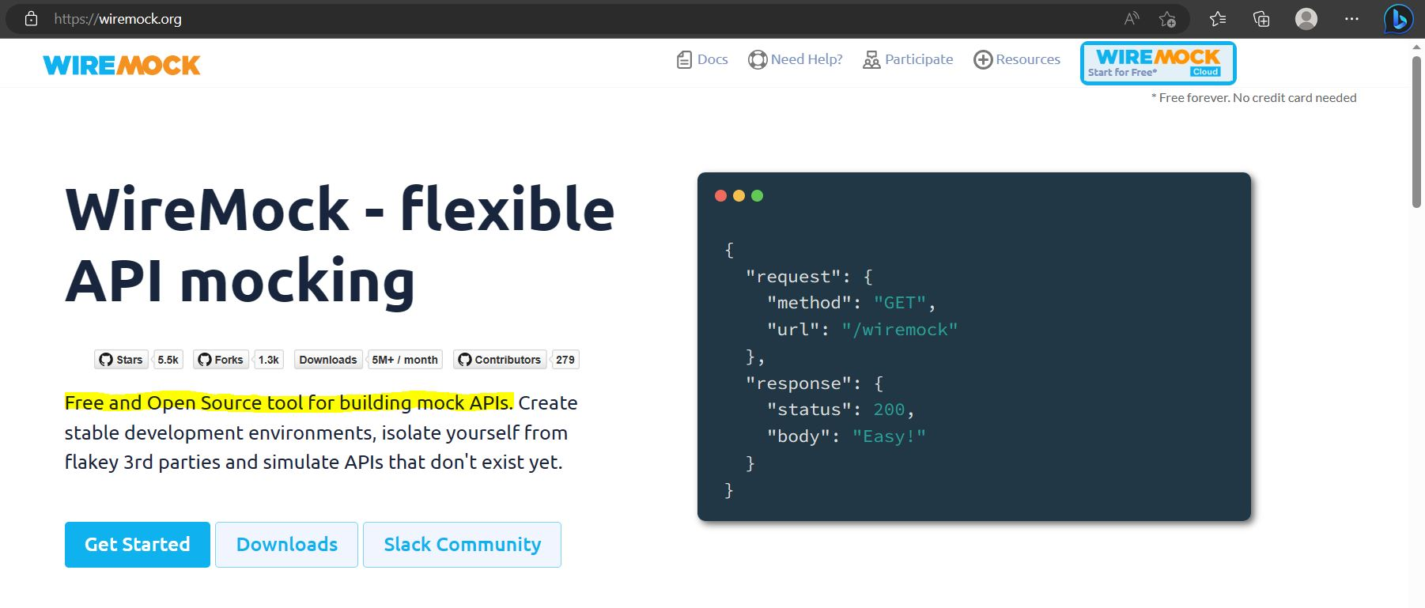
WIREMOCK WEBSITE https://wiremock.org/

Slide 3

WIREMOCK
A TOOL that can be used for performing Integration Testing for Applications.

Slide 4
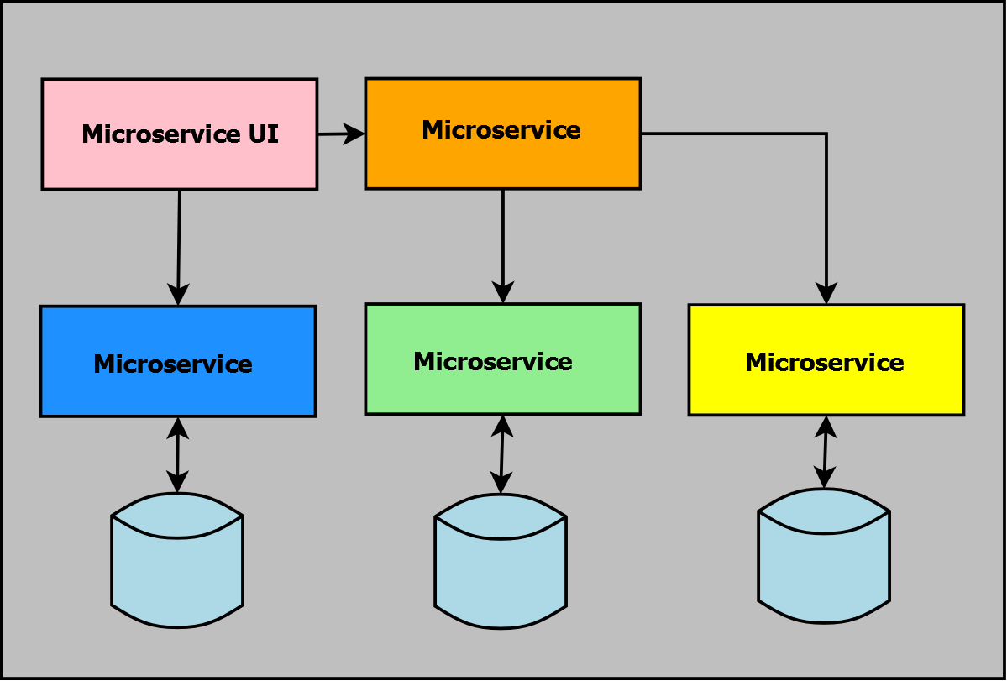
INTEGRATION TESTING
Large Application consists dozens of Microservices
Microservice Layers

Slide 5
