Slide 1
WIREMOCK
By
Subhajit Saha software engineer, Capgemini

Slide 2
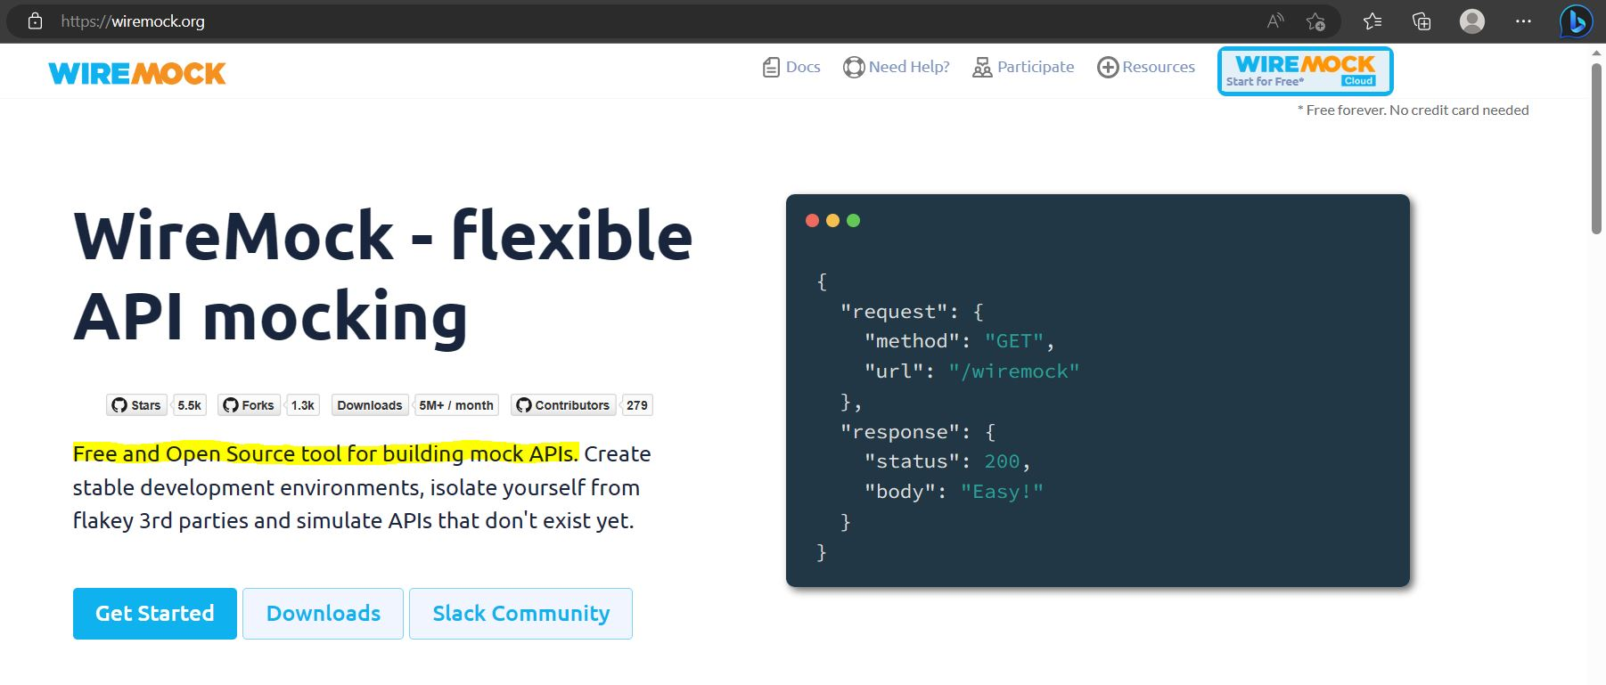
WIREMOCK WEBSITE https://wiremock.org/

Slide 3

WIREMOCK
A TOOL that can be used for performing Integration Testing for Applications.

Slide 4
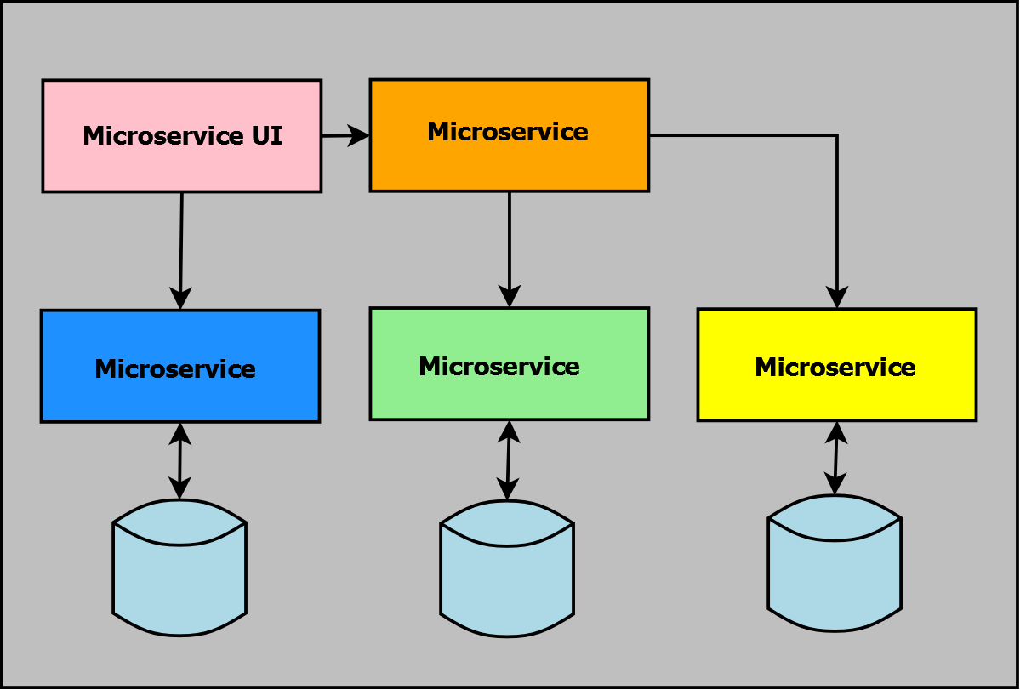
INTEGRATION TESTING
Large Application consists dozens of Microservices
Microservice Layers

Slide 5
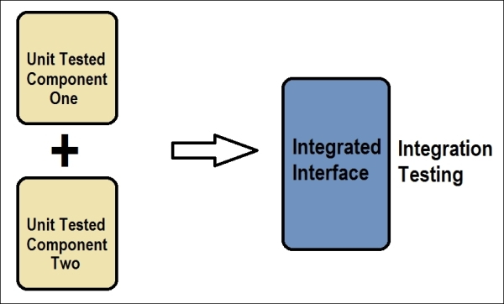
INTEGRATION TESTING
Conducted to evaluate the compliance of a system or component with specified functional requirements.
It occurs after Unit Testing.
Mainly to check the API calls between different microservices/components.
Application should work well as a single entity, comprised of all the dependant microservices.

Slide 6

WIREMOCK: What is it?
WireMock is a tool for mocking HTTP-based APIs that runs in the unit tests, on the desktop, or in the test environment.
We can also say it is a simulator for HTTP-based APIs, acting as a service virtualization tool or a mock server.
WireMock is completely free under the Apache 2.0 license.

Slide 7
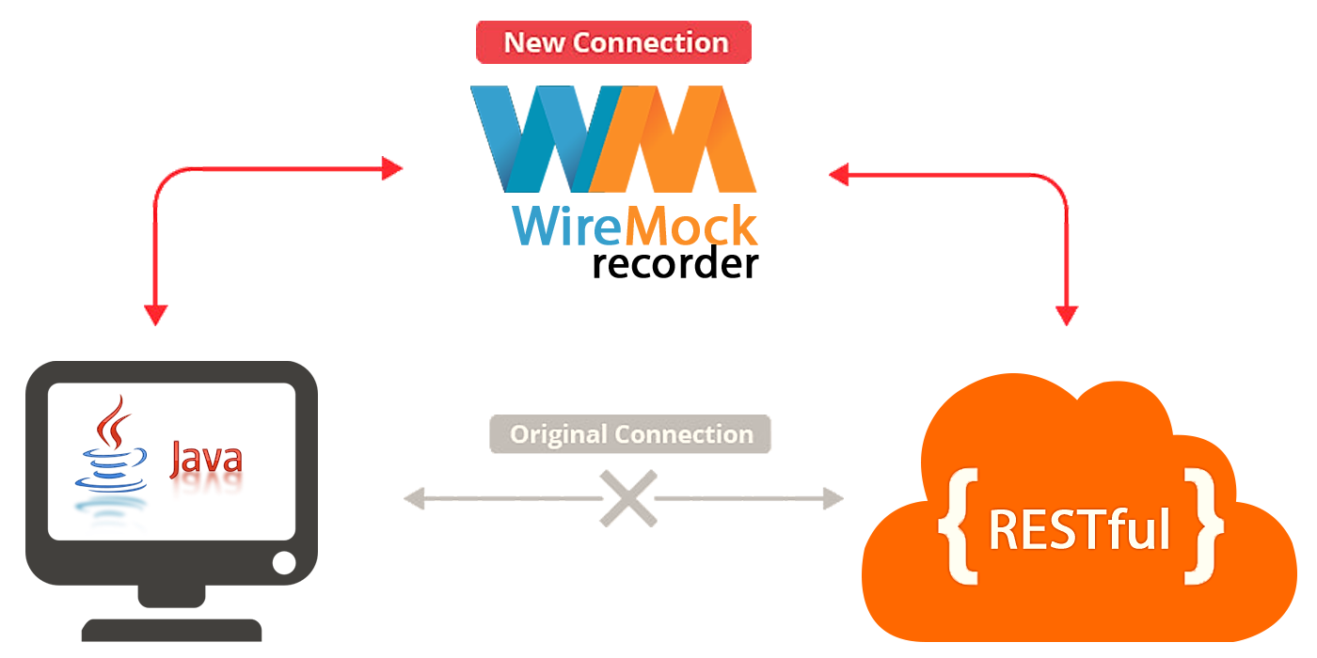
WIREMOCK: When to use it?
It is mainly used during the development, but more significantly during the Integration testing while a system or service talks to one or multiple external or internal dependencies/services.

Slide 8
WIREMOCK: When to use it?
It enables you to stay productive when an API you depend on
Doesn’t exist, or
Isn’t complete, or
Costly to access
It’s fast so reduces build time significantly.
WireMock is a mocking setup for integration testing.

Slide 9
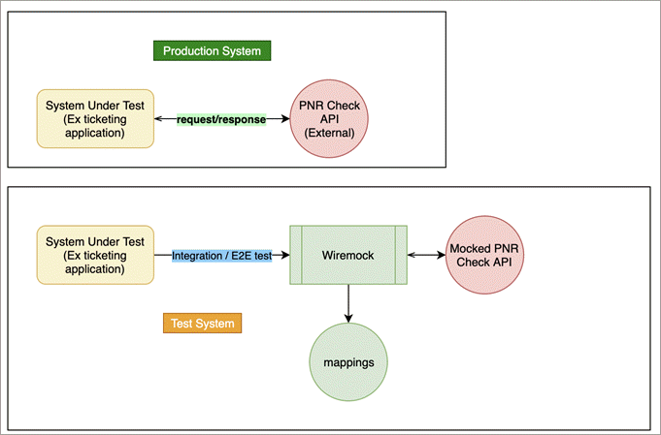
WIREMOCK: Ticketing App
Reduces gap/differences between production and testing environments.
Paid Service
PNR Check API
(External)
Returns an expected response for a given request
Service Virtualization Tool

Slide 10
WIREMOCK vs MOCKITO
Wiremock provides a simulator for HTTP-based APIs while Mockito provides the mock implementation of the method/object.
WIREMOCK | MOCKITO
In WireMock, the webserver just acts like the real API. | In Mockito, there is no webserver.
It is a real HTTP call. | There is no HTTP call in Mockito.
It is external to the app code. | It is a part of the application code.
It can simulate the network calls. | In Mockito, it can’t.
Whether you are working on Java, Python, or Groovy language if it’s a REST-based response you can use it. | It’s a language-specific mocking library. In Java programming, the mocking library is named Mockito.

Slide 11
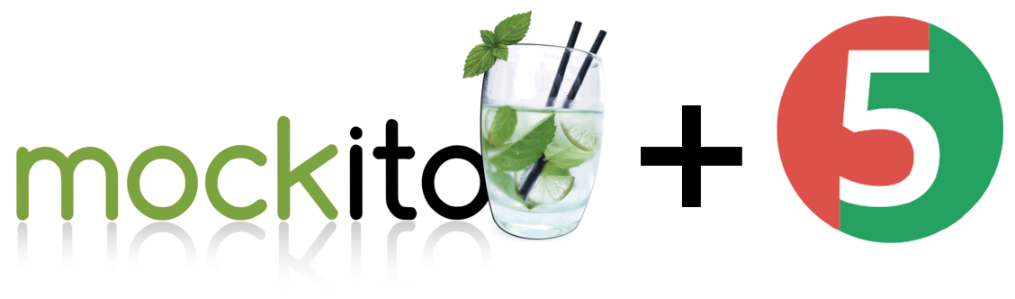

WIREMOCK vs MOCKITO
Application under testing
Using Mockito library (for Java)
Mock the methods, service and BO layers
Returning Java objects/values
Using WireMock (for any language)
Mock the Server/API Response, gateway layer
Returning JSON, XML etc
Junit/End to End testing
3rd Party/external API

Slide 12
WIREMOCK: When?
When an API you depend on doesn’t exist, or isn’t complete.
Parallel Development
Non-Parallel Development
Service A
Service A
Service B
Service B
Service C
Service C
Sends Mocked Responses
WireMock- Mock Server for Service C

Slide 13
WIREMOCK: When?
When an API you depend on is costly to access.
Application Service
Application Service
You need to run continuous test calls Suppose, 100 rupees per 500 calls
We know the response format, type, pattern; So, we mock the response by configuring a Mock Server and simulate the API call Save the cost.
3rd Party API
Mock Server using WM
3rd Party API

Slide 14
WIREMOCK: When?
It supports testing of
Edge Cases, like timeout simulation
Failure Modes, like network failure simulation
We can simulate such scenarios/add such features to the mock server configuration using WireMock.

Slide 15
WIREMOCK: Features
Stubbing It is a technique that allows configuring the HTTP response that is returned by the WireMock server when it receives a specific HTTP request.
Verification The WireMock server registers all requests it receives in memory until it is reset. And that makes it possible to verify that a request matching a specific pattern was received, and also to fetch the requests’ details.

Slide 16
WIREMOCK: Features
Record-playback of interactions WireMock can create stub mappings from requests it has received. Combined with its proxying feature this allows you to “record” stub mappings from interaction with existing APIs.
Injection of faults and delays One of the main reasons it’s beneficial to use web service fakes when testing is to inject faulty behavior that might be difficult to get the real service to produce on-demand.

Slide 17
WIREMOCK: Features
Simulation of Stateful Behaviour Most web services tend to have some state, which changes as you and others interact with them. HTTP is stateless. So, we can introduce session keys, cookies etc. using Wiremock that will allow us to simulate statefulness.
Can be used as
JVM library in unit testing
Run as a standalone process either on the same host or remote server or on the cloud.

Slide 18
WIREMOCK: Features
All of WireMock’s features are easily accessible via its REST (JSON) interface and its’ Java API.
HTTP Request
Application
WireMock Mock Server
REST
JSON Response

Slide 19

Who uses WireMock?

Slide 20
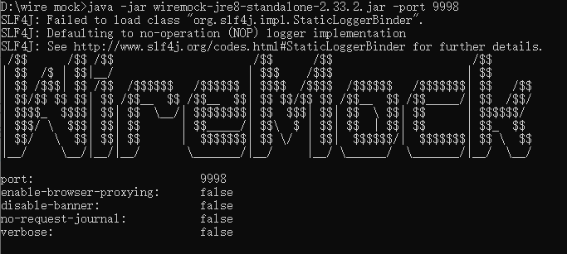
WIREMOCK
As a standalone service : Run-> java -jar wiremock-jre8-standalone-2.35.0.jar http://localhost:8080/__admin/mappings http://localhost:8080/__admin/recorder/

Slide 21
WIREMOCK
AS a JVM library in unit testing testImplementation 'com.github.tomakehurst:wiremock:3.0.0-beta-8’ testImplementation 'junit:junit:4.13.2'

Slide 22
CONCLUSION
A very helpful tool to check REST API calls
Independent of 3rd party server
You can record real world responses and add them to your mappings using Record feature
Saves a lot of cost and time

Slide 23
THANK YOU
Presented by: Subhajit Saha Software Engineer, Capgemini

