Slide 1
Recommending a Strategy
Ideas for today and tomorrow

Slide 2
Vision Statement
Categorising the countries using some socio-economic and health factors that determine the overall development of the country. Also suggesting the countries which the CEO needs to focus on the most.

Slide 3
About Organization
HELP International is an international humanitarian NGO that is committed to fighting poverty and providing the people of backward countries with basic amenities and relief during the time of disasters and natural calamities. It runs a lot of operational projects from time to time along with advocacy drives to raise awareness as well as for funding purposes.
After the recent funding programmes, they have been able to raise around $ 10 million. Now the CEO of the NGO needs to decide how to use this money strategically and effectively. The significant issues that come while making this decision are mostly related to choosing the countries that are in the direst need of aid.

Slide 4
Goal and Objective
Categorising the countries using some socio-economic and health factors that determine the overall development of the country. Also suggesting the countries which the CEO needs to focus on the most.
Performing PCA on the dataset and obtain the new dataset with the Principal Components.
Outlier Analysis done on dataset.
Done K-means and Hierarchical clustering(both single and complete linkage) on this dataset to create the clusters.
Analyse the clusters and identify the ones which are in dire need of aid.
Performed visualisations on the clusters that have been formed.

Slide 5
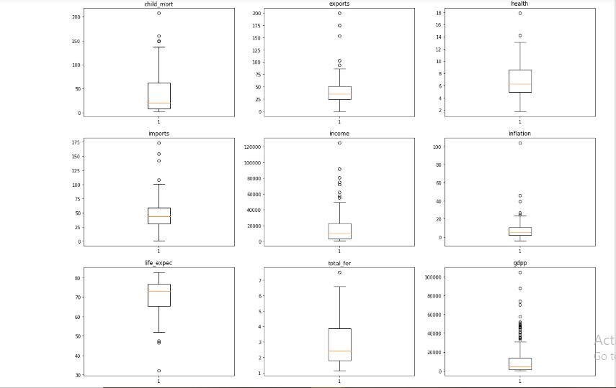
Today’s Situation

Slide 6
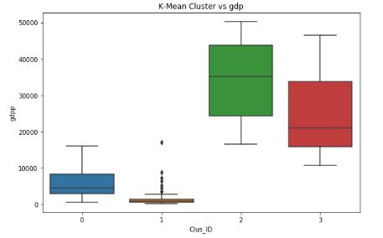
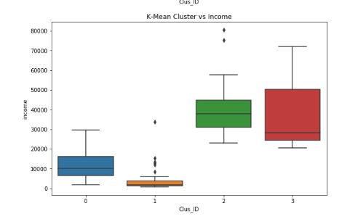
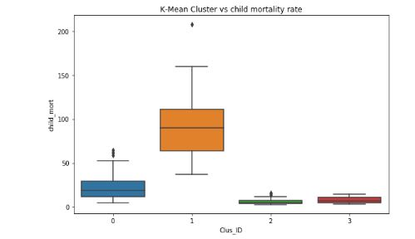

Slide 7
How Did We Get Here?
Upon classifying the countries into 4 clusters we found that below points:-
Countries with high GDP has low Child Mortality rate.
Income in high GDP countries is evenly distributed where as countries with medium and low GDP rate, Income is not even.
Also it can be seen that countries with high Child Mortality rate falls under very low Income and low GDP group.

Slide 8
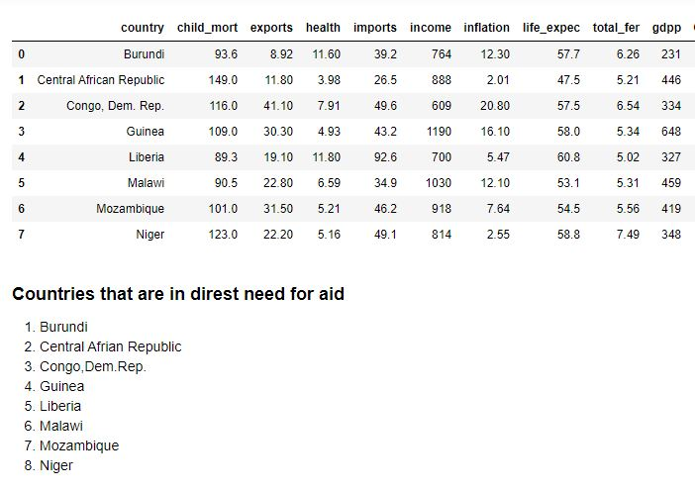
Recommendation

Slide 9


