Slide 1
CONFIDENTIAL | EY Middle East | Strategy & Operations
Digital Transformation
Performance Analysis
Saudi Telecom Operator | Engagement ME-SO-2023-0147
EY Middle East | Strategy & Operations Practice | October 2023
Building a better working world

Slide 2
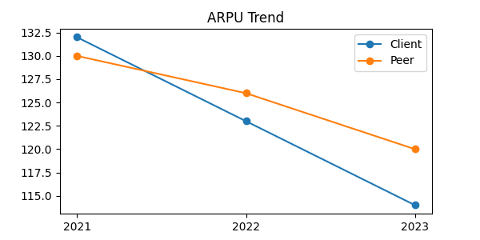
ARPU Decline: Client vs GCC Peer Benchmarks
14%
Client ARPU decline
2021–2023
8%
GCC Peer Avg
decline
SAR 114
Client ARPU
Q4 2023
Source: EY Middle East Analysis | Q4 2023

Slide 3
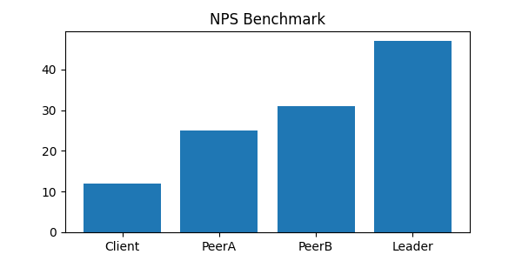
Customer Experience: NPS Benchmarking vs GCC Peers
Key Insight
Client NPS of +12 sits at the 28th percentile of GCC operators. Closing the gap to regional leader (+47) requires a
+35 NPS point
improvement target
by 2026
Source: EY Middle East CX Benchmarking Study | Q3 2023

Slide 4
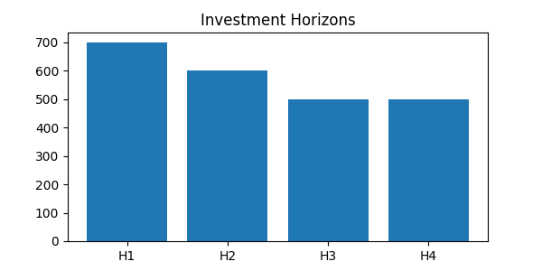
Capital Allocation: SAR 2.3B Across Four Horizons
H1
Cloud BSS
Core CDP
8 decommissions
H2
AI CX App
Omnichannel
60% L1 auto
H3
5G slicing
IoT platform
B2B2X model
H4
AIOps
Revenue AI
Data BU
Total Programme NPV: SAR 4.8B | Payback Period: 22 months | IRR: 34%

Slide 5
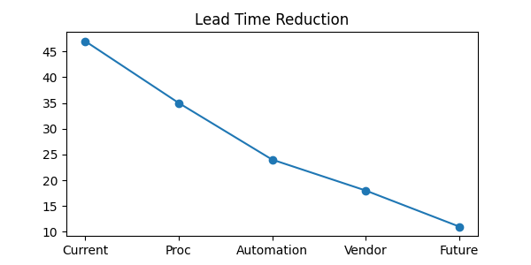
Lead Time Reduction: From 47 Days to 11 Days
Source: EY Middle East Supply Chain Diagnostics | KSA Industrial Cluster | Jan 2024

