Slide 1
CONFIDENTIAL | EY Middle East | Risk & Compliance
Risk & Compliance
Dashboard Report
Multi-Engagement Portfolio View | GCC Financial Services | Q4 2023
Building a better working world

Slide 2
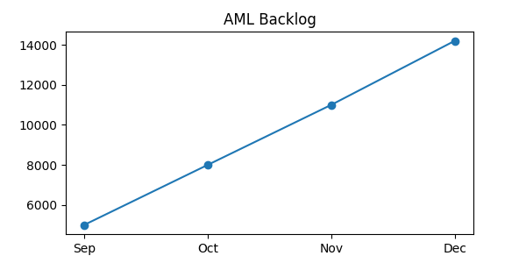
AML Alert Backlog: UAE Bank – Critical Escalation
Status: CRITICAL
14,200
Current Backlog
2,000
Target Backlog
7.1x
Over Target
14,200
Peak reached Dec
Source: EY AML Assessment ME-RC-2023-0089 | UAE Bank

Slide 3

Enterprise Risk Heat Map – Bahrain Development Bank
Top Priority Actions
Credit Risk (SME)
Deploy IFRS 9 ECL model
Establish Watchlist Committee
Cyber Risk
PAM + EDR deployment
SOC tier-2 staffing
Regulatory Capital
ICAAP monthly review
Buffer alignment plan
Source: EY ERM Framework Assessment ME-RC-2023-0134 | BDB Bahrain

Slide 4
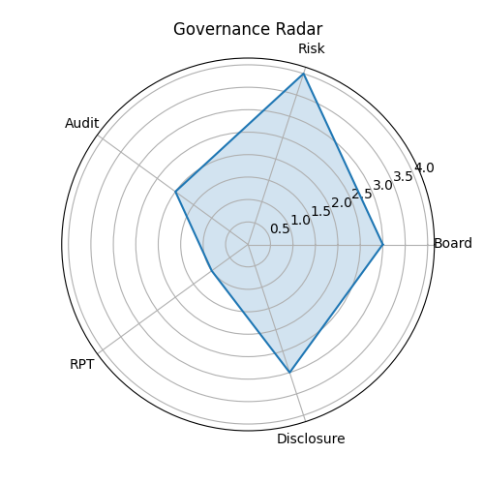
Governance Maturity: KSA Conglomerate Pre-IPO Assessment
IPO Readiness Gaps
Board Composition
-18pts
Add 4 independent directors
RPT Governance
-26pts
Overhaul policy + disclosures
Board Information
-23pts
Redesign pack + analytics
Source: EY Governance Assessment ME-RC-2023-0312 | KSA Conglomerate | Nov 2023

Slide 5
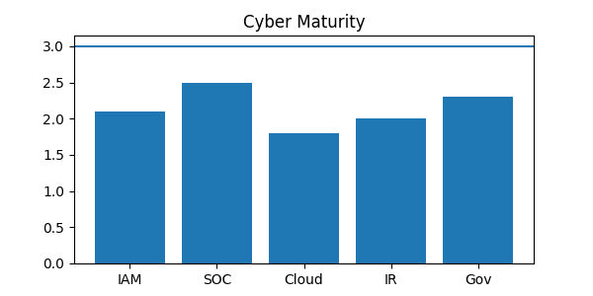
Cybersecurity Maturity Gaps – Jordan Telecom
TRC Minimum Target: 3.0 by Q4 2025 | Source: EY Cybersecurity Assessment ME-RC-2024-0041 | Feb 2024

