Slide 1
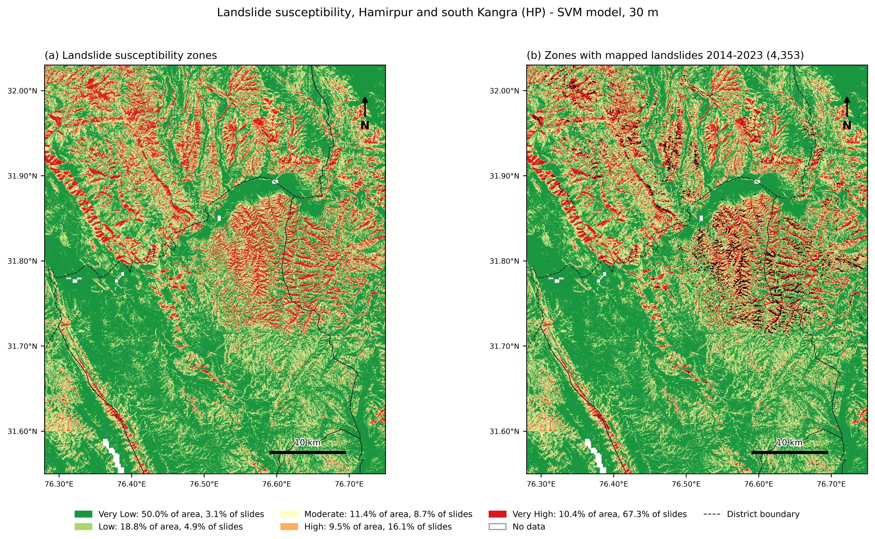
B.Tech Project · IIT Jodhpur · 2026
Where will the hills fail next?
Landslide susceptibility mapping of Hamirpur and south Kangra, Himachal Pradesh, using GIS and machine learning
Subham Agrawal (B23CI1038)
Department of Civil and Infrastructure Engineering
Supervisor: Prof. Susmita Panda · Co-supervisor: Prof. Nallala Sarath Chandra Reddy
Notes:
One-line pitch: I used satellite data and machine learning to map, at 30 m resolution, where landslides are most likely around Hamirpur, and then checked which roads and people sit on that ground. The map on the right is the final result.

Slide 2
Every monsoon, landslides cut roads in the Shivalik hills
Goal: a 30 m map of where landslides are likely, learned from past landslides
Weak sandstone, conglomerate and clay hills, about 1,860 mm of rain a year
ISRO's Bhuvan portal has mapped every landslide after the 2014, 2017 and 2023 monsoons
Five objectives: inventory and factors, compare ML models, susceptibility map, key factors, risk framework for roads and people
4,431
2,360
mapped landslides in the study area
km² of hills around Hamirpur
14
2.62 M
ground factors per point
30 m pixels mapped
0.905
ROC-AUC of the final model on areas it never saw
Notes:
Why it matters: the Shivalik hills are weak sandstone, conglomerate and clay with heavy monsoon rain. The 2023 monsoon alone produced about 3,700 mapped landslides inside my study area. The goal is a map that says WHERE (not when) landslides are likely, so slope protection and drainage money can go to the right road stretches.

Slide 3
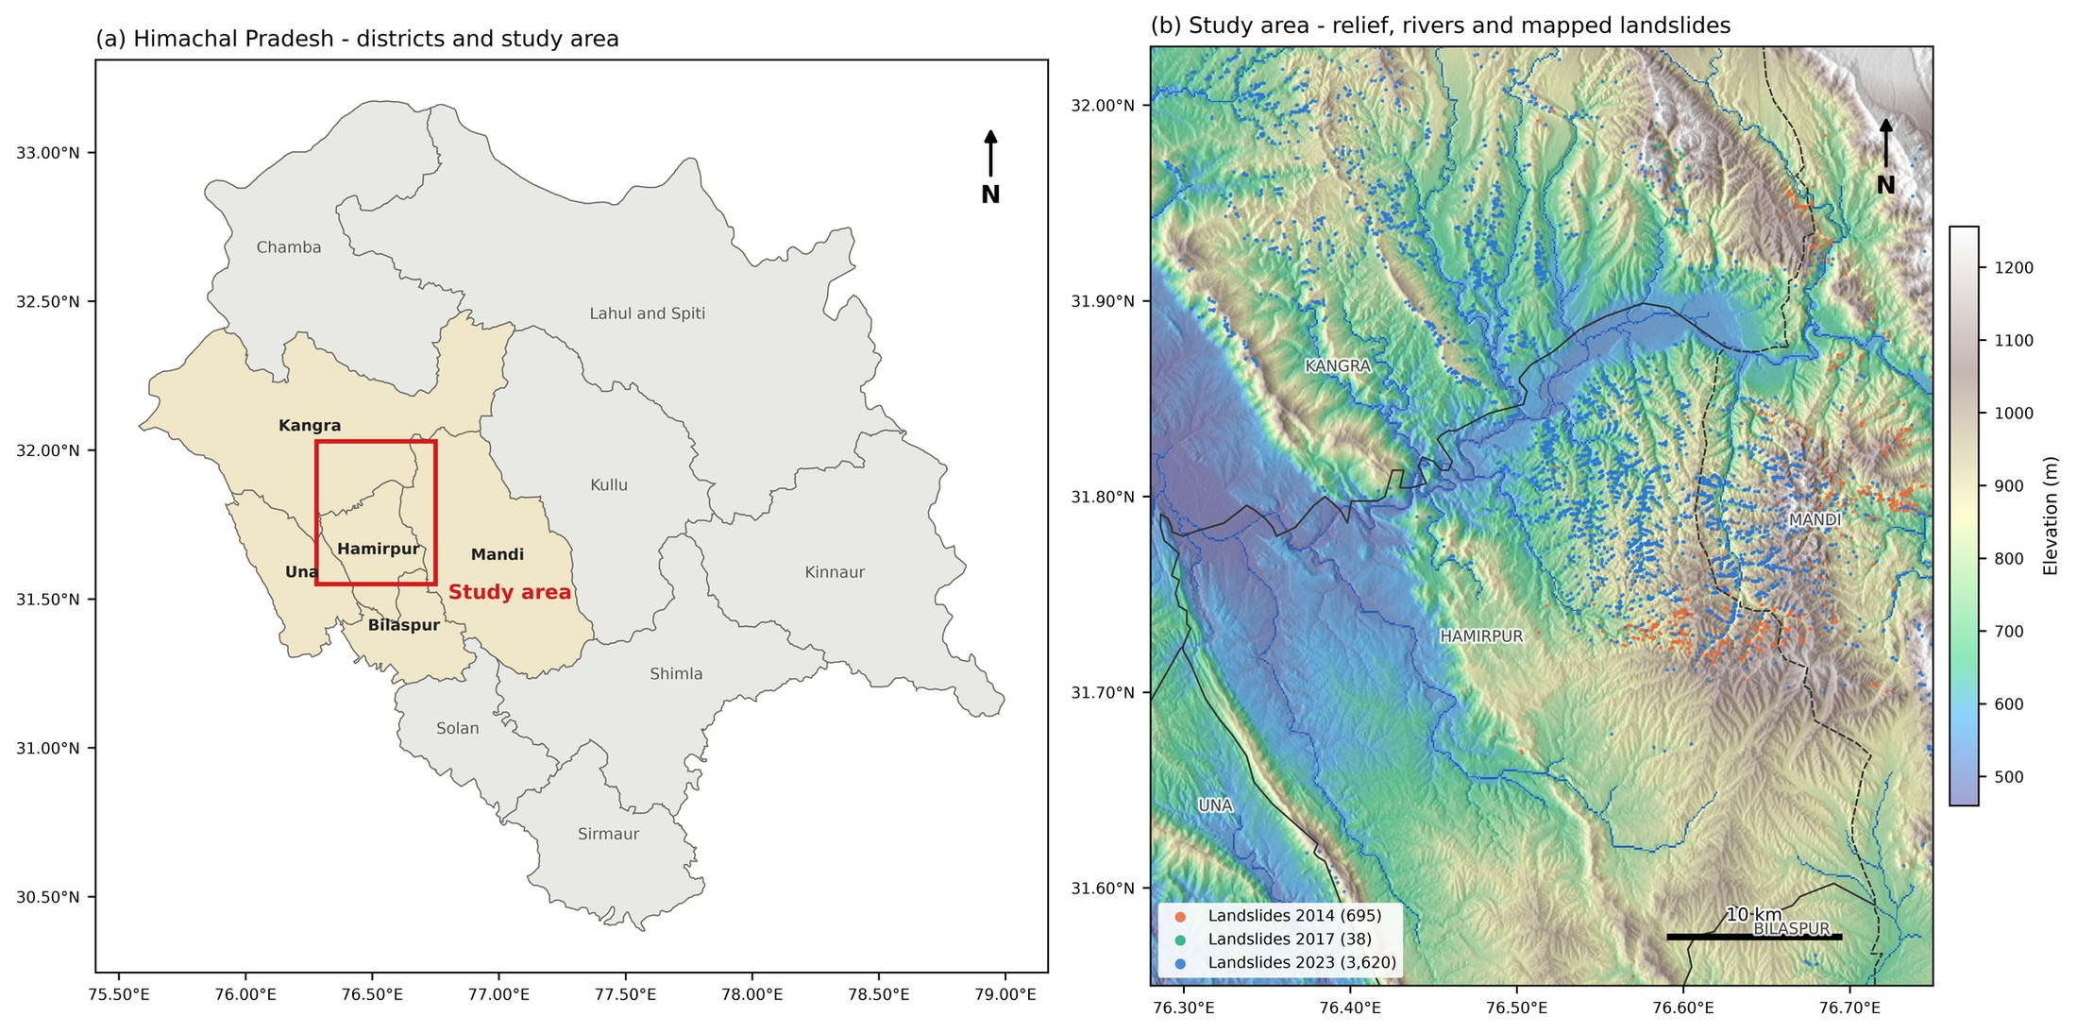
Study area: the densest landslide ground in Himachal
76.28-76.75°E, 31.55-32.03°N
Hamirpur plus parts of Kangra, Mandi, Una and Bilaspur, along the Beas
Moved from Kinnaur: too few landslides to train on
Box shifted 0.15° north: 3,214 → 4,431 landslides
All raster work in UTM 43N (true metres)
Notes:
Kinnaur, my first area, had too few mapped landslides to train a model, so we moved to Hamirpur, which has the highest landslide density in HP, about 178 per 100 km². A sliding-window search showed the densest box of this size sits just north-west of Hamirpur, so I shifted the box 0.15 degrees north. That raised landslides inside from 3,214 to 4,431. All raster work is in UTM 43N so slope and distance are in real metres.

Slide 4
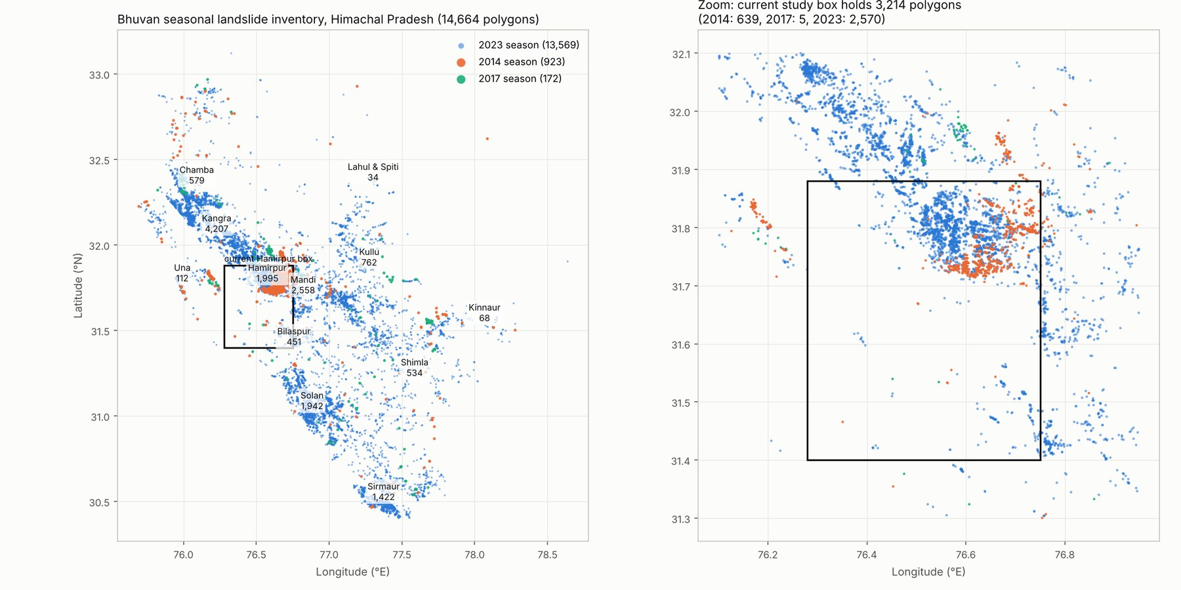
Pulling Bhuvan's landslides without a download button
14,664 landslides in HP
698 + 39 + 3,694 = 4,431 inside the study box (2014, 2017, 2023)
4,353 landslide points
after merging slides that fall in the same 30 m pixel
Whole state as one 1x1 pixel → one WMS GetFeatureInfo request returns every polygon. (Right panel shows the first box, before the 0.15° shift north.)
+4,353 stable points
0.5-3 km from a slide: mapped ground, but not a slide
Notes:
Bhuvan shows the polygons on its map but has no download button. Its map server answers WMS GetFeatureInfo, the request a map sends when you click a pixel. If you squeeze the whole state into one 1x1 pixel and click it, the server returns every polygon in the layer with attributes. One request per season gave 14,664 HP landslides. Then: same-pixel duplicates merged, equal number of non-landslide points placed 0.5 to 3 km from the nearest slide, so they are inside the mapped area but off the slides.

Slide 5
Fourteen ground factors from satellite data in Earth Engine
Vegetation and land
Terrain (SRTM 30 m)
Water (MERIT Hydro)
NDVI, NDWI, NDBI
Landsat 5/7 (~2006), Sentinel-2 (~2016, ~2024)
Elevation, slope, plan curvature, northness, eastness
Wetness index (TWI), drainage density, distance to river
People and soil
Rain (CHIRPS)
Two data fixes
Distance to road (GRIP4), soil clay (OpenLandMap)
Mean annual rainfall, 2009-2025 only
Aspect → cos and sin (circular)
CHIRPS before 2009 dropped (466 vs 1,862 mm)
Each point reads factors from imagery taken BEFORE its landslide season, so the model cannot just see fresh scars.
Notes:
Three indices change over time, read from median cloud-free composites. Ten layers are static. Aspect is circular, 0 and 359 degrees are both north, so I split it into northness (cos) and eastness (sin): 13 layers become 14 inputs. Rainfall uses CHIRPS 2009-2025 only, because CHIRPS shows 466 mm/yr before 2009 and 1,862 after, while ERA5-Land shows 1,350 vs 1,604. That jump is a data problem, not climate.

Slide 6
The pipeline: one notebook, seventeen cells
1
Composites
2
Factor stack
3
Points
4
Sample
Cloud-masked medians, 3 periods (Cells 3-5)
13 layers per period (Cells 6-8)
4,353 slides + 4,353 stable (Cell 10)
Pre-event values, 8,696 points (Cell 11)
5
Compare
6
Tune
7
Map
8
Risk
5 models x 3 tests (Cell 12)
Random search on spatial CV (Cell 13)
Best model on 2.62 M pixels (Cell 14)
Roads, buildings, people per zone (Cell 17)
Notes:
Walk through left to right. Everything is in study_area/Hamirpur.ipynb, and each code cell is followed by a Result note. Steps 1-4 build the dataset (8,696 points after 10 no-data points dropped). Steps 5-6 pick the model. Steps 7-8 turn it into a map and a risk framework.

Slide 7
Three ways to test a model, and only one is honest for maps
A · Random 70/30
B · Spatial 5 km blocks
C · Temporal
The textbook split.
Nearby points are near-twins, so a test point usually has a twin in training. Flatters models that memorise places.
Whole blocks held out, 5 folds.
Mimics the real use: predicting ground with no recorded landslides. This is the main result.
Train on 2014 + 2017, test on 2023.
Can past seasons predict a much more extreme one?
Metrics: ROC-AUC (ranking: 0.5 = coin toss, 1 = perfect), overall accuracy, F1, Cohen's kappa
Models: kNN, SVM, ANN (MLP), Random Forest, XGBoost
Notes:
Neighbouring points have almost the same slope, rain and vegetation. In a random split, a test point usually has a near-twin in training, so the model can memorise places and still look great. Spatial block CV cuts the area into roughly 5 km blocks and holds out whole blocks, 5 folds, so the test is on genuinely new ground, which is how the map is used. The temporal test asks whether the past predicts a future season.

Slide 8
Random splits crown XGBoost; new ground ranks it last
−0.116
XGBoost AUC lost from random to spatial test, the largest drop
0.901
best spatial AUC before tuning (ANN)
Testing design changes the winner. Report the spatial number.
Notes:
Read the chart in pairs. Every model drops when whole blocks are held out, but XGBoost drops the most, 0.967 to 0.851, a loss of 0.116. It was partly memorising locations, which only shows up on new ground. ANN is best under spatial CV at 0.901 with default settings. Temporal test: 0.77 to 0.82 on 2023.

Slide 9
Tuned on spatial CV, the SVM wins
0.905
83.0%
0.66
≤ 0.05
spatial ROC-AUC
overall accuracy
Cohen's kappa
AUC gap between all tuned models
Model | Spatial AUC default → tuned | OA tuned | Kappa
kNN | 0.876 → 0.888 | 80.7% | 0.61
SVM (final) | 0.886 → 0.905 | 83.0% | 0.66
ANN | 0.901 → 0.901 | 82.0% | 0.64
Random Forest | 0.875 → 0.875 | 78.6% | 0.57
XGBoost | 0.851 → 0.860 | 77.1% | 0.54
The sampling and testing design matters more than which algorithm you pick.
Notes:
15 percent of points are held out as a final test set. On the other 85 percent, each model gets a random search over 20 settings, scored by 5-fold spatial block CV so tuning cannot reward memorisation. Gains are small, at most 0.019 for SVM. XGBoost's random score fell 0.969 to 0.934 while its spatial score rose 0.851 to 0.860: it over-fits less. Final SVM: RBF kernel, C = 1.31, gamma = 0.027. Probabilities via CalibratedClassifierCV. Kappa 0.66 is 'substantial' on Landis and Koch.

Slide 10
Slope, rainfall and northness drive the predictions
Slope
#1 in Random Forest, #2 in XGBoost: slope-stability mechanics
Rainfall
#1 in XGBoost, but the 5.5 km grid may act partly as a location label
Weakest
TWI, drainage, soil clay: coarse 90-250 m source data
Notes:
Permutation importance: shuffle one factor's values and measure how much ROC-AUC drops. Computed for random forest and XGBoost on the random test split. Slope is first for RF, matching slope-stability mechanics. Rainfall is first for XGBoost, but the CHIRPS grid is about 5.5 km, so there are few distinct values and it may partly act as a location label. Northness may reflect moisture and vegetation differences between north and south faces. TWI, drainage and soil clay come from coarse 90-250 m data.

Slide 11
A tenth of the area holds two-thirds of the landslides
Zone | Area | Slides | FR
Very Low | 50.0% | 3.1% | 0.06
Low | 18.8% | 4.9% | 0.26
Moderate | 11.4% | 8.7% | 0.77
High | 9.5% | 16.1% | 1.70
Very High | 10.4% | 67.3% | 6.45
83.3% of mapped slides fall in High + Very High. Frequency ratio = share of slides ÷ share of area.
Notes:
The tuned SVM was run on all 2.62 million 30 m pixels with ~2024 imagery, and probabilities split into five zones at 0.2 steps. Frequency ratio is a zone's share of landslides divided by its share of area. It rises from 0.06 to 6.45, and 83.3 percent of slides fall in High plus Very High. Caveat: these landslides were used in training, so this is a consistency check. The independent test is the spatial CV. Red follows the steep dissected hills east of the Beas and the Shivalik ridges; green is valleys and terraces.

Slide 12
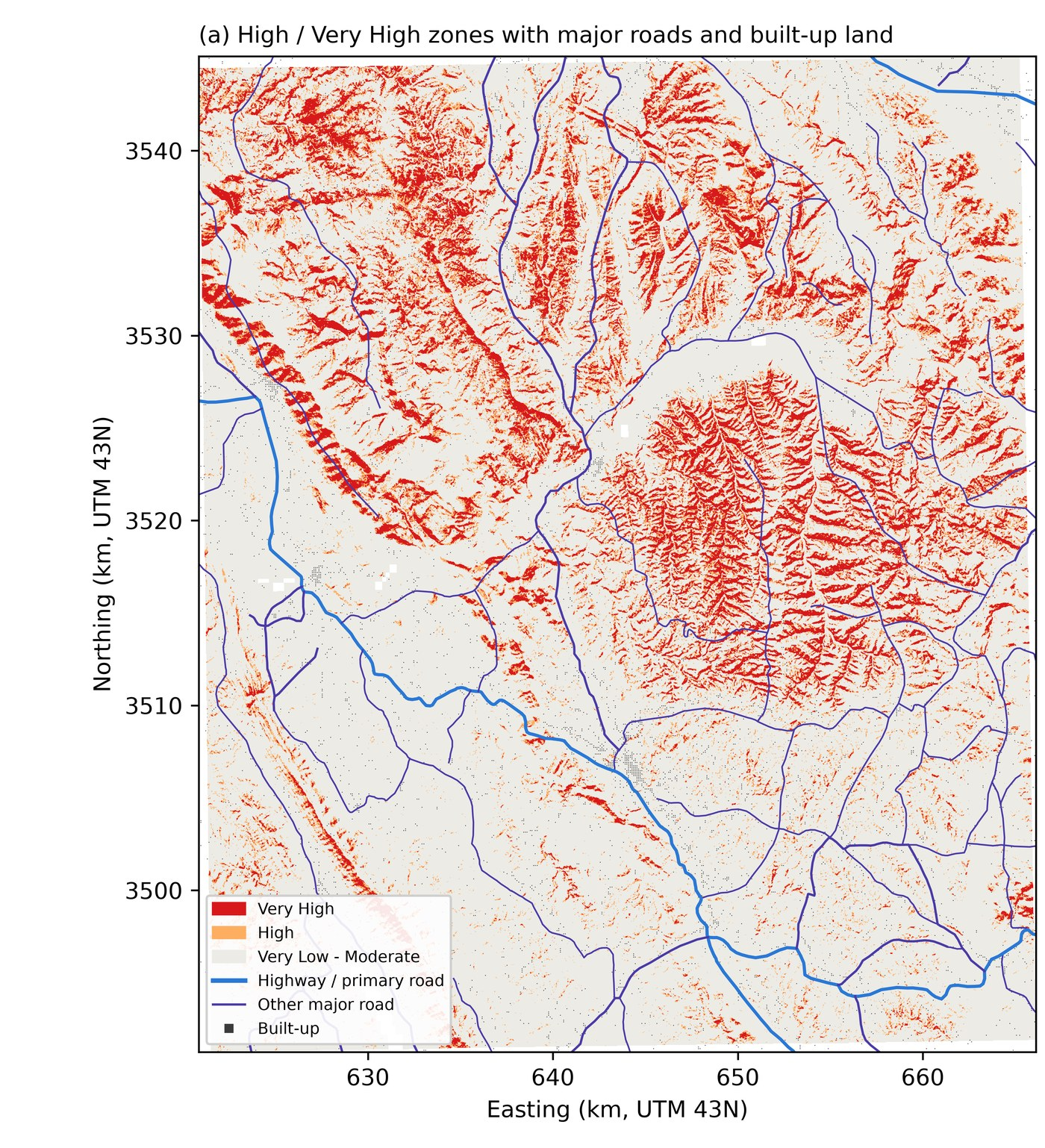
Roads, not homes, carry the risk
71.9 km
~57,000
major roads in High + Very High (10.5%)
people in High + Very High (6.0%)
40
28.2%
priority road stretches, 17.5 km in total
of the Kangra part is High or Very High
74% of people and 88% of built-up land sit in the Very Low zone
Roads must cross the hills, so they are the exposed asset
Notes:
Overlay with GRIP4 roads, ESA WorldCover built-up land and GHSL 2020 population. Most people (74 percent) and buildings (88 percent) are in the Very Low zone on terraces and valley floors. Roads have to cross the hills, so 10.5 percent of major roads are in High or Very High. By district, the Kangra part has the most High and Very High ground at 28.2 percent, then Mandi 22.8 and Hamirpur 13.7. 40 stretches of 300 m or more, 17.5 km in total and 37 of them tertiary roads, are the first candidates for slope protection and drainage.

Slide 13
What the map cannot tell you yet
No lithology input, though 76.6% of slides are in sandstone and boulder-conglomerate units
2023 is about 83% of the inventory; 2017 has only 39 slides
Coarse inputs: rainfall ~5.5 km, soil 250 m, hydrology ~90 m
Frequency-ratio check reuses the training landslides
Geotechnical strength (c, φ) not yet in the model
Context checks (Cell 16)
Area got greener: NDVI 0.57 → 0.64. 2023 slides were not where vegetation was lost.
Earthquakes: 101 M3+ within 150 km, all slides rainfall-triggered.
Next steps
Add a lithology layer · IMD gridded rainfall · geotechnical c and φ · test on the next Bhuvan monsoon inventory
Notes:
Context from Cell 16: NDVI rose from about 0.57 to 0.64, so the area got greener, and 2023 slides were not concentrated where vegetation was lost. 101 M3+ earthquakes within 150 km since 2005; all landslides are recorded as rainfall-triggered, so earthquakes are unlikely to explain them. Limitations: no geology layer although 76.6 percent of slides are in coarse sandstone and boulder conglomerate; 2023 is about 83 percent of the inventory; coarse rainfall, soil and hydrology data; ~2016 imagery is effectively 2017; c and phi not included.

Slide 14
What this project shows
1
Honest testing changes the answer
Random splits flatter models. Under spatial CV the best random-split model, XGBoost, comes last.
2
A defensible final model
Tuned SVM: spatial ROC-AUC 0.905, accuracy 83.0%, kappa 0.66.
3
Physically sensible drivers
Slope, rainfall and northness carry the predictions.
4
Actionable output
19.9% of the area is High or Very High; 40 road stretches (17.5 km) flagged for protection.
Code, data and results: github.com/Subham1709/BTP
Notes:
Close on the one idea worth remembering: how you test a spatial model matters more than which model you pick. Then the practical output: the priority road list.

