Slide 1
ASSIGNMENT ALIGNMENT
Module 2 requirement
Assignment
Project
Compare YOLO, SSD, and Faster R-CNN with respect to:
Analysis of Real-Time Object Detection Using YOLO
Accuracy
Speed
Real-time suitability
Research component
Implementation component
Source: Module 2 assignment PDF, Option 5.

Slide 2
PROJECT DEFINITION
Problem and objectives
Problem
Objectives
A detector can draw bounding boxes, but a real-time system also needs evidence about how quickly and consistently it processes a continuous stream.
Detect multiple objects from image, video, or webcam input.
Display bounding boxes, classes, and confidence scores.
Measure inference latency, FPS, counts, and confidence.
Export CSV/JSON results and neutral-tone performance plots.
Evaluate controlled changes in image size and confidence threshold.
Design principle
Measure the same run that produces the visual output - do not report borrowed benchmark numbers as project results.

Slide 3
TECHNICAL FOUNDATION
Object detection fundamentals
CLASSIFICATION
What is present?
LOCALIZATION
Where is it?
DETECTION
What + where
for many objects
Typical model output
Real-time constraint
Field
Purpose
Latency and throughput matter because the detector is processing a stream of time-ordered frames.
Bounding box
Object location
Class
Object category
Confidence
Model confidence

Slide 4
MODEL CONCEPT
Why YOLO for this project
The original YOLO formulation framed detection as a single-network prediction task, emphasizing end-to-end inference and real-time operation.
FRAME
YOLO
BOXES
YOLO
Single-stage path
For the implementation
Historical context: the original YOLO paper reported 45 FPS for its base model and 155 FPS for Fast YOLO on its own evaluation setup; these figures are not current performance guarantees.
Ultralytics Python API for inference
Configurable checkpoint, image size, confidence, IoU, and device
OpenCV for camera/video/image I/O
CSV + JSON + plots for reproducible evidence

Slide 5
COMPARATIVE ANALYSIS
YOLO vs SSD vs Faster R-CNN
Criterion
YOLO
SSD
Faster R-CNN
Architecture
Single-stage
Single-stage
Two-stage
Core mechanism
One-network box + class prediction
Multi-scale default boxes
RPN proposals + detector
Real-time orientation
High
High
Lower relative compute efficiency
Implementation effort
Moderate
Moderate
Higher
Module 2 project fit
Direct match
Comparison reference
Comparison reference
Conceptual comparison. Exact accuracy and speed depend on model version, checkpoint, dataset, input size, and hardware.
Historical paper results are useful for explaining architectural trade-offs, but they should not be mixed with modern hardware measurements.

Slide 6
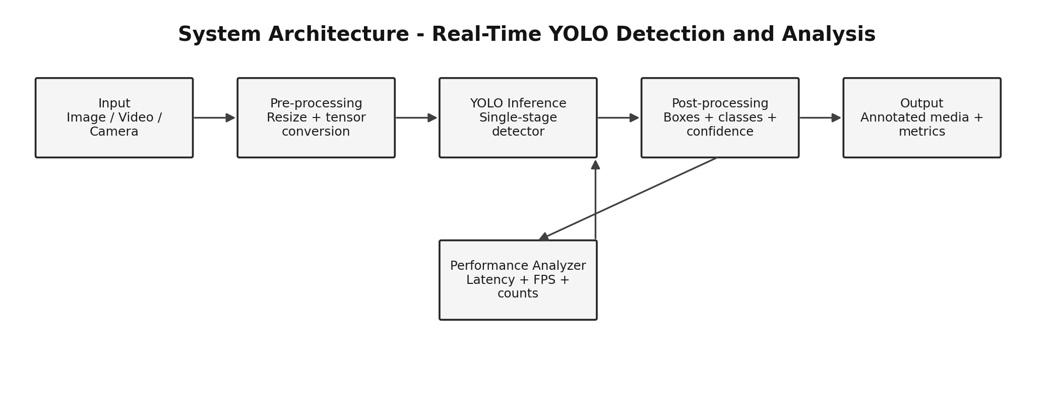
DESIGN
Proposed system architecture
The performance analyzer runs alongside inference and feeds the evidence-generation layer.

Slide 7
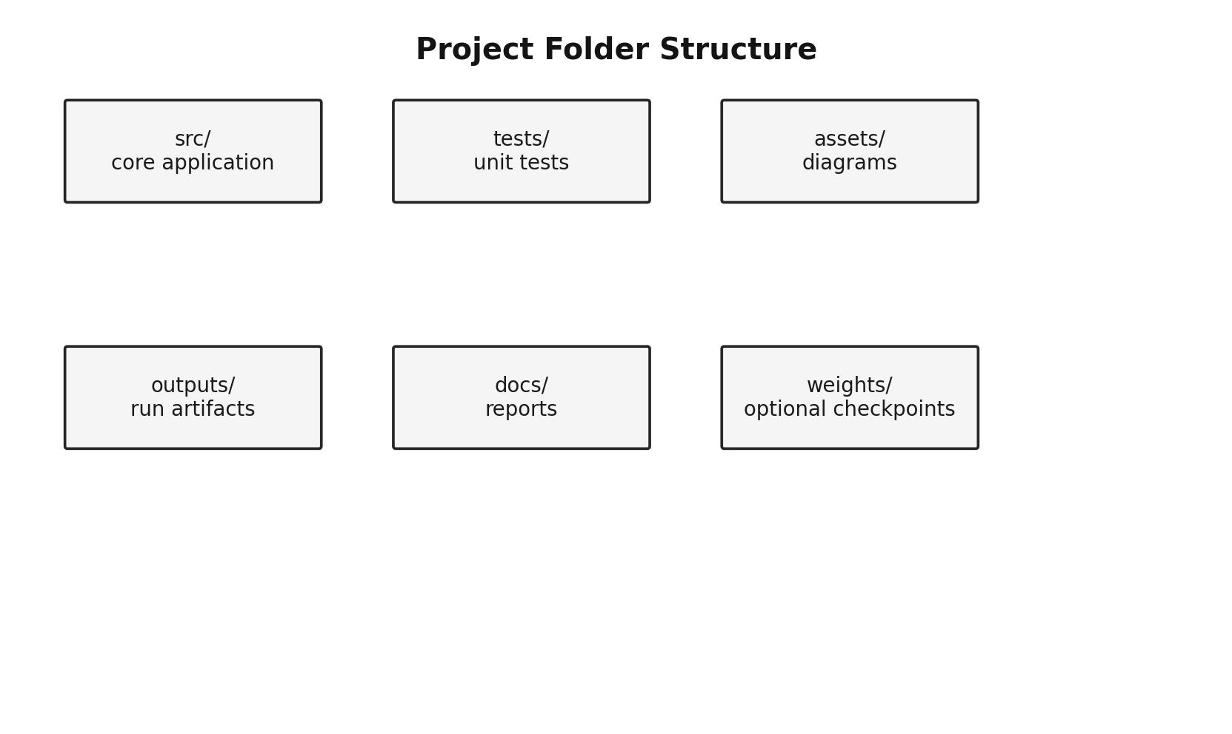
SOFTWARE DESIGN
Implementation modules
config.py
Defaults and runtime configuration
detector.py
YOLO model loading, inference, result summary
io_utils.py
Source parsing and video writer
metrics.py
Latency, FPS, P95, confidence, counts
overlay.py
On-frame metrics panel
reporting.py
CSV, JSON, and plots
main.py
CLI orchestration

Slide 8
PERFORMANCE ANALYSIS
What the system measures
Inference latency
ms per model inference
Average FPS
Throughput after first frame
P95 latency
Tail-latency indicator
Mean confidence
Average retained confidence
Detections / frame
Scene/object density
Why P95?
Averages can hide occasional slow frames. P95 exposes the upper tail of observed inference time.
Artifacts generated automatically
metrics.csv - one row per frame
summary.json - aggregate run statistics
fps_over_frames.png
inference_latency.png
detections_per_frame.png

Slide 9
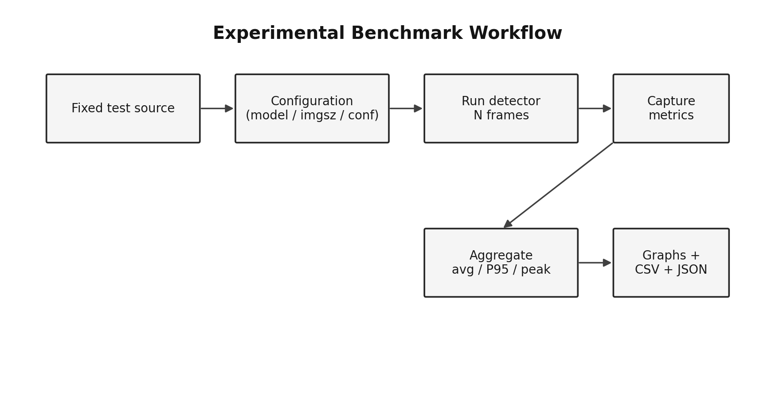
EVALUATION
Controlled experimental protocol
Run
imgsz
conf
Purpose
A
640
0.25
Baseline
B
512
0.25
Lower input
C
320
0.25
Speed-oriented
D
640
0.50
Higher threshold
Control variables
Same source • same checkpoint • same frame count • same computer
Exact measured values must come from the target machine. This project does not fabricate benchmark results.

Slide 10
RESULTS
Evidence for the final report
ANNOTATED OUTPUT
Image / video with boxes and labels
METRICS CSV
Per-frame measurements
SUMMARY JSON
Aggregate run statistics
PERFORMANCE GRAPHS
FPS + latency + detection counts
EXPERIMENT TABLE
Actual values from the submission PC
The evidence trail links the visible detection output to the numerical performance analysis.

Slide 11
DISCUSSION
Limitations and future scope
Current limitations
Future scope
Pretrained generic detection is not domain-specific traffic perception.
Speed varies with hardware, input resolution, model checkpoint, and runtime.
The project does not implement tracking, lane detection, planning, or actuation.
Performance numbers must be re-measured on the final submission computer.
Fine-tune on a traffic-focused dataset.
Add multi-object tracking and trajectory estimation.
Evaluate precision, recall, and mAP together with runtime.
Export to an optimized deployment runtime where appropriate.
Integrate detector output with a broader autonomous-driving perception stack.

Slide 12
TAKEAWAY
Conclusion
The project turns a YOLO detector into a measurable real-time perception experiment.
DETECT
Objects in each frame
MEASURE
Latency and FPS
COMPARE
Controlled runs
REPORT
Evidence
This structure directly supports the Module 2 Option 5 requirement while keeping results reproducible and transparent.

Slide 13
SOURCES
References
[1] Redmon, J., Divvala, S., Girshick, R., Farhadi, A. “You Only Look Once: Unified, Real-Time Object Detection.” arXiv:1506.02640.
[2] Liu, W. et al. “SSD: Single Shot MultiBox Detector.” arXiv:1512.02325.
[3] Ren, S., He, K., Girshick, R., Sun, J. “Faster R-CNN: Towards Real-Time Object Detection with Region Proposal Networks.” arXiv:1506.01497.
[4] Ultralytics. Official documentation: Install Ultralytics; Modes / Predict. Accessed 28 Sep 2026.
[5] Module 2 Assignment & Project PDF - Option 5: Object Detection.
Reference URLs are included in the accompanying report and README.

