Slide 1
AI-Based Automotive Review
and Customer Sentiment Analytics
Module 3 (Connectivity) | BERT • XLM-R • NLP
MODULE 3 - CONNECTIVITY
1

Slide 2
Project brief and target outcome
Source-aligned scope
Analyze automotive customer reviews.
Identify sentiment for individual aspects of a vehicle experience.
Use BERT / XLM-R and NLP techniques.
Cover vehicle, engine, battery, mileage, safety, comfort, service, infotainment and price.
Produce aspect-level sentiment rather than only one review-level label.
Example from brief
“The battery range is excellent, but the charging time is too long.”
Battery range -> Positive
Charging time -> Negative
MODULE 3 - CONNECTIVITY
2

Slide 3
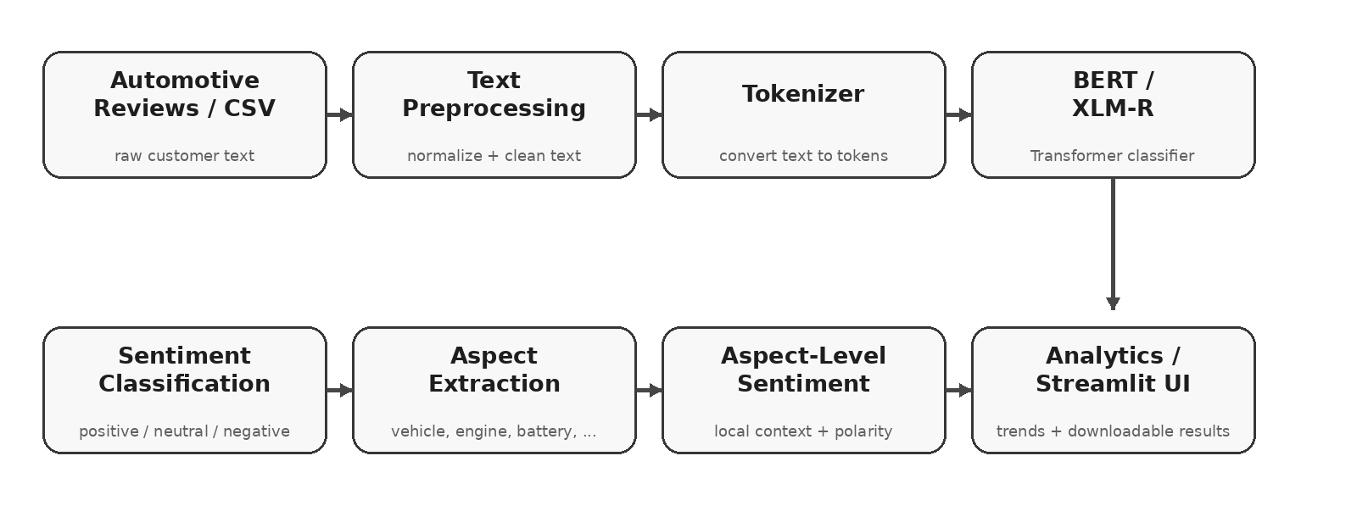
System architecture
Review -> NLP -> model -> aspect analytics
End-to-end software architecture implemented in the project
MODULE 3 - CONNECTIVITY
3

Slide 4
Implementation modules
Modular Python codebase
preprocess.py
Normalization + clause splitting
aspects.py
Automotive aspect vocabulary
sentiment_engine.py
XLM-R + BERT + fallback
analyzer.py
End-to-end review analysis
analytics.py
Batch result aggregation
app.py
Streamlit dashboard
MODULE 3 - CONNECTIVITY
4

Slide 5
Transformer models
Primary and alternate configurations
XLM-R - primary
Multilingual XLM-RoBERTa sentiment model.
Labels: Positive / Neutral / Negative.
Selected as the default project model.
BERT multilingual - alternate
BERT product-review sentiment model.
Outputs 1-5 stars; the application maps these to a shared three-class sentiment representation.
MODULE 3 - CONNECTIVITY
5

Slide 6
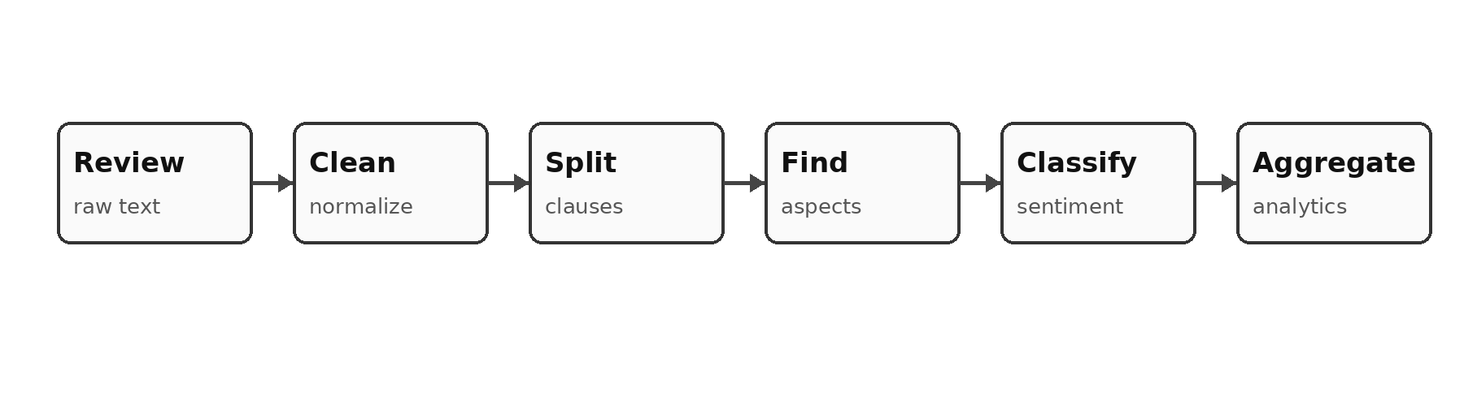
Processing pipeline
Transparent aspect-context attribution
The same flow is used for single reviews and batch analysis
Aspect extraction is vocabulary-driven; sentiment is Transformer-based when model weights are available.
MODULE 3 - CONNECTIVITY
6

Slide 7
What the system returns
Machine-readable and user-facing outputs
Overall sentiment
Positive / Neutral / Negative
Overall confidence
Model score
Aspect
Battery, Engine, Safety, ...
Aspect sentiment
Polarity for local context
Aspect confidence
Classifier score
Context
Clause supporting the decision
Backend / model
Transformers or offline fallback
MODULE 3 - CONNECTIVITY
7

Slide 8
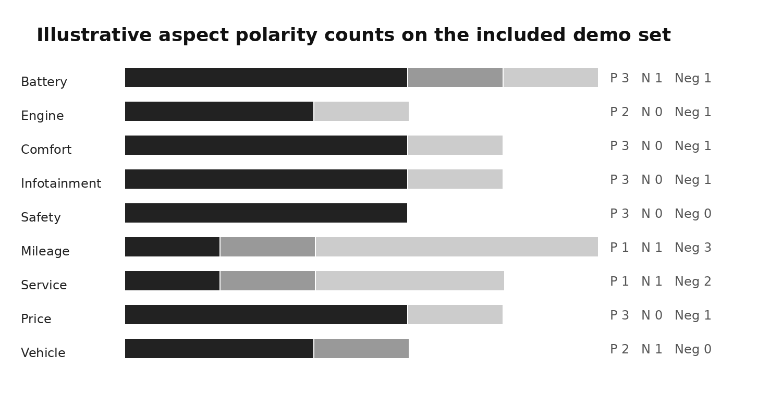
Demo dataset and analytics
Curated validation data - not a benchmark
24 automotive review examples are bundled with the source code.
The examples cover the nine aspects specified in the brief.
The dataset is used to validate CSV ingestion, extraction, analysis and export.
It is not presented as an external benchmark dataset.
Illustrative aspect polarity counts from the bundled demo set
MODULE 3 - CONNECTIVITY
8

Slide 9
Reliability and fallback design
Model-backed when possible, explicit when not
Primary path: Hugging Face Transformer inference.
Alternate path: multilingual BERT product-review sentiment model.
Offline path: small deterministic lexicon fallback for classroom demonstration.
Every result reports its backend, so fallback output is not mistaken for Transformer output.
No fabricated accuracy number is included without an independently labeled test set.
MODULE 3 - CONNECTIVITY
9

Slide 10
Evaluation protocol
How to turn the prototype into a measured experiment
Use an independently labeled automotive review dataset.
Report precision, recall, F1 and confusion matrix for sentiment classes.
Evaluate aspect presence and aspect polarity separately.
Measure latency per review and throughput on the deployment machine.
Keep the test set untouched when any fine-tuning is performed.
MODULE 3 - CONNECTIVITY
10

Slide 11
Limitations and future scope
Clear boundaries for the prototype
Current limitations
Vocabulary-driven aspect extraction
General-domain pretrained sentiment models
No claimed benchmark accuracy
Local-clause approximation for aspect polarity
Future scope
Fine-tuned automotive ABSA model
Aspect discovery beyond fixed vocabulary
Time-based review trends
Multilingual Indian-language analysis
Empirical BERT vs XLM-R comparison
MODULE 3 - CONNECTIVITY
11

Slide 12
Conclusion
A complete, modular software prototype
Transforms raw automotive reviews into structured sentiment insights.
Combines NLP preprocessing, aspect extraction and Transformer inference.
Provides both an interactive dashboard and command-line batch processing.
Keeps outputs transparent by exposing confidence, context and backend information.
MODULE 3 - CONNECTIVITY
12

